Slide 1
Budget Buddy
Bottom text

Slide 2
Team Members
Harrison Black -Project manager
Jacob Caulk -
Jesus Duran -
Tuan Pham -Web app’s front-end, back-end, RESTful API
Terrell Richardson -
Tom Serrano -React Native iOS development
Xixian Yang -

Slide 3
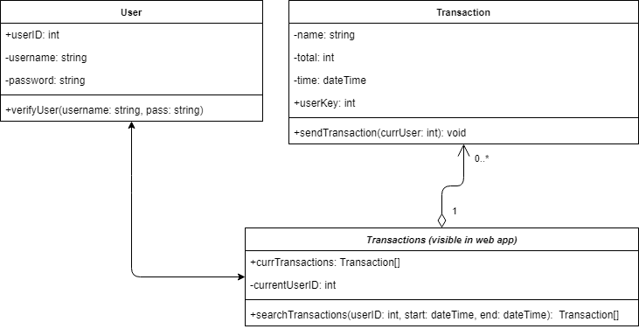
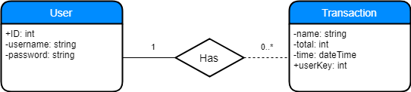
Class Diagram, ERD

Slide 4
Use Cases

Slide 5
Gantt Chart

Slide 6
Harrison’s Slide

Slide 7
Jacob’s Slide

Slide 8
Data Visualization - ChartJS
We use the ChartJS library for creating the graph
Actual fetching of the data is done through the Django RESTful Framework
*insert picture of graph here?*

Slide 9
Jesus’ Slide

Slide 10
Tuan – Front/Back ends, API
Front-end
Bootstrap
Chart JS for data’s graphical presentation
Back-end
Django: provide scaffold, easy to build more complex features
RESTful API
Model Serializers: convert data to JSON for HTTP requests from mobile app
JSON Web Token Authentication: authenticate users and requests

Slide 11
Terrell’s Slide

Slide 12
Tom – React Native
iOS App
Would supplement Android app
React Native
High demand
Platform independent
Incomplete
High learning curve
Little experience on team
Stretch Goal (Only one dedicated developer)

Slide 13
David’s Slide

Slide 14
Stacks

Slide 15
Successes

Slide 16
Failures

Slide 17
What We Would Do Differently

Slide 18
Live Demo
Web Page
Github

