Slide 1
Budget Buddy
Bottom text

Slide 2
Team Members
Harrison Black -Project manager
Jacob Caulk -
Jesus Duran -
Tuan Pham -
Terrell Richardson -
Tom Serrano -React Native iOS development
Xixian Yang -

Slide 3
Gantt Chart

Slide 4
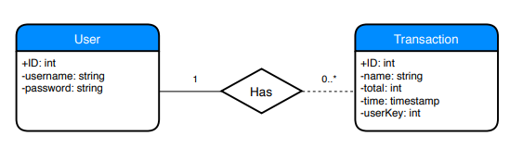
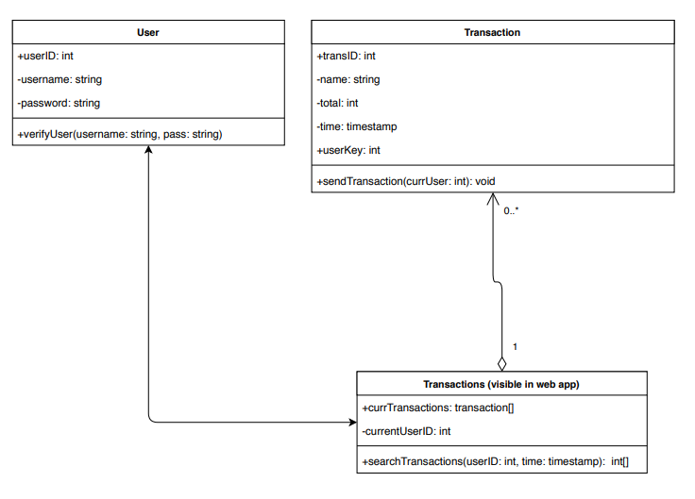
ERD, Class, Use-Case

Slide 5
Harrison’s Slide

Slide 6
Jacob’s Slide

Slide 7
Jesus’ Slide

Slide 8
Tuan’s Slide

Slide 9
Terrell’s Slide

Slide 10
Tom’s Slide
React Native
iOS

Slide 11
David’s Slide

Slide 12
Stacks

Slide 13
Successes

Slide 14
Failures

Slide 15
What We Would Do Differently

Slide 16
Live Demo
Click here!

