Slide 1
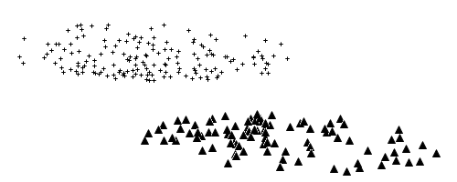
Maximal Variance Direction (PCA)
Maximal Separation Direction (LDA)

Slide 2
M
M
Maximal Covariance Direction for Set Y
Maximal Covariance Direction for Set X

