Slide 1
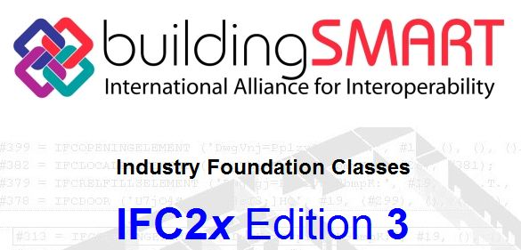


IFC, Open Source BIMServer and BIMsie API
Mehmet Yalcinkaya
PhD Candidate
IT in Construction, Building Information Modeling
mehmet.yalcinkaya@aalto.fi

Slide 2

What will we learn?
Industry Foundation Classes (IFC)
BIMServer Setup and User Interface UI
Creating Project and Upload an IFC file with UI
BIMsie API and Interaction with BIMServer
Requirements and Downloads:
Open Source BIMServer executable jar file
Text editor (Preferable Sublime Text)
Python 2.7 (Library installation will be made during class)

Slide 3
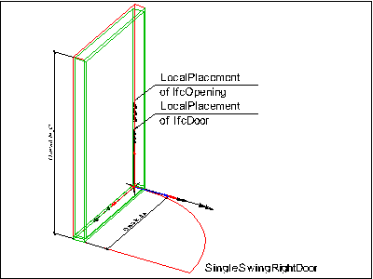
Industry Foundation Classes (IFC)
IFC is a definition of a standard format to describe a Building Information Model
IFC defines how information should be provided/stored for all stages of a building projects lifecycle.
It goes right down to the properties of the individual object
It can do from “very little” information to “everything”.
IFC can hold data for geometry, calculation, quantities, facility management (almost %40), pricing etc. .... for many different professions (architect, electrical, HVAC, structural, terrain etc. )
IfcDoor represents a door modelled in
BIM software.
In IFC structure, it has many properties
which can be defined and updated in
BIM software.

Slide 4
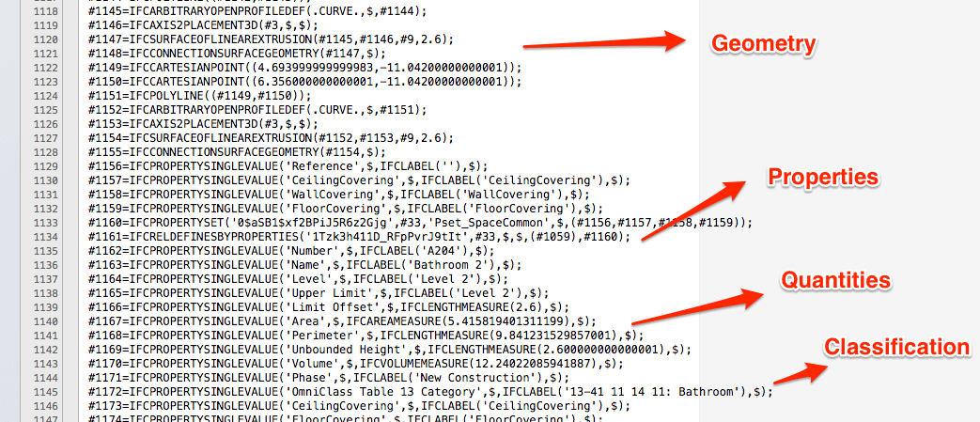
Industry Foundation Classes (IFC)
100Ks of lines about the BIM model. Impossible to read and understand.

Slide 5
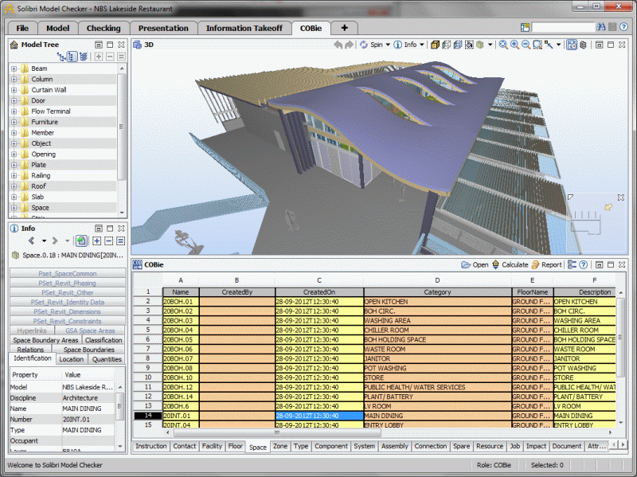
Industry Foundation Classes (IFC)

Slide 6
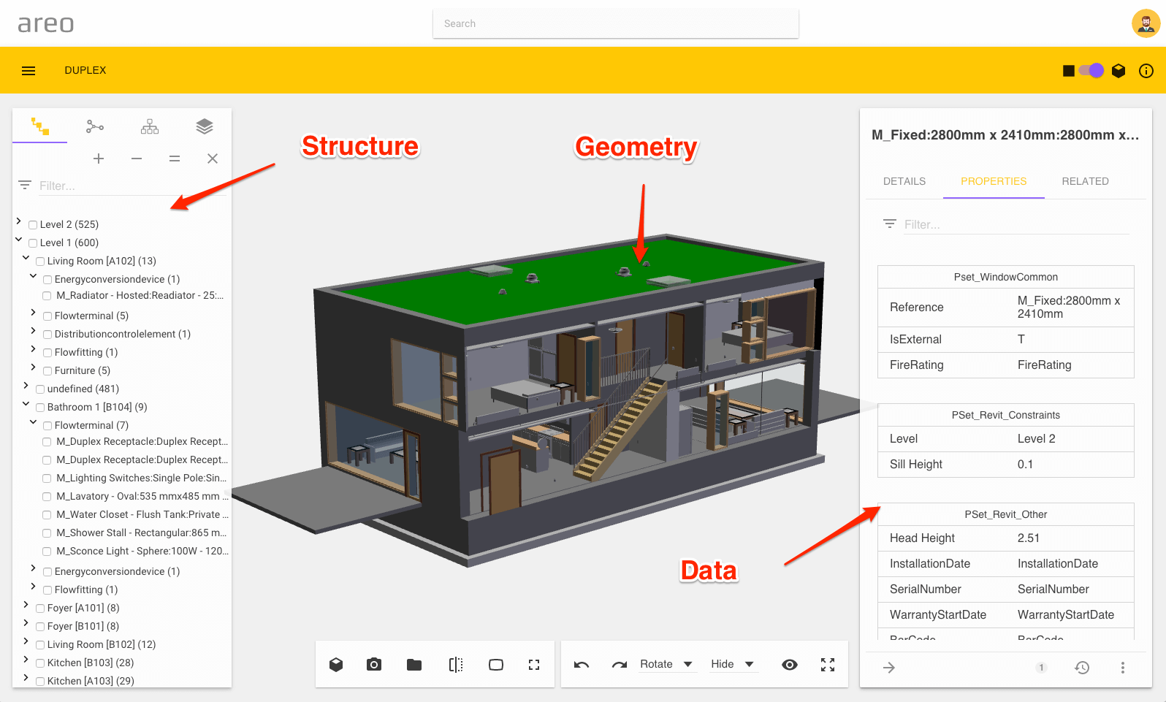
Industry Foundation Classes (IFC)
The information in IFC can be grouped under 2 main categories
Graphical 3D Model Information
Numerical and Textual Information

Slide 7
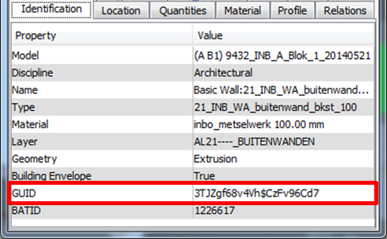
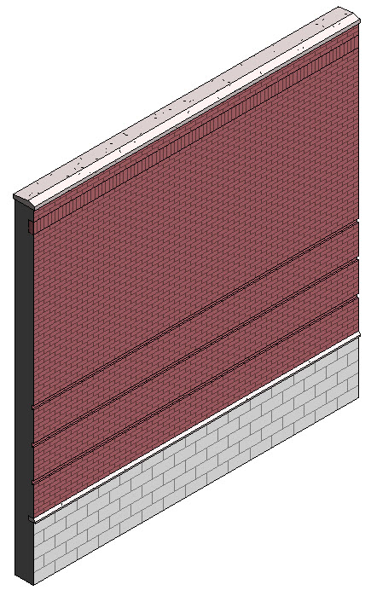
Industry Foundation Classes (IFC)
Numerical and Textual Information
Each building entity has a Global Unique Identication Number (GUID)
BIM applications store and query the specific building entity based on GUIDs

Slide 8
Open source BIMServer
An open source development in Eindhoven University of Technology and
TNO Research Center-Netherlands
You can upload your IFC files to view 3D model and retrieve information
You cannot modify/update your BIM file in BIMServer
Collaborative: Multiple users can login and use the same model at the same time
Converter: IFC files can be converted to many file formats for easy process
and integration. Make them more human-readable ☺

Slide 9
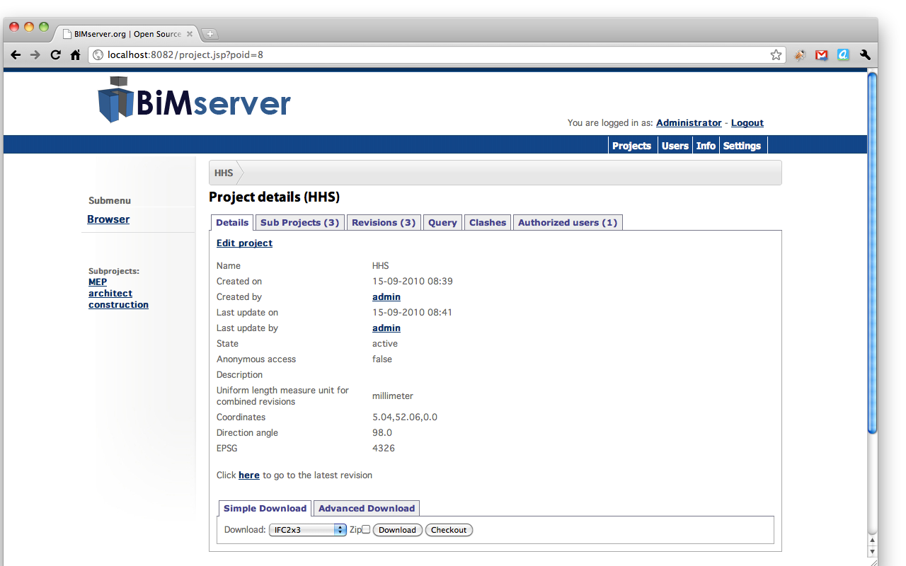
Open source BIMServer
DEMO TIME

Slide 10
BIMsie API
BIM standard information exchange (sie) Application Programming Interface (API)
Set of functions which can communicate with BIMServer
In other words, it is the vocabulary that we can talk with BIMServer
We can do what REVIT or ARCHICAD can do

Slide 11
BIMsie API
Go localhost:8082/console.html to see the API functions
If you cannot setup BIMServer go
https://buildingsmart.github.io/BIMSie/
There are 100s of functions which you can use for many purposes
BIMsie API is available to use with JavaScript, Python and Ruby languages

Slide 12
BIMsie API
DEMO TIME with PYHTON
Task1: Create a new project and upload an IFC file to BIMServer
Task2: Query the detailed information of a specific building object with GUID number

