Slide 1


Weekly Report
王军晓
23 May 2022

Slide 2
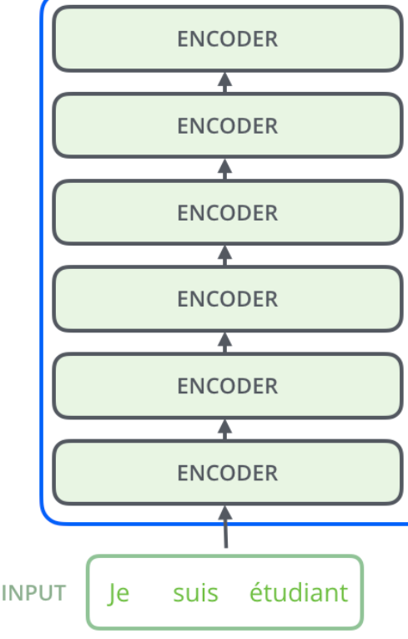
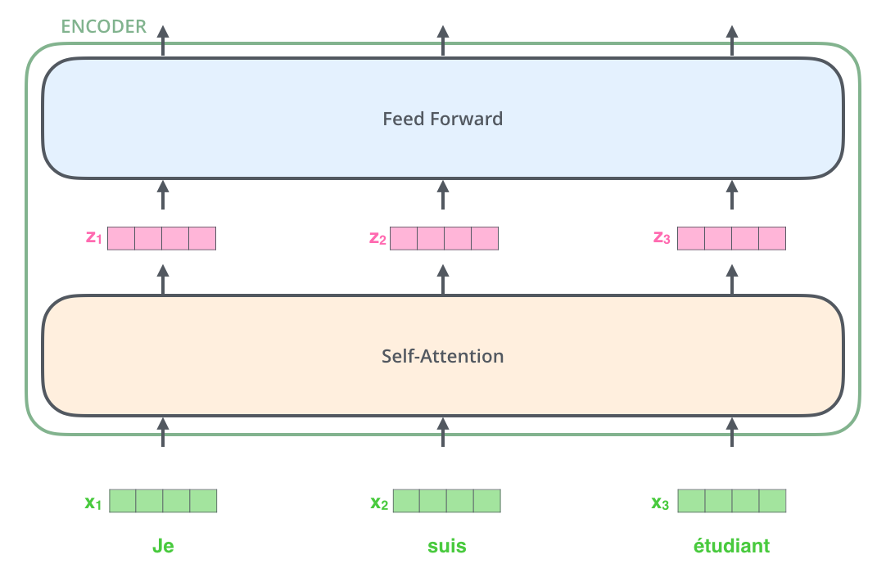
Self-Attention in Transformers
2

Slide 3
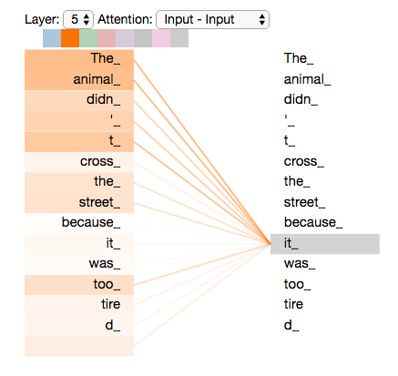
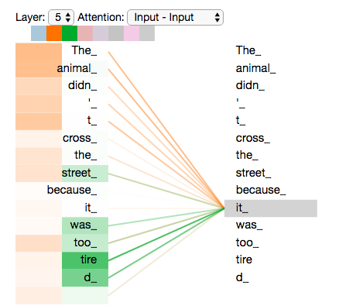
Self-Attention Map in Pre-Trained Language Models (e.g., BERT)
”The animal didn't cross the street because it was too tired”
3

Slide 4
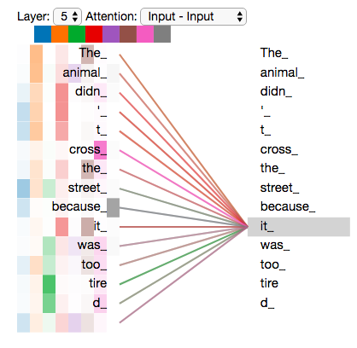
Self-Attention Map in Pre-Trained Language Models (e.g., BERT)
”The animal didn't cross the street because it was too tired”
4

Slide 5
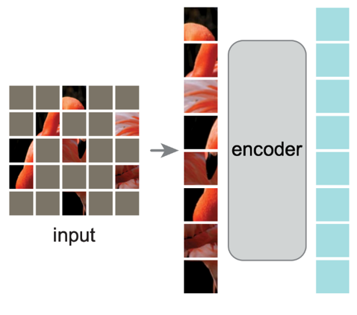
Transformers: Language Models vs. Vision Models
5

Slide 6
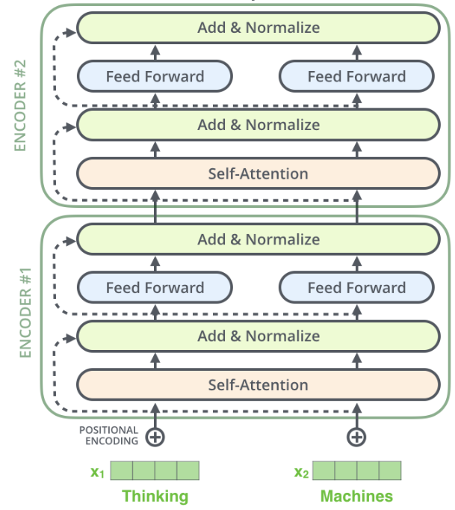
Visualization: Self-Attention Map
Here we are
6

Slide 7
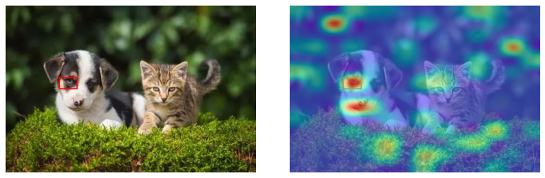
Settings | Values
Image Size | 224 × 224
Patch Size | 16 × 16
No. Encoders | 24
No. Heads | 16
Embedding Dim | 1, 024
Visualization: Self-Attention Map
MAE with ViT Large as Backbone
24th Encoder, 7th Attention Head
7

Slide 8
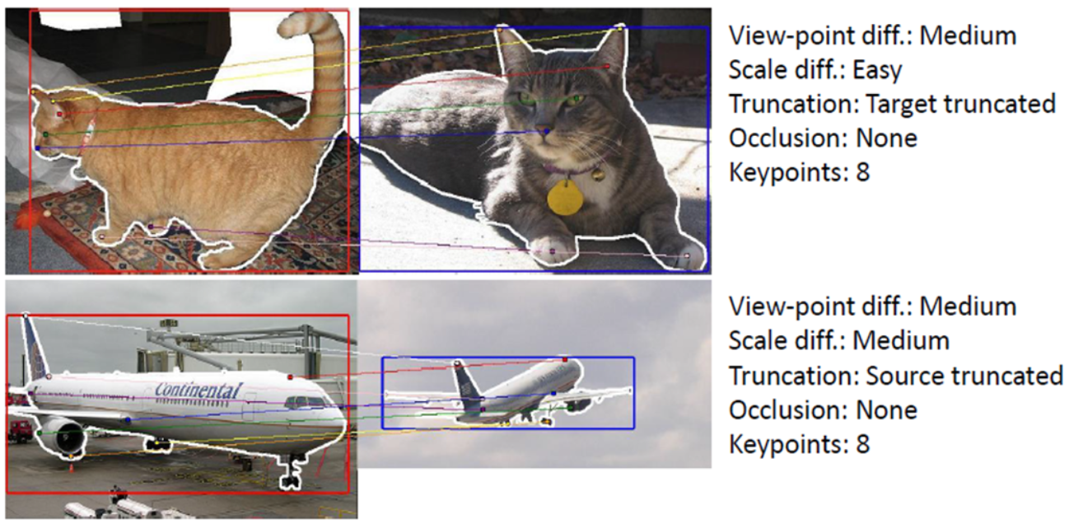
Visualization: Self-Attention Map
MAE with ViT Large as Backbone
24th Encoder, 7th Attention Head
Semantic Query Benchmark
(Pre-trained Knowledge Extracting)
1. Attention on those Keypoints
(Sample-level Knowledge)
2. Class Attention Consistency
8

Slide 9
Pre-trained Knowledge Forgetting
Here we are
Ranking the Neuron Contribution to
that Extracted Knowledge.
Pruning those Contributed Neurons,
and Preserve those Irrelevant.
9

