Slide 1
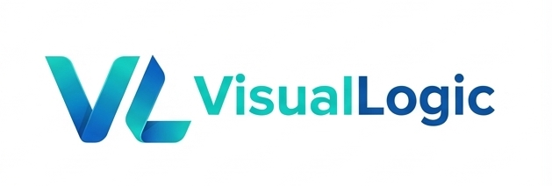
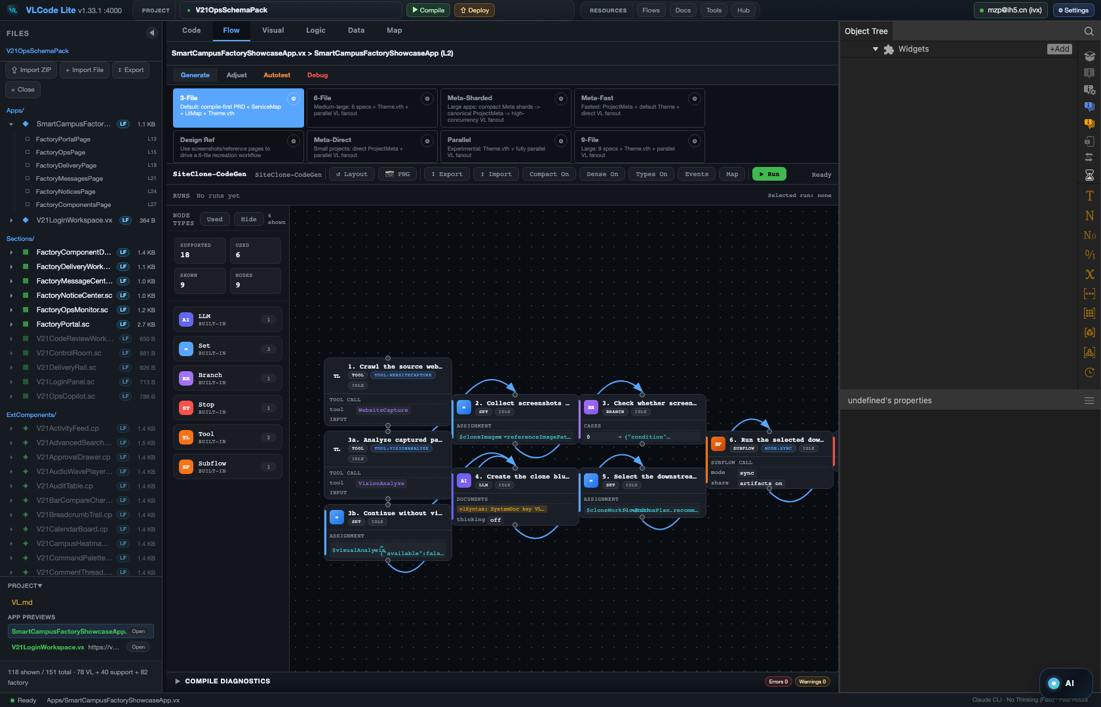
LOCAL AGENT APP STUDIO · AGENT OS
Agents you can
install, pause & audit.
A local, runtime-first studio for agents, tools, approval flows and automation — each one a single, portable .vflow.
Open source · Local-first, not SaaS
Every Agent App runs as a DAG you can pause and resume.
github.com/VisualLogic-AI/VLCode-Lite-agent-os

Slide 2
01
TWO PRODUCTS, ONE FOUNDATION
VL Agent produces. VLCode consumes. .vflow connects.
VL Agent
VLCode
.vflow
Agent App Studio + local Agent OS. Authors / governs / validates the automation.
Enterprise app dev base. Imports the .vflow to generate / adjust / orchestrate apps.
Same VL · same DAG engine · same Resource Center · one account · one download.
VL AGENT · Local Agent App Studio + Agent OS
github.com/VisualLogic-AI/VLCode-Lite-agent-os

Slide 3
02
THE SHARED SPINE
Both products tame AI inside the same DAG.
AI is brilliant at a point; it can't hold a line. A DAG is the bridge from point intelligence to process intelligence — creativity in the nodes, determinism in the edges. VLCode tames AI into enterprise apps; VL Agent tames AI into governed, auditable automation. Same engine underneath.
Creativity in the nodes. Determinism in the edges.
A run unfolds into a finite, acyclic, auditable trace.
VL AGENT · Local Agent App Studio + Agent OS
github.com/VisualLogic-AI/VLCode-Lite-agent-os

Slide 4
03
WHY A PROMPT ISN'T ENOUGH
A reliable agent must be installed, paused, resumed, audited, governed.
A chat agent lives inside the prompt. A real automation cannot: it must survive restarts, wait on humans, record every step, and answer “what happened and why” weeks later. That needs a runtime — not a longer prompt. VL Agent is that runtime, on your own machine.
A chat agent needs a prompt. A dependable agent needs a runtime.
VL AGENT · Local Agent App Studio + Agent OS
github.com/VisualLogic-AI/VLCode-Lite-agent-os

Slide 5
04
WHAT VL AGENT IS
A local Agent App Studio — and a local Agent OS.
“A local Agent OS centered on workspace execution, workflow runtime, control-plane persistence, and resource governance. VL is the first deep domain pack, not the system boundary.”
A desktop workbench for building runtime-first AI applications on your own machine: agents, tools, approval flows, automations, and process apps.
VL AGENT · Local Agent App Studio + Agent OS
github.com/VisualLogic-AI/VLCode-Lite-agent-os

Slide 6
05
WHAT YOU BUILD
An Agent App is a single, portable .vflow.
An entry workflow + a top-level app block. Install · start · pause · resume · audit.
Manifest → Workflow Engine executes → Control Plane persists → VL renders.
Approval Flow Runtime
Goal Convergence console
Website Clone Studio
Paper-to-Agent-App
Durable background approval — requester / approver cards + SLA reminders.
Inspect goal contracts, task frontiers, scorecards, mainline, rollback.
DAG-first authorized site exploration → VL clone.
Turn a paper into a runnable Agent App.
Shipped in the box — grounded examples, not roadmap.
VL AGENT · Local Agent App Studio + Agent OS
github.com/VisualLogic-AI/VLCode-Lite-agent-os

Slide 7
06
THE LOCAL AGENT OS UNDERNEATH
Every run recorded. Every resource reviewed.
SQLite control plane
150+ workflows out of the box
Resource Center governance
Records every run, task, artifact and review — any run is replayable and auditable.
From 3-/6-/9-file VL code generation to multi-actor team delivery, approval runtimes and data factories.
Review-gated lifecycle for components / flows / docs / tools / skills / packs. Resources pass through review before they ship.
Built-in vlflow CLI — dry-run-validates any workflow without mutating it; closure expansion embeds subflows so a .vflow ships self-contained.
VL AGENT · Local Agent App Studio + Agent OS
github.com/VisualLogic-AI/VLCode-Lite-agent-os

Slide 8
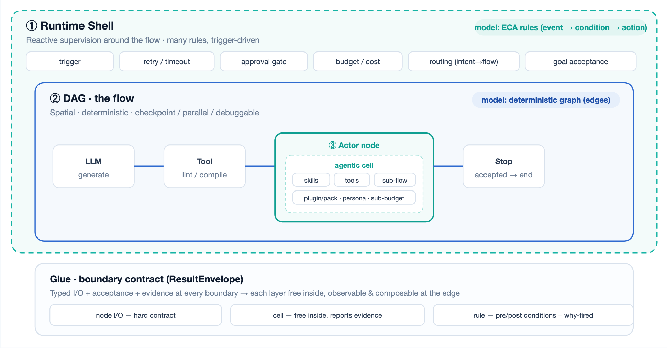
07
THE RUNTIME
Three runtimes. One system.
Each layer uses the computational model that fits it — never one nested inside another.
① Shell · rules
Event→condition→action around the flow: trigger, retry, approval, budget, routing, goal acceptance.
② DAG · deterministic
Explicit edges, checkpoint, parallel, node breakpoints. The stable, reproducible spine.
③ Cell · exploratory
An Actor node mounts skills + tools + sub-flows and explores freely — held by a typed contract.
VL AGENT · Local Agent App Studio + Agent OS
github.com/VisualLogic-AI/VLCode-Lite-agent-os

Slide 9
08
DAG VS SKILLS
When to draw a graph. When to hand it to the agent.
Dimension | Skills · agent loop | DAG · workflow
Control flow | Model decides — non-deterministic | Edges & branches fixed — deterministic
Debugging | Hard — no nodes, no breakpoints | Breakpoint / pause / rerun / checkpoint
Parallelism | Mostly sequential | Real Fork / Loop fan-out
Acceptance | Self-declared “done” (soft) | Explicit gates + Score / Review
Observability | Weak | Run ledger + artifact lineage
Authoring cost | Low — a few sentences | Higher — lay out the graph
Best for | Open-ended, judgment, one-off | Repeatable, parallel, audited
Where new logic goes: repeatable → DAG · judgment → skill in an Actor node · reactive → shell rule
VL AGENT · Local Agent App Studio + Agent OS
github.com/VisualLogic-AI/VLCode-Lite-agent-os

Slide 10
09
THE CONNECTOR
.vflow is the hand-off.
1
2
3
Author & repair
Govern
Import
in VL Agent
via Resource Center (review-gated)
into VLCode — generate, run, adjust
VL Agent produces, governs, validates. VLCode consumes. .vflow is the contract between them.
VL AGENT · Local Agent App Studio + Agent OS
github.com/VisualLogic-AI/VLCode-Lite-agent-os

Slide 11
10
WHY .VFLOW IS STRONG
One self-describing, tamper-evident bundle.
Portable & plain
Declares its portability
A ZIP: the complete Workflow JSON (a steps DAG, Spec 4.1), its subflows, an auto-generated resource manifest, prompts and docs — in plain folders, not a black box.
self-contained / needs-runtime / needs-secrets — you know before you open it whether it will just run.
Tamper-evident
Add an app block → Agent App
Every file is sha256-checksummed against the manifest; a mismatched or missing file is rejected on import. (Checksums, not signatures.)
The same .vflow becomes installable; the flow's own human steps become its interaction cards. Per-node AI config travels inside the file.
VL AGENT · Local Agent App Studio + Agent OS
github.com/VisualLogic-AI/VLCode-Lite-agent-os

Slide 12
11
WHICH ONE IS FOR ME?
Same foundation, two jobs.
VLCode
VL Agent
When you build complete enterprise applications — with backends, project managers, and long-step interaction. The productized harness for apps.
When you build the agents, tools, and automation that power those apps — runtime-first, installable, auditable, as a single .vflow.
One account, one site, one download — zero re-learning across products.
VL AGENT · Local Agent App Studio + Agent OS
github.com/VisualLogic-AI/VLCode-Lite-agent-os

Slide 13
THE MOAT
Two products.
One foundation.
One .vflow.
When software scales and AI goes deeper, whoever controls the representation layer controls the ceiling. And this is just the beginning.
github.com/VisualLogic-AI/VLCode-Lite-agent-os

