Slide 1
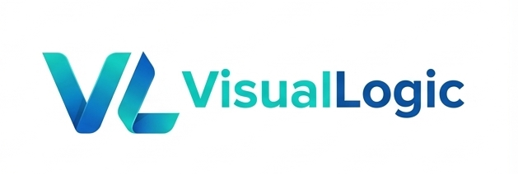
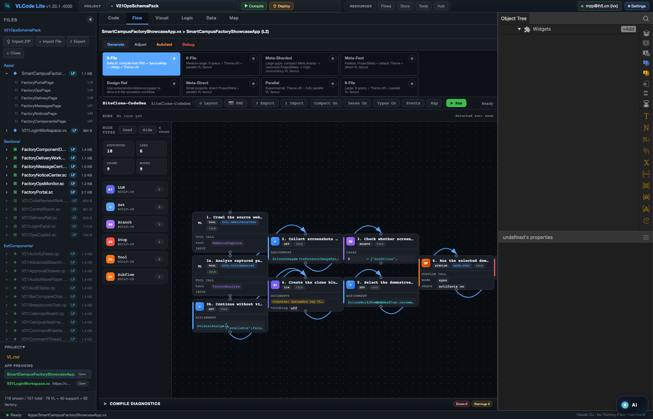
ENTERPRISE AI ASSETS · LOCAL-FIRST
Own the intelligence. Don't rent it.
An AI asset must outlive any model and stay inside the enterprise. The carrier that makes it concrete: a .vflow — the whole workflow that solves one problem — maintained and run as a local-first Agent App.
Open source · Local-first — assets stay inside the enterprise
An AI asset, made concrete — a .vflow that runs as a DAG.
github.com/VisualLogic-AI/VL-Code

Slide 2
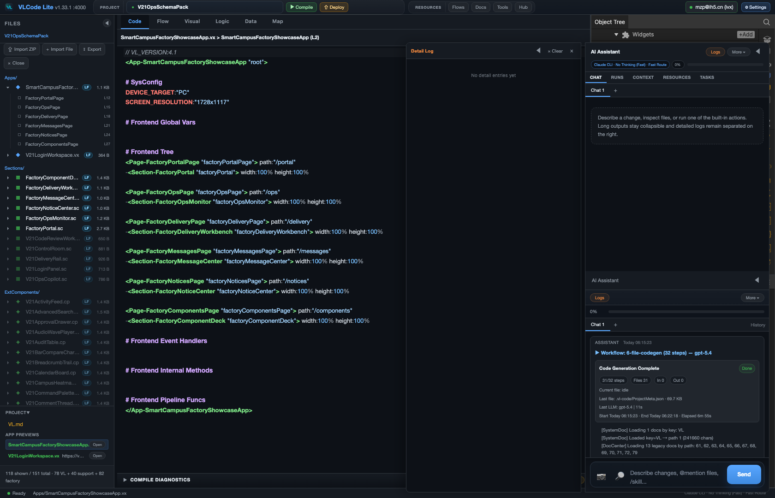
01
THE GAP
A game needs a prompt. An app needs a harness.
AI coding can make a game from one sentence — so why not durable enterprise value?
A game can live inside the prompt — rules, assets, state, and feedback are self-contained. A real enterprise solution cannot: it must connect backend resources, data contracts, approvals, and human decisions across many steps. It is not that AI cannot write the code; harnessing a real project is a long, grounded process — not one giant super-node. That long, grounded process is where today's AI value evaporates: it lives in throwaway chats and one person's prompts, and nothing accumulates.
One AI node creates output. A DAG harness creates progress.
Chat alone: output, but no asset.
ENTERPRISE AI ASSETS · decoupled from the model, kept in-house
github.com/VisualLogic-AI/VL-Code

Slide 3
02
THE DEFINITION
An AI asset. Not a chat log.
Most AI adoption leaves nothing durable. An enterprise AI asset is the opposite — it meets four conditions.
Decoupled from the model
Accumulates your own
Kept inside the enterprise
A solution, carried by Flow
Pluggable providers, right-model-per-node — the model is a swappable input, not the asset. The value lives in the representation, which outlives any model version.
It banks the enterprise's own knowledge, methods, AI capabilities, and production experience — generate once, store it, reuse it, instead of re-buying it each time.
Local-first means the asset never has to leave — Lint / Compile / codegen run offline. Cloud deploy is an option, not a cage; export the React+Node source = 0 lock-in.
A complete solution — or a sharp one to a specific problem. Knowledge, docs (including skills), code and components, orchestrated into one Workflow / DAG: a tamper-evident .vflow bundle.
ENTERPRISE AI ASSETS · decoupled from the model, kept in-house
github.com/VisualLogic-AI/VL-Code

Slide 4
03
PILLAR 1 · MODEL-DECOUPLED
The model is an input. Not the asset.
Swap the model — the asset survives intact.
Pluggable providers, right model per node
VL is the IR — value that outlives any model
Anthropic, OpenAI, DeepSeek, Kimi, GLM, Gemini — all swappable. Expensive models for the hard nodes, cheap ones for the routine. The model plugs in; swapping it never destroys the asset.
Representation efficiency > model size. The asset lives in the VL representation — human intent compiled to executable code — not in whichever model generated it. Whoever controls the representation controls the ceiling.
ENTERPRISE AI ASSETS · decoupled from the model, kept in-house
github.com/VisualLogic-AI/VL-Code

Slide 5
04
PILLAR 2 · PRECIPITATE IN-HOUSE
Keep it in-house. Compound it.
The asset never leaves the building — and grows every time you use it.
Local-first, zero lock-in
Bank the token-compute
Govern who uses what
VL Agent is local-first, not SaaS. Assets stay on your machines; export the source any time. The enterprise owns the intelligence — not a vendor.
The Component Factory stores expensive token-compute: generate once, reuse forever. Don't buy more GPUs — store the compute, share it to everyone.
The Resource Center runs a review-gated lifecycle — local → cloud-private → submitted → platform-shared. Nothing reaches the shared inventory without review.
ENTERPRISE AI ASSETS · decoupled from the model, kept in-house
github.com/VisualLogic-AI/VL-Code

Slide 6
05
PILLAR 3 · FLOW IS THE CARRIER
A solution isn't a prompt. It's a Flow.
Knowledge + docs (incl. skills) + code + components, orchestrated to solve one problem — that is exactly a Workflow / DAG.
A real enterprise solution must connect resources, steps, validation, and human decisions across a long line — and AI is brilliant at a point but can't hold a line. A DAG is the bridge from point intelligence to process intelligence: creativity in the nodes, determinism in the edges. So the natural carrier of a complete or problem-specific solution is a Flow — the one bundle that holds the whole line, not a clever sentence that holds none of it.
A game needs a prompt. A solution needs a Flow.
Flow mode — a solution as a verifiable DAG.
ENTERPRISE AI ASSETS · decoupled from the model, kept in-house
github.com/VisualLogic-AI/VL-Code

Slide 7
06
PILLAR 3 · THE ASSET IS A .VFLOW
The asset IS a .vflow
Not a black box. One self-describing bundle that carries the whole solution.
Portable & plain
Declares its portability
Tamper-evident
A ZIP: the complete Workflow JSON (a steps DAG, Spec 4.1), its subflows, an auto-generated resource manifest, prompts and docs — in plain folders, not a black box.
self-contained / needs-runtime / needs-secrets — you know before you open it whether it will just run.
Every file is sha256-checksummed against the manifest; a mismatched or missing file is rejected on import. Checksums, not signatures.
A .vflow is the asset itself — plain, portable, verifiable.
ENTERPRISE AI ASSETS · decoupled from the model, kept in-house
github.com/VisualLogic-AI/VL-Code

Slide 8
07
PILLAR 4 · MAINTAIN
Maintain it visually.
Everything is a picture you can inspect — and any run you can pause, resume, and audit.
Architecture → Map
Process → DAG
Data → ER
The whole asset as one architecture graph — see how every part connects at a glance.
Each run is a verifiable steps DAG: set breakpoints, pause, resume, rerun from any step.
Data modeled as an ER graph; code ↔ graph is 1:1 bidirectional — edit either side.
Everything graphical · the IDE is a projection of the language.
ENTERPRISE AI ASSETS · decoupled from the model, kept in-house
github.com/VisualLogic-AI/VL-Code

Slide 9
08
PILLAR 4 · RUN
Same file. Now an Agent App.
Add one app block — the same .vflow becomes installable. Not a separate .vapp file.
1
2
3
Install
Run
Audit
An entry workflow plus a top-level app block makes one installable, portable Agent App — install, start, pause, resume.
The flow's own human-in-the-loop steps become the app's interaction cards automatically. Manifest runs, the Workflow Engine executes, VL renders.
A SQLite control plane records every run, task, artifact, and review — so any run is replayable and auditable.
ENTERPRISE AI ASSETS · decoupled from the model, kept in-house
github.com/VisualLogic-AI/VL-Code

Slide 10
09
THE ASSET · TWO SHAPES
Two shapes. One compounding library.
An AI asset is a complete solution — or a solution to one specific problem. Both ship as a .vflow.
A complete solution
A problem-specific solution
An end-to-end Agent App as one .vflow — like the in-box Approval Flow Runtime: requester and approver cards, SLA reminders, durable background execution. The whole solution, in one portable file.
One sharp capability as a .vflow — knowledge, docs (incl. skills), code and components orchestrated to solve a single problem. Drop it into your library; import it into VLCode when you need it.
Generate once, reuse forever — the enterprise's intelligence compounds.
ENTERPRISE AI ASSETS · decoupled from the model, kept in-house
github.com/VisualLogic-AI/VL-Code

Slide 11
10
GOVERNANCE & AUDIT
Not a file. A governed asset.
Trustworthy by construction — every run replayable, every change reviewed, every byte checked.
Control-plane ledger
Review-gated lifecycle
Tamper-evident bundle
A SQLite control plane records every run, task, artifact, and review. The ledger is what turns a clever one-off into an institutional asset.
Review before ship. Resources move local → cloud-private → submitted → platform-shared — govern who can use what at every gate.
Every file in the .vflow is sha256-checksummed against its manifest; a mismatched or missing file is rejected on import — byte-for-byte across both products.
Integrity is sha256 checksums — tamper-evident, not signed or encrypted.
ENTERPRISE AI ASSETS · decoupled from the model, kept in-house
github.com/VisualLogic-AI/VL-Code

Slide 12
11
THE WHOLE THESIS
Don't rent intelligence by the token. Own it as an asset.
Four pillars, one carrier: model-decoupled (pluggable providers, right model per node) · precipitated in-house (knowledge, methods, AI capability, production experience) · carried by Flow (a .vflow bundles the whole solution) · maintained and run as a local-first Agent App.
The model is a swappable input. The asset is what outlives it — and stays inside the enterprise.
ENTERPRISE AI ASSETS · decoupled from the model, kept in-house
github.com/VisualLogic-AI/VL-Code

Slide 13
THE BEST HOME
Own the intelligence. Don't rent it by the token.
A workflow .vflow — maintained and run as a local-first Agent App — is the best home for enterprise AI assets. Decoupled from the model · kept inside the enterprise · compounding.
github.com/VisualLogic-AI/VL-Code · github.com/VisualLogic-AI/VLCode-Lite-agent-os

