Slide 1
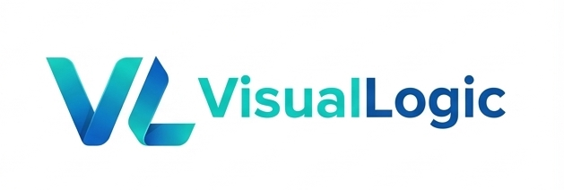
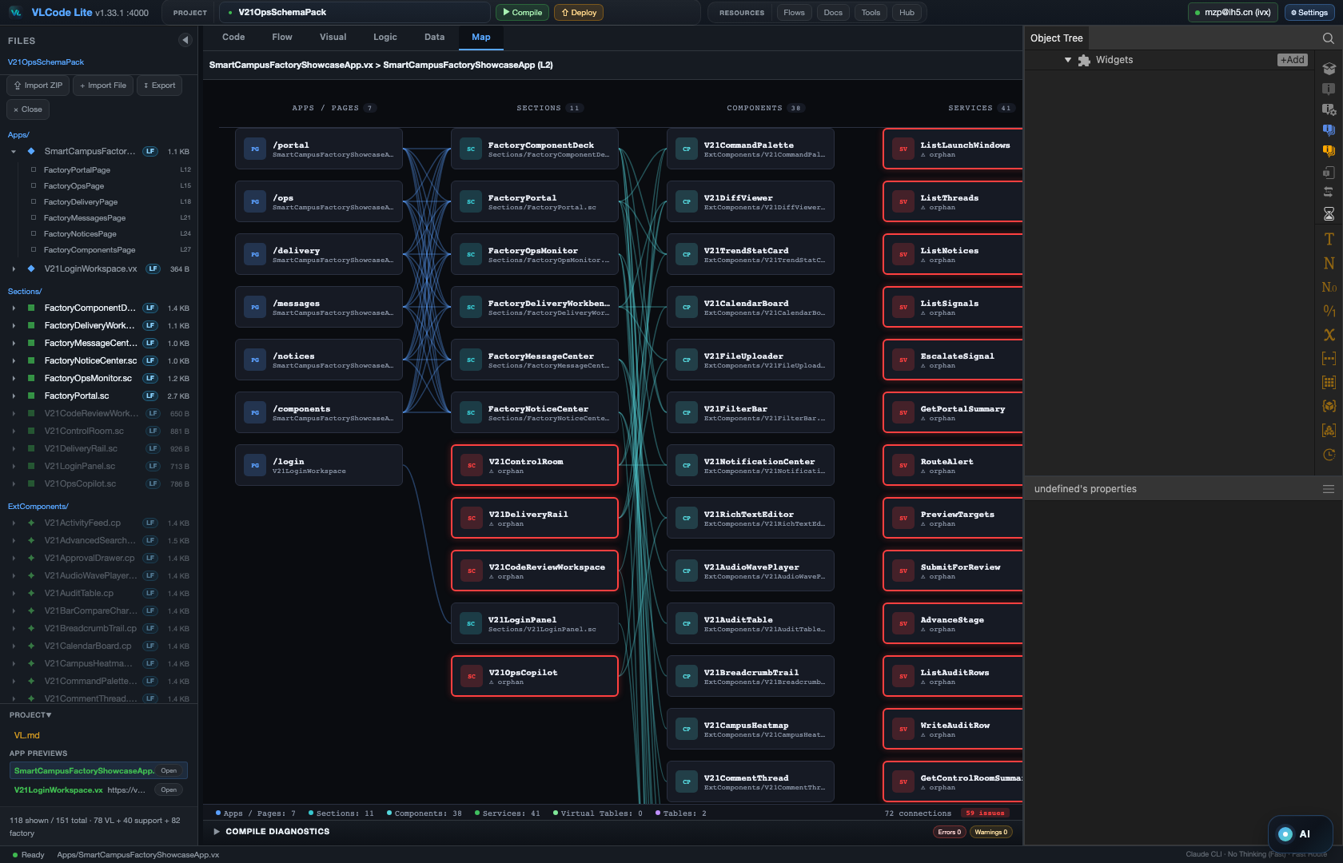
LOCAL · AI-NATIVE · ENTERPRISE APP BASE
Tame AI
inside a DAG.
Ship complete, deployable enterprise applications — backend and all, not toys.
Open source (MIT) · Local-first
Map mode — a whole VL app as one architecture graph.
github.com/VisualLogic-AI/VL-Code

Slide 2
01
THE FRAME
Not AI-assisted. AI-native.
VL Language
VL IDE
AI Generation
Component-oriented,
minimal but complete
A graphical projection
of the language
AI-first,
multi-agent parallel
Not Low-Code · Not No-Code · Not DSL — general-purpose, no capability ceiling.
Low-code hides complexity. VL structures it.
VLCODE · Tame AI inside a DAG
github.com/VisualLogic-AI/VL-Code

Slide 3
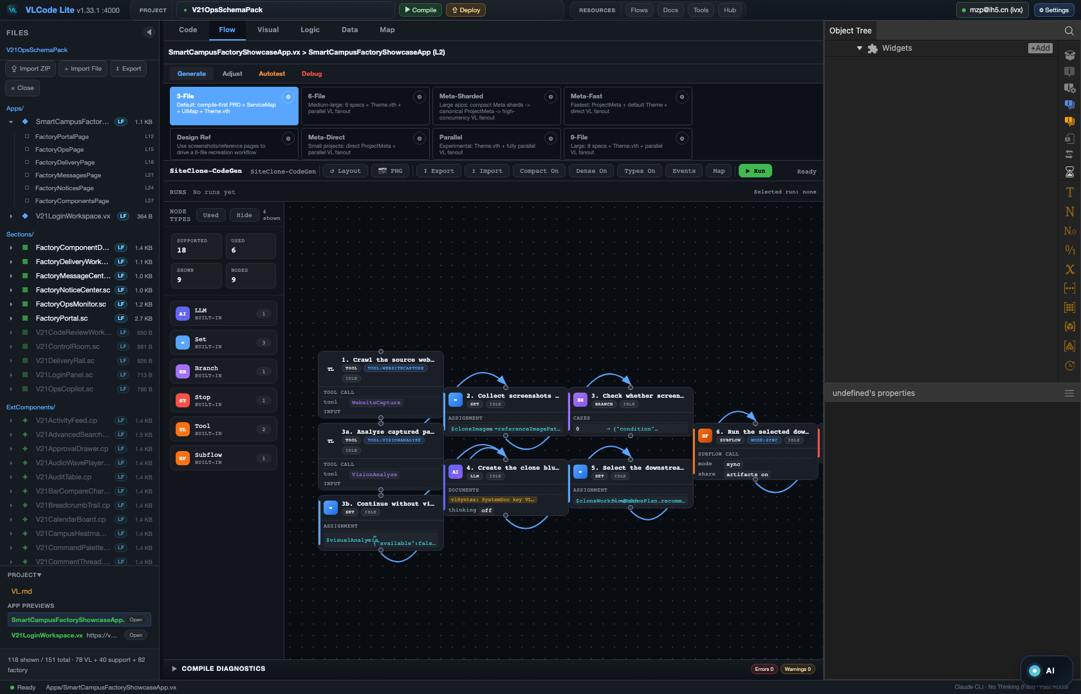
02
THE SPINE
AI is brilliant at a point. It can't hold a line.
So VLCode puts the AI inside a DAG.
Neural nets, approval flows, dependency chains, data pipelines — most real program logic is nodes plus directed edges. Put AI in that graph: creativity lives inside each node, determinism lives in the edges. You stop babysitting and start orchestrating.
Same AI. A 10× gap between people. A DAG is what flattens it.
Flow mode — each build runs as a verifiable DAG.
VLCODE · Tame AI inside a DAG
github.com/VisualLogic-AI/VL-Code

Slide 4
03
THE MOAT
VL is AI's Intermediate Representation.
Representation efficiency > model size
One ~100 KB Bible.
Infinite apps.
Human intent → VL (IR) → executable React / Node. Whoever controls the representation layer controls the system's ceiling.
The whole VL syntax fits in ~100 KB — UI, logic, backend, database, deployment. Traditional full-stack means learning 50+ framework docs. VL needs one source of truth.
VLCODE · Tame AI inside a DAG
github.com/VisualLogic-AI/VL-Code

Slide 5
04
THE HARNESS
A game needs a prompt. An enterprise app needs a harness.
A game lives inside the prompt — rules, assets, state, feedback are self-contained. A real enterprise app cannot: it must connect backend resources, data contracts, identities, permissions, approvals, deployment, logs, and human decisions across many steps. That long, grounded process is AI coding's dead angle — not the code, the harness.
VLCode = the harness, productized. Freeze repeatable flows, resource patterns, validation habits and team knowledge into a product — so you orchestrate instead of carrying it all in your head.
VLCODE · Tame AI inside a DAG
github.com/VisualLogic-AI/VL-Code

Slide 6
05
VLCODE CAPABILITIES · I
Enterprise-grade, end to end.
Enterprise AI coding
Complete applications
Strong backend
An agentic orchestrator drives ~34 tools across the whole build loop — not a side chat box. Pluggable providers (Anthropic, OpenAI, DeepSeek, Kimi, GLM, Gemini). Feature Safety Guard preflights every change with rollback checkpoints.
VL covers frontend + backend + data + theme in one language. Deployed apps read real database rows — not mockups.
Typed ServiceDomain methods, VirtualTable projections with vector search, typed Field contracts, service-level auth. The backend is first-class, not an afterthought.
VLCODE · Tame AI inside a DAG
github.com/VisualLogic-AI/VL-Code

Slide 7
06
VLCODE CAPABILITIES · II
Fast, reusable, governable.
Fast & parallel generation
The Component Factory
Concurrent waves up to concurrency 24. Grounded: 150 methods + 30 pages, 0 lint errors, 476s; a faster run: 108 methods + 90 pages, 233s.
Install real .wc components with install contracts. Every install dual-writes to the Factory and the Resource Center — build once, reuse and share instantly.
Powerful workflow DAG
Customize & share everything
VL Workflow Engine (spec 4.1): checkpoint, resume, rerun-from-step, breakpoints, human Review gates, Actor execution, and Score / Grow / Channel / Topology / Iteration.
Components, flows, skills, docs, themes, prompts — all customizable, shared through the Resource Center's review-gated lifecycle (local → cloud-private → submitted → platform-shared).
VLCODE · Tame AI inside a DAG
github.com/VisualLogic-AI/VL-Code

Slide 8
07
ENTERPRISE BACKEND, BUILT-IN
Cloud, identity, permissions — as components.
The harness that real enterprise apps need — assembled, not bolted on afterward.
Backend · cloud integration
User components
Permission components
Typed ServiceDomain methods + VirtualTable projections with vector search bind real backend & cloud capabilities — first-class, not glue.
Identity & user-management building blocks (UserAuth + user tables), plus your own .cp components — reusable through the Component Factory.
Service-level auth declares authn / authz semantics; data-auth components and platform permission config gate every access.
VLCODE · Tame AI inside a DAG
github.com/VisualLogic-AI/VL-Code

Slide 9
08
THE NUMBERS
Verifiable, not hopeful.
÷10
×10
10×
tokens
speed
scale
1 line of VL ≈ 200–400 lines of code · ~80% less code · ~90% token savings · 500+ components beyond context limits.
From “looks right” to verified. From probability to process.
Every DAG node can run lint / compile / preview / test / human gate — runs are reproducible and auditable.
VLCODE · Tame AI inside a DAG
github.com/VisualLogic-AI/VL-Code

Slide 10
09
LOCAL-FIRST
Local-first. Cloud optional. Export = zero lock-in.
Fully offline core
Export anywhere
Cloud deploy is an option
Lint / Compile / codegen run against a pinned local parser — no cookie, no project ID, no network.
Export as portable .vl, .vl + dev state, a VL .zip, or a .vflow. Or export React + Node source and self-host.
Production publish with its own production DB + real-domain URL is there when you want it — an option, not a cage.
VLCODE · Tame AI inside a DAG
github.com/VisualLogic-AI/VL-Code

Slide 11
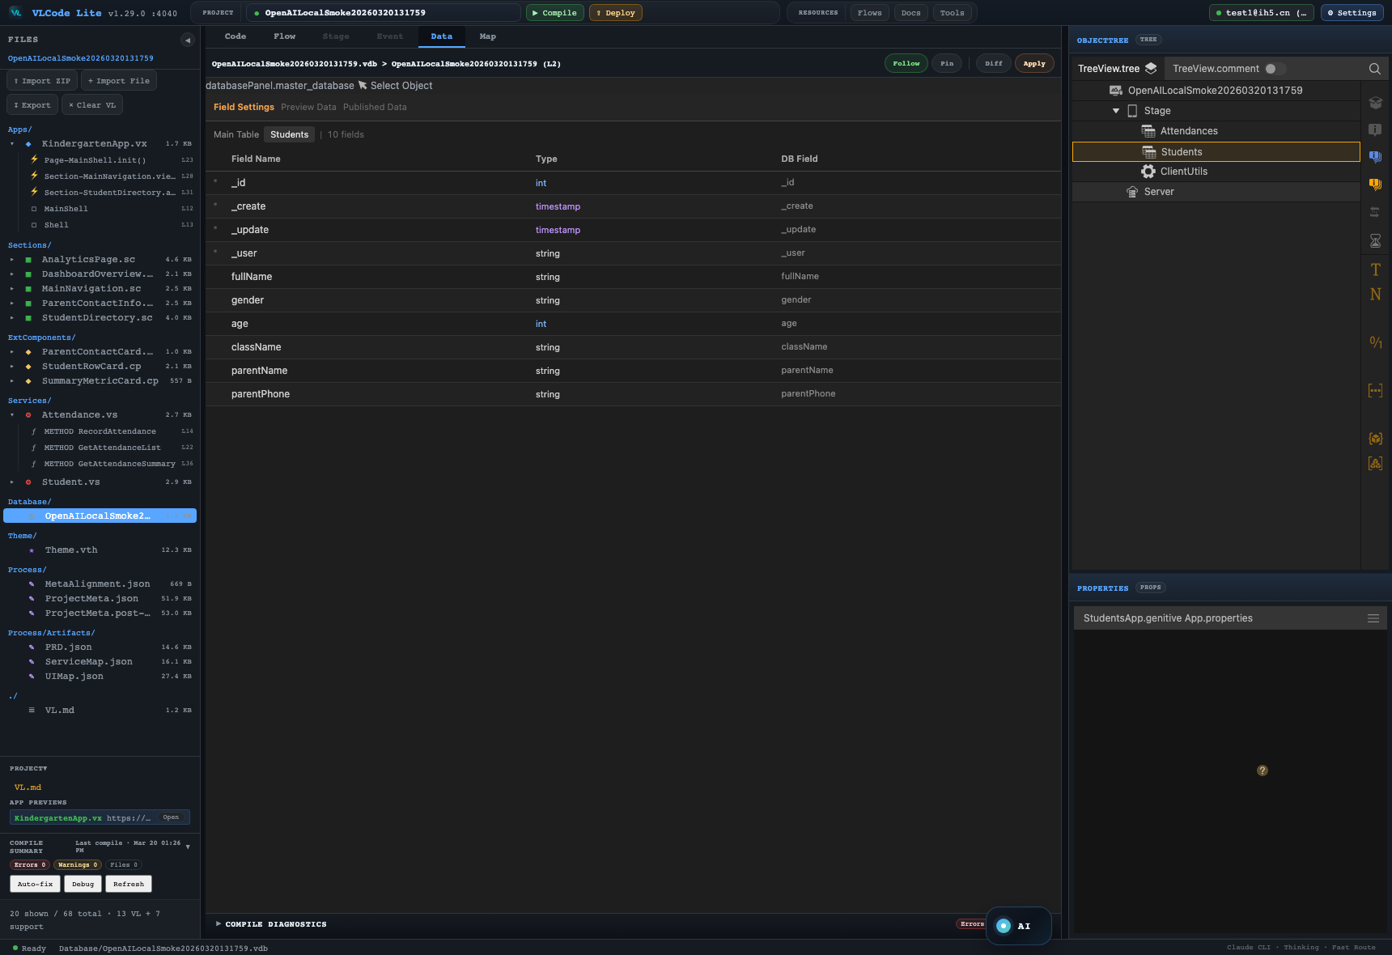
10
EVERYTHING GRAPHICAL
You reason in pictures, not buried text.
Architecture → Map · Process → DAG + Event · Data → ER. Code ↔ Graph, 1:1 bidirectional.
Map — architecture
Flow — process DAG
Data — ER model
VLCODE · Tame AI inside a DAG
github.com/VisualLogic-AI/VL-Code

Slide 12
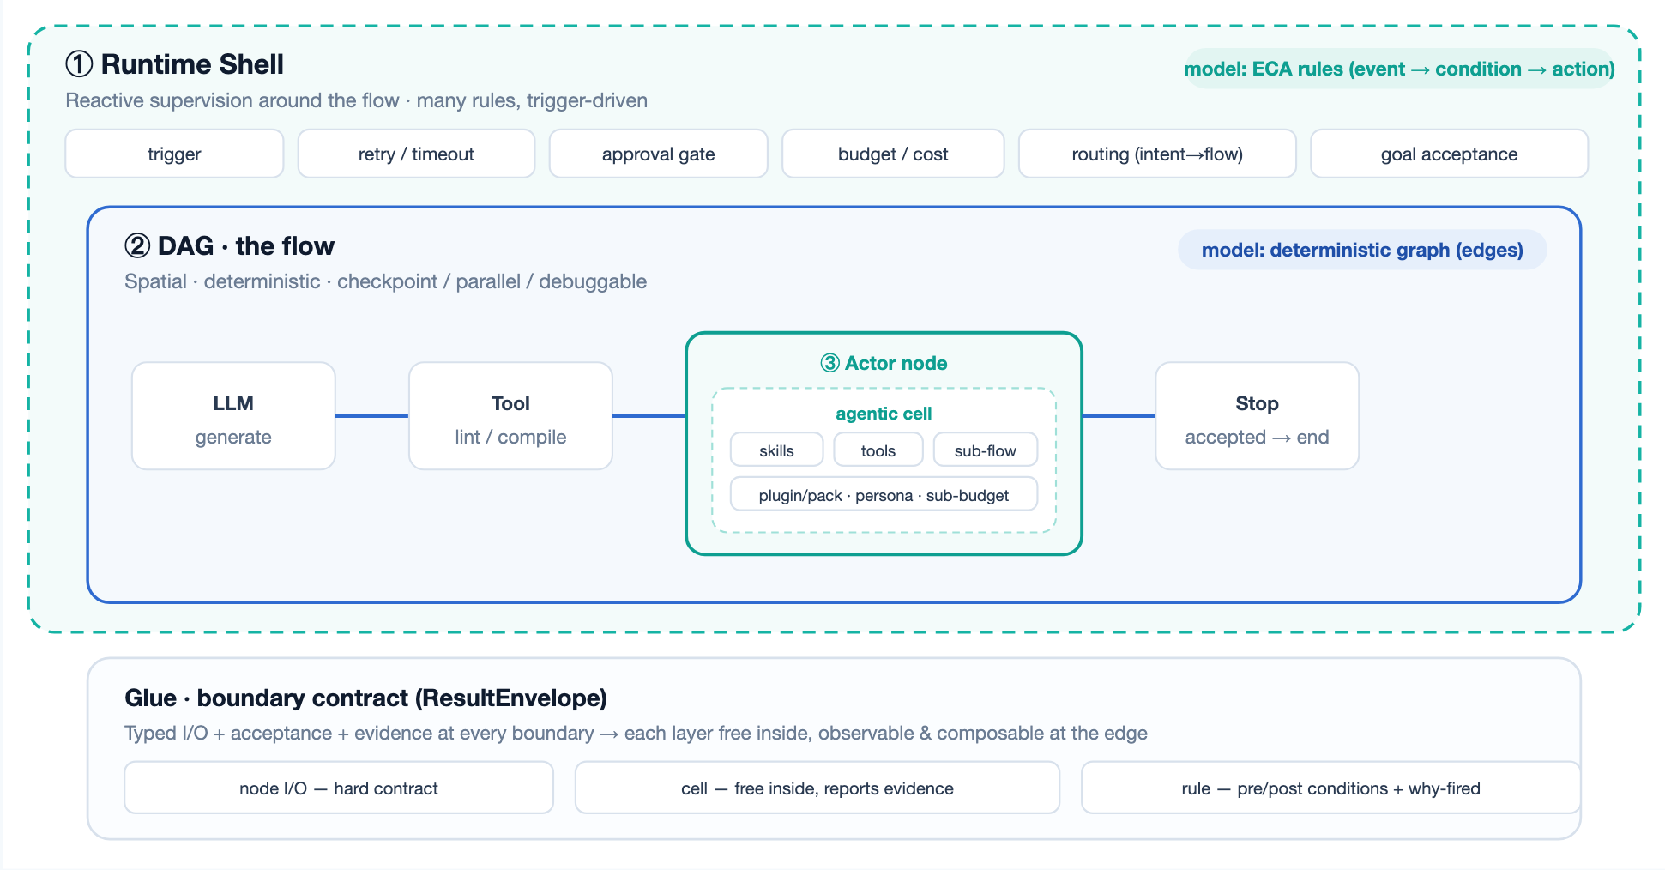
11
THE RUNTIME
Three runtimes. One system.
Each layer uses the computational model that fits it — never one nested inside another.
① Shell · rules
Event→condition→action around the flow: trigger, retry, approval, budget, routing, goal acceptance.
② DAG · deterministic
Explicit edges, checkpoint, parallel, node breakpoints. The stable, reproducible spine.
③ Cell · exploratory
An Actor node mounts skills + tools + sub-flows and explores freely — held by a typed contract.
VLCODE · Tame AI inside a DAG
github.com/VisualLogic-AI/VL-Code

Slide 13
12
DAG VS SKILLS
When to draw a graph. When to hand it to the agent.
Dimension | Skills · agent loop | DAG · workflow
Control flow | Model decides — non-deterministic | Edges & branches fixed — deterministic
Debugging | Hard — no nodes, no breakpoints | Breakpoint / pause / rerun / checkpoint
Parallelism | Mostly sequential | Real Fork / Loop fan-out
Acceptance | Self-declared “done” (soft) | Explicit gates + Score / Review
Observability | Weak | Run ledger + artifact lineage
Authoring cost | Low — a few sentences | Higher — lay out the graph
Best for | Open-ended, judgment, one-off | Repeatable, parallel, audited
Where new logic goes: repeatable → DAG · judgment → skill in an Actor node · reactive → shell rule
VLCODE · Tame AI inside a DAG
github.com/VisualLogic-AI/VL-Code

Slide 14
THE MOAT
Two products.
One foundation.
One .vflow.
When software scales and AI goes deeper, whoever controls the representation layer controls the ceiling. And this is just the beginning.
github.com/VisualLogic-AI/VL-Code

