Slide 1
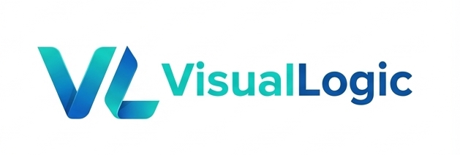
Contract
Harness AI
Intent
schema
input
Validate
check
with a DAG
AI Node
generate
The graph abstraction behind neural nets, approval flows, and real program logic.
Package
ship
VL
DAG
AI Assistant
Project
real app
VisualLogic AI

Slide 2
The pattern is already everywhere
VLC integrates proven graph ideas into AI-native software production.
Process graphs
Agent + node graphs
VLC integration
BPMN
business flows
approval routes
handoffs
LangGraph
ComfyUI graphs
dataflow DAGs
Simulink blocks
VL language
components
validation
logs
deployable apps
VisualLogic AI

Slide 3
One AI node is powerful, but unmanaged
A big output is not the same as a complete process.
Brief
Docs
Code
Large output
AI
Memory
impressive, variable
Tools
Rules
Risk
The next step is implicit. Stability depends on the operator, the prompt, and the run.
User intent
Examples
VisualLogic AI

Slide 4
A DAG turns AI into a process
The same graph shape appears in neural nets, approvals, pipelines, and programs.
Intent
Plan
Tool
Repair
human input
decompose
execute
loop
Manifest
AI
Validate
Output
runtime contract
generate
quality gate
ship
Neural-style nodes | typed dataflow | checkpoints | retries | human gates
VisualLogic AI

Slide 5
Loops are allowed; execution stays traceable
The design graph may cycle, while each run unfolds into an auditable acyclic trace.
Input
Neuron
Weight
Activation
Output
Request
Review
Approve
Notify
Record
Spec
AI Build
Validate
Loop Node
Ship
Retry loops
Cycles
State machines
Loop nodes
Acyclic trace
VisualLogic AI

Slide 6
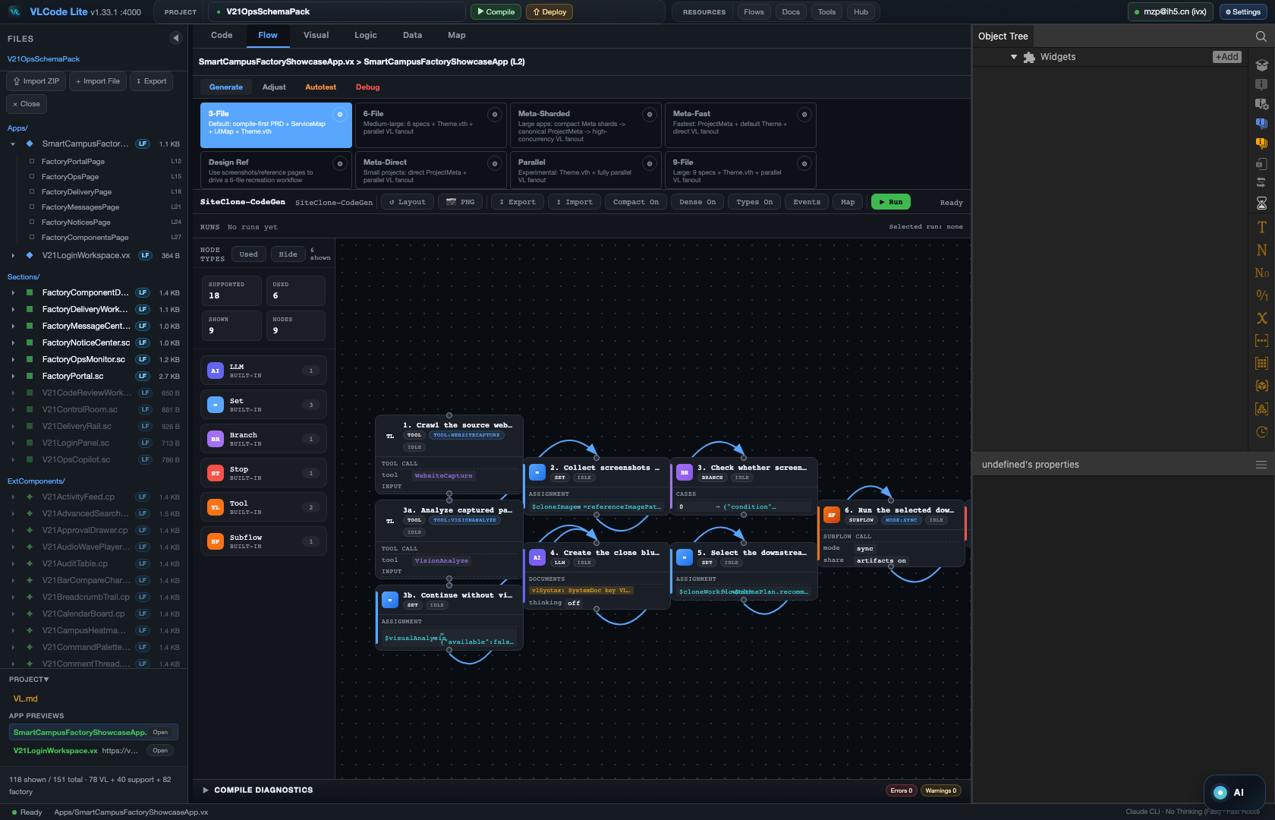
Real VLC Flow mode
Complex DAG workflows are already visible and runnable inside VLC.
A real VisualLogic graph: specialized nodes, visible state, logs, validation, and repair loops.
VisualLogic AI

Slide 7
Agent Apps are DAG plus manifest
A workflow becomes a runnable, shareable application.
Agent App
DAG
Manifest
process
runtime
runnable
Inputs / outputs
UI panels
Permissions
Typed entry points
Interaction surface
Runtime boundaries
Tools / skills
Human gates
Packaging
Callable capabilities
Review and approval
Local or remote run
VisualLogic AI

Slide 8
VL makes the system composable
Structured layers plus components make parallel AI development practical.
Structured layers
Pure components
Simple for agents
Contracts, services, pages, sections, and themes are decoupled. Once the contract is clear, teams and agents can build in parallel.
Everything can be composed: UI, flows, tools, skills, services, and theme resources. Components expose methods, properties, and events.
The language is easy for people and AI to learn. Agents can call components directly instead of guessing hidden behavior.
More reusable components -> faster delivery -> more reliable enterprise adoption.
VisualLogic AI

Slide 9
VisualLogic AI
VL + DAG + AI Assistant
Free local IDE
Open resources
Enterprise landing
Download VL-Code and build real projects with visual flows, component resources, tools, skills, and AI assistance.
Design and upload flows, components, tools, and skills. Platform resources from VisualLogic are free to use.
Designed for complete project generation, not isolated code fragments. Project managers and non-developers can participate directly.
github.com/VisualLogic-AI/VL-Code
github.com/VisualLogic-AI/VisualLogic.ai-VL
VisualLogic AI

