Slide 1
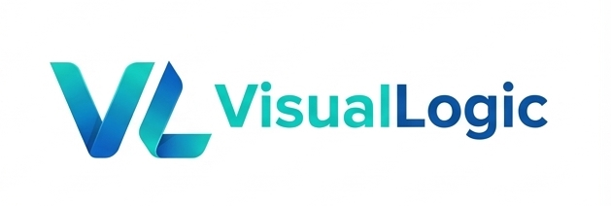
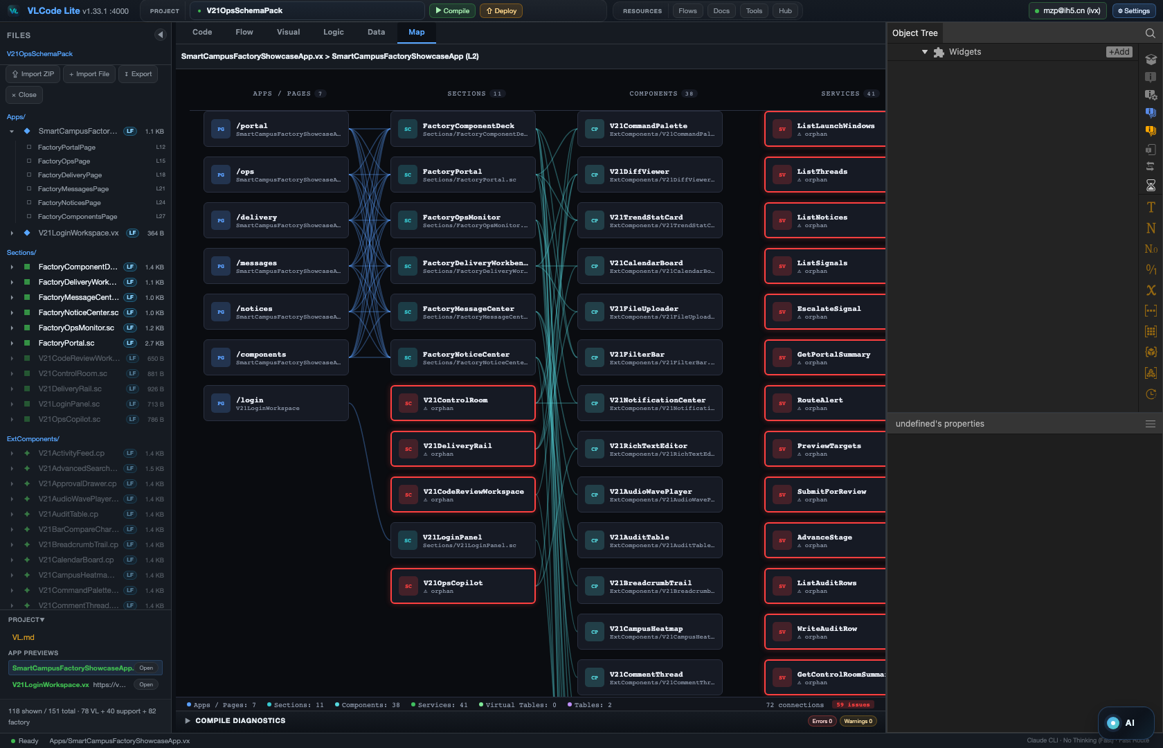
THE LOCAL · AI-NATIVE DEVELOPMENT PLATFORM
Tame AI
inside a DAG.
AI's capability and creativity — with the stability of a graph you can trust.
Open source (MIT) · Local-first
Map mode — a whole VL app as one architecture graph.
github.com/VisualLogic-AI/VL-Code

Slide 2
01
THE FRAME
Not AI-assisted programming. AI-native programming.
VL Language
VL IDE
AI Generation
Component-oriented,
minimal but complete
A graphical projection
of VL syntax
Native AI-first,
multi-agent parallel
Not Low-Code · Not No-Code · Not DSL — general-purpose, no capability ceiling.
Low-code hides complexity. VL structures it.
VL · CODE · Tame AI inside a DAG
github.com/VisualLogic-AI/VL-Code

Slide 3
02
WHY NOW
Programming languages were never designed for AI.
THE 60-YEAR ASSUMPTION
NOW WE FORCE AI INTO IT
Human + Compiler
A fundamental mismatch
Millions of lines to understand
We built languages for humans to write and compilers to run — then dropped a probabilistic model into the middle and hoped.
Linear, sequential structure
Implicit relationships
“This is fundamentally misaligned.”
Line-by-line generation
VL · CODE · Tame AI inside a DAG
github.com/VisualLogic-AI/VL-Code

Slide 4
03
LANGUAGES, LEVELED
To AI, every language looks alike.
WHAT AI ERASED
WHAT STILL DIFFERS — A LOT
Natural languages — English · Chinese · Japanese.
Programming languages too —
Python · Java · JS.
Tokens burned per I/O
How logic is expressed
How an app is composed
To a model, one language is much like another.
The cost is wildly unequal.
If the model is indifferent, design the language that costs it the least — a language whose user is the AI, not the human. (People still learn it in an afternoon.)
VL · CODE · Tame AI inside a DAG
github.com/VisualLogic-AI/VL-Code

Slide 5
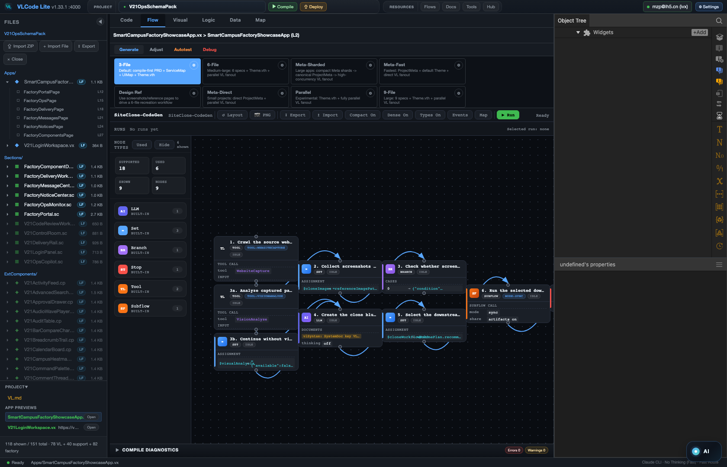
04
THE CORE IDEA
AI is brilliant at a point.
It can't hold a
line.
Today's best coding agents are point-wise: one input, one output. You can't predict the output — so you can't predict the next step's starting point, and you end up babysitting every move.
So VLC puts the AI inside a DAG. Creativity lives in the nodes. Determinism lives in the edges. You stop babysitting and start orchestrating.
Flow mode — every build runs as a verifiable DAG: generate → check → fix → preview.
VL · CODE · Tame AI inside a DAG
github.com/VisualLogic-AI/VL-Code

Slide 6
05
THE LEVELER
Same AI. 10× the gap between people.
On a single point, you can't out-think AI anymore. But apps aren't a point — they're a line of many points, stacked in layers. Driving every I/O along that line is the whole job now: with the same model, one builder ships 10× while another stalls.
WHY A DAG CAN DO THIS
1
Logic decomposes — and recomposes
Any complex process splits into points and edges; so does the compute behind it.
A DAG is the leveler. It's the path-plan that drives AI across the whole line — and the AI can draw that plan itself.
2
AI is exceptional at logic
Give the model explicit structure and it plans, fills and checks each step reliably.
VL · CODE · Tame AI inside a DAG
github.com/VisualLogic-AI/VL-Code

Slide 7
06
THE MOAT
VL is AI's Intermediate Representation.
→
→
Human Intent
VL
Executable
Natural language
The Intermediate
Representation
React, Node.js, …
AI generates VL · VL compiles to any target
Whoever controls the representation layer controls the system's ceiling. Representation efficiency > model size — the real moat.
VL · CODE · Tame AI inside a DAG
github.com/VisualLogic-AI/VL-Code

Slide 8
07
ONE SOURCE OF TRUTH
One document. Infinite apps.
TRADITIONAL FULL-STACK
VL FULL-STACK
React · Node · Express · TypeScript · PostgreSQL · Redis · Tailwind · Prisma + 50 more
The VL Syntax Reference — “The Bible.” One ~100 KB document covers UI, logic, backend, database, deployment.
Scattered across hundreds of docs — always changing.
1
100
∞
Document
KB
Apps
VL · CODE · Tame AI inside a DAG
github.com/VisualLogic-AI/VL-Code

Slide 9
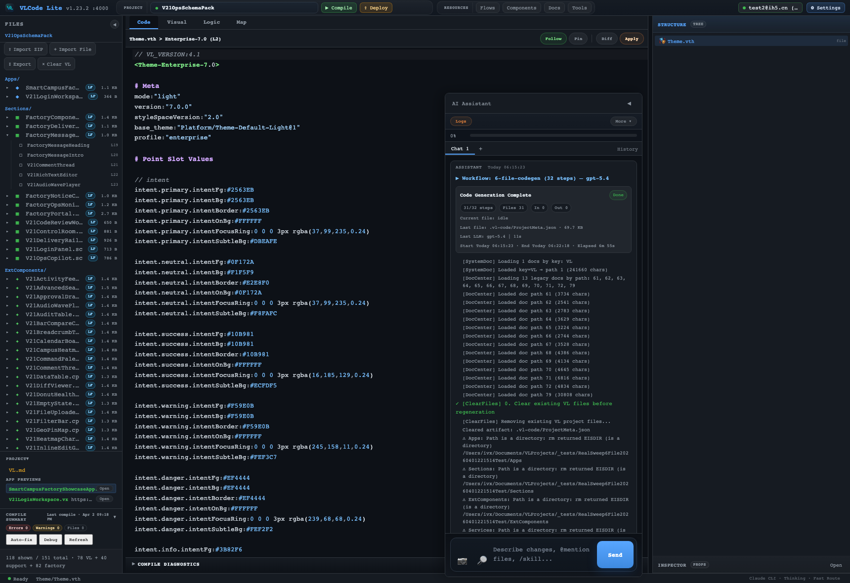
08
ARCHITECTURE
Decoupled on every axis.
Front / back
Sections + Components ( .sc + .cp ) vs Services ( .vs )
Look / structure
Visuals & design tokens live in THEME — apart from logic
Build / deploy
What you author is not what you ship
Data / data-usage
Schema ( .vdb ) vs VirtualTable
Small focused files
Every file < 100 lines, one responsibility, no cross-file mess
THEME — visuals decoupled from structure.
Smaller, independent surfaces → less ambiguity in, fewer hallucinations out.
VL · CODE · Tame AI inside a DAG
github.com/VisualLogic-AI/VL-Code

Slide 10
09
THE MODEL
Everything is a component.
P
Properties
M
Methods
E
Events
Data state, configuration
Actions, business logic
Triggers, interactions
P + M + E — the trinity in every component. Program = component composition.
From 1D to 2D programming. Lines in sequence → a multi-dimensional graph of components with explicit relationships.
VL · CODE · Tame AI inside a DAG
github.com/VisualLogic-AI/VL-Code

Slide 11
10
REUSE
Bank the token-compute. Share it to everyone.
Every asset is encapsulated as a reusable component. Generate it once, store it, and share it to every developer — the expensive token-compute of AI becomes a reusable asset instead of a one-off spend.
Higher output.
Lower spend.
The cost of intelligence is paid once and amortized across everyone who builds on it.
1
Generate once — AI pays the token cost a single time
2
Store — The component is banked, versioned
3
Reuse everywhere — Amortized across every project & team
VL · CODE · Tame AI inside a DAG
github.com/VisualLogic-AI/VL-Code

Slide 12
11
STORE, DON'T BURN
Don't buy more GPUs. Store the compute.
The industry races to add GPUs and power. We think that's the wrong axis. Most of that compute is storable — once AI pays the tokens to build something correct, the result is banked forever. The Component Factory is exactly that: a compute-storage center.
10,000,000
COMPONENTS BANKED
Generated once, stored, shared to everyone
The compute to “write code” all but vanishes. You assemble banked compute — you don't re-spend it.
99.999%
OF ALL SOFTWARE NEEDS
Web · platform · enterprise — already covered
VL · CODE · Tame AI inside a DAG
github.com/VisualLogic-AI/VL-Code

Slide 13
12
THE NUMBERS
Fewer tokens. Faster. Bigger.
÷10
×10
10×
TOKENS
SPEED
SCALE
Components are pre-abstracted — pure logic, no boilerplate
Files generate in parallel, not one after another
500+ components — beyond ordinary token limits
1 line of VL ≈ 200–400 lines of code · 80% less code · 90% token savings
VL · CODE · Tame AI inside a DAG
github.com/VisualLogic-AI/VL-Code

Slide 14
13
AVAILABLE TODAY
VL needs less AI capability — and it works today.
TRADITIONAL AI IDE
VL AI IDE
Strong reasoning across complex codebases
Simple P + M + E — one consistent pattern
Many frameworks at once, implicit state
One document covers everything
500+ lines per feature, context overflow
50–100 lines per file, parallel generation
High hallucination under complexity
Structural validation catches errors
Stable complex-app generation: 5–10 more years.
Stable VL-app generation: AVAILABLE TODAY.
Because the bar is lower, cheap, small, even local models run VL well.
VL · CODE · Tame AI inside a DAG
github.com/VisualLogic-AI/VL-Code

Slide 15
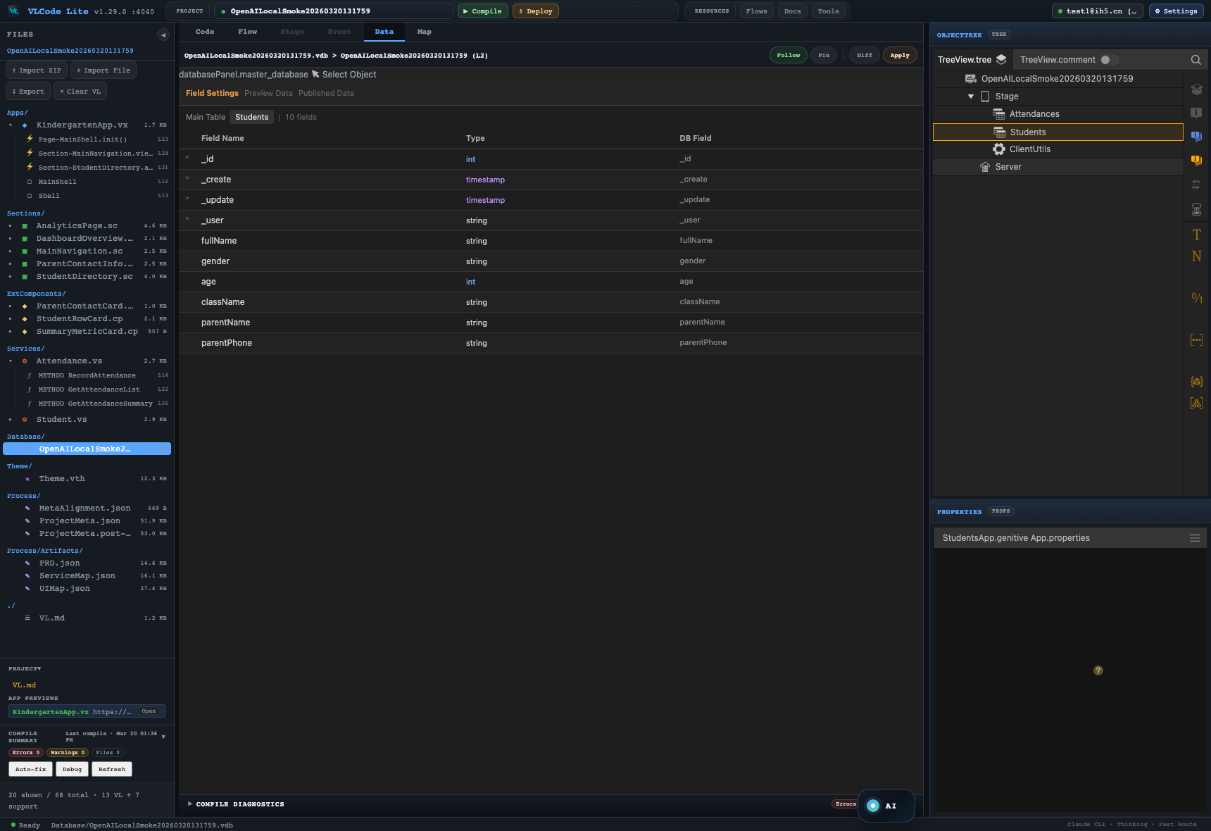
14
SEE THE SYSTEM
You reason in pictures, not buried text.
Architecture → Map
Process → DAG + Event
Data → ER
Code ↔ Graph, 1:1 and bidirectional. The VL IDE is VL Code.
VL · CODE · Tame AI inside a DAG
github.com/VisualLogic-AI/VL-Code

Slide 16
15
TRUST
From “looks right” to verified.
Because every build is a DAG, every node can run lint, compile, preview, a test, or a human gate. AI can only debug explicit structure — so debugging becomes structural, not textual. Runs are reproducible and auditable.
Raw LLM chat
VLC — AI in a DAG
Next step
Unpredictable
Defined by the graph
Your role
Babysit every output
Orchestrate the flow
Trust
“Looks right”
Compile / test / gate
“From probability to process.”
Reuse
Copy-paste prompts
Components, tools, skills
VL · CODE · Tame AI inside a DAG
github.com/VisualLogic-AI/VL-Code

Slide 17
15
DAG HARNESS
One AI node creates output. A DAG harness creates progress.
Point AI
many inputs → one powerful output
DAG Harness
inputs, outputs, node types and checkpoints are explicit
Prompt
Intent
Plan
Contract
Build
Docs
input
AI
manifest
AI/tool
Code
AI
OUTPUT
Data
Check
Repair
Preview
lint
AI
output
Tools
• Next step is implicit
A DAG makes the AI process programmable: each node knows what to receive, what to produce, how to validate, and where the next step begins.
• Operator skill dominates
• Run-to-run output drifts
VL · CODE · Tame AI inside a DAG
github.com/VisualLogic-AI/VL-Code

Slide 18
16
TEAM + COST
Collaborate without competing for lines.
Human + AI, at the component layer
The right model for every node
Components are self-contained units. People and agents both work on structure and merge at the component layer — no fighting over the same lines, no git text-conflicts.
Route expensive models to the hard nodes and cheap models or tools to the routine ones. Capability where it counts, savings everywhere else.
VL · CODE · Tame AI inside a DAG
github.com/VisualLogic-AI/VL-Code

Slide 19
17
YOUR WAY
Local-first. Cloud optional. Zero lock-in.
RECOMMENDED
OPTIONAL
0 BINDING
Run local
Deploy to cloud
Export source
Download & run the IDE on your machine — local read/write + AI, the smoothest path.
One click to managed cloud. Pay-as-you-go compute. Zero server ops.
Take the React + Node source out and self-host anywhere. Full data sovereignty.
Use the cloud when it helps — walk away with your code whenever you want.
VL · CODE · Tame AI inside a DAG
github.com/VisualLogic-AI/VL-Code

Slide 20
THE BET
Whoever controls the representation layer
controls the ceiling.
AI's creativity, harnessed — not hoped for. And this is just the beginning.
github.com/VisualLogic-AI/VL-Code
VisualLogic.ai-VL — language & samples
editor.visuallogic.ai
Open source (MIT) · Local-first · An AI-native development platform

