Slide 1
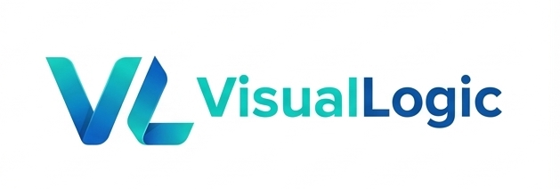
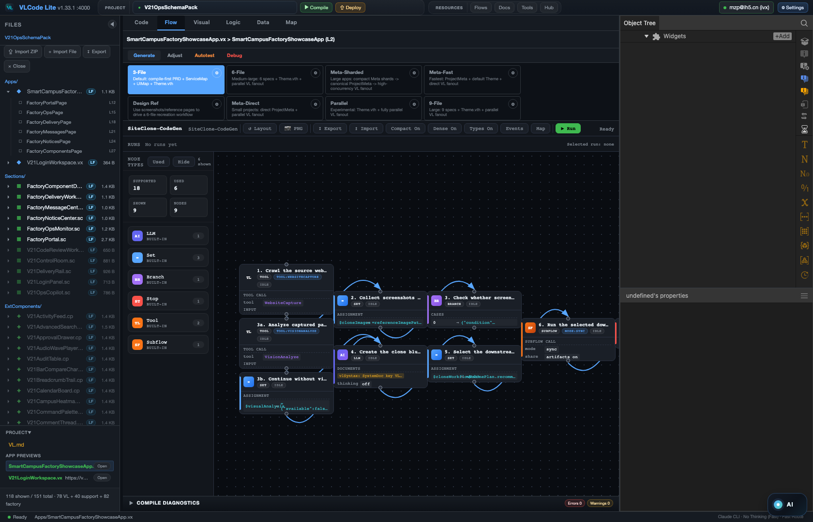
VL + VLC
AI-native software generation,
controlled by a DAG.
A language designed for AI. A local IDE that makes every step visible, verifiable and reusable.
DAG workflow: generation inside a controllable structure.

Slide 2
01
THE REAL PROBLEM
The bottleneck is not model intelligence. It is representation.
Human + Compiler
Old premise: humans write; compilers execute.
Coding agents are powerful at a point. Real applications are a long chain of decisions. VL changes the structure AI works on; VLC changes the process AI works through.
AI + Linear Code
Mismatch: AI must infer structure from text.
Answer: change representation and process.
VL-Code · Local AI-native IDE
github.com/VisualLogic-AI/VL-Code

Slide 3
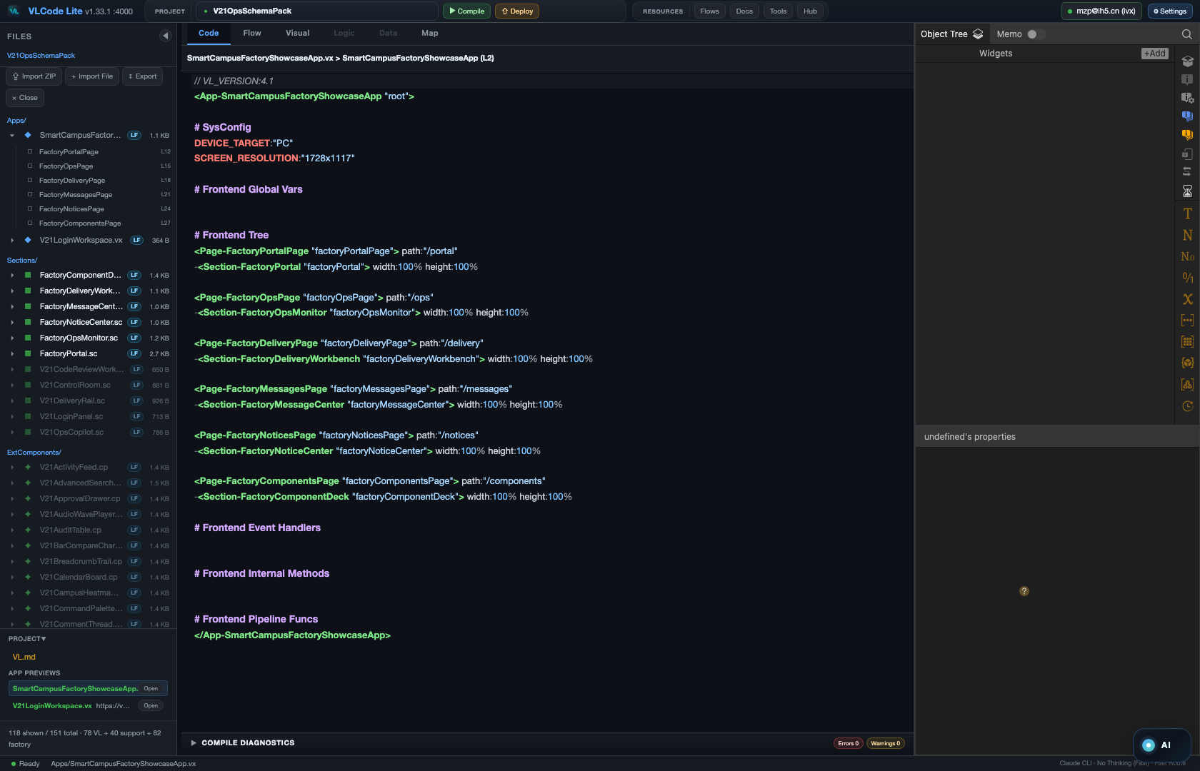
02
VL LANGUAGE
VL is a programming language designed for AI.
Compact syntax. Explicit sections. Typed properties, events and methods. A small, stable representation layer that AI can reliably generate, inspect and repair.
01
Small syntax
02
Explicit structure
03
Compilable
VL-Code · Local AI-native IDE
github.com/VisualLogic-AI/VL-Code

Slide 4
03
ARCHITECTURE
Full decoupling makes parallel generation possible.
App
Section
App, Section, Service, Component and Theme are separated by responsibility. Frontend modules and backend capabilities can be generated concurrently, then assembled through explicit interfaces.
Service
Component
Theme
Decouple → parallelize → assemble
VL-Code · Local AI-native IDE
github.com/VisualLogic-AI/VL-Code

Slide 5
04
COMPONENT PROGRAMMING
Frontend and backend are both components.
Properties
Events
The component is the stable unit of programming. Every component exposes properties, events and methods, which gives agents a precise interface for search, wiring and reuse.
Component
Stable interfaces are what agents need
Methods
VL-Code · Local AI-native IDE
github.com/VisualLogic-AI/VL-Code

Slide 6
05
COMPONENT FACTORY
The factory turns compute into reusable engineering assets.
16K+
P/M/E
DAG
components
interfaces
consumption
16,000+ components are searchable, installable and verifiable. A component is not just a visual block; it carries an installation contract that a workflow can consume.
Generate once
Store as component
Load on demand
Compute becomes installable capability
VL-Code · Local AI-native IDE
github.com/VisualLogic-AI/VL-Code

Slide 7
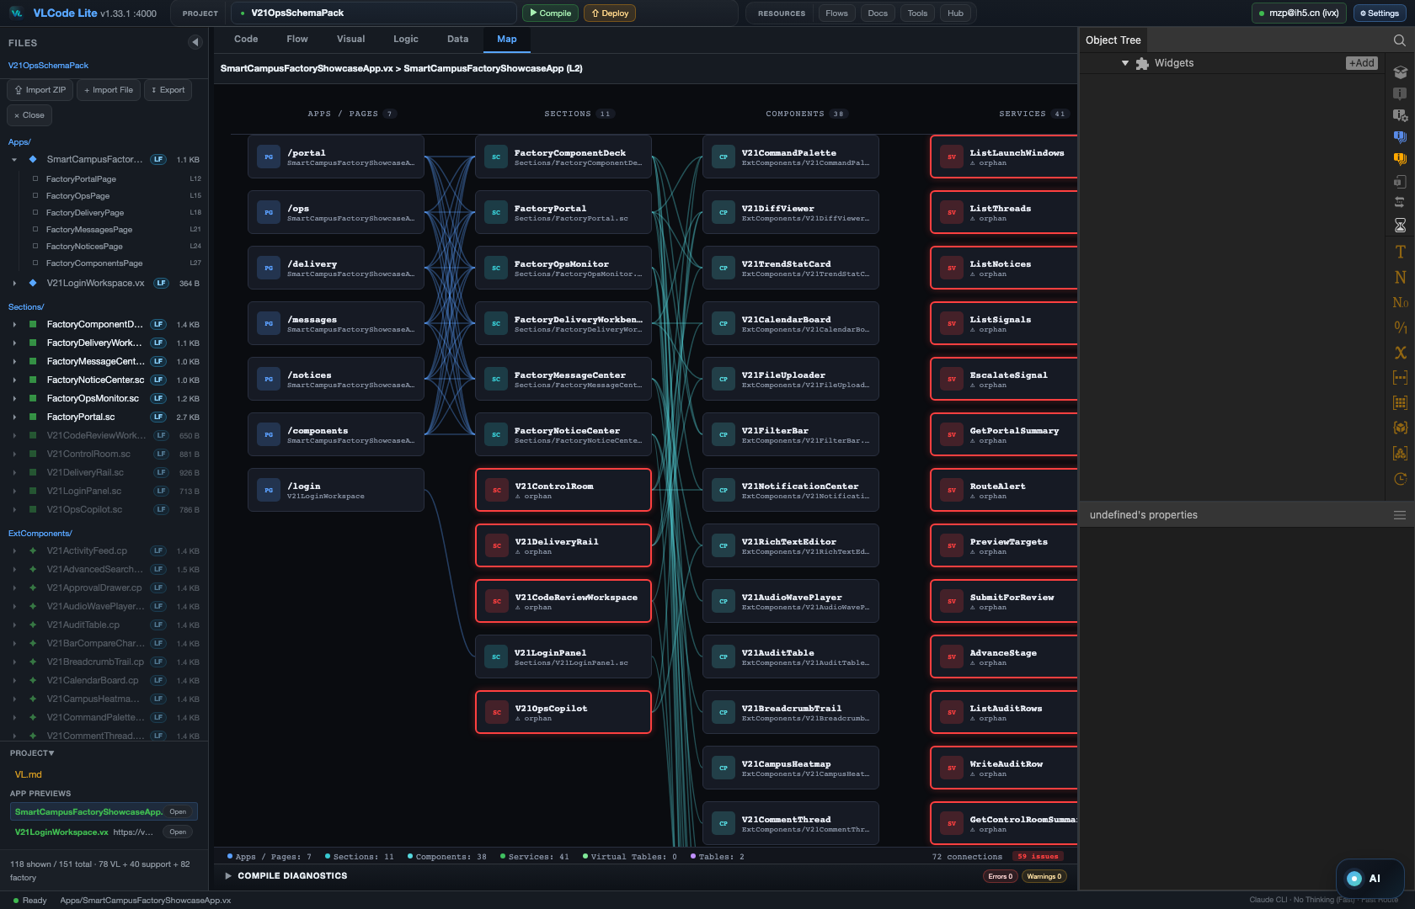
06
VLC IDE
A local IDE built for VL + AI.
It feels familiar like VS Code, but the native surfaces are visual: code, logic, map, DAG, data, theme and AI workflow all live in one local workspace.
VL-Code · Local AI-native IDE
github.com/VisualLogic-AI/VL-Code

Slide 8
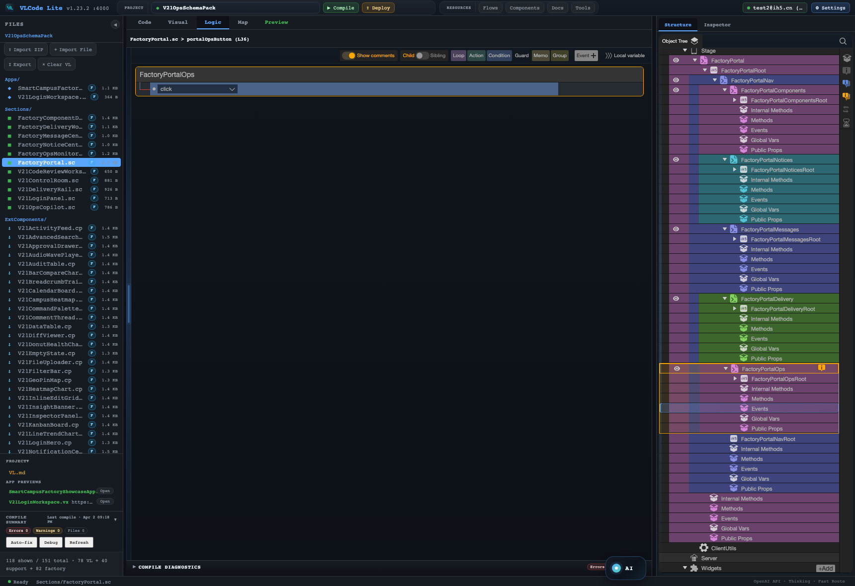
07
VISUALIZATION
Every hidden layer becomes visible.
Event Panel shows logic. Map shows layered relationships. DAG shows the generation process itself. The IDE is a projection of the language, not a skin over text.
Map
DAG
Event
VL-Code · Local AI-native IDE
github.com/VisualLogic-AI/VL-Code

Slide 9
08
DAG CORE
DAG is the mechanism that tames AI.
Plan
Generate
Search
Install
Creativity lives inside nodes. Determinism lives in edges. Each node has inputs, outputs, checks, retries and human gates, so the result stays inside the designer's intent.
Lint
Fix
Preview
Ship
Creativity in nodes. Determinism in edges.
VL-Code · Local AI-native IDE
github.com/VisualLogic-AI/VL-Code

Slide 10
09
AGENT COMPARISON
Point I/O agents answer. DAG agents orchestrate.
Point
Line
Most agents produce one unpredictable output at a time. VLC turns the whole build into a visible program, where models, tools and checks cooperate node by node.
single I/O
unpredictable
whole process
orchestrated
VL-Code · Local AI-native IDE
github.com/VisualLogic-AI/VL-Code

Slide 11
10
DAG HARNESS
Point AI creates output. A DAG harness creates progress.
A single AI node can absorb many inputs and produce a powerful result. But a complex system is never finished in one step; next steps, validation and repair must be structured.
Single AI node
DAG Harness
Prompt
Docs
Intent
Manifest
Generate
Check
Repair
Preview
AI
Output
input
contract
AI
lint
AI
output
Code
Data
Each node has typed input, expected output, validation and a defined next step.
unstable next step · expert operator required
VL-Code · Local AI-native IDE
github.com/VisualLogic-AI/VL-Code

Slide 12
10
ASSEMBLY WORKFLOW
Components can be searched and assembled inside the DAG.
A workflow node searches the factory, AI confirms fit, selected components are installed, dependencies close, and the final VL app is linted and compiled.
VL-Code · Local AI-native IDE
github.com/VisualLogic-AI/VL-Code

Slide 13
11
TOKEN ECONOMY
VLC stores compute in components.
1
2
3
Expensive generation happens once, then becomes a reusable component in the cloud. When needed, VLC loads engineering capability instead of spending tokens again.
Generate once
Store as component
Load on demand
Reuse stored engineering capability instead of regenerating it
VL-Code · Local AI-native IDE
github.com/VisualLogic-AI/VL-Code

Slide 14
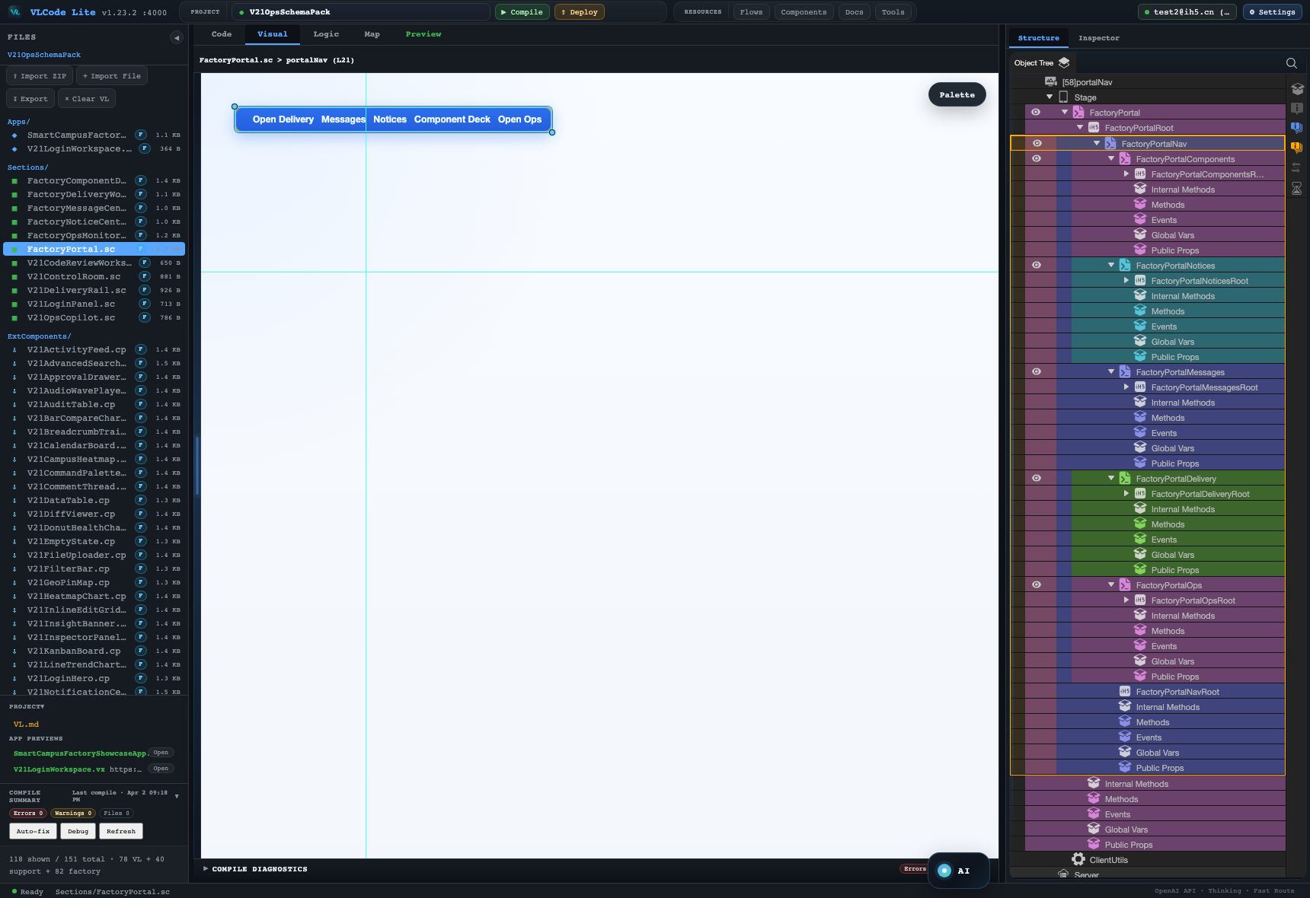
12
ZERO-CODE DOORWAY
Application creation opens to everyone.
Users describe intent, inspect the visual structure, refine components and run the DAG. Code still exists, but it is no longer the only entrance to software creation.
VL-Code · Local AI-native IDE
github.com/VisualLogic-AI/VL-Code

Slide 15
13
OPEN RESOURCES
Developers can bring their own building blocks.
Workflows / DAGs
Docs
Tools
Workflows, documents, tools, components, skills and themes can be uploaded, shared, searched and reused. VLC is an open resource layer, not a closed agent box.
Components
Skills
Themes
Resources can be uploaded, searched, reused and consumed by DAGs
VL-Code · Local AI-native IDE
github.com/VisualLogic-AI/VL-Code

Slide 16
14
FREEDOM
Generated apps can be exported and privately deployed.
VL syntax, core technical documents and components are open. Apps can be exported and self-hosted with no platform lock-in.
1
2
3
Local-first
Export source
Private deploy
Build locally. Own source. Deploy freely.
VL-Code · Local AI-native IDE
github.com/VisualLogic-AI/VL-Code

Slide 17
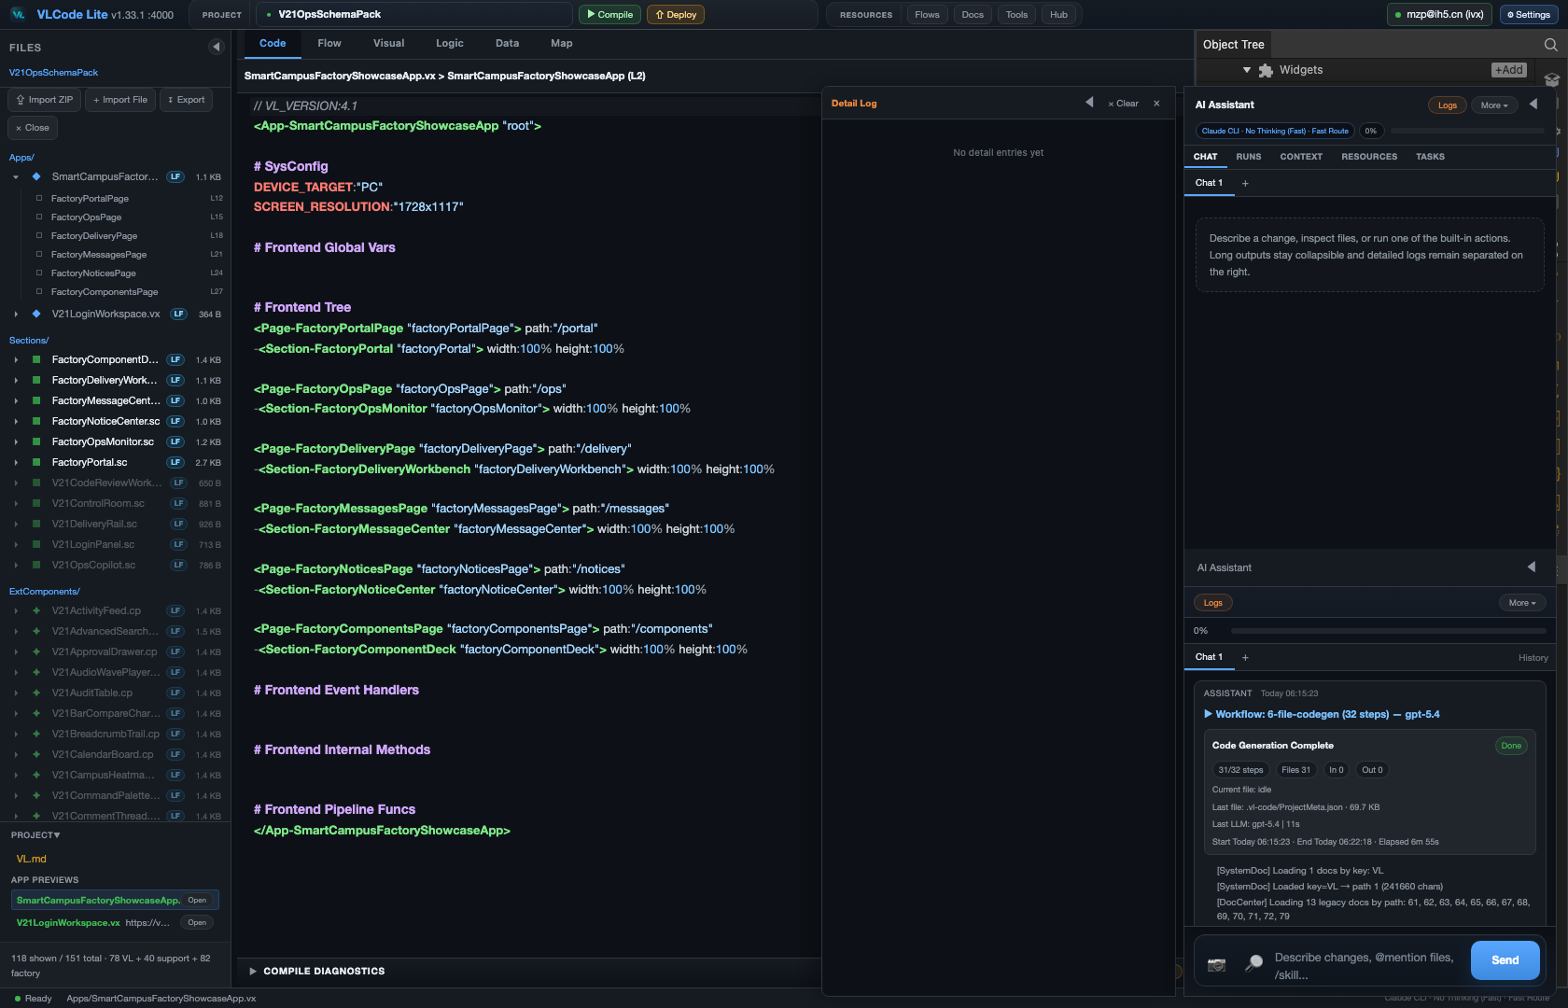
15
THE CLAIM
VLC solves the control problem of AI software generation.
VL gives AI the right representation. DAG gives AI the right process. Components give AI reusable engineering memory.
VL-Code · Local AI-native IDE
github.com/VisualLogic-AI/VL-Code

