Slide 1
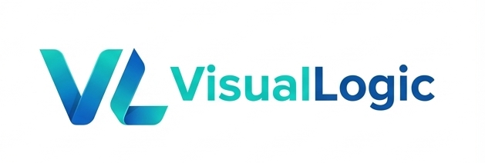
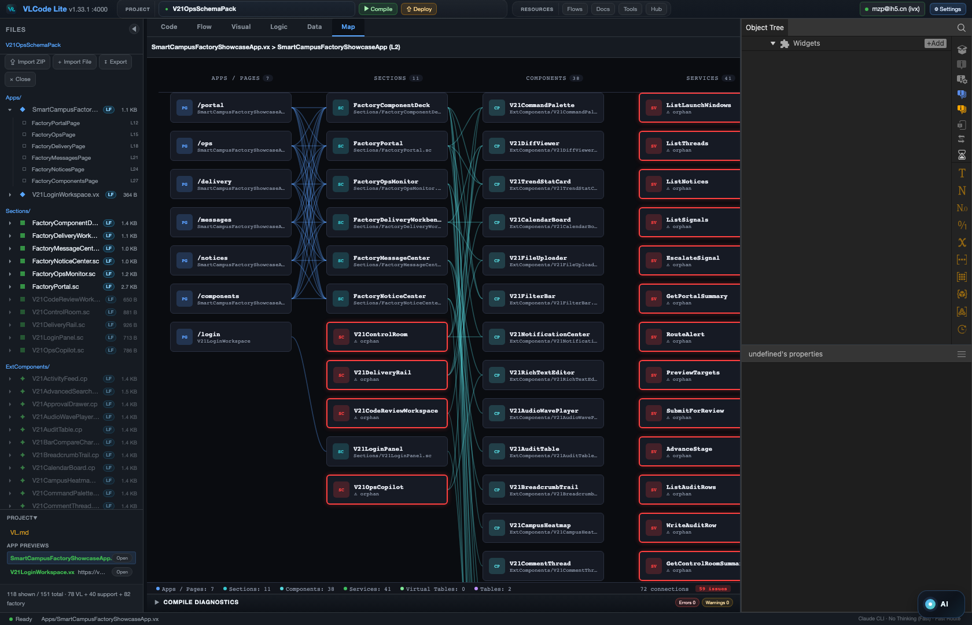
VL PROGRAMMING LANGUAGE · VLC LOCAL IDE
A language built for AI —
and a DAG that tames it.
VL redesigns how software is represented for AI. VLC turns the entire build process into a graph you can see, verify, and trust.
Map mode — an entire VL app as one architecture graph.
Open source (MIT) · Local-first · Export anytime
github.com/VisualLogic-AI/VL-Code

Slide 2
01
THE PROBLEM
AI can ace a 'point'.
It can't hold the 'line'.
The bottleneck is no longer model intelligence. It is how code is represented and how the process is controlled.
Languages were never built for AI
They assume a human author + a compiler. AI is left to guess the hidden structure.
Agents drift off course
Point-by-point I/O wanders — you babysit every step, and still miss.
Expensive, expert-only
Tokens burned regenerating the same code — that you still have to read.
VL changes the representation. VLC changes the process.
VL · CODE — An AI-native language, tamed by a DAG
github.com/VisualLogic-AI/VL-Code

Slide 3
02
PART I · THE LANGUAGE
VL is a language designed for AI —
not low-code, not a DSL.
General-purpose, with no capability ceiling. It works with today's models — even small, cheap, local ones.
AI-native
General-purpose
Stable today
Language, IDE and AI designed together from day one.
No ceiling — real apps, front to back, not toy flows.
Models already generate VL reliably. No 'wait 5 years'.
Low-code hides complexity. VL structures it.
VL · CODE — An AI-native language, tamed by a DAG
github.com/VisualLogic-AI/VL-Code

Slide 4
03
PART I · THE LANGUAGE
Decoupled on every axis —
so generation runs in parallel.
Front/back · look/structure · build/deploy · data/usage. Each file is small, single-purpose, and standalone.
Front / Back
Look / Structure
High-concurrency generation
.sc + .cp / .vs
THEME / components
Services and front-end modules generate in parallel, not one long file.
Build / Deploy
Data / Usage
Automatic assembly
source / target
.vdb / VirtualTable
Clean contracts let the factory snap components together.
Small files · single responsibility → small context, parallel, fewer hallucinations.
VL · CODE — An AI-native language, tamed by a DAG
github.com/VisualLogic-AI/VL-Code

Slide 5
04
PART I · THE LANGUAGE
Everything is a component —
front-end and back-end alike.
The minimal unit of a VL program. The shape an AI agent reasons about best.
P
Properties
M
Methods
E
Events
what it holds
what it does
what it reacts to
1D — lines of text
2D — a graph of components
A program is a composition of components. Structured, decoupled — exactly how an Agent works.
VL · CODE — An AI-native language, tamed by a DAG
github.com/VisualLogic-AI/VL-Code

Slide 6
05
PART I · COMPONENT FACTORY
The Component Factory:
16,000+ reusable building blocks.
Not just UI snippets — installable contracts for real VL projects. The expensive token-compute, banked.
16,000+
P+M+E
0
÷10
components
every interface
manual glue
tokens
Expensive generation happens once. Everyone reuses it forever.
VL · CODE — An AI-native language, tamed by a DAG
github.com/VisualLogic-AI/VL-Code

Slide 7
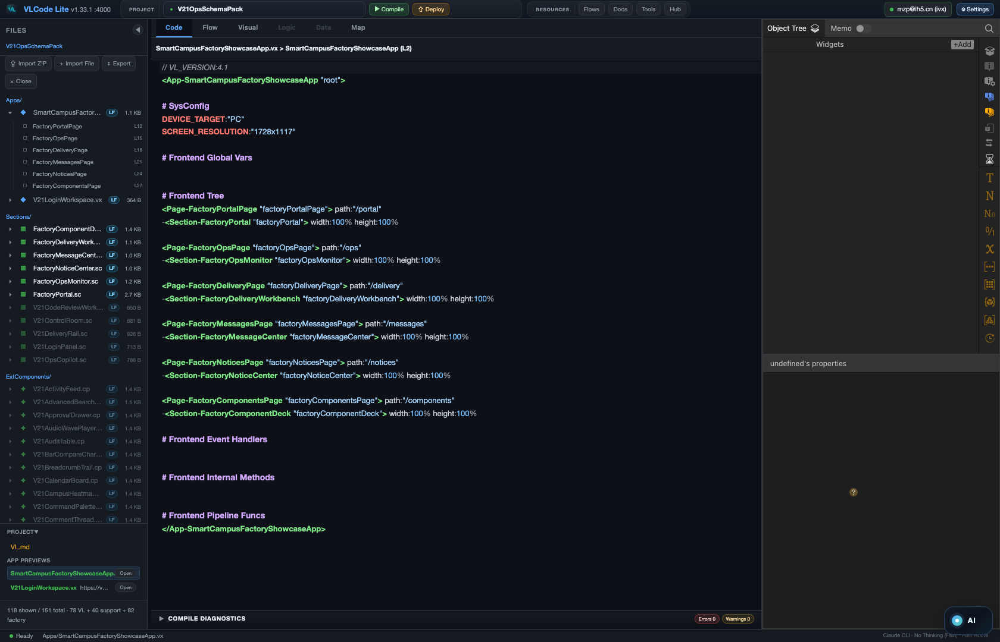
06
PART II · THE IDE
VLC: a local IDE built for VL + AI.
As familiar as VS Code — and designed end-to-end for the VL language and AI. Local-first: your machine, your code, your models.
Local read/write + AI — the smoothest path
Cloud optional, pay-as-you-go
Zero lock-in, export anytime
Code mode — VL and generated source, side by side.
Local-first. Cloud optional. The whole stack on your machine.
VL · CODE — An AI-native language, tamed by a DAG
github.com/VisualLogic-AI/VL-Code

Slide 8
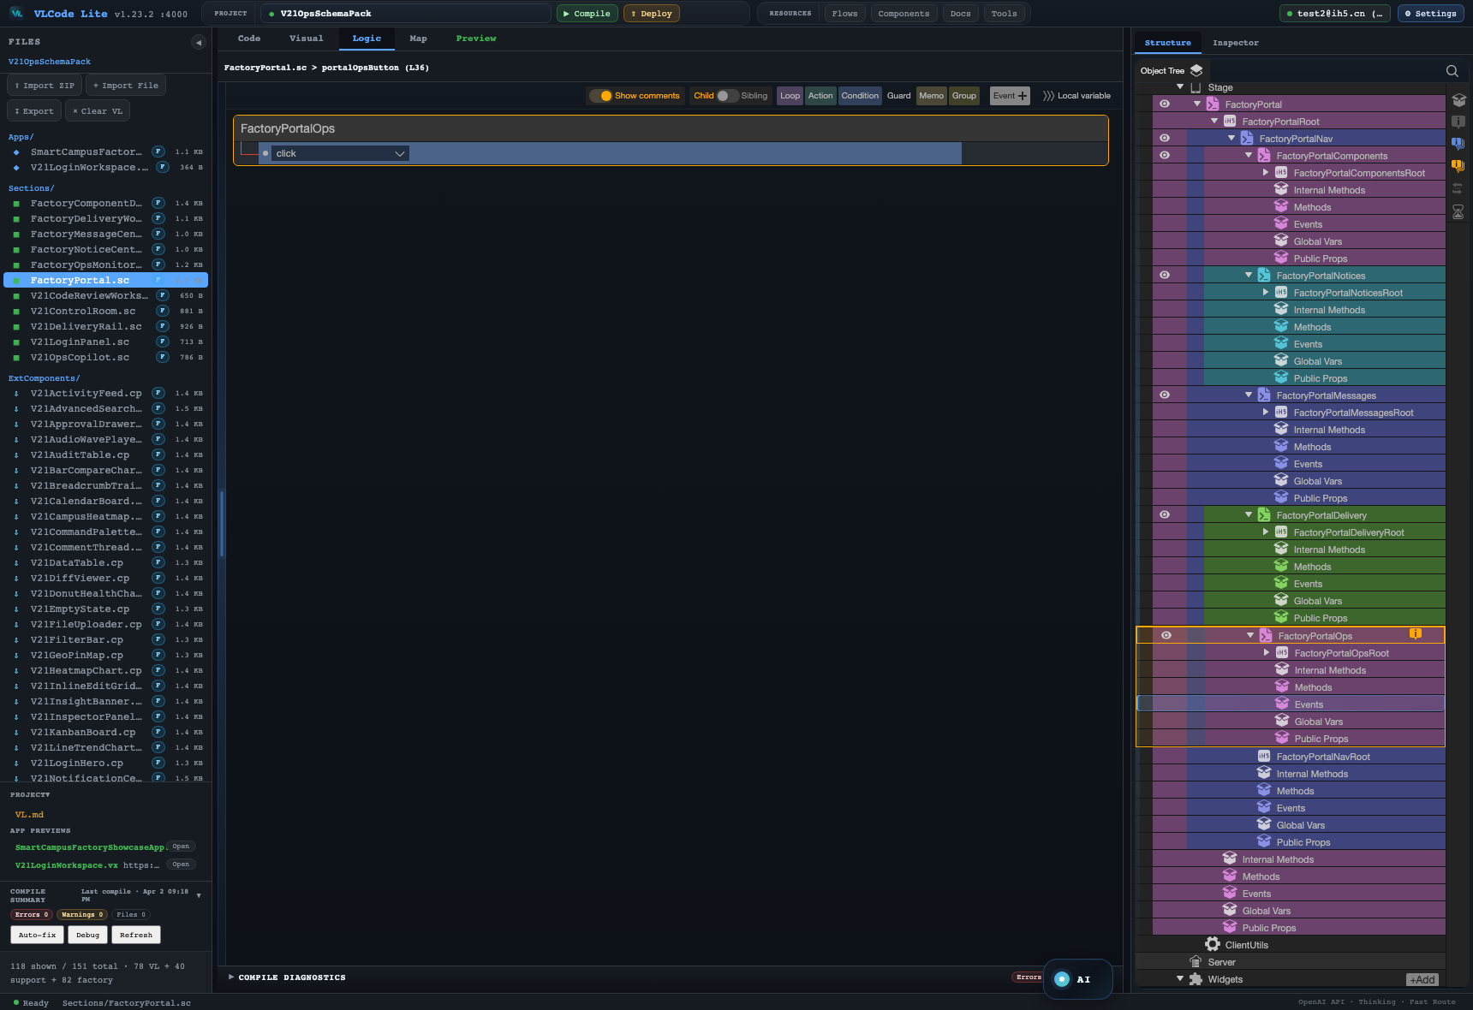
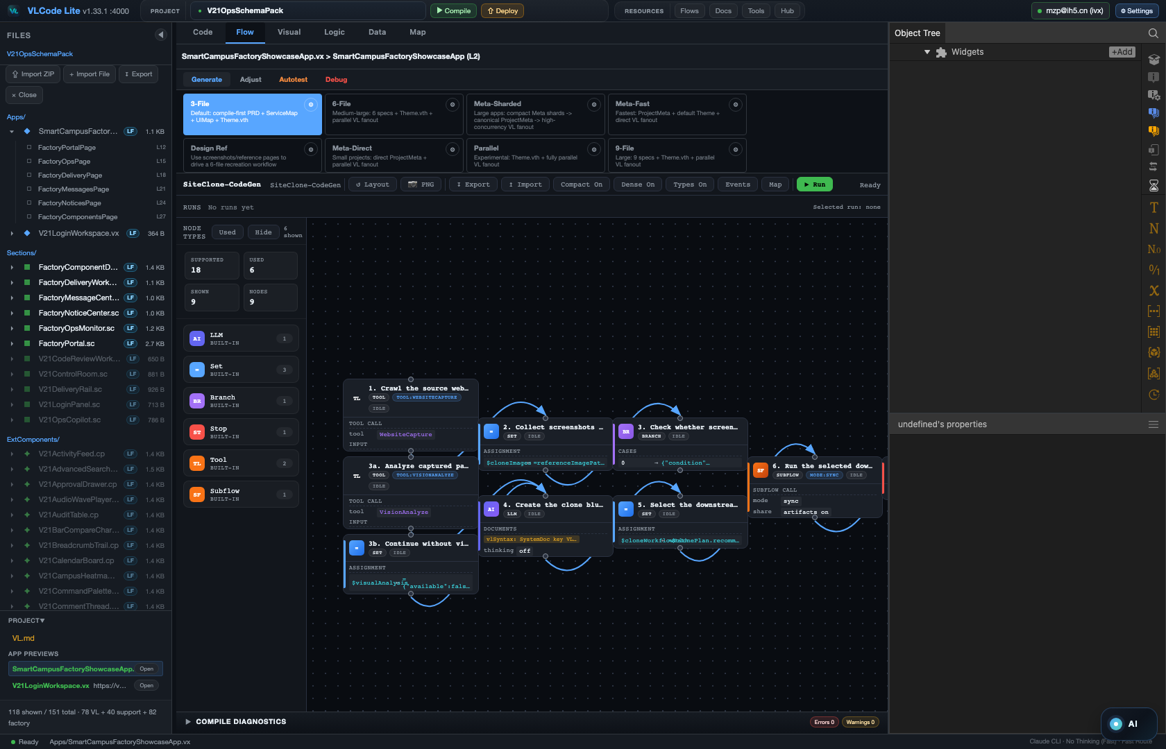
07
PART II · THE IDE
See everything:
logic, structure, and process.
Every internal detail of a VL app is projected as a picture — and code ↔ graph stays 1:1, both directions.
Event Panel — internal logic
Map — layered call graph
DAG — the generation process
You reason in pictures. The IDE is a projection of the language.
VL · CODE — An AI-native language, tamed by a DAG
github.com/VisualLogic-AI/VL-Code

Slide 9
08
PART II · DAG CORE
DAG is the core of VLC —
and the tool that tames AI.
Every agent works around the DAG. Creativity lives inside the nodes; determinism lives in the edges.
Plan
Generate
Search
Assemble
Verify
Ship
Inside nodes = creativity
Between edges = determinism
AI stays powerful — the process stays controllable.
VL · CODE — An AI-native language, tamed by a DAG
github.com/VisualLogic-AI/VL-Code

Slide 10
09
WHY DAG WINS
DAG vs. today's agents.
Most agents are either too complex (you must code them) or a single I/O point. The DAG makes the whole agent process visible and programmable.
Today's agents
VLC's DAG
✕
Too complex to wire — or just a single I/O point
✓
Visual + programmable orchestration, zero coding
✕
A black box that drifts off course
✓
Always in bounds — fully controllable
✕
"Looks right" — hard to verify
✓
Every node can lint / compile / preview / test
✕
Output you can't predict
✓
Produces exactly what the designer intended
All of AI's power, kept inside the lines — technically ahead of point-wise agents.
VL · CODE — An AI-native language, tamed by a DAG
github.com/VisualLogic-AI/VL-Code

Slide 11
10
DAG HARNESS
Point AI creates output. A DAG harness creates progress.
Complex systems are not finished in one step. A DAG makes inputs, outputs, node capability, validation and the next step explicit.
Single AI node
DAG Harness
Prompt
Intent
Manifest
AI Build
Tool
Docs
input
contract
AI
node
Code
AI
Output
Data
Tools
Check
Repair
Ship
Powerful, but the next step depends on a skilled operator — and each run may drift.
lint
AI
output
The graph harnesses every capability: AI nodes, tool nodes, manifests, checks, human gates and outputs.
VL · CODE — An AI-native language, tamed by a DAG
github.com/VisualLogic-AI/VL-Code

Slide 12
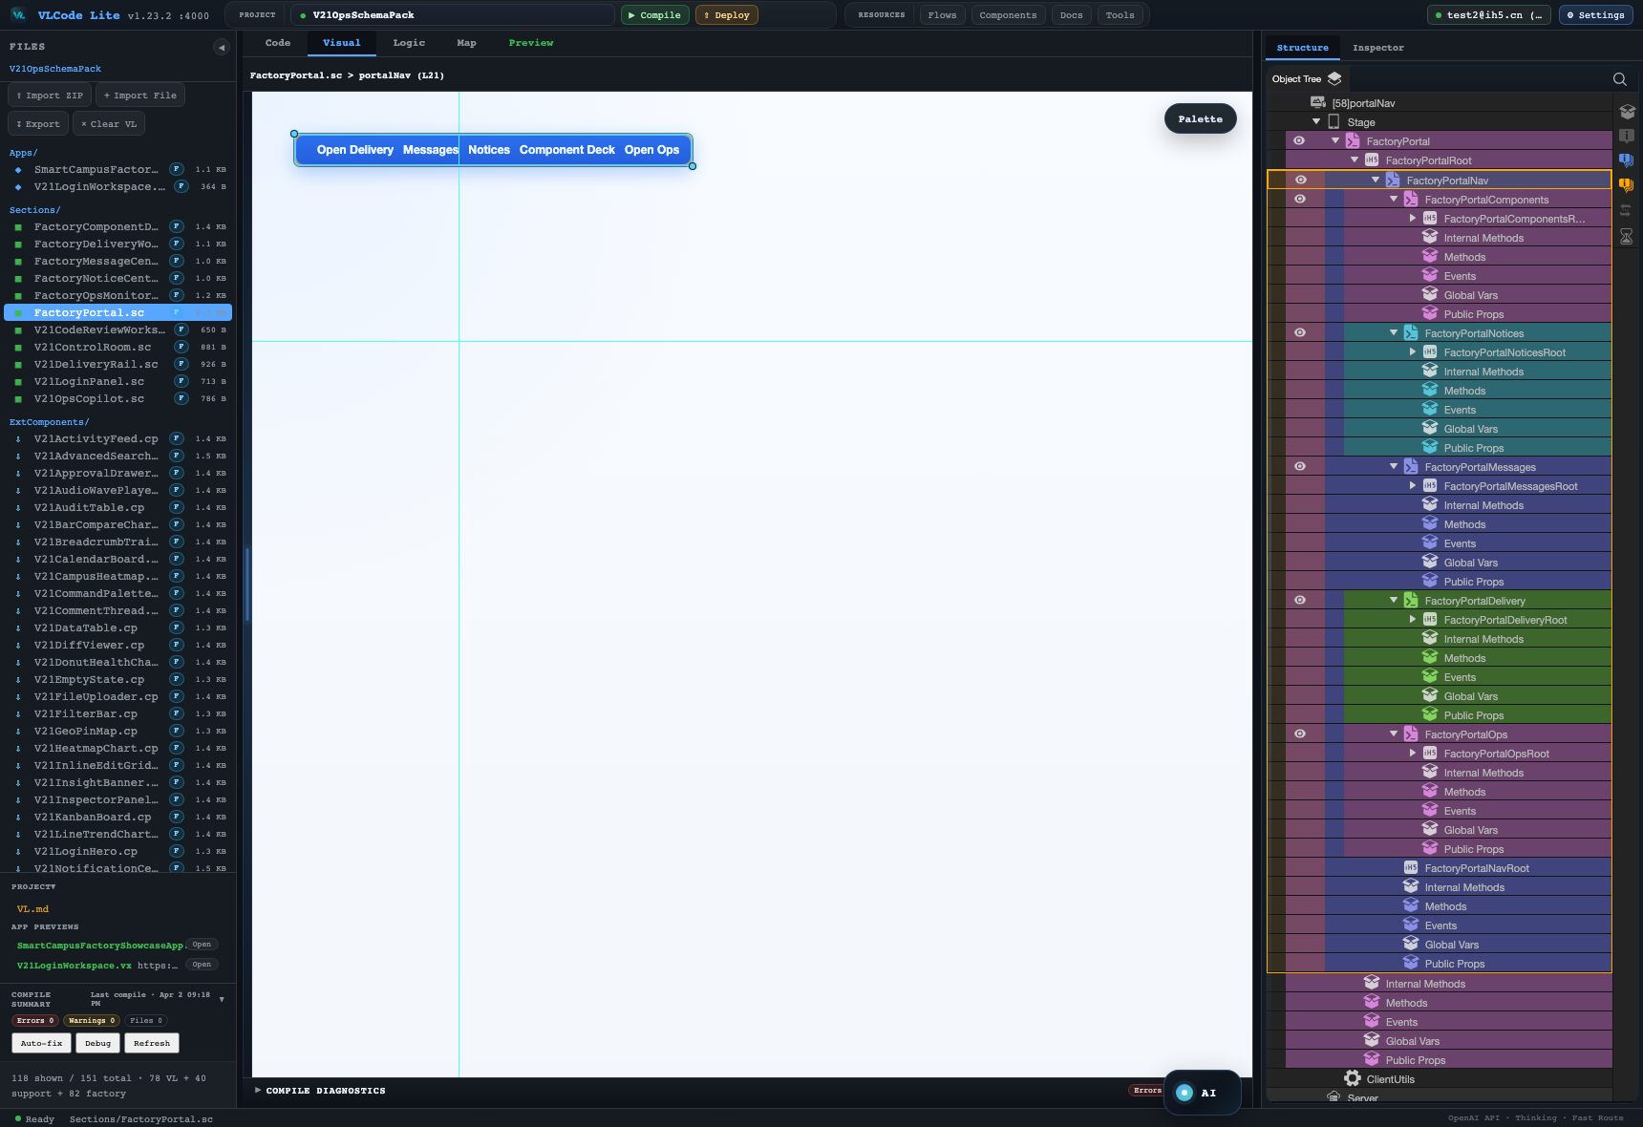
10
PART II · THE IDE
Build software with
zero programming knowledge.
Say what you want, watch the DAG run, refine visually. Code is still there — but it's no longer the only doorway in.
Intent
DAG
Visual edit
say what to build
watch the process
refine the structure
Visual Panel — inspect and adjust the app as structure.
For the first time, the door to programming opens to everyone.
VL · CODE — An AI-native language, tamed by a DAG
github.com/VisualLogic-AI/VL-Code

Slide 13
11
PART II · THE IDE
Search-and-assemble nodes:
store the compute, don't burn it.
Drop a 'search components' node into the DAG. Every match is fetched, the AI confirms, and they snap together automatically.
Search components
AI confirms
Auto-assemble
Compile
÷10
tokens vs. regenerating from scratch
Intelligence is banked in components, in the cloud — loaded on demand, not re-billed.
VL · CODE — An AI-native language, tamed by a DAG
github.com/VisualLogic-AI/VL-Code

Slide 14
12
PART III · OPEN
Nothing is a black box —
bring your own.
Every resource layer is open for you to extend. Upload it, version it, reuse it across projects.
↑
↑
↑
↑
↑
Workflows
Docs
Tools
Components
Skills
your own DAGs
specs & context
custom actions
into the Factory
agent capabilities
Your workflows, your components, your tools — all uploadable, all yours.
VL · CODE — An AI-native language, tamed by a DAG
github.com/VisualLogic-AI/VL-Code

Slide 15
13
PART III · OPEN
Export, self-host, open source —
zero lock-in.
What you build is yours, with no limits on where it runs and no walls around the core technology.
Export
Self-host
Open source
Apps export to React + Node source — run them anywhere.
Private deployment with no restrictions whatsoever.
VL syntax and core docs are open. Every component is open.
Generate once, own it forever. The syntax and every component are open.
VL · CODE — An AI-native language, tamed by a DAG
github.com/VisualLogic-AI/VL-Code

Slide 16
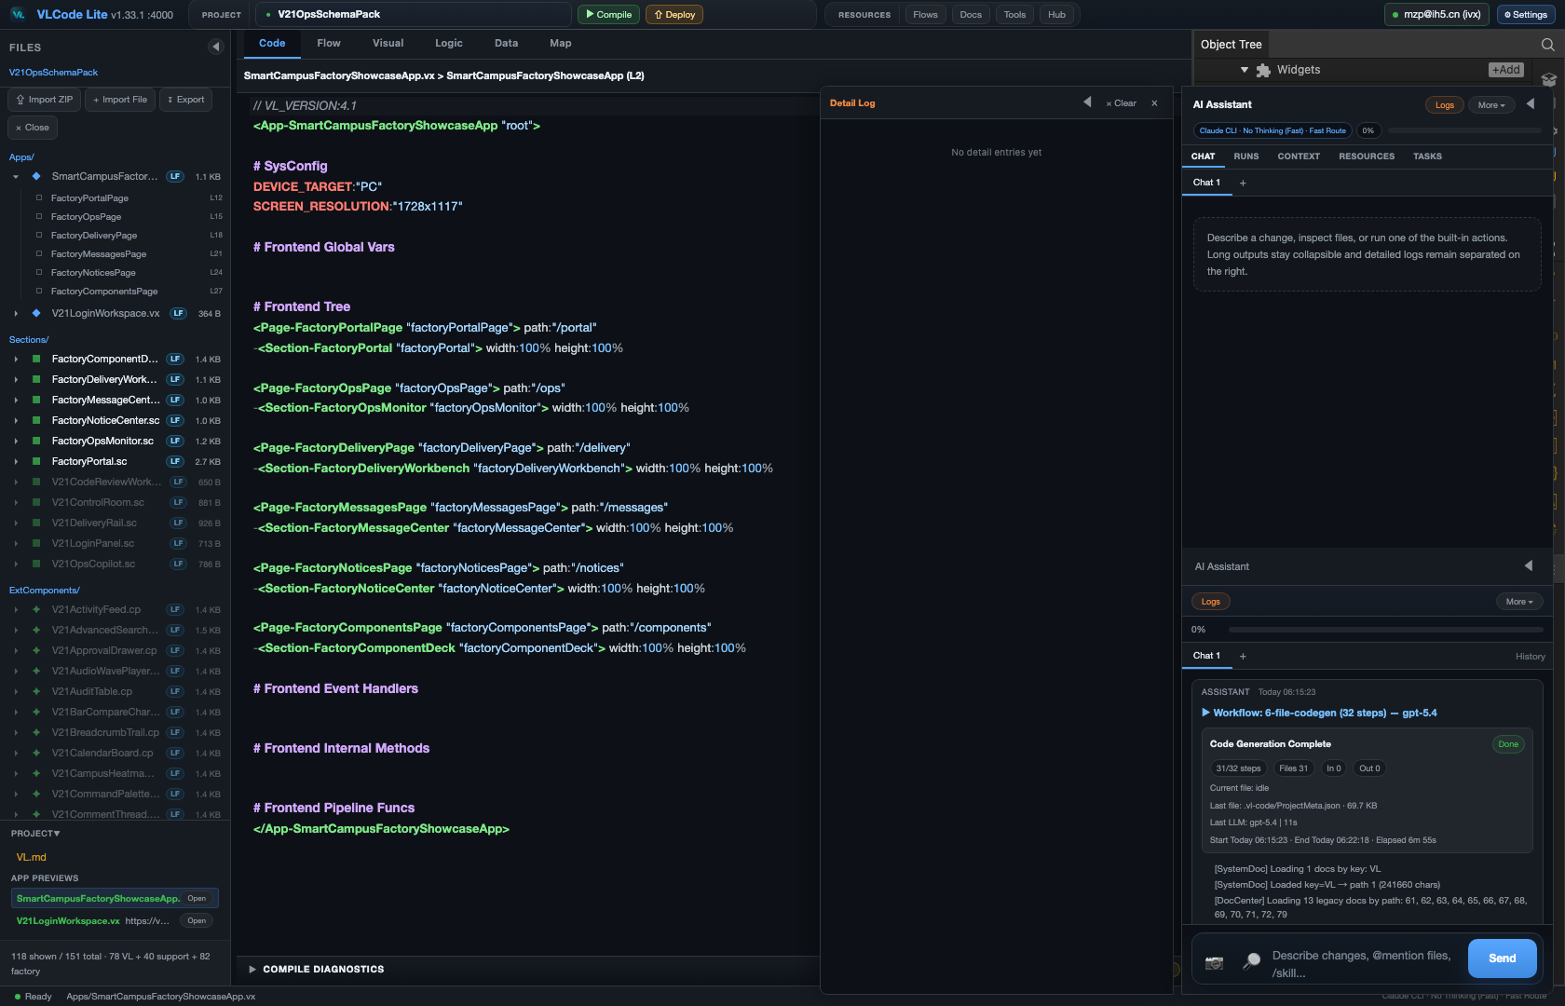
WHAT WE SOLVE
VLC solves the control problem
of AI software generation.
VL gives AI the right representation.
DAG gives AI the right process.
The Factory gives AI reusable engineering memory.
Chat + project context + DAG execution — in one local IDE.
github.com/VisualLogic-AI/VL-Code

