Slide 1
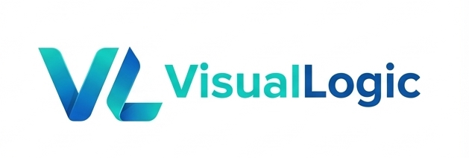
Contract
Harness AI
Intent
schema
input
Validate
check
with a DAG
AI Node
generate
From impressive AI outputs to repeatable enterprise execution.
Package
ship
VL
DAG
AI Assistant
Project
real app
VisualLogic AI

Slide 2
The symptom: context rot
Longer memory helps, but it does not define the process.
Current fixes
What is still missing
The core answer
Longer context
Retrieval
Memory summaries
Prompt rules
Guardrails
Execution order
Dataflow contracts
Quality gates
Repair loops
Human handoffs
Plan the whole harness as a runnable graph, then let AI operate inside that graph.
VisualLogic AI

Slide 3
One AI node is powerful, but unmanaged
A big output is not the same as a complete process.
Brief
Docs
Code
Large output
AI
Memory
impressive, variable
Tools
Rules
Risk
The next step is implicit. Stability depends on the operator, the prompt, and the run.
User intent
Examples
VisualLogic AI

Slide 4
A DAG turns AI into a process
AI becomes one node type in a controlled harness.
Intent
Plan
Tool
Repair
human input
decompose
execute
loop
Manifest
AI
Validate
Output
runtime contract
generate
quality gate
ship
Explicit execution order | typed dataflow | checkpoints | retries | human gates
VisualLogic AI

Slide 5
The DAG is the program
A runnable graph captures execution, dataflow, contracts, branches, and repair.
Brief
Spec
Contract
UI Flow
Service Flow
Component Search
AI Build
Tool Call
Compile
Preview
Human Gate
Lint
Repair Loop
Package
Deploy
Docs
Memory
Tools
Skills
Components
VisualLogic AI

Slide 6
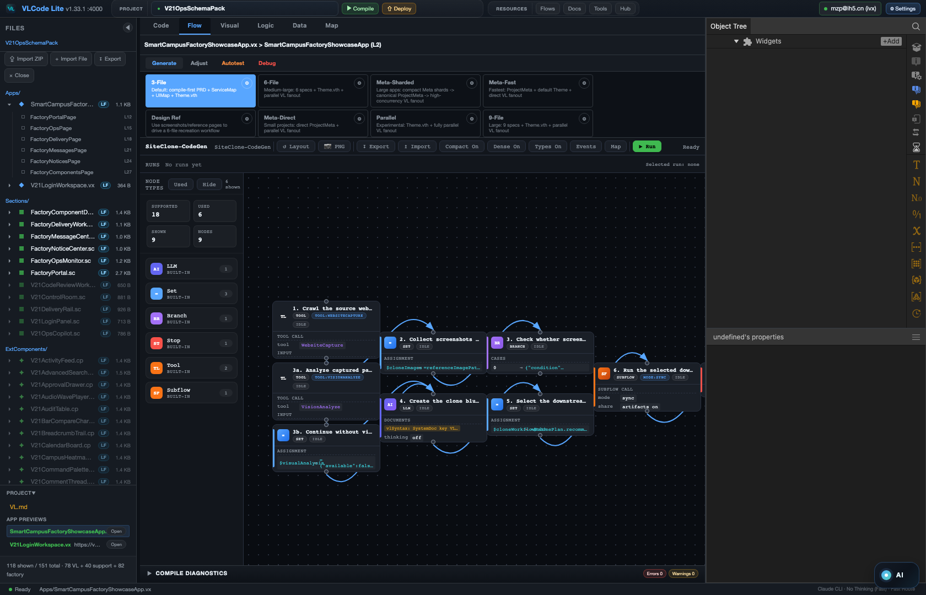
Real VLC Flow mode
Complex DAG workflows are already visible and runnable inside VLC.
A real VisualLogic graph: specialized nodes, visible state, logs, validation, and repair loops.
VisualLogic AI

Slide 7
Agent Apps are DAG plus manifest
A workflow becomes a runnable, shareable application.
Agent App
DAG
Manifest
process
runtime
runnable
Inputs / outputs
UI panels
Permissions
Typed entry points
Interaction surface
Runtime boundaries
Tools / skills
Human gates
Packaging
Callable capabilities
Review and approval
Local or remote run
VisualLogic AI

Slide 8
VL makes the system composable
Structured layers plus components make parallel AI development practical.
Structured layers
Pure components
Simple for agents
Contracts, services, pages, sections, and themes are decoupled. Once the contract is clear, teams and agents can build in parallel.
Everything can be composed: UI, flows, tools, skills, services, and theme resources. Components expose methods, properties, and events.
The language is easy for people and AI to learn. Agents can call components directly instead of guessing hidden behavior.
More reusable components -> faster delivery -> more reliable enterprise adoption.
VisualLogic AI

Slide 9
VisualLogic AI
VL + DAG + AI Assistant
Free local IDE
Open resources
Enterprise landing
Download VL-Code and build real projects with visual flows, component resources, tools, skills, and AI assistance.
Design and upload flows, components, tools, and skills. Platform resources from VisualLogic are free to use.
Designed for complete project generation, not isolated code fragments. Project managers and non-developers can participate directly.
github.com/VisualLogic-AI/VL-Code
github.com/VisualLogic-AI/VisualLogic.ai-VL
VisualLogic AI

