Slide 1
EUR/INR currency data analysis

Slide 2
Introduction
Welcome, everyone! Today, we’ll delve into the fascinating world of currency exchange rates.
Focus: The EUR/INR pair—where the Euro meets the Indian Rupee.
Explore historical data, technical indicators, and potential trading opportunities.

Slide 3
Data Collection
I have sourced data from Yahoo Finance—a reliable hub for financial information.
Analysis spans from January 1, 2023, to February 16, 2024.

Slide 4
Metrics
Moving Averages (MA)
Simple Moving Average (SMA): Smooths out price fluctuations.
Exponential Moving Average (EMA): Gives more weight to recent data.
Formulas: SMA = Sum of prices / Number of days; EMA = (Today’s price × α) + (Yesterday’s EMA × (1 - α)) / α.
Bollinger Bands
Volatility indicators that hug the price.
Upper Band = SMA + (2 × Standard Deviation)
Lower Band = SMA - (2 × Standard Deviation)
Commodity Channel Index (CCI)
Measures deviation from the statistical average.
Formula: CCI = (Typical Price - SMA) / (0.015 × Mean Deviation)

Slide 5
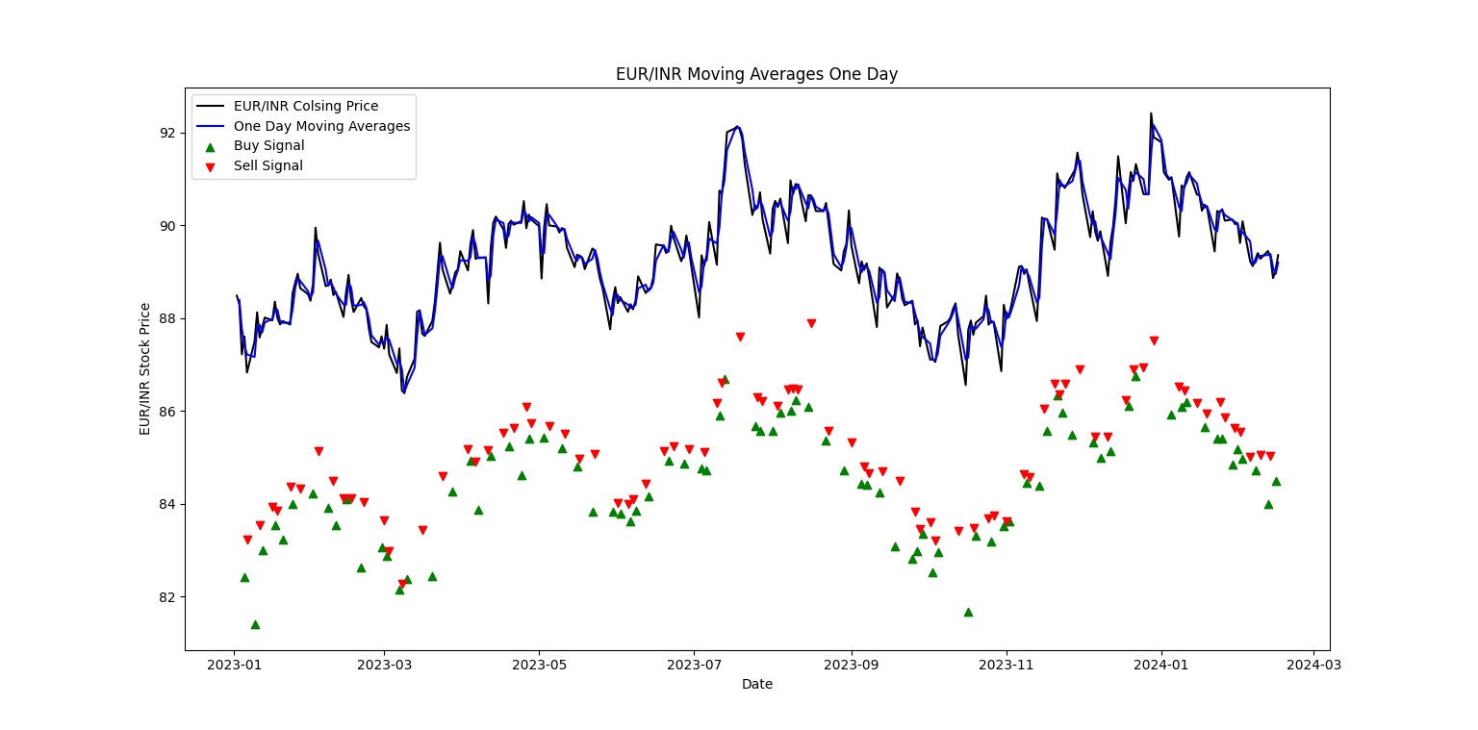
Results
1. Moving Averages (MA)

Slide 6
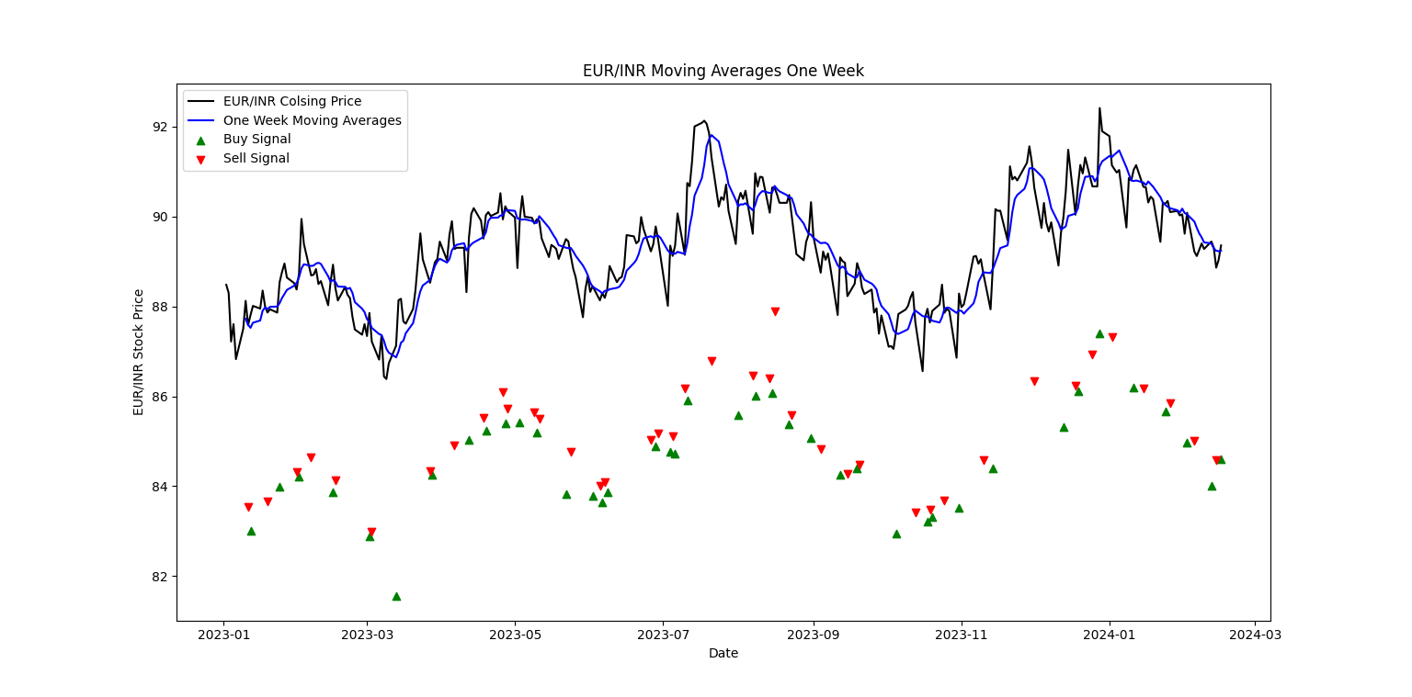

Slide 7
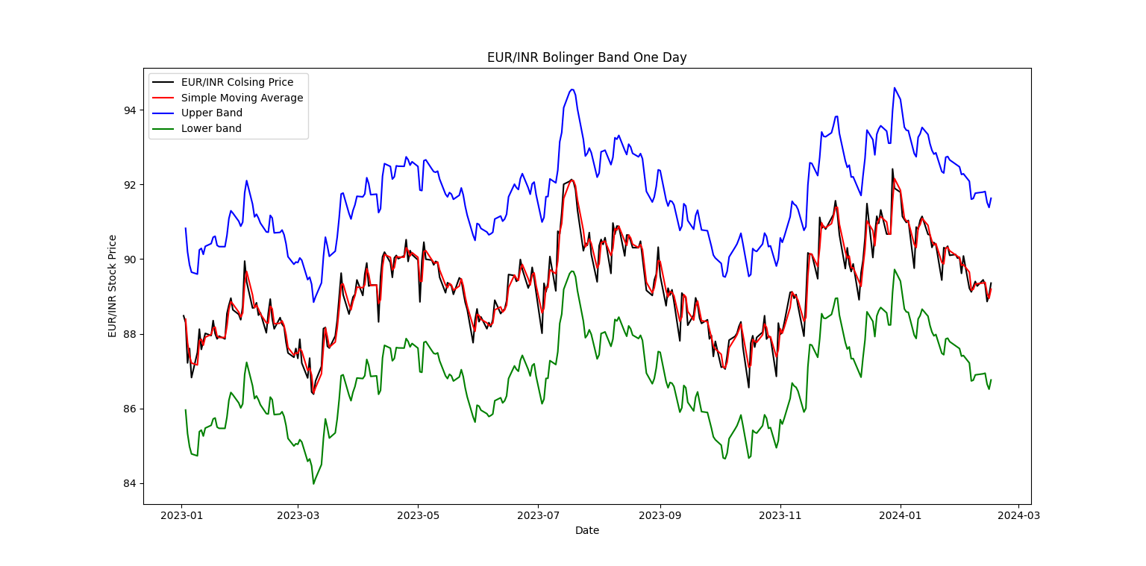
2. Bollinger Band

Slide 8
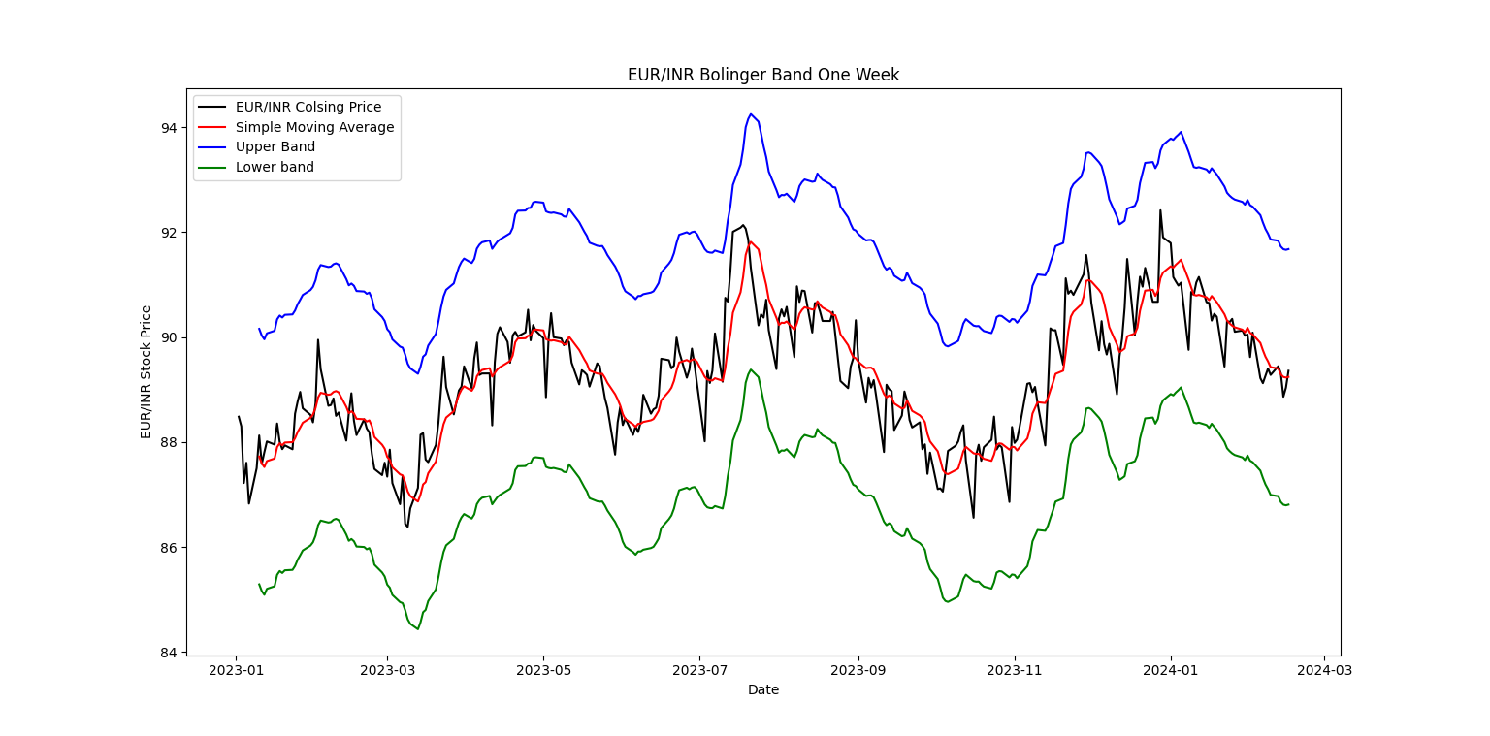

Slide 9
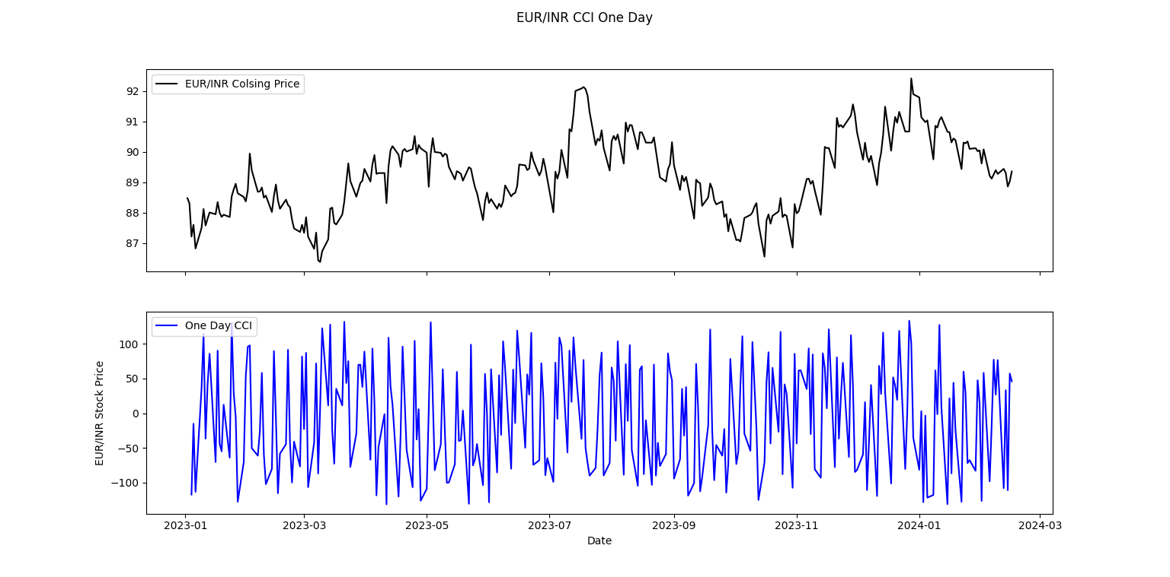
2. CCI (Commodity Channel Index)

Slide 10
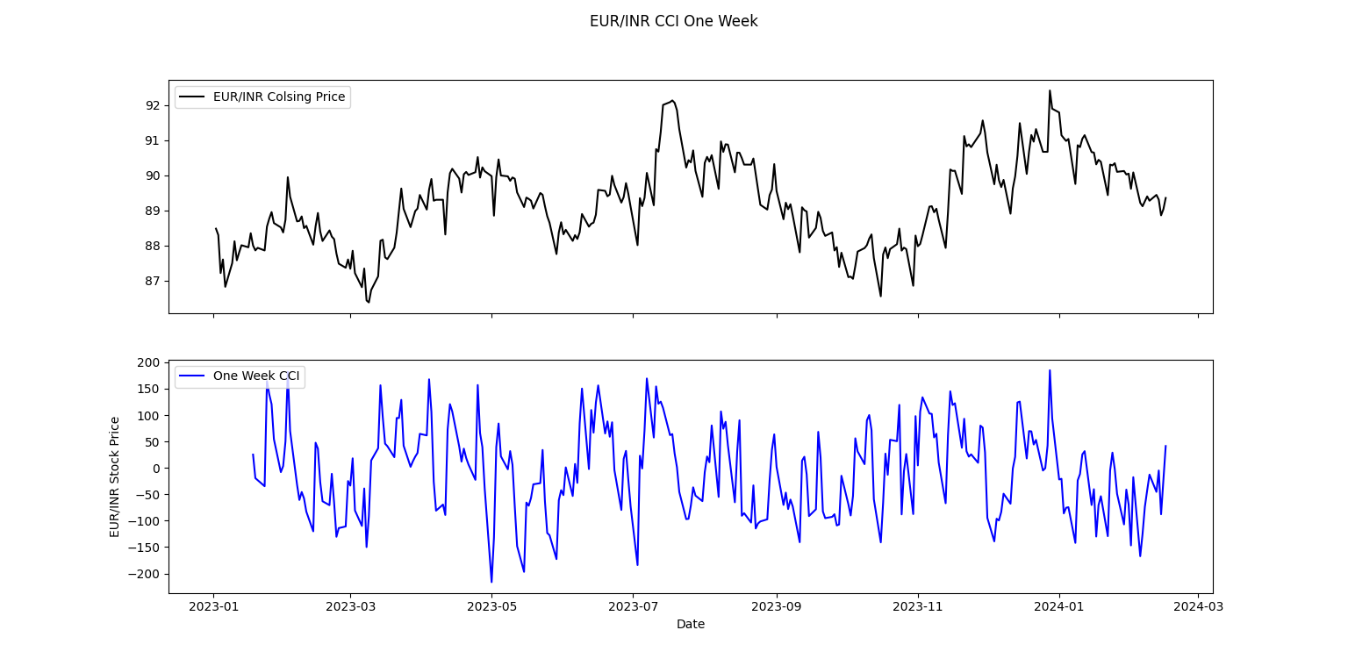

Slide 11
Conclusion
Moving Averages indicate recent trends.
Bollinger Bands Upper band suggests potential overbought conditions Lower band indicates possible oversold conditions.
Commodity Channel Index (CCI) Values above +100: Overbought (reversal down) Values below -100: Oversold (reversal up).
Implications for Traders and Investors Confirm trends using moving averages. Manage risk based on CCI signals. Combine technical and fundamental analysis for informed decisions.

Slide 12



Thank you!
Visu S
+91 9597287503
visu7503@gmail.com
www.visu.visha.xyz

