Slide 1
Cryptography

Slide 2
Cryptography
Throughout most of this history:
cryptography = “secret writing”:
“Scramble” (encrypt) text such that it is hopefully unreadable by anyone except the intended receiver that can decrypt it.
Recurring theme: (until 1970’s)
Secret code invented
Typically claimed “unbreakable” by inventor
Used by spies, ambassadors, kings, generals for crucial tasks.
Broken by enemy using cryptanalysis.

Slide 3
Examples
1587: Ciphers from Mary of Scots plotting assassination of queen Elizabeth broken; used as evidence to convict her of treason.
1860’s (civil war): Confederacy used good cipher (Vigenere) in a bad way. Messages routinely broken by team of young union cryptanalysts; in particular leading to a Manhattan manufacturer of plates for printing rebel currency.
1878: New York Tribune decodes telegram proving Democrats’ attempt to buy an electoral vote in presidential election for $10K.
1914: With aid of partial info from sunken German ships, British intelligence broke all German codes. Cracked telegram of German plan to form alliance with Mexico and conquer back territory from U.S. As a result, U.S. joined WWI.
WWII: Cryptanalysis used by both sides. Polish & British cryptanalysts break supposedly unbreakable Enigma cipher using mix of ingenuity, German negligence, and mechanical computation. Churchill credits cryptanalysts with winning the war.

Slide 4
This Course
What you’ll learn:
Foundations and principles of the science
Basic primitives and components.
Definitions and proofs of security
High-level applications
Critical view of security suggestions and products
What you will not learn:
Buzzwords
The most efficient and practical versions of components.
Designing secure systems*
Will help you avoid designing insecure systems.
“Hacking” – breaking into systems.
Viruses, worms, Windows/Unix bugs, buffer overflow etc..
Everything important about crypto

Slide 5
This Course
Modern (post 1970’s) cryptography:
Provable security – breaking the “invent-break-tweak” cycle
Perfect security (Shannon) and its limitations
Computational security
Pseudorandom generators, one way functions
Beyond encryption – public-key crypto and other wonderful creatures
Public-key encryption based on factoring and RSA problem
Digital signatures, hash functions
Zero-knowledge proofs
Active security – Chosen-Ciphertext Attack
Advanced topics (won’t have time for all ☹ )
The SSL Protocol and attacks on it
Secret Sharing
Multi-party secure computation
Quantum cryptography
Password-based key-exchange, broadcast encryption, obfuscation

Slide 6
Prerequisites
Required:
1. Ability to read and write mathematical proofs and definitions.
2. Familiarity with algorithms – proving correctness and analyzing running time (O notation).
3. Familiarity with basic probability theory (random variables, expectations – see handout).
Helpful but not necessary:
Complexity. NP-Completeness, reductions, P, BPP, P_{/poly}
Probabilistic Algorithms. Primality testing, hashing,
Number theory. Modular arithmetic, prime numbers
See web-site for links and resources.

Slide 7
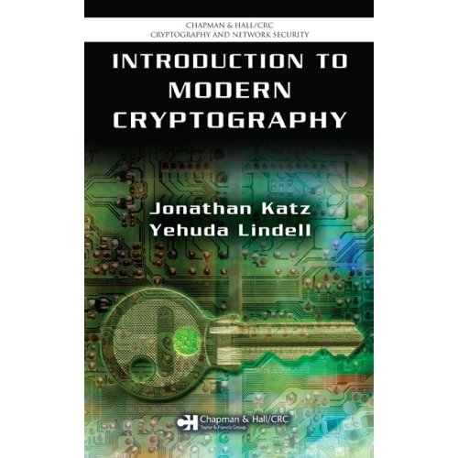
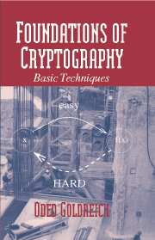
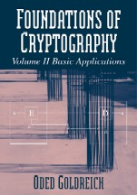
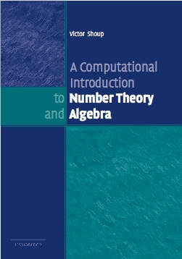
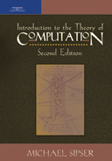
Reading
Introduction to Modern Cryptography / Katz & Lindell Main text used, though not 100% followed
Foundations of Cryptography / Goldreich.
Graduate-level text, will be sometimes used.
Computational Intro to Algebra and Number Theory / Shoup. (Available also on the web)
Introduction to the Theory of Computation / Sipser. For complexity background
Lecture notes on web: (links on web site)

Slide 8
Requirements
Exercises: Weekly from Thursday till Thursday before class.
Submit by email / mailbox / in class to Rajsekar.
Flexibility: 4 late days, bonus questions
Take home final.
Final grade:
50% homework, 50% final
Honor code. Collaboration on homework with other students encouraged. However, write alone and give credit.
Work on final alone and as directed.

Slide 9
This course is hard
Challenging weekly exercises
Emphasis on mathematical proofs
Counterintuitive concepts.
Extensive use of quantifiers/probability
But it’s not my fault :)
Good coverage of crypto (meat, vegetables and desert) takes a year.
Simulation / experimentation can’t be used to show security.
Need to acquire “crypto-intuition”
Quantifiers, proofs by contradiction, reductions, probability are inherent.
Mitigating hardness
Avoid excessive exercises – only questions that teach you something.
Try best to explain intuition behind proofs
Me and Rajsekar available for any questions and clarifications.

Slide 10

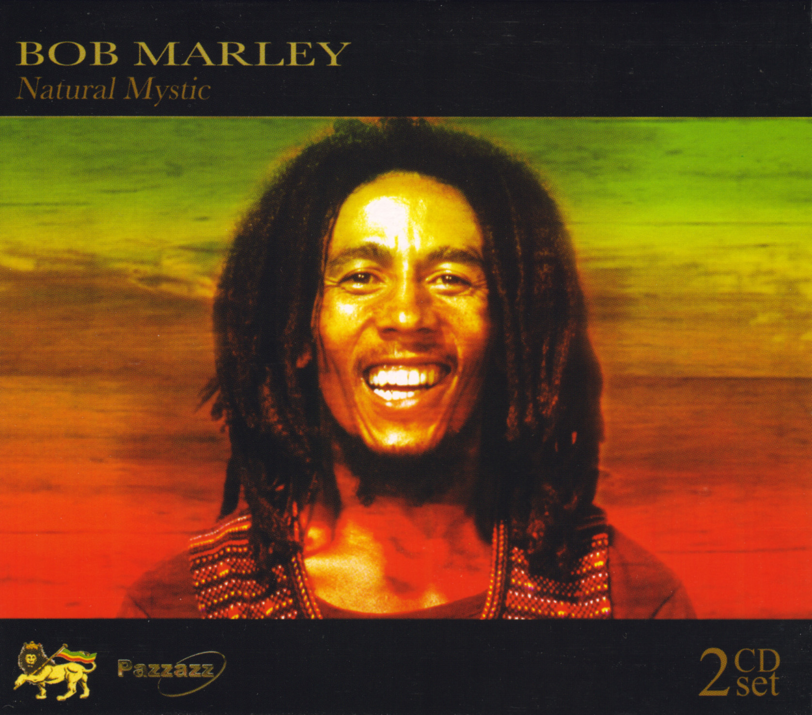
Encryption Schemes
Alice wants to send Bob a secret message.
c
c = E(m,k)
m’ = D(c,k)
They agree in advance on 3 components:
Encryption algorithm: E
Decryption algorithm: D
Secret key: k
To encrypt plaintext m, Alice sends c = E(m,k) to Bob.
To decrypt a cyphertext c, Bob computes m’ = D(c,k).
A scheme is valid if m’=m
Intuitively, a scheme is secure if eavesdropper can not learn m from c.

Slide 11
Example 1: Caesar’s Cipher
Key: k = no. between 0 and 25.
Encryption: encode the i^{th} letter as the (i+k) ^{th} letter.
(working mod 26: z+1=a )
Decryption: decode the j^{th} letter to the (j-k) ^{th} letter.
Plain-text:
S E N D R E I N F O R C E M E N T
Key: 2
Cipher-text:
U G P F T F K P H Q T E G O G P V
Problem: only 26 possibilities for key – can be broken in short time.
Kerchoff’s Principle (1883): System should be secure even if algorithms are known, as long as key is secret.
In other words: “security through obscurity” does not work.

Slide 12
Example 2: Substitution Cipher
Key: k = table mapping each letter to another letter
A
B
C
Z
U
R
B
E
Encryption and decryption: letter by letter according to table.
# of possible keys: 26!
( = 403,291,461,126,605,635,584,000,000 )
However – substitution cipher is still insecure!
Key observation: can recover plaintext using statistics on letter frequencies.
Here e r e h e t t r r ht
ethe eet e r e h h t e e t e
HereUpOnLeGrandAroseWithAGraveAndStatelyAirAndBrought
MeTheBeetleFromAGlassCaseInWhichItWasEnclosedItWasABe
He e e e h e t t ht
ethe eet e e h h t e e t e
Here e ra a e ha a ea tat a ra r ht
ethe eet e r a a e h h t a e e t a a e
LIVITCSWPIYVEWHEVSRIQMXLEYVEOIEWHRXEXIPFEMVEWHKVSTYLX
ZIXLIKIIXPIJVSZEYPERRGERIMWQLMGLMXQERIWGPSRIHMXQEREKI
I – most common letter
I=e L=h X=t
LI – most common pair
V=r E=a Y=g
XLI – most common triple

Slide 13
Example 3- Vigenere
(Belaso, 1553)
“Multi-Caesar Cipher” – A statefull cipher
Key: k = (k₁,k₂,…,k_{m}) list of m numbers between 0 and 25
Encryption:
n^{th} letter encoded w/ key=k_{(n mod m)} : i → I + k_{(n mod m)} (mod 26)
1st letter encoded as Caesar w/ key=k₁ : i → I + k₁ (mod 26)
Decryption: In the natural way
2nd letter encoded as Caesar w/ key=k₂ : i → I + k₂ (mod 26)
…
Important Property: Can no longer break using letter frequencies alone.
m^{th} letter encoded as Caesar w/ key=k_{m} : i → I + k_{m} (mod 26)
‘e’ will be mapped to ‘e’+k₁,‘e’+k₂,…,‘e’+k_{m} according to location.
m+1th letter encoded as Caesar w/ key=k₁ : i → I + k₁ (mod 26)
Considered “unbreakable” for 300 years (broken by Babbage, Kasiski 1850’s)

Slide 14
Example 3- Vigenere
(Belaso, 1553)
“Multi-Caesar Cipher” – A statefull cipher
Key: k = (k₁,k₂,…,k_{m}) list of m numbers between 0 and 25
Encryption:
n^{th} letter encoded w/ key=k_{(n mod m)} : i → I + k_{(n mod m)} (mod 26)
Decryption: In the natural way
Breaking Vigenere:
LIVITC
SWPIYV
EWHEVS
RIQMXL
EYVEOI
EWHRXE
XIPFEM
VEWHKV
Step 1: Guess the length of the key m
Step 2: Group together positions {1, m+1, 2m+1, 3m+1,…}
{2, m+2, 2m+2, 3m+2,…}
…
{m-1, 2m+m-1, 3m+m-1,…}

Slide 15
Example 3- Vigenere
(Belaso, 1553)
“Multi-Caesar Cipher” – A statefull cipher
Key: k = (k₁,k₂,…,k_{m}) list of m numbers between 0 and 25
Encryption:
n^{th} letter encoded w/ key=k_{(n mod m)} : i → i + k_{(n mod m)} (mod 26)
Decryption: In the natural way
Breaking Vigenere:
LIVITC
SWPIYV
EWHEVS
Step 1: Guess the length of the key m
RIQMXL
EYVEOI
Step 2: Group together positions 1, m+1, 2m+1, 3m+1,…
EWHRXE
XIPFEM
{2, m+2, 2m+2, 3m+2,…}
VEWHKV
…
{m-1, 2m+m-1, 3m+m-1,…}
Step 3: Frequency-analyze each group independently.

Slide 16
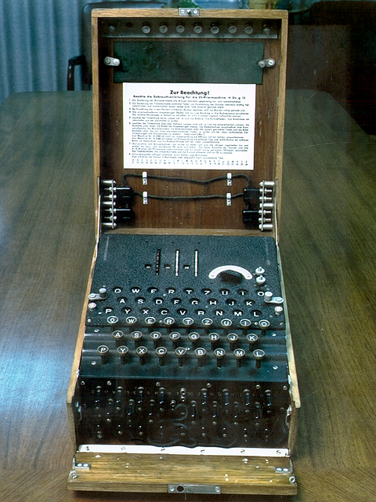
Example 4 - The Enigma
A mechanical statefull cipher.
Used by Germany in WWII for top-secret communication.
Roughly: composition of 3-5 substitution ciphers implemented by wiring.
Wiring on rotors moving in different schedules, making cipher statefull
Key:
1) Wiring of machine (changed infrequently)
2) Daily key from code books
3) New operator-chosen key for each message
Tools used by Poles & British to break Enigma:
1) Mathematical analysis combined w/ mechanical computers
2) Captured machines and code-books
3) German operators negligence
4) Known plaintext attacks (greetings, weather reports)
5) Chosen plaintext attacks

Slide 17
Post 1970’s Crypto
Two major developments:
1) Provably secure cryptography
Encryptions w/ mathematical proof that are unbreakable*
* Currently use conjectures/axioms,
however defeated all cryptanalysis effort so far.
2) Cryptography beyond “secret writing”
Public-key encryptions
Digital signatures
Zero-knowledge proofs
Anonymous electronic elections
Privacy-preserving data mining
e-cash
…

Slide 18
Review of Encryption Schemes
Alice wants to send Bob a secret message.
c
c = E(m,k)
m’ = D(c,k)
Encryption algorithm: E
Decryption algorithm: D
Secret key: k
To encrypt m, Alice sends c = E(m,k) to Bob.
To decrypt c, Bob computes m’ = D(c,k).
Q: Can Bob send Alice the secret key over the net?
A: Of course not!! Eve could decrypt c!
Q: What if Bob could send Alice a “crippled key”
useful only for encryption but no help for decryption

Slide 19
Public Key Cryptography [DH76,RSA77]
Alice wants to send Bob a secret message.
e
c
choose d,e
c = E(m,e)
m’ = D(c,d)
Encryption algorithm: E
Decryption algorithm: D
Key: Bob chooses two keys:
Secret key d for decrypting messages.
Public key e for encrypting messages.
To encrypt m, Alice sends c = E(m,e) to Bob.
Even if Eve knows the key e!
Should be safe to send e “in the clear”!
To decrypt c, Bob computes m’ = D(c,d).
A scheme is valid if m’=m
Intuitively, a scheme is secure if eavesdropper can not learn m from c.

Slide 20
Other Crypto Wonders
Digital Signatures. Electronically sign documents in unforgeable way.
Zero-knowledge proofs. Alice proves to Bob that she earns <$50K without Bob learning her income.
Privacy-preserving data mining. Bob holds DB. Alice gets answer to one query, without Bob knowing what she asked.
Playing poker over the net. Alice, Bob, Carol and David can play poker over the net without trusting each other or any central server.
Distributed systems. Distribute sensitive data to 7 servers s.t. as long as <3 are broken, no harm to security occurs.
Electronic auctions. Can run auctions s.t. no one (even not seller) learns anything other than winning party and bid.

Slide 21
Cryptography & Security
Prev slides: Have provably secure algorithm for every crypto task imaginable.
Q: How come nothing is secure?
A1: Not all of these are used or used correctly:
Strange tendency to use “home-brewed” cryptosystems.
Combining secure primitives in insecure way
Misunderstanding properties of crypto components.
Strict efficiency requirements for crypto/security:
The cost is visible but benefit invisible.
Many provably secure algs not efficient enough
Easy to get implementation wrong – many subtleties
Compatibility issues, legacy systems,

Slide 22
Cryptography & Security
Prev slides: Have provably secure algorithm for every crypto task imaginable.
Q: How come nothing is secure?
A2: Cryptography is only part of designing secure systems
Chain is only as strong as weakest link.
A “dormant bug” is often a security hole.
Many subtle issues (e.g., caching & virtual memory, side channel attacks)
Security is hard to “modularize”
(hard to add to existing system, changes in system features can have unexpected consequences)
Human element
Key storage and protection issues.

