Slide 1
CHAPTER 5
FOURIER TRANSFORMATION
By: Prof. (Dr.) Paramartha Dutta
Visva Bharati University
Santiniketan, West Bengal, India

Slide 2
Fourier Transformation
Continuous & Discrete Fourier Transformation
Properties of Fourier Transformation
Fast Fourier Transformation
Back to Course Content Page
Click Here

Slide 3


Fourier Transformation ( 1-D Continuous Signal)
Fourier Transformation :
Let f(x) is a continuous function of some variable then the Fourier transformation of f(x) is F(u)
Here f(x) must be continuous & integralable
Inverse Fourier Transformation:
F(u) is a Fourier transform of signal f(x) so after inverse Fourier transformation of F(u) we get f(x)

Slide 4




Fourier Transformation ( 1-D Continuous Signal)
Fourier Transformation Pair
F(u) → Fourier Transform of signal f(x)
f(x) → Original Signal or Inverse Fourier Transform of F(u)
Here F(u) is a complex function contains real part & imaginary part
F(u) = R(u) + jI(u)
We have
Fourier Spectrum:
The phase angle:
Power Spectrum :

Slide 5


Fourier Transformation ( 2-D Continuous Signal)
Forward Fourier Transformation:
Let f(x,y) is 2 dimensional signal with 2 variable
Inverse (Backward) Fourier Transformation:

Slide 6



Fourier Transformation ( 2-D Continuous Signal)
Fourier Spectrum:
Phase angle :
Power Spectrum:

Slide 7


2-D Discrete Fourier Transformation
Forward 2D discrete Fourier Transformation:
Let we have an Image of size MxN then F(u,v) is the F T of image f(x,y)
Where variable u = 0, 1, 2, …., M-1 and v = 0, 1, 2, …., N-1
Inverse (Backward) Fourier Transformation :
Where variable x = 0, 1, 2, …., M-1 and y = 0, 1, 2, …., N-1

Slide 8


2-D Discrete Fourier Transformation
For a square image i.e. M = N and the Fourier Transformation Pair is as follows

Slide 9
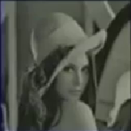
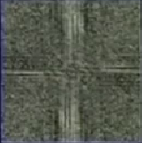
Discrete F T Result
DFT
IDFT
Original
Image
Transformed Image

Slide 10
Back to the chapter content
Click Here

Slide 11
Properties of Fourier Transformation
Seperability
Translation
Periodicity
Conjugate
Rotation
Distributive
Scaling
Convolution
Corelation

Slide 12

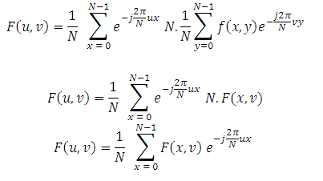
Seperability
The separbility property says that we can do 2D Fourier transformation as two 1 D Fourier Transformation
Inverse Fourier Transform
X represent row of image so x is fixed
Fourier Transformation along row

Slide 13
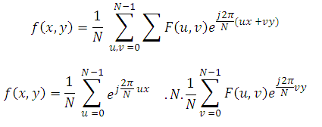

Seperability Cont…
2D Inverse Fourier transformation can also be viewed as two 1 D Inverse Fourier Transformation
IDFT along rows
IDFT along columns
Advantage of Seperability:
Operation become much simpler and less time complexity

Slide 14
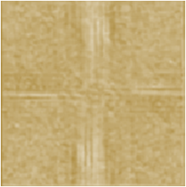
Seperability Concept
N-1
N-1
(0,0)
(0,0)
Row Transform
N-1
N-1
f(x,y) → Original Image
F(x,v) → Intermediate Coefficient of F T along row
(0,0)
N-1
N-1
(0,0)
Column Transform
N-1
N-1
F(x,v) → Intermediate Coefficient of F T along row
F(u,v) → Complete Coefficient of F T

Slide 15



Translation
Translation of x and y by x₀ and y₀ respectively.
(x₀.,y₀)
Fourier Transform
Magnitude of FT remains same
Additional Phase

Slide 16

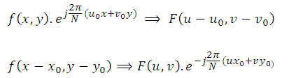
Translation Cont..
Inverse Fourier Transform
Here sift x₀, y₀ does not change Fourier spectrum but it add some phase sift diff

Slide 17





Periodicity
Periodicity property says that the Discrete Fourier Transform and Inverse Discrete Fourier Transform are periodic with a period N
Proof:
So we can say that Discrete Fourier Transform is periodic with N

Slide 18
Conjugate
If f(x,y) is a real valued function then
F(u,v) = F* (-u, -v)
Where F* indicate it complex conjugate
Now Fourier Spectrum
|F(u,v)| = |F(-u,-v)|
This property help to visualize Fourier Spectrum

Slide 19
Rotation
Let x = rcosθ and y = sinθ
u = wcosø and v = sinø
Then we have
f(x,y) = f(r,θ) in Spatial Domain
F(u,v) = F(w, ø) in Frequency Domain
Now Rotated Image is f(r, θ + θ₀ ) and
f(r, θ + θ₀ ) ↔ F(w, ø + ø₀)
F(w, ø + ø₀) is F T of Rotated image

Slide 20

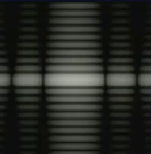

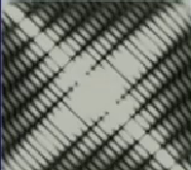
Rotation Concept
Rectangle
FT
Rectangle inclined with 45⁰ Angle
FT

Slide 21
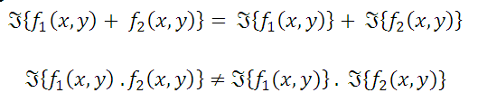
Distributivity
DFT is distributive over addition but not on multiplication

Slide 22

Scaling
If a and b are two scaling quantity then
a f(x,y) ↔ a F(u,v)
If f(x,y) is multiplied by scalar quantity a then its F T is also multiplied by same scalar quantity
Scaling Individual dimension

Slide 23
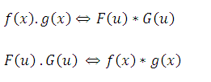

Correlation & Correlation
Convolution:
Convolution in spatial domain is equivalent to multiplication in frequency domain and vice versa
Correlation:
Where f* and F* indicate conjugates of f and F respectively

Slide 24
Back to the chapter content
Click Here

Slide 25



Fast Fourier Transformation
A 2D Fourier transform
Has complexity O(N⁴)
For a 1D Discrete F T complexity become O(N²)
Where we take for simplification. We have N = 2^{N} no. of input and we assume N = 2M

Slide 26






Fast Fourier Transformation
Re-write F(u) as
We take
Total complexity reduces to N log₂^{N}

Slide 27
Back to the chapter content
Click Here

