Slide 1
CHAPTER 6
IMAGE ENHANCEMENT
By: Prof. (Dr.) Paramartha Dutta
Visva Bharati University
Santiniketan, West Bengal, India

Slide 2
Image Enhancement
Necessity of Image Enhancement
Spatial Domain Operation
Back to Course Content Page
Click Here

Slide 3
Image Enhancement
Image Enhancement: It is processing of enhancement of certain feature of image
  Removal of noise
  Increasing contrast for a dark image etc.
  Choice of image enhancement technique are vary from problem to problem
  i.e. Best technique fro enhancement of X-Ray image may not be suitable for enhancement of microscopic images.

Slide 4
Image Enhancement
There are two image enhancement technique
  Spatial Domain Technique
    Work on image plane itself
    Discrete manipulation of pixels in an image
  Frequency Domain Technique
    Modify Fourier Transform coefficient of image and taking inverse Fourier Transform of modified image to obtain modified image

Slide 5
Back to the chapter content
Click Here

Slide 6
Spatial Domain Operation
Let we image f(x,y) then
g(x,y) = T[f(x,y)]
Where T [ . ] is the transfer function which transform the input image f(x,y) (which need to be enhanced) to enhanced image g(x,y)
The operator T operates at point (x,y) considering certain neighborhood of the point (x,y) of the image
Similarly for a single pixel x we can write
g(x) = T[f(x)]

Slide 7
Spatial Domain Operation
y
 |  |  | p
3 x 3 neighborhood at point (x,y)
For different technique neighborhood size may be different depending upon the type of image and type of operation
x
Input Image f(x,y)

Slide 8
Spatial Domain Operation
Spatial domain operation includes
  Point Processing Techniques
  Histogram Based Technique
  Mask Processing Technique

Slide 9
Point Processing Technique
In case of point processing neighborhood sixe considered is 1x1
In point processing we process single pixel at a time
So Transfer function become
S = T(r)
Where s is the processed point image
r is the point to be processed
T is transfer function

Slide 10
Point Processing Technique
Type of Transfer function
light
light
s
s
Wider range in processed image
T(r)
T(r)
Dark
r
Dark
r
Dark
light
Dark
light
Narrow range in original image
Thresholding Transfer function

Slide 11
Point Processing Technique
Point Processing Technique Includes
  Image Negative
  Contrast Stretching
  Gray Level Slicing

Slide 12
Image Negative
Light image converted to darker image
Darker image converted to lighter image
s
L -1
s = T(r) = L-1-r
Concept:
max intensity → min intensity
min intensity → max intensity
r
0
L -1
This kind of Transfer function is very useful in medical science

Slide 13
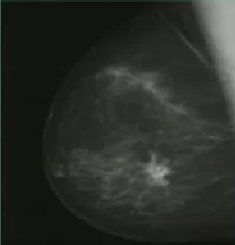
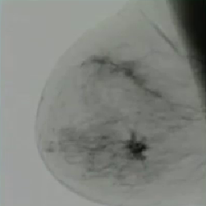
Image Negative Result
Cancer region detection

Slide 14
Contrast Stretching
Contrast image is process of increasing low contrast image to high contrast image
Concept:
Narrow intensity range in original image is converted wide intensity range in processed image
For enhancement operation
r₁ ≤ r₂ and s₁ ≤ s₂
For r₁ = r₂ , s₁ = 0 and s₂ = L-1 the transfer function become thresholding operation
s
L -1
(r₂,s₂)
s = T(r)
wide
(r₁,s₁)
r
0
L -1
Narrow

Slide 15
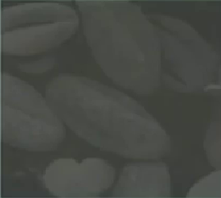
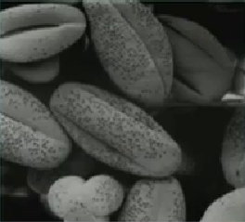
Contrast Stretching Result

Slide 16
Gray Level Slicing
s
s
L -1
L -1
r
r
0
0
A B
A B
L -1
L -1
Concept:
Here it shows that only in the range A – B the image is enhanced and for all other pixel value are suppressed
Concept:
Here it shows that only in the range A – B the image is enhanced and all other pixel value are retained

Slide 17
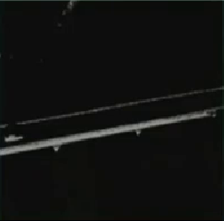
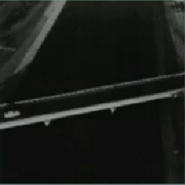
Gray Level Slicing Results

Slide 18
Histogram Based Technique
Histogram Definition
A image having (0 , L-1) discrete intensity level
Then Histogram:
h(r_{k}) = n_{k}
Where r_{k}: Intensity level
n_{k}: No. of pixel having intensity level r_{k}
The plot of distinct intensity level against all possible intensity level is known at Histogram

Slide 19
Histogram Based Technique
Normalized Histogram:
p(r_{k}) =n_{k}/n
Where n is the total no. of pixel in the image
P(r_{k}) indicate the probability of occurrence of intensity of level r_{k} in the image
Histogram Techniques includes
  Histogram equalization
  Histogram specification
  Image Subtraction
  Image Averaging

Slide 20
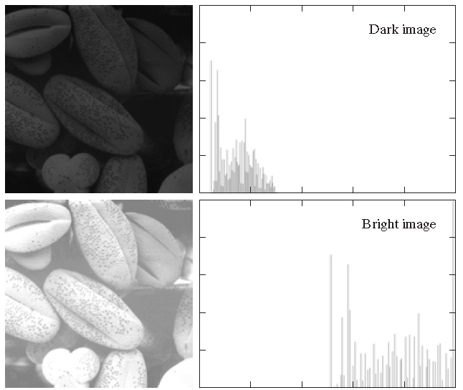
Histogram Based Technique

Slide 21
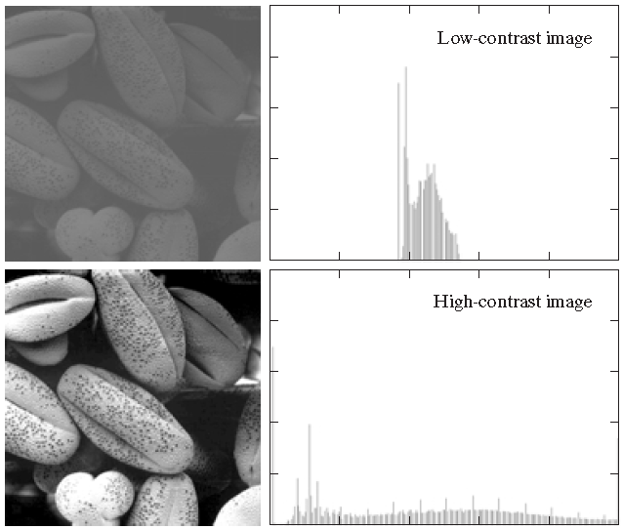
Histogram Based Technique

Slide 22
Histogram Equalization
Let r represents gray level in an image
Assume [0,1] is the normalized pixel in the image where 0 → back pixel and 1 → white pixel
s = T(r)
where r is the intensity in original image and s is the intensity in the processed image
We assume the transfer function satisfy the following condition
  T(r) must be a single valued & monotonically increasing in the range 0 ≤ r ≤ 1 i.e. Darker pixel remains darker in the processed image
  0 ≤ T(r) ≤ 1 for 0 ≤ r ≤ 1 i.e. any pixel intensity vale may not be larger than the maxim intensity level.

Slide 23
Histogram Equalization
Inverse Transfer
r = T⁻¹(s)
It should also satisfy the above condition
For continuous domain
p_{r}(r) → pdf of r
p_{s}(s) → pdf of s
For elementary probability theory we know that if p_{r}(r) and p_{s}(s) are known and T-1(s) is single valued monotonically increasing function
Then we can obtained
p_{s}(s) = p_{r}(r)|dr/ds|_{at r = T-1(s)}

Slide 24
Histogram Equalization
Now we take transfer function
s = T(r) = ∫_{0→r} pr(w) dw
From this we can compute
ds/dr = p_{r}(r)
p_{s}(s) = p_{r}(r) |dr/ds|
= p_{r}(r). 1/p_{r}(r) = 1
Discrete Formulation
p_{r}(r_{k}) = n_{k}/n
Histogram equalization become
s_{k} = T(r_{k}) = ∑_{i= 0 – k} p_{r}(r_{i})
= ∑_{i= 0 – k} n_{i}/n

Slide 25
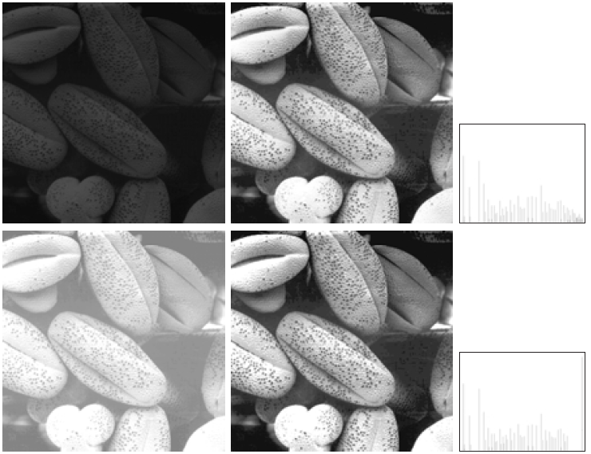
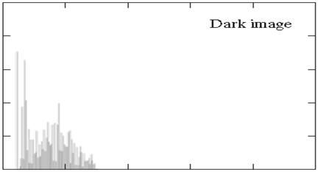
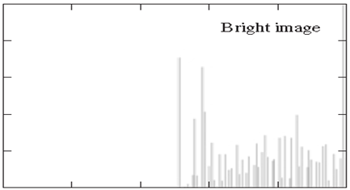
Histogram Equalization

Slide 26
Histogram Specification/Matching
Target Histogram
Let r → given image and z → target area in the image
Hence p_{z}(z) → target histogram
s = T(r) = ∫_{0→r} pr(w) dw
Similarly we have function G(z) instead T(r) for target histogram
G(z) = ∫_{0→z} p_{z}(t) dt
Discrete formulation
s_{k} = T(r_{k}) =∑_{i= 0 – k} n_{i}/n = ∑_{i= 0 – k} p_{r}(r_{i})
Let p_{z}(z) is the specified target histogram
V_{k} = G(z_{k}) = ∑_{i= 0 – k} p_{z}(z_{i}) = s_{k}
Z_{k} = G⁻¹ [T(r_{k})] = G⁻¹(s_{k})

Slide 27
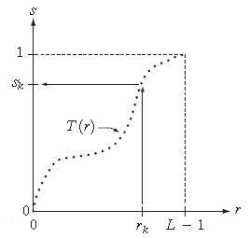
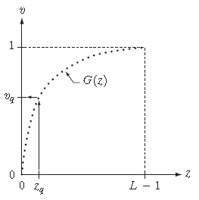
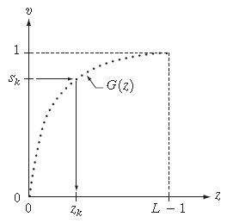
Histogram Specification/Matching
Graphical interpretation of mapping from r_{k} to s_{k} via T(r).
Mapping of z_{q} to its corresponding value v_{q} via G(z).
Inverse mapping from s_{k} to its corresponding value of z_{k}

Slide 28

Histogram Exercise
For digital image
Min Intensity = 0
Max Intensity (r_{L-1}) = 255
The Mapping function
Where 0 ≤ s_{k} ≤ 1 to 0 ≤ s’_{k} ≤ 255

Slide 29
Problem Histogram Equalization
Given that
r → 0,1,2,…….., 7 input image
s → 0,1,2,…….., 7 processed image
And given probability of occurrence of r_{k}
p_{r}(0) = 0.0 , p_{r}(1) = 0.1
P_{r}(2) = 0.1 , p_{r}(3) = 0.3
P_{r}(4) = 0.0 , p_{r}(5) = 0.0
P_{r}(6) = 0.4 , p_{r}(7) = 0.1
Perform Histogram Equalization

Slide 30
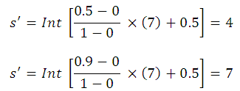
Problem Histogram Equalization
r | p_{r}(r) | s_{k} = T(r_{k}) = ∑_{i= 0 – k} p_{r}(r_{i}) | s’
0 | 0 | 0 | 0
1 | 0.1 | 0.1 | 1
2 | 0.1 | 0.2 | 2
3 | 0.3 | 0.3 | 4
4 | 0 | 0.5 | 4
5 | 0 | 0.5 | 4
6 | 0.4 | 0.9 | 7
7 | 0.1 | 1.0 | 7
For r = 3 s’ = 4
For r = 6 s’ = 7

Slide 31
Histogram Specification
Histogram equalization is not suitable for interactive histogram processing but histogram specification is
Problem
p_{r}(0) = 0.0 , p_{r}(1) = p_{r}(2) = 0.1 , p_{r}(3) = 0.3
p_{r}(4) = p_{r}(5) = 0.0 p_{r}(6) = 0.4 , p_{r}(7) = 0.1
And
p_{z}(0) = 0.0 , p_{z}(1) = 0.1 p_{z}(2) = 0.2 , p_{z}(3) = 0.4
p_{z}(4) = 0.2 , p_{z}(5) = 0.1 p_{r}(6) = p_{r}(7) = 0.1
Perform Histogram Specification

Slide 32
Histogram Specification
Input Image |  |  | Processed Image | Target Image
r | p_{r}(r) | s_{k} = T(r_{k}) = ∑_{i= 0 – k} p_{r}(r_{i}) | z’ | z | P_{z}(z) | G(z) = ∑_{i= 0 – k} p_{z}(z_{i})
0 | 0 | 0 | 0 | 0 | 0.0 | 0
1 | 0.1 | 0.1 | 1 | 1 | 0.1 | 0.1
2 | 0.1 | 0.2 | 2 | 2 | 0.2 | 0.3
3 | 0.3 | 0.3 | 3 | 3 | 0.4 | 0.7
4 | 0 | 0.5 | 3 | 4 | 0.2 | 0.9
5 | 0 | 0.5 | 3 | 5 | 0.1 | 1.0
6 | 0.4 | 0.9 | 4 | 6 | 0.0 | 1.0
7 | 0.1 | 1.0 | 5 | 7 | 0.0 | 1.0
Z’ = Minimum value of z for which G(z) – s ≥ 0
At r = 3, Z’ = 3 because for value
z = 2 G(2) – 0.5 = -0.2 ≤ 0; z = 3 G(3) – 0.5 = 0.2 ≥ 0; z = 4 G(4) – 0.5 = 0.2 ≥ 0

Slide 33
Image Differencing
g(x,y) = f(x,y) – h(x,y)
where h(x,y) is the image subtracted from image f(x,y)
Application of Image Subtraction
  Mask mode radiography: ( It is a image differencing preprocess for showing oriental diseases.)
In this case h(x, y), the mask, is an X-ray image of a region of a patient’s body captured by an intensified TV camera (instead of traditional X-ray film) located opposite an X-ray source. The procedure consists of injecting a contrast medium into the patient’s bloodstream, taking a series of images of the same anatomical region as h(x, y), and subtracting this mask from the series of incoming images after injection of the contrast medium. The net effect of subtracting the mask from each sample in the incoming stream of TV images is that the areas that are different between f(x, y) and h(x, y) appear in the output image as enhanced detail.

Slide 34
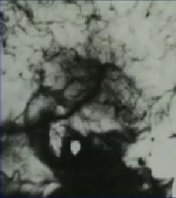
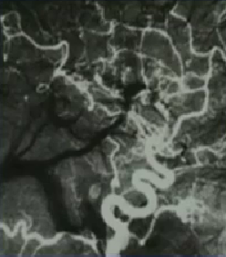
Application Image Differencing
An image (taken after injection of a contrast medium into the bloodstream) with mask subtracted out
Mask image.

Slide 35
Image Averaging
g(x,y) = f(x,y) + η(x,y)
g’(x,y) = 1/k ∑_{i = 1 to K} g_{i}(x,y)
E [g’(x,y) ] = f(x,y)
Application in Astronomical Field
Noise reduction by image averaging
Error (noise must be zero mean)
average of k frames

Slide 36
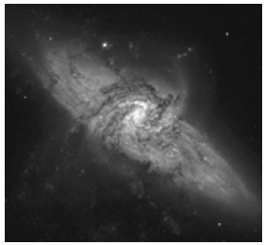
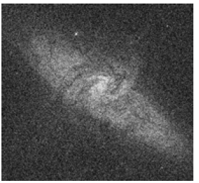
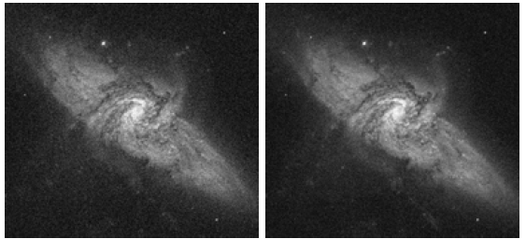
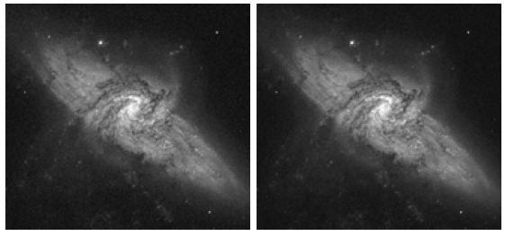
Image Averaging Result
a
b
c
d
e
f
(a) Image of Galaxy Pair NGC 3314. (b) Image corrupted by additive Gaussian
noise with zero mean and a standard deviation of 64 gray levels. (c)–(f) Results of averaging K=8, 16, 64, and 128 noisy images.

Slide 37
Mask Processing Techniques
y
W_{-1,-1} | W_{-1,} ₀ | W_{-1,} ₁
W_{0, -1} | W_{0,} ₀ | W_{0,} ₁
W_{1, -1} | W_{1,} ₀ | W_{1,} ₁
 |  | p
(x,y)
All the pixel value centered at (x,y) are multiplied by the mask to modify that (x,y) centered neighbour
x
Image f(x,y)
3X3 Mask
g(x,y) = ∑ ∑ w_{ij} f(x+i, y+i) for i = -1 to 1 & j = -1 to 1
Where w_{ij} is the mask coefficient and this mask coefficient is different for different techniques
For mask processing neighbourhood must be greater then 1
Operations: Image sharpening, Averaging etc.

Slide 38
Mask Processing Techniques
The mask processing technique includes
  Linear Smoothing Filter
  Median Filter (non linear)
  Sharpening Filter

Slide 39
Linear Smoothing Filter
Performing averaging on an image means smoothening an image
If an image is smoothen much more it become blurred
Averaging Filter
1 | 1 | 1
1 | 1 | 1
1 | 1 | 1
1/9 x
g(x,y) = 1/9 ∑ ∑ w_{ij} f(x+i, y+i)
for i = -1 to 1 & j = -1 to 1

Slide 40

Linear Smoothing Filter
Weighted Averaging
Weight reduces when point are away from the center and increases when comes closer to center
1 | 2 | 1
2 | 4 | 2
1 | 2 | 1
1/16 x
g(x,y) = 1/16 ∑ ∑ w_{ij} f(x+i, y+i)
for i = -1 to 1 & j = -1 to 1
In general form :
For mask size MXN where M = 2a +1 & N = 2b +1

Slide 41
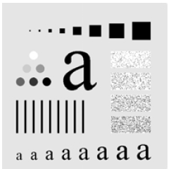
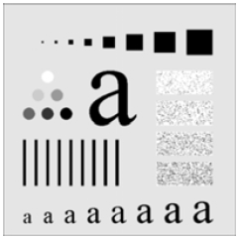
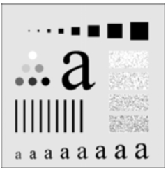

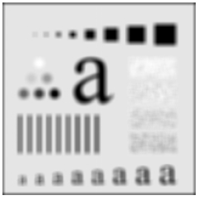
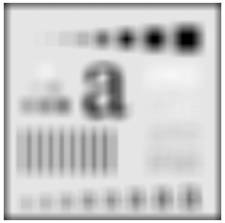
Results
(a) Original image
(b)
(c)
(d)
(e)
(f)
(a) Original image, of size 500*500 pixels(b)–(f) Results of smoothing
with. square averaging filter masks of sizes n=3, 5, 9, 15, and 35, respectively.

Slide 42
Median Filter (non linear)
It is also known as Order-statistics filters
Order-statistics filters are nonlinear spatial filters whose response is based on ordering (ranking) the pixels contained in the image area encompassed by the filter, and then replacing the value of the center pixel with the value determined by the ranking result.
Median filter is a well known nonlinear filter

Slide 43
Median Filter (non linear)
X is replaced by the median value of its neighbourhood
85
90
98
99
100
101
102
105
108
Intensity values less than median value
…. | … | ….
…. | X | X | x
….. | x | 100 | x
 | x | x | x
After arranging pixel in ascending order according to their intensity value
100 | 85 | 98
99 | 105 | 102
90 | 101 | 108
median value
Intensity values greater than median value
Target pixel is replaced by median value

Slide 44
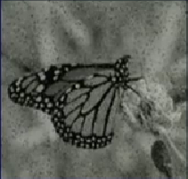
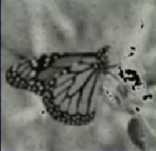
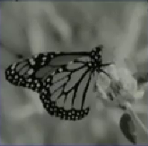
Results
Original Image
Result of Averaging using mask size 5x5
Result of Median filtering
Superiority of median filter over averaging filter

Slide 45
Sharpening Filter
In the smoothening filters (linear & non linear) the image are smoothen and as a result image looses it detailing.
Image sharpening is a process to enhance an image such that it can extract various details of an image
Averaging is basically an integration operation whereas sharpening uses derivative operation over image
Two type of derivative operation are First Order Derivative & Second Order Derivative

Slide 46
Desirable Response of Derivative Filters
First Order Derivative Filter.
  Must be Zero in area of constant gray level
  Non Zero at the onset of grey level step or ramp
  Non Zero along ramp
Second Order Derivative Filter
  Zero in flat area
  Non Zero at onset and end of a gray level step or ramp
  Zero along ramp of constant slope

Slide 47



Sharpening Filter
First Order Derivative Filter.
Second Order Derivative Filter

Slide 48
Choice between 1st & 2nd Order Derivative
thin line
ramp
flat
step
5 | 5 | 4 | 3 | 2 | 1 | 0 | 0 | 0 | 6 | 0 | 0 | 0 | 0 | 1 | 3 | 1 | 0 | 0 | 0 | 0 | 7 | 7
Non Zero ramp
0 | -1 | -1 | -1 | -1 | -1 | 0 | 0 | 6 | -6 | 0 | 0 | 0 | 1 | 2 | -2 | -1 | 0 | 0 | 0 | 7 | 0 | 0
Zero ramp
-1 | 0 | 0 | 0 | 0 | 1 | 0 | 6 | -12 | 6 | 0 | 0 | 0 | 1 | 1 | -4 | 1 | 1 | 0 | 0 | 7 | -7 | 0
Non Zero onset at end of the ramp
Response of 2nd order derivative of isolated point is much stronger than 1st order similarly thin line
Almost same for step

Slide 49
Observation
1st Order derivation generally produce thicker edge in an image
2nd Order derivative gives stronger response to fine details such as thin line and isolated point
1st order derivative have stronger response to gray level step
2nd order derivative produce a double response at step edge
Second Order derivative are better suitable for image enhancement
Discrete formulation of 2nd Order derivative filter should Isotropic in nature (The response of filter should be independent of the orientation of the discontinuity in the image)

Slide 50
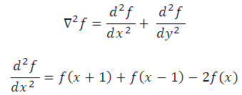
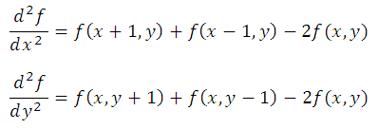
Laplacian Operator
Popularly known 2nd order derivative operator is Laplacian Operator , it is Isotropic in nature
Laplacian Operator in continuous domain
For image f(x,y)

Slide 51
Laplacian Operator
Adding equations we get Laplacian Operator in discrete domain
0 | 1 | 0
1 | -4 | 1
0 | 1 | 0
1 | 1 | 1
1 | -8 | 1
1 | 1 | 1
Laplacian Operator for
Vertical & Horizontal direction
Laplacian Operator allow
diagonal direction also

Slide 52
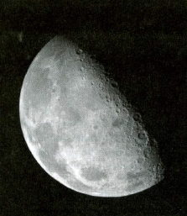
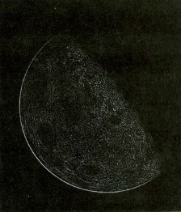
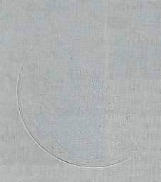
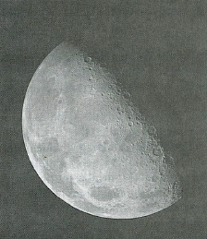
Laplacian Operator Results
(a)
(b)
Original Image
(b) Laplacian filtered iage
(c) Laplacian scaled image
(d) Enhanced image using laplacian operator
(c)
(d)

Slide 53
Back to the chapter content
Click Here

