Slide 1

Gemini Chatbot in Fundraiser Planner
Technical Overview of AI Integration
Visvatharsan Saravanan| 12300830 | 25
Hariharan S| 12309768 | 36
Bharathi Kannan G| 12307027 | 07

Slide 2
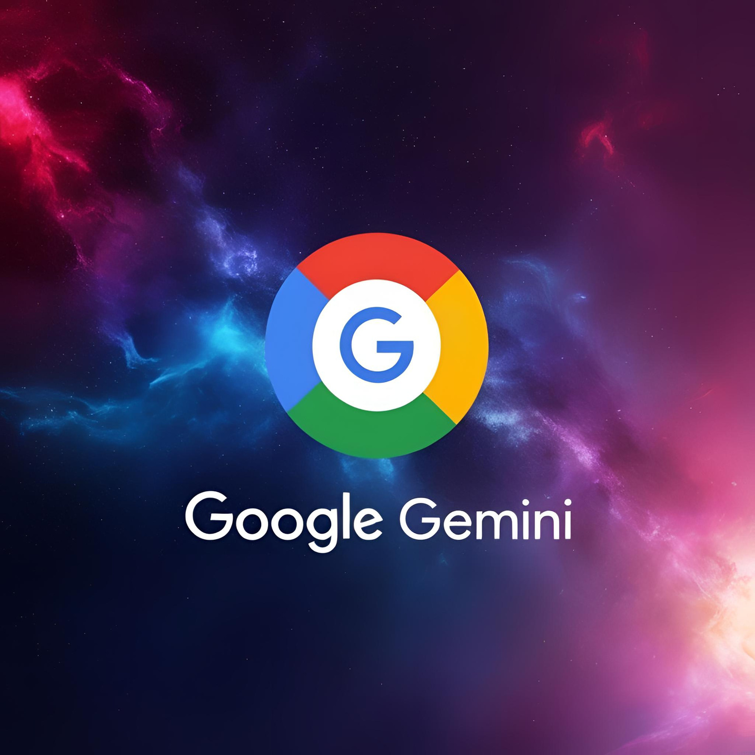
Introduction to Gemini Chatbot
The Gemini Chatbot acts as a smart assistant, available 24/7 to enhance the planning and execution of fundraising events.
It leverages advanced natural language processing to understand user needs and respond appropriately.
Integrated seamlessly into the Fundraiser Planner, Gemini helps users:
1.Draft outreach emails and messages
2.Organize donor data efficiently
3.Generate data-driven reports and projections
4.Streamline decision-making with real-time insights

Slide 3




Chatbot's Role in Fundraiser Planner
- Suggest fundraising ideas and plans
- Generate task lists and schedules
- Analyze event data and provide summaries
- Answer user questions using natural language

Slide 4
System Architecture Overview
The system is designed for user-friendliness and scalability→
1. Frontend: User interacts via a sleek UI built with HTML, CSS and JavaScript for web interfaces.
2. Backend: Frameworks like Node.js , Express.js process requests and handle authentication, validation, and routing.
3. Gemini API: The core AI engine processes natural language queries and generates intelligent responses.
Eg: User: "Generate a sponsorship email for our charity marathon."
Chatbot: Returns a polished, professional draft instantly.

Slide 5
Gemini Integration Flow
1. Authentication & Initialization: Ensures secure and authorized access to the Gemini API.
2. Prompt Engineering: Transforms user input into structured prompts to ensure accurate AI interpretation.
3. API Communication: Asynchronous communication allows fast, real-time data exchange.
4. Response Parsing: Results are cleaned and formatted before display to ensure clarity and usability.
5. Follow-Up Actions: Includes features like storing suggestions, generating documents, and suggesting next steps.

Slide 6
Gemini Technical Features
- Multi-turn Handling: Keeps track of past interactions to build context (e.g., continuing a planning session).
- Real-Time Responses: Users get instant help, improving engagement and workflow efficiency.
- Context Awareness: Adapts suggestions based on the fundraising event type, donor history, and user preferences.
- Security: Uses secure API gateways and token management to protect data.
- Scalability: This can be hosted on cloud infrastructure, easily handling increased user demand and data load.

Slide 7
Challenges & Solutions
01
Challenge: Integrating AI with fundraising-specific workflows Solution: Custom prompts and feedback loops for continuous learning.
02
Challenge: Ensuring data privacy Solution: Tokenized authentication and encrypted data storage.
03
Challenge: Real-time performance under high load Solution: Asynchronous APIs and cloud autoscaling mechanisms.
04
Challenge: User trust in AI responses Solution: Transparent feedback and the ability to revise AI-generated outputs.

Slide 8

Future Enhancements
Voice input/output capabilities
Integration with CRM and payment systems
Smarter event suggestions based on past success
Enhanced real-time collaboration features
Custom training with organizational data

Slide 9
Conclusion
Gemini Chatbot transforms fundraising from a manual, time-consuming effort into a smart, AI-driven process.
Future upgrades include multilingual support, emotion detection for messages, and predictive analytics.
Gemini evolves with every interaction, becoming smarter and more tailored to your organization’s unique fundraising goals over time.
By reducing the technical burden, Gemini allows organizers to focus more on building relationships and creating impact, not on managing tools.

Slide 10
Project Link: https://github.com/Visvatharsan/Fundraiser-Planner-

Slide 11
THANK YOU!

