Slide 1
Adversarial Learning
For Visual Recommendations

Slide 2
Problem
Visual recommendations in different domains such as fashion, food, etc. are prone to various adversarial attacks which can harm the integrity of the system
Poisoning attacks on the training dataset can push the target towards higher recommendations.
Evasion attack is even easier to alter the recommendation by uploading an adversarial version of images on platforms such as Amazon, eBay, etc.

Slide 3
Motivation
Real Life Connection
Many people uses e-commerce for shopping. Easy to connect the scenario with real life.
Vulnerability to attacks
Possibility of different adversarial attacks and its impacts especially evasion attack

Slide 4
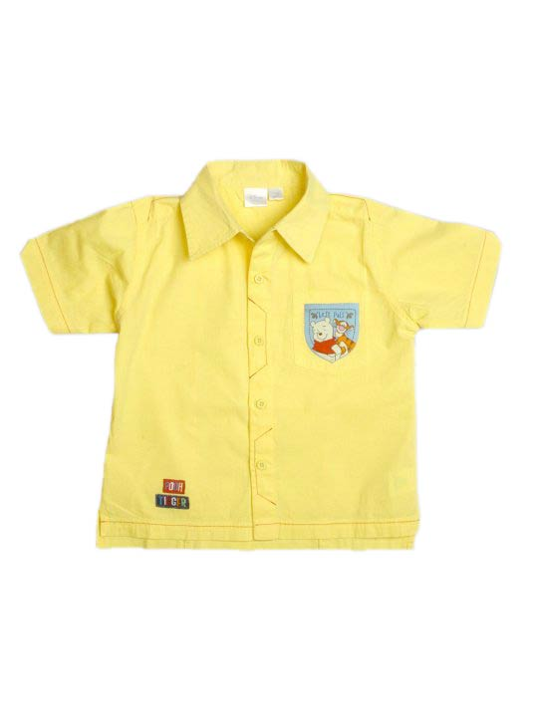
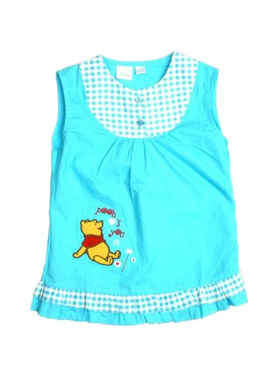
Dataset
2900 Fashion Images
Categories:
Girls Apparel
Boys Apparel
Girls Footwear
Boys Footwear
Image Data:
Product IDs, Gender, Category, Subcategory, Product Type, Colour, Usage, Image URL

Slide 6
Approaches
Generative Adversarial Network
Variational Autoencoder
Generates Image from random noise
Complex Training Process
Generates Quality Images
Capable of generating realistic images
Generates Image from latent vectors
Relatively Easier Training Process
Blurriness in the final output

Slide 7
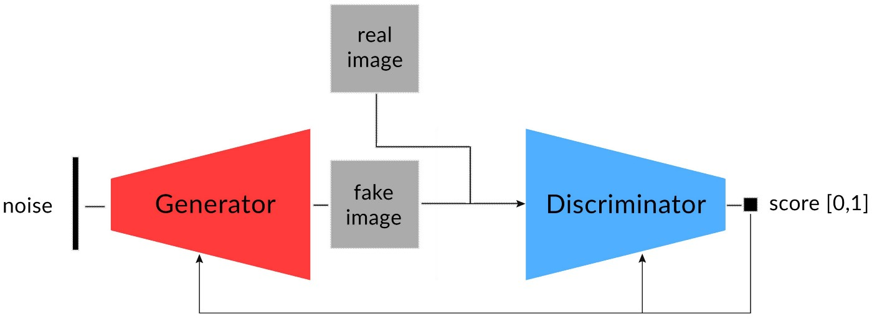
Generative Adversarial Network

Slide 8
Solution Steps
Prepare data for test and train
Model Training
Image Pre-Processing
Capturing Loss Functions
Discriminator Creation
Performance Evaluation
Generator Creation
Increase of training data if required

Slide 9
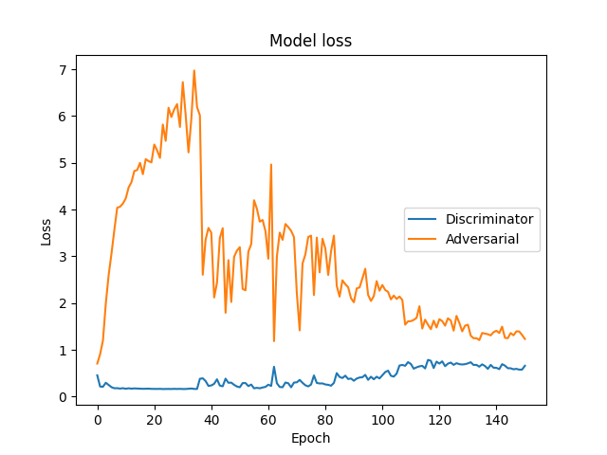
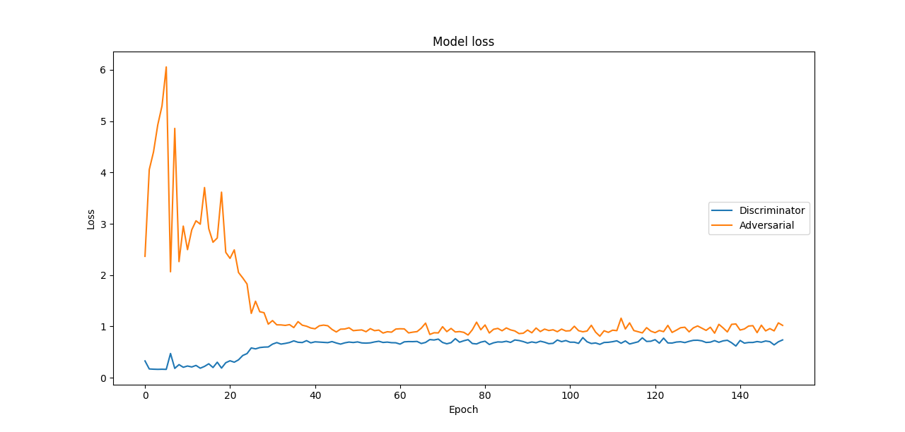
Progress – Loss Functions
With Less Data
With More Data

Slide 10
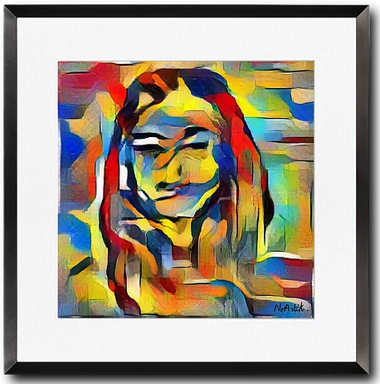
Ethical / Social / Legal Issues
Product Farming
People can create artwork using GAN and claim those as their own work and even sell it
The career of Artists and Painters?
Job Replacement
GANs can replace the need for someone on screen and talk.
Lists Include social media influencers, talk show host and so on.
Other Issues
Signature forging using handwritten recognition algorithms
Privacy Related

Slide 11
Conclusion
Learned about the types of adversarial attacks and its impacts, the scope of adversarial learning in future
More data using augmentation technique could have improved the training
As part of future work, one of the extensions of GAN such as conditional GAN can be used to bring out better performance of the model by using any data from the CSV file in dataset

Slide 12
Anything to discuss?

