Slide 1
Intro to Programming
Chapter 1

Slide 2

Setting up Python
You can download Python at no charge from www.python.org

Slide 3
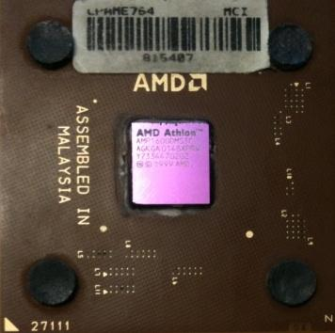





Computers want to be helpful...
Computers are built for one purpose - to do things for us
But we need to speak their language to describe what we want done
Users have it easy - someone already put many different programs (instructions) into the computer and users just pick the ones we want to use
What
Next?
What
Next?
What
Next?
What
Next?
What
Next?
What
Next?

Slide 4
Users .vs. Programmers
Users see computers as a set of tools - word processor, spreadsheet, maps, to-do list, email, etc.
Programmers learn the computer “ways” and the computer language
Programmers have some tools that allow them to build new tools
Programmers sometimes write tools for lots of users and sometimes programmers write little “helpers” for themselves to automate a task

Slide 5
Why be a programmer?
To get some task done - we are the user and programmer
Help analyze and process data (many programs have APIs)
To produce something for others to use – write programs
Fix an issue with a program

Slide 6
What is Code? Software? A Program?
A sequence of stored instructions
It is a little piece of our intelligence in the computer
It is a little piece of our intelligence we can give to others - we figure something out and then we encode it and then give it to someone else to save them the time and energy of figuring it out
A piece of creative art - particularly when we do a good job on user experience

Slide 7
Program for a Computer
name = raw_input('Enter file:')
handle = open(name, 'r')
text = handle.read()
words = text.split()
counts = dict()
for word in words:
counts[word] = counts.get(word,0) + 1
bigcount = Nonebigword = None
for word,count in counts.items():
if bigcount is None or count > bigcount:
bigword = word
bigcount = countprint bigword, bigcount

Slide 8
Hardware Architecture

Slide 9
Generic
Computer
Computer
Input
and Output
Devices
Central
Processing
Unit
Secondary
Memory
Main
Memory

Slide 10
Definitions
Central Processing Unit: Runs the Program - The CPU is always wondering “what to do next”? Not the brains exactly – not smart but very very fast
Input Devices: Keyboard, Mouse, Touch Screen
Output Devices: Screen, Speakers, Printer, DVD Burner
Main Memory: Fast small temporary storage - lost on reboot - aka Random Access Memory (RAM)
Secondary Memory: Slower large permanent storage - lasts until deleted - disk drive / memory stick

Slide 11
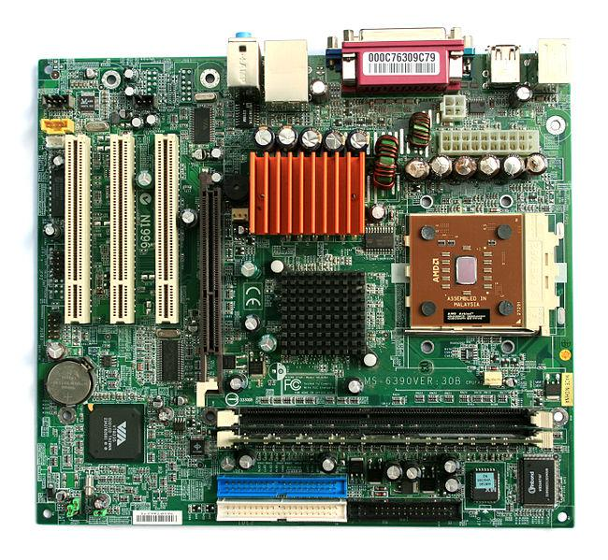
Motherboard
Source: http://commons.Wikimedia.org

Slide 12
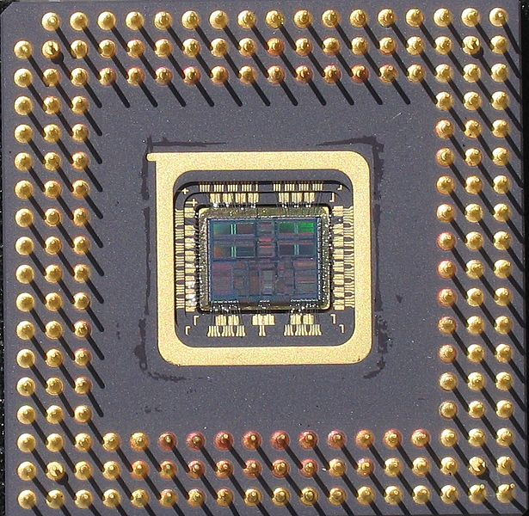
Central Processing Unit (CPU)
Source: http://commons.Wikimedia.org

Slide 13
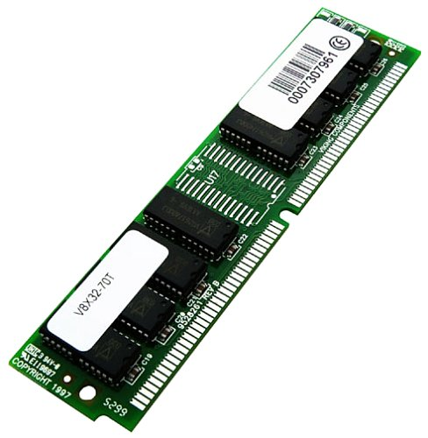
Memory (RAM)
Source: http://commons.wikimedia.org

Slide 14
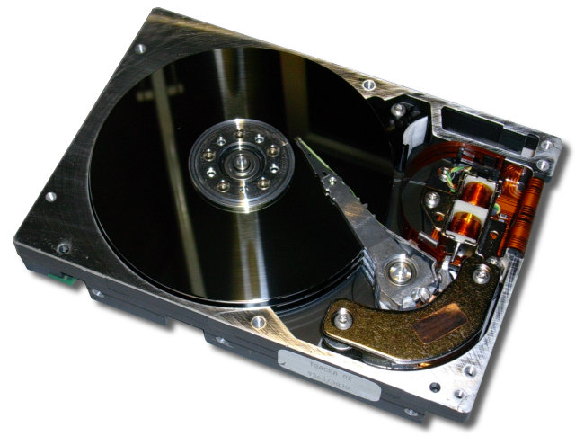
Hard Drive
Source: http://commons.Wikimedia.org

Slide 15
Python as a Language

Slide 16
Python: A Computer Language
We need to learn the Python language so we can communicate our instructions to Python. In the beginning we will make lots of mistakes
When you make a mistake, the computer does not think you are “cute”. It says “syntax error” - given that it “knows” the language and you are just learning it.
You must remember that you are intelligent and can learn - the computer is simple and very fast - but cannot learn - so it is easier for you to learn Python than for the computer to learn English...

Slide 17
Talking to Python : The Interpreter

Slide 18
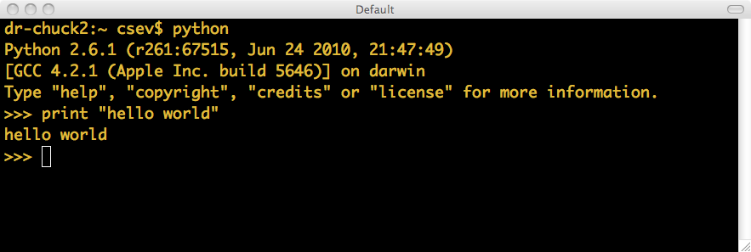
The Prompt ...

Slide 19
Elements of Python
Vocabulary / Words - Variables and Reserved words (Chapter 2)
Sentence structure - valid syntax patterns (Chapters 3-5)
Story structure - constructing a program for a purpose

Slide 20
Reserved Words
You can not use reserved words as variable names / identifiers
and del for is raise assert elif from lambda
return break else global not try class except
if or while continue exec import
pass yield def ﬁnally in print

Slide 21
Statements
x = 2
x = x + 2
print x
Assignment Statement
Assignment with expression
Print statement
Variable
Operator
Constant
Reserved Word

Slide 22
Python Scripts
Interactive Python is good for experiments and programs of 3-4 lines long
But most programs are much longer so we type them into a file and tell python to run the commands in the file.
In a sense we are “giving Python a script”
As convention, we add “.py” as the suffix on the end of these files to indicate they contain Python

Slide 23
Interactive vs. Script
Interactive
- You type directly to Python one line at a time and it responds
Script
- You enter a sequence of statements (lines) into a file using a text editor and tell Python to execute the statements in the file

Slide 24
Program Steps and Program Flow
Like a recipe or installation instructions, a program is a sequence of steps to be done in sequence
Some steps are conditional
Sometimes a step or group of steps are to be repeated
Sometimes we store a set of steps to be used over and over as needed several places throughout the program

Slide 25
Sequential Steps
x = 1
x = 1
print x
x = x + 1
print x
print x
x = x + 1
print x
When a program is running, it flows from one step to the next. We as programmers set up “paths” for the program to follow.
Chapter 2

Slide 26
Conditional Steps
x = 5
X < 10 ?
Yes
print 'Smaller'
X > 20 ?
Yes
print 'Bigger'
print 'Finis'
Chapter 3

Slide 27
Repeated Steps
n = 5
No
n > 0 ?
Yes
Program:
n = 5
while n > 0 :
print n
n = n – 1
print 'Blastoff!'
print n
n = n -1
print 'Blastoff'
Loops (repeated steps) have iteration variables that change each time through a loop. Often these iteration variables go through a sequence of numbers.
Chapter 5

Slide 28
Stored (and reused) Steps
Program:
def hello():
print 'Hello'
print 'Fun'
hello()
print 'Zip‘
hello()
def
hello():
print 'Hello'
Output:
Hello
Fun
Zip
Hello
Fun
print 'Fun'
hello()
print 'Zip'
hello()
We call these reusable pieces of code “functions”.
Chapter 4

Slide 29
Variables, Objects, and Classes
A variable is a reference to a value stored in a computer’s memory.
Variables can be sorted into a variety of categories (or data types) such as numbers (int/float etc), Boolean values (true/false), and sequences (strings, lists etc).
An object is a collection of data from a computer’s memory that can be manipulated.
ALL VARIABLES ARE OBJECTS although some objects can be defined by data referred to by multiple variables.
Methods are the functions used to act on/alter an object’s data. They describe what your object can “do.”

Slide 30
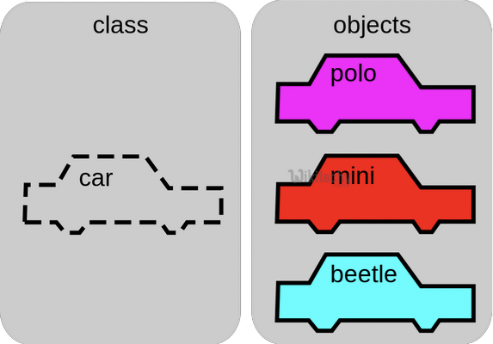
Variables, Objects, and Classes (cont.)
A class is a collection of objects who share the same set of variables/methods.
The definition of the class provides a blueprint for all the objects within it (instances).
Instances may share the same variables (color, size, shape, etc.), but they do NOT share the same values for each variable (blue/red/pink, small/large, square/circular etc.)
Instance #1
Color: Pink
Name: Polo
Instance #2
Color: Red
Name: Mini
Instance #3
Color: Blue
Name: Beetle

Slide 31

Basic Syntax Rules
The name of your variable (myInt etc.) is placed on the left of the “=“ operator.
Most variable names are in camel case where the first word begins with a lowercase letter and any subsequent words are capitalized
Variable names may also appear in snake case where all words are lowercase, with underscores between words
The assignment operator (“=“) sets the variable name equal to the memory location where your value is found.
The value of your variable (“Hello, World”) is placed on the right of the “=“ operator.
The type of this value does NOT need to be stated but its format must abide by a given object type (as shown).
myString = “Hello, World” myInt = 7 myFloat = 7.0 myList = [7, 8, 9] myBoolean = true

Slide 32
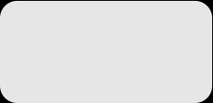
Basic Syntax Rules
Function Syntax
def...: indicates that you are defining a new function.
function() refers to the name of your function. By convention, this name is typically lowercase and represents a verb/action.
a,b refers to parameters (values or variables) that can be used within the statements of your function’s definition (......). If your function has no parameters, an empty parenthetical () is used.
The return statement is an optional statement that will return a value for your function to your original call.
def function(a, b):
......
return a + b

Slide 33
Summary
This is a quick overview of Chapter 1
We will revisit these concepts throughout the course
Focus on the big picture

