Slide 1

ESTIMATION OF OBESITY LEVELS BASED ON EATING HABITS AND PHYSICAL CONDITION’S.
NAME: VISWANATHA REDDY KAMIREDDYGARI
DATE: 12/09/2024
SUBJECT: MACHINE LEARNING (FALL 2024)
YESHIVA UNIVERSITY
KATZ SCHOOL OF SCIENCE AND HEALTH

Slide 2
1) OBJECTIVE
Obesity is a growing public health concern worldwide, significantly affecting individuals' health and well-being. This dataset aims to facilitate the estimation and classification of obesity levels in individuals from Mexico, Peru, and Colombia, based on their eating habits and physical attributes. With 17 features and 2111 records, The dataset categorizes individuals into seven obesity levels: Insufficient Weight, Normal Weight, Overweight Levels I & II, and Obesity Types I, II, & III.
The objective is to develop and evaluate machine learning models that can accurately classify individuals into these obesity levels. Such models can be used to identify at-risk populations and guide targeted interventions to address obesity and promote healthier lifestyles.

Slide 3
2) DATA SET OVERVIEW
Data set link: https://archive.ics.uci.edu/dataset/544/estimation+of+obesity+levels+based+on+eating+habits+and+physical+condition.
This dataset includes 2111 records and 17 features, designed to predict obesity levels across individuals in Mexico, Peru, and Colombia. Attributes range from demographic factors like Gender and Age to lifestyle behaviors such as physical activity and eating habits

Slide 4
Gender: Biological gender of the individual (Male or Female).
Age: Age of the individual in years.
Height: Height of the individual in meters.
Weight: Weight of the individual in kilograms.
Family history with overweight: Indicates if there is a family history of being overweight.
FAVC: Frequency of consuming high-calorie food (Yes or No).
FCVC: Frequency of vegetable consumption (scale: 1–3).
NCP: Number of main meals consumed per day.
CAEC: Frequency of eating between meals (No, Sometimes, Frequently, Always).
SMOKE: Whether the individual smokes (Yes or No).
CH2O: Daily water intake in liters.
SCC: Whether the individual monitors their caloric intake (Yes or No).
FAF: Frequency of physical activity in hours per week.
TUE: Time spent using technology in hours per day.
CALC: Frequency of alcohol consumption (No, Sometimes, Frequently, Always).
MTRANS: Primary mode of transportation (e.g., Walking, Automobile).
NObesity: Obesity level classified into seven categories.

Slide 5
3) METHODOLOGY
1. Data Collection
The dataset was sourced from the University of California, Irvine (UCI) and consists of 2111 records and 17 attributes, including demographic, physical, and lifestyle factors.
2. Data Preprocessing
Encoding Categorical Features: Used label encoding to convert categorical variables (e.g., Gender, CAEC) into numerical values for model compatibility.
Scaling Numerical Features: Applied Standard Scaler to normalize features like Height, Weight, and CH2O to improve the performance of models sensitive to magnitude differences.
Rounding Attributes: Simplified attributes such as Age, Weight, and NCP by rounding them to meaningful values for better representation.

Slide 6
3. Data Splitting:
The dataset was split into 80% training and 20% testing subsets to evaluate model performance on unseen data, ensuring generalizability.
4. Model Training:
Multiple machine learning models were trained and compared:
a) Logistic Regression: Used as a baseline due to its simplicity.
b) Random Forest: Selected for its robustness and ability to handle feature interactions.
c) Gradient Boosting: Explored for its iterative approach in reducing errors.
d) Decision Tree: Chosen for its interpretability.
e) Support Vector Machine (SVM): Evaluated for its ability to handle complex decision boundaries.

Slide 7
5. Model Evaluation
Models were assessed using key metrics:
Accuracy: Proportion of correctly classified instances.
2) Precision and Recall: Evaluated the model’s ability to avoid false positives and false negatives.
3) F1-Score: Used as the primary metric for selecting the best model, balancing precision and recall. The Random Forest model was chosen with the highest F1-Score of 0.948.
6. Model Deployment
The selected model was deployed using Streamlit, a Python-based framework. An interactive web application was created, allowing users to input features and receive real-time predictions of obesity levels.

Slide 8
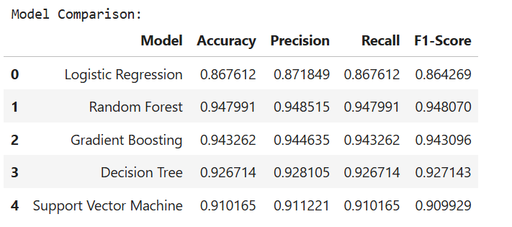
4) MODEL COMPARISION
To determine the best-performing model, multiple machine learning algorithms were trained and evaluated on the dataset. The performance metrics used for comparison included Accuracy, Precision, Recall, and F1-Score. The results for each model are summarized

Slide 9
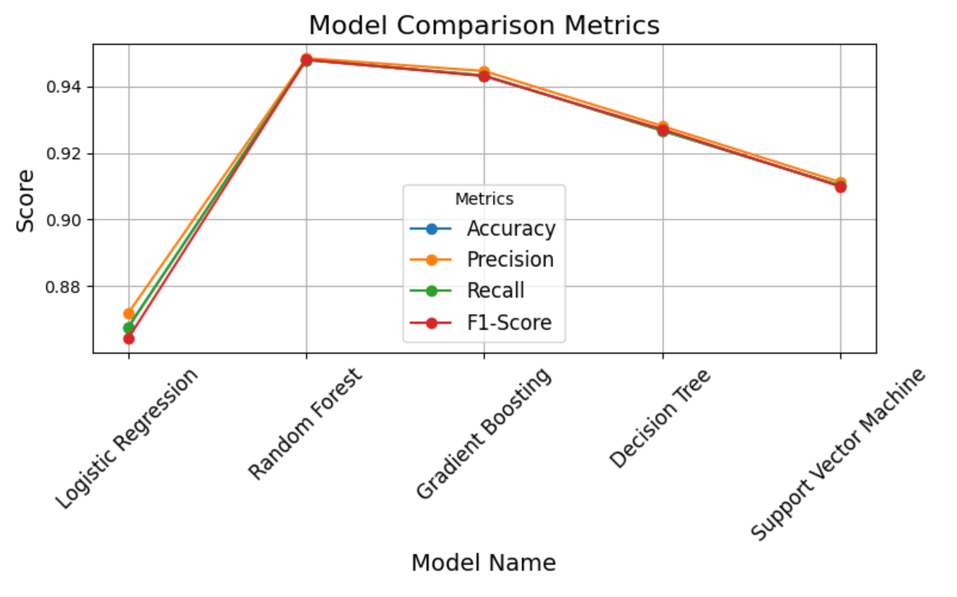
5) VISUAL COMPARISION

Slide 10
6) MODEL DEPLOYMENT
The Random Forest model was deployed as an interactive web application using Streamlit to provide real-time predictions of obesity levels based on user inputs. The trained model, along with preprocessing tools like the scaler and label encoders, was saved using pkl (Pickle) for efficient reuse. The Streamlit app features a user-friendly interface where users can input attributes such as age, height, weight, and lifestyle habits. The app preprocesses the data in real-time and displays the predicted obesity level. This deployment ensures accessibility, as the app can run locally

Slide 11
7) CONCLUSION
In this project, I successfully developed and deployed a machine learning model to predict obesity levels based on physical attributes, eating habits, and lifestyle factors. Among the evaluated models, Random Forest emerged as the best performer, achieving a high F1-Score of 0.948, ensuring robust and accurate predictions across all obesity levels. The model was deployed as an interactive web application using Streamlit, making it accessible and easy to use for real-time predictions

Slide 12
THANK’S YOU

