Slide 1
CREDIT CARD FRAUD DETECTION USING MACHINE LEARNING
Dataset
284,807
transactions
Fraud cases
492
0.1727% of dataset
Final Project Presentation
Logistic Regression • EDA • Power BI • Gradio
ROC-AUC
0.9737
final test evaluation
Presented by: Viswadharini Navamani
Viswadharini Navamani

Slide 2
Presented By
Viswadharini Navamani
Credit Card Fraud Detection Using Machine Learning

Slide 3
Problem Statement & Objectives
01 • OVERVIEW
Problem
Objectives
Credit card fraud detection is challenging because fraudulent transactions are rare and fraud patterns can change over time.
• Analyze legitimate and fraudulent transaction patterns.
• Clean and prepare the transaction data for modeling.
• Handle severe class imbalance.
• Build and evaluate a Logistic Regression classifier.
• Identify important fraud predictors.
• Create a Power BI dashboard and a user-facing prediction interface.
Credit Card Fraud Detection Using Machine Learning • 2

Slide 4

Dataset & Data Preparation
02 • DATA
Transactions
Input features
Fraud
Duplicates removed
284,807
30
492
1,081
Time, V1–V28, Amount
Class = 1
during data cleaning
Data preparation workflow
• SQL extraction / data access
• Pandas loading and profiling
• Missing-value and duplicate checks
• Class distribution analysis
• Feature scaling using StandardScaler
• Train / validation / test split with stratification
Final split: 182,276 training • 45,569 validation • 56,962 testing
Credit Card Fraud Detection Using Machine Learning • 3

Slide 5
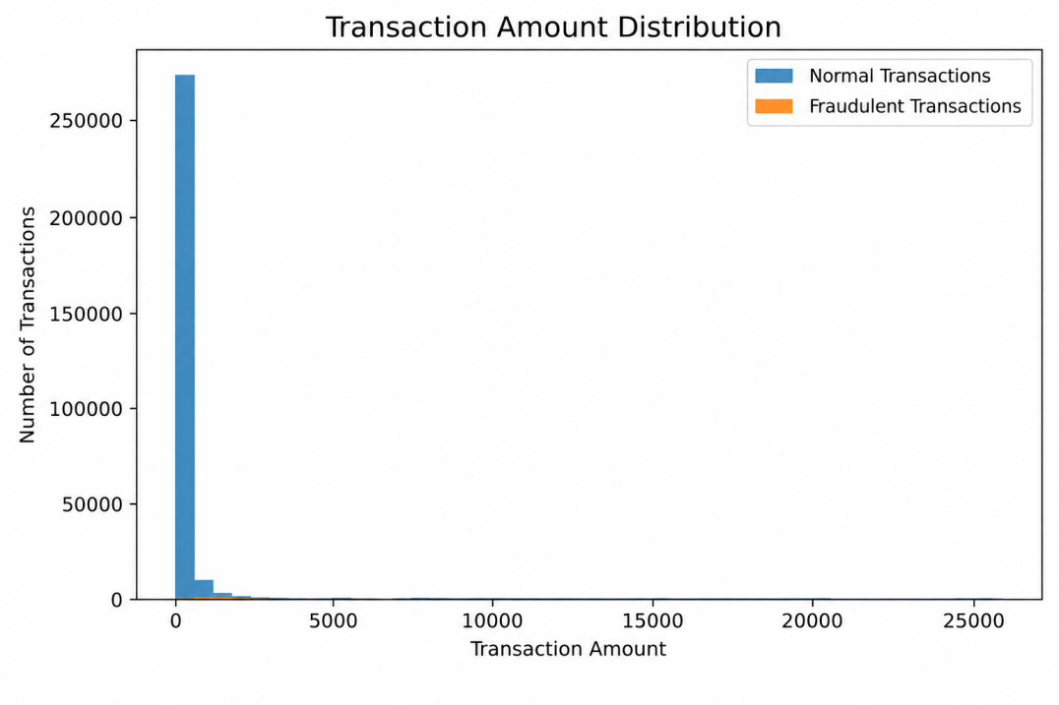
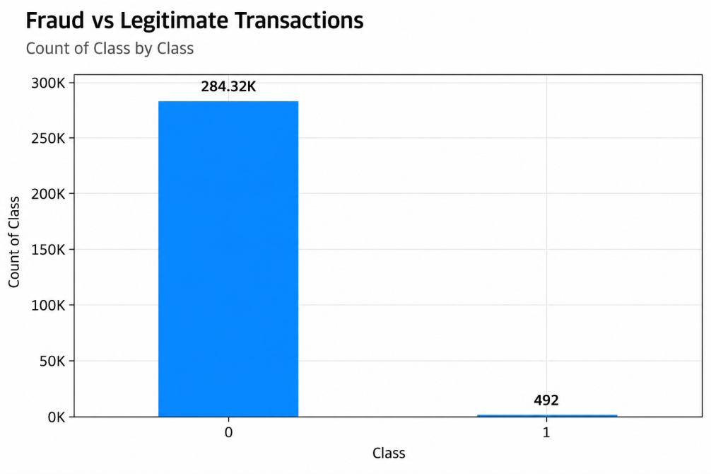
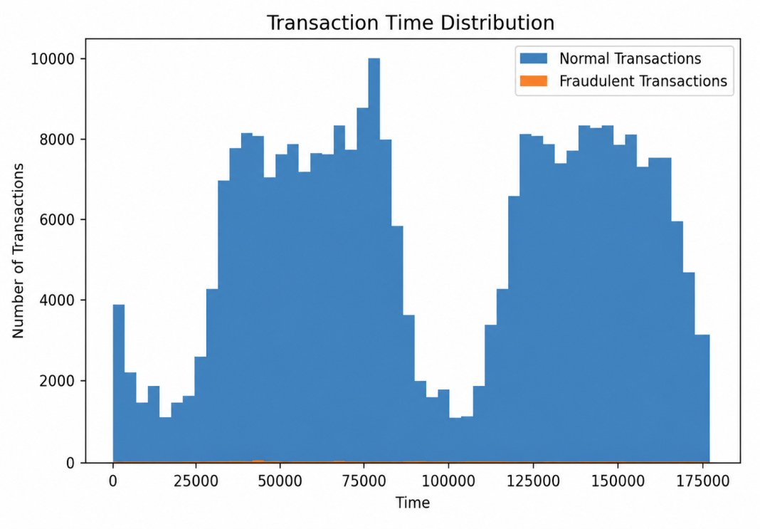
Exploratory Data Analysis
03 • EDA
Severe class imbalance
Transaction amount and timing
Legitimate vs fraudulent transactions
Credit Card Fraud Detection Using Machine Learning • 4

Slide 6
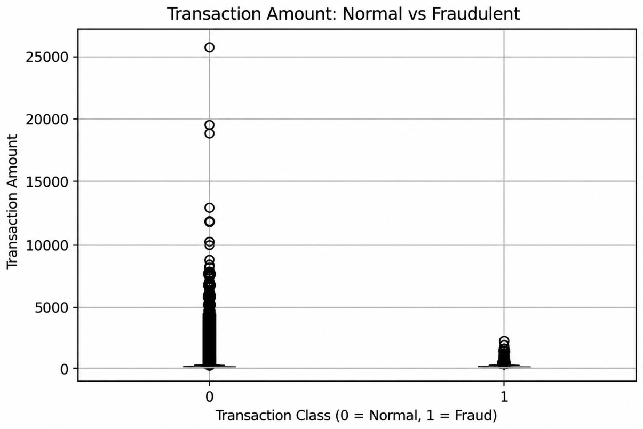
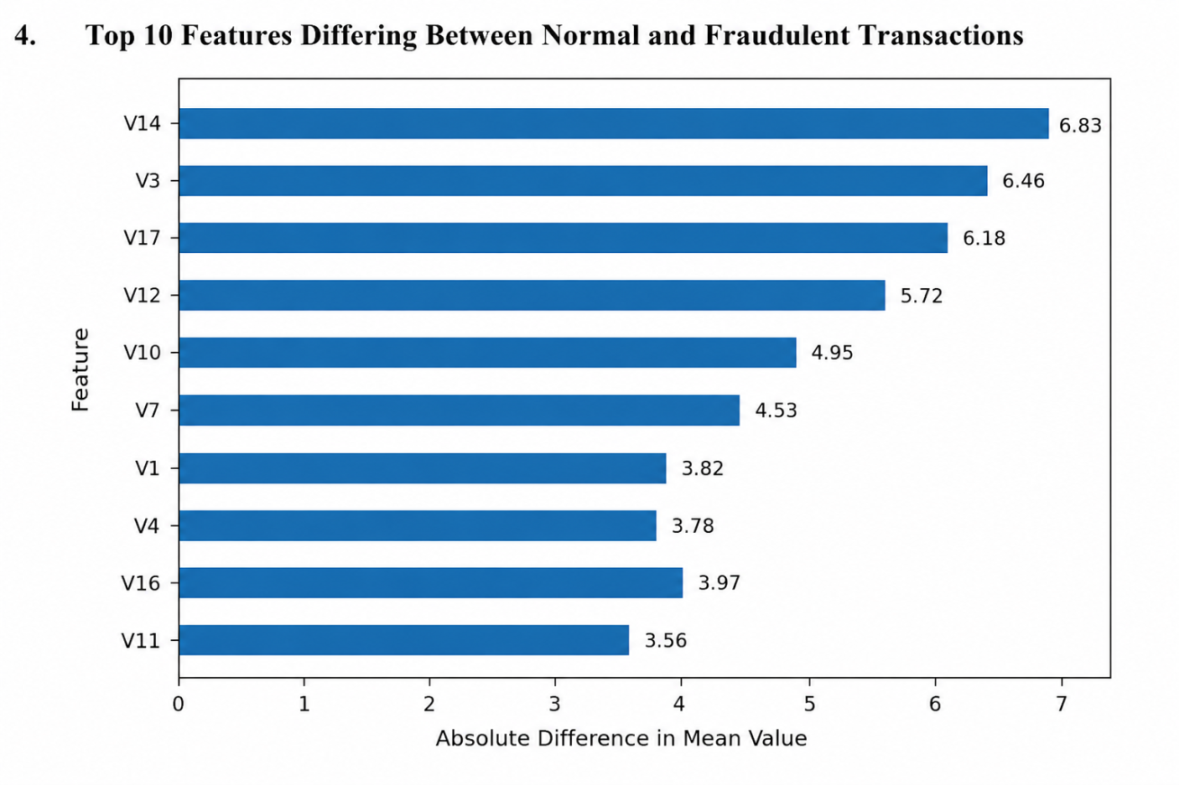
Key EDA Findings
03 • EDA
Fraudulent transactions show distinct distributions in transaction amount and several anonymized features.
Credit Card Fraud Detection Using Machine Learning • 5

Slide 7
Model Development
04 • MODEL
1
2
3
4
5
Split
Scale
Train
Tune
Evaluate
Train / validation / test
StandardScaler
Logistic Regression
Validation-selected threshold
Unseen test data
Why Logistic Regression?
Threshold selection was performed on validation data rather than the final test set, avoiding test-set leakage.
• Suitable baseline for binary classification.
• Produces interpretable coefficients for predictor analysis.
• Balanced class weights address the strong class imbalance.
Validation-selected threshold
0.9999984280
used for final test classification
Credit Card Fraud Detection Using Machine Learning • 6

Slide 8
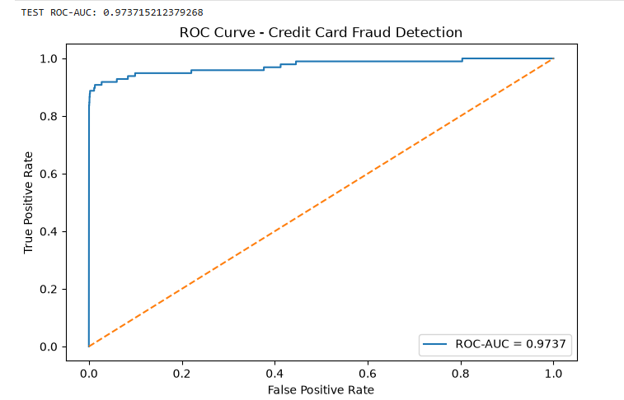
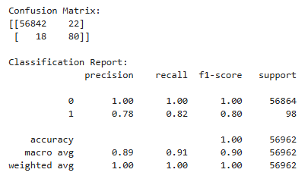
Model Performance
04 • MODEL
ROC-AUC
Fraud Precision
Fraud Recall
Fraud F1
0.9737
0.78
0.82
0.80
The model demonstrates strong discrimination while correctly identifying most fraudulent transactions with relatively few false positives.
Credit Card Fraud Detection Using Machine Learning • 7

Slide 9
Confusion Matrix Interpretation
04 • MODEL
Final test-set outcomes
• 56,842 legitimate transactions correctly classified.
• 22 legitimate transactions incorrectly flagged as fraud.
• 80 fraudulent transactions correctly detected.
• 18 fraudulent transactions missed by the model.
Test set
56,962
98 fraudulent transactions
Credit Card Fraud Detection Using Machine Learning • 8

Slide 10
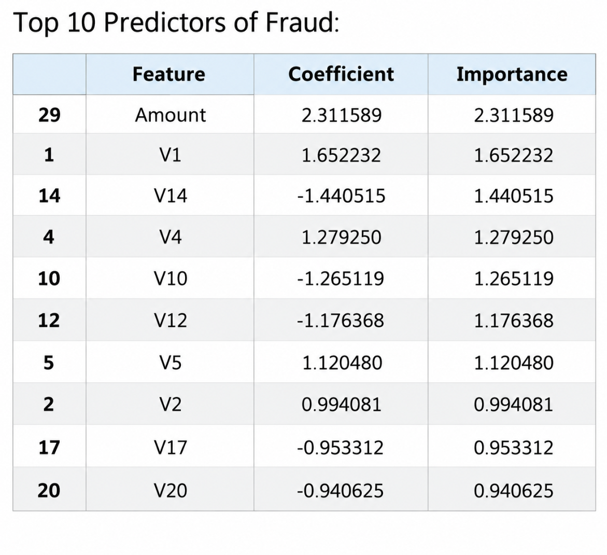
Top Fraud Predictors
05 • INTERPRETATION
Most influential model coefficients
• Amount
• V1
• V14
• V4
• V10
• V12
• V5
• V2
• V17
• V20
Importance is based on the absolute Logistic Regression coefficient.
Credit Card Fraud Detection Using Machine Learning • 9

Slide 11
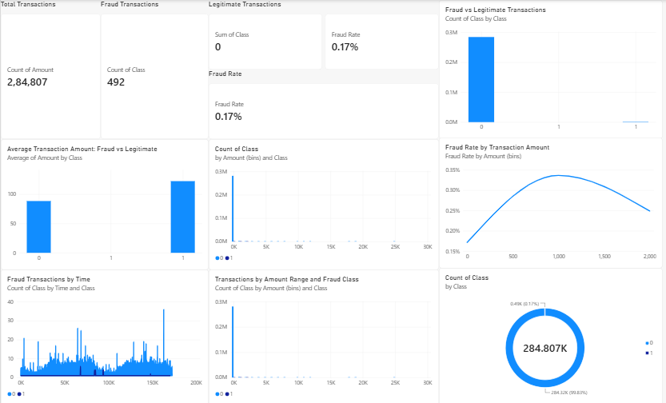
Power BI Dashboard
06 • BUSINESS INSIGHTS
Interactive view of transaction volume, fraud distribution, transaction amounts, fraud rates and time-based patterns.
Credit Card Fraud Detection Using Machine Learning • 10

Slide 12
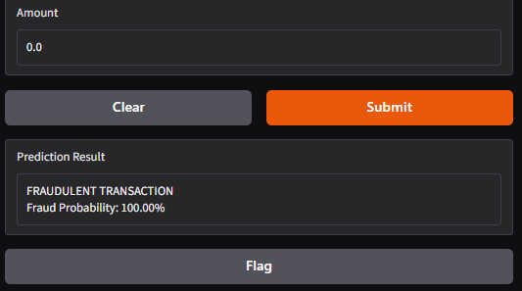
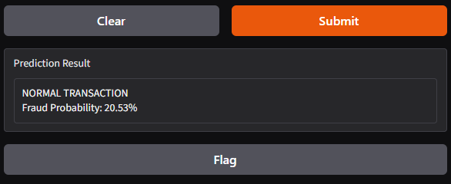
Fraud Detection Interface
07 • IMPLEMENTATION
Normal transaction prediction
Fraudulent transaction prediction
The Gradio interface accepts transaction features and returns a predicted class and fraud probability.
Credit Card Fraud Detection Using Machine Learning • 11

Slide 13
Conclusion & Future Scope
08 • CLOSING
Conclusion
Future Scope
• The Logistic Regression model achieved ROC-AUC of 0.9737.
• Fraud precision, recall and F1-score were 0.78, 0.82 and 0.80.
• The model correctly detected 80 of 98 fraudulent test transactions.
• Top predictors were identified from model coefficients.
• Power BI and Gradio added practical analytical and prediction capabilities.
• Evaluate additional machine learning and deep learning models.
• Introduce real-time transaction monitoring.
• Explore advanced anomaly-detection techniques.
• Continuously retrain with new transaction data.
• Optimize thresholds and deploy as a production-level application.
Final takeaway
Strong fraud discrimination
with a practical analytics and prediction workflow
Credit Card Fraud Detection Using Machine Learning • 12

Slide 14
THANK YOU
Questions & Discussion
Credit Card Fraud Detection Using Machine Learning

