Slide 1
SECURE DATA HIDING IN IMAGES USING STEGANOGRAPHY
CAPSTONE PROJECT
Presented By:
Student Name : Viswajith Menon

Slide 2
OUTLINE
Problem Statement
Technology used
Wow factor
End users
Result
Conclusion
Git-hub Link

Slide 3
Problem Statement
Data sent during communication between users can be subject to eavesdropping, tampering etc. by attackers. The challenge is to securely send data while preserving confidentiality as well as the integrity of the message. Steganography is a means to solve this challenge by hiding the data within another medium such as audio, images, video etc.

Slide 4
Technology used
Libraries – OpenCV, OS, String
IDEs - VS Code, IDLE
Language - Python
Platforms – Windows 11

Slide 5
Wow factors
Embed a string securely within an image
Passcode protection provides an additional layer of security

Slide 6
End users
Military and defence organizations
MNCs that need to secure their data
Any other users who require confidential communication

Slide 7
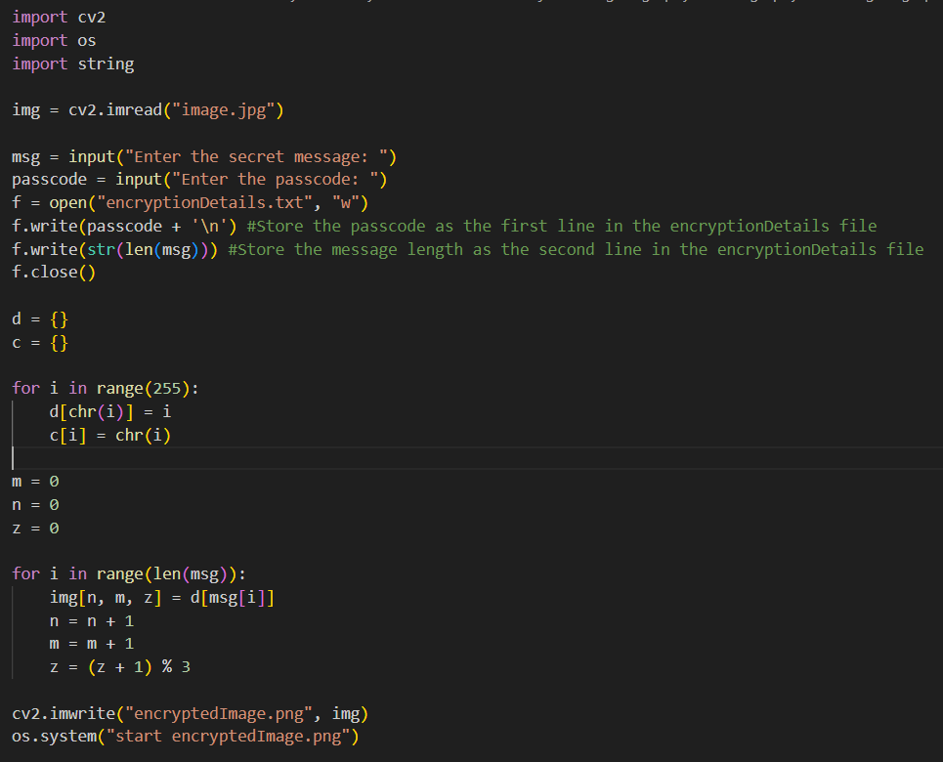
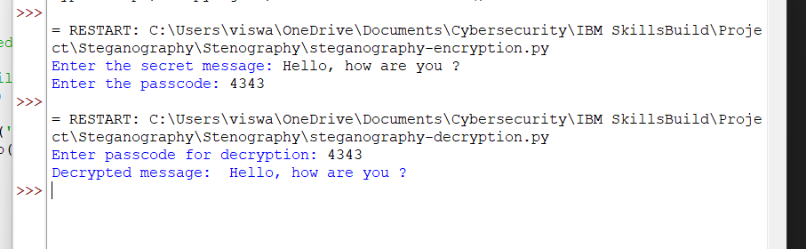

Results

Slide 8
Conclusion
We were successfully able to embed a message within an image and retrieve it back as well. The technique of steganography helped meet the demands of confidentiality and integrity of data.

Slide 9
GitHub Link
https://github.com/ViswajithMenon95/Steganography.git

Slide 10
THANK YOU

