Slide 1
Data Hiding in Image Using Steganography
CAPSTONE PROJECT
Presented By: Viswanadh Mavuri
Student Name : Viswanadh Mavuri
College Name & Department : Gayatri Vidya Parishad College of Engineering & Computer Science and Engineering

Slide 2
OUTLINE
Problem Statement
Technology used
Wow factor
End users
Result
Conclusion
Git-hub Link
Future scope

Slide 3
Problem Statement
Develop a Python program using OpenCV to implement a basic image steganography technique by embedding a secret message into an image's pixel values. The program should securely encode and decode the message while ensuring data integrity and preventing potential indexing errors or data loss.

Slide 4
Technology used
Python – Programming language used for implementation.
OpenCV (cv2) – Used for image processing and manipulation.
OS Module – Executes system commands to open the encrypted image.
Dictionary Data Structure – Maps characters to numerical values for encoding and decoding.

Slide 5
Wow factors
Simple Pixel-Based Steganography – The message is embedded directly into pixel values, making it an easy-to-understand approach.
Custom Character Mapping – Uses a dictionary to encode and decode characters, allowing flexible message storage.
Passcode Protection – Ensures only authorized users can decrypt the hidden message.
Automated Image Display – Opens the modified image immediately after encryption for verification.
Lightweight and Fast – No need for external dependencies beyond OpenCV and Python’s standard library.

Slide 6
End users
Cybersecurity Enthusiasts – Individuals interested in learning steganography techniques.
Students & Researchers – Those studying information security, cryptography, or digital forensics.
Journalists & Activists – People needing to hide sensitive messages in images for secure communication.
Developers & Hobbyists – Anyone experimenting with image processing and data hiding techniques.
Forensic Analysts – Professionals investigating hidden data in digital media

Slide 7
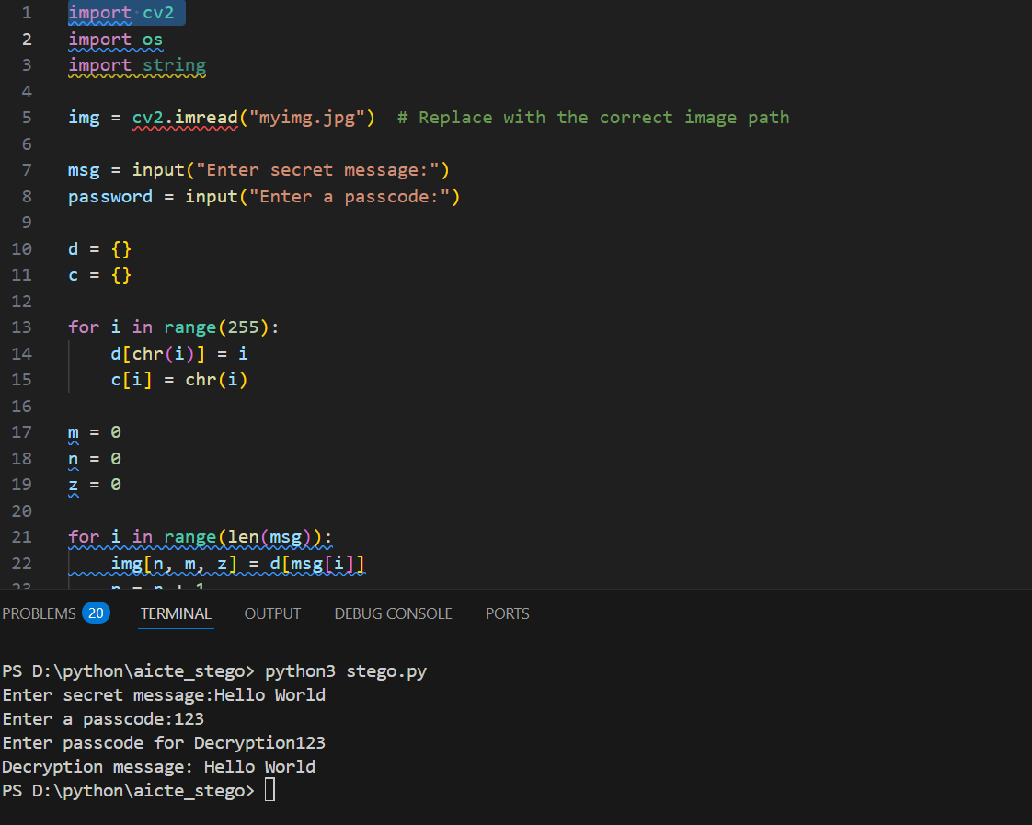
Results

Slide 8
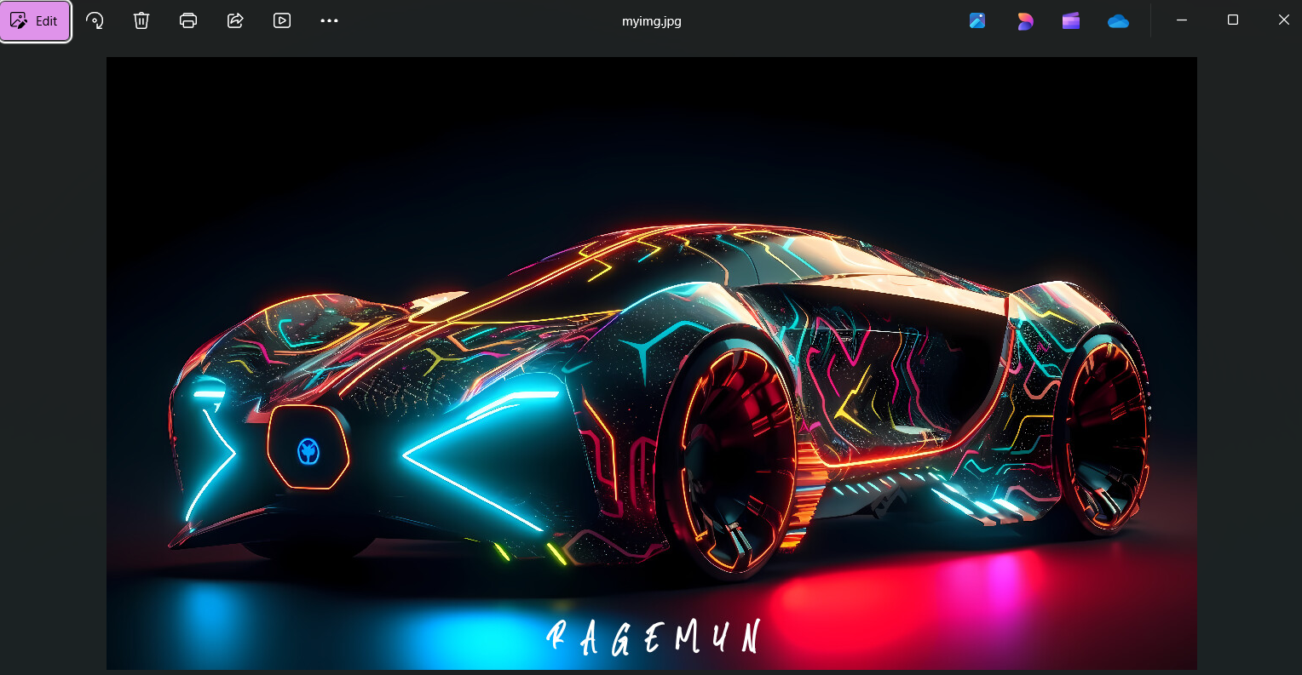
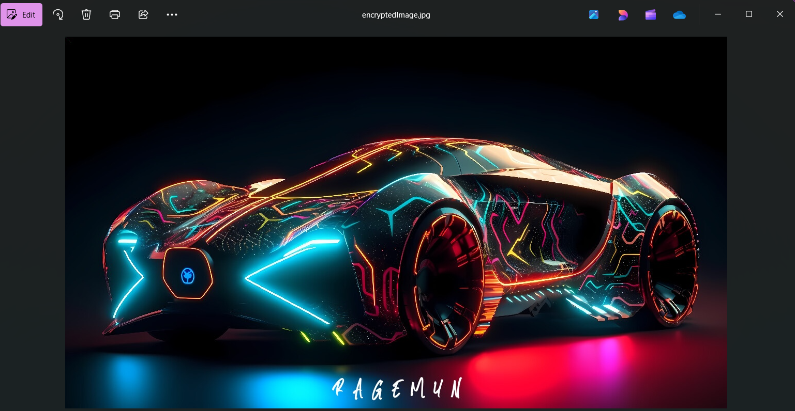
COVER IMAGE
ENCRYPTED IMAGE

Slide 9
Conclusion
This project implements basic image steganography using OpenCV, allowing users to hide and retrieve secret messages from an image. It secures the message with a passcode, making it a simple yet effective approach to covert communication. While functional, enhancements like LSB encoding and stronger encryption can improve security. Overall, it serves as a great learning tool for beginners in cybersecurity and steganography.

Slide 10
GitHub Link
https://github.com/Viswanadh29/Stegono/tree/main

Slide 11
Future scope(optional)
Enhanced Security – Implement advanced encryption techniques to protect the hidden message.
Least Significant Bit (LSB) Encoding – Improve data concealment without visibly altering the image.
Support for Larger Messages – Optimize storage techniques to hide longer messages efficiently.
Multi-Format Support – Extend compatibility to different image formats like PNG and BMP.
Graphical User Interface (GUI) – Develop a user-friendly interface for easier encryption and decryption.

Slide 12
THANK YOU

