Slide 1



Multi-Zone Electric Power Consumption Forecasting using Machine Learning

Slide 2

Learning Objectives
1
Data Preparation and Exploration
2
Time-Series and Pattern Analysis
GOAL
3
Relationship Analysis (Weather vs. Power)
4
Machine Learning Model Evaluation
Source :
www.freepik.com/

Slide 3
Tools and Technology used
Category | Tool/Technology | Key Use Cases
Programming & Environment | Python 3, Kaggle | Core language, execution environment.
Data Handling | pandas, NumPy | Data loading, manipulation, numerical operations, time-series feature creation.
Visualization | matplotlib, seaborn, mpl_toolkits | Creating plots for data exploration.
Machine Learning (Scikit-learn) | train_test_split, StandardScaler, MultiOutputRegressor, LinearRegression, RandomForestRegressor, XGBRegressor, r2_score, mean_absolute_error (and others) | Data scaling, model training (Linear, Tree, Ensemble, KNN), multi-output prediction, and performance evaluation.

Slide 4
Methodology
1.Data Preparation: This included loading the data, creating temporal features from the Datetime column (e.g., Hour, Month, IsWeekend) , checking for duplicates/nulls , and scaling the five weather features using StandardScaler.
2.Exploratory Data Analysis (EDA): Visualization was used to identify trends, including Time-Series Plots of power consumption , analysis of Hourly and Monthly Patterns , and scatter plots/3D plots to examine relationships between weather, time, and power consumption. A Correlation Heatmap quantified variable relationships.
3.Machine Learning Modeling: The data was split into training and testing sets (80/20). Eight different regression models (e.g., Linear, KNN, Random Forest, XGBoost) were tested. Each model used a Multioutput Regressor to predict the power consumption of all three zones simultaneously. Performance was evaluated using the R2Score and Mean Absolute Error (MAE).

Slide 5

Problem Statement:
The Problem Statement is that electricity consumption is highly variable and non-linear. Unforeseen demand spikes or drops can lead to significant operational costs, grid instability, or even brownouts. Accurate forecasting is essential for resource planning. Our primary GOAL was to achieve a highly accurate predictive model for the three zones, capable of forecasting consumption with minimal error. We accomplished this using standard Tools and Technology, specifically Python with core libraries like Pandas for data handling, and the Scikit-learn and XGBoost frameworks for our model development.

Slide 6
Solution:
Develop a machine learning model to predict electric power consumption across three zones.
The process began by establishing the primary objective: building a machine learning model to predict power consumption in three different zones.
Perform thorough cleaning and preprocessing to ensure data quality and consistency.
Apply Feature Engineering to get more detailed features that help model to identify patterns
Perform EDA to identify seasonal patterns and trends
Experiment with various machine learning algorithms to determine the most accurate model for power prediction.
Choose the best and appropriate model to the business problem.

Slide 7
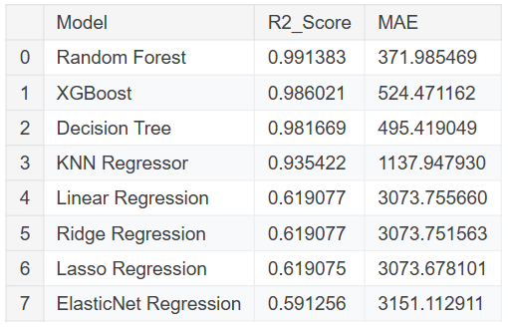
Screenshot of Output:
The image shows performance of various models on test data. Random Forest, XGBoost, Decisoin Tree and KNN Regressor are the top-performing models explaining over 90% variance of testing data.
Random Forest stands out with significantly high R2 Score and low Mean Absolute Error making it more powerful model

Slide 8
Conclusion:
In conclusion, this project successfully delivered a highly accurate, deployable solution for multi-zone electric power consumption forecasting. Our methodology, which effectively integrated engineered temporal features (like Hour and Month) with external weather data, was validated by exceptional model performance.
The Random Forest Regressor was identified as the optimal model, achieving an R2 Score of over 0.99% and the lowest Mean Absolute Error (MAE) of just 371.98, demonstrating its capability to explain nearly all the variance in complex, non-linear consumption data.
This level of high-accuracy prediction is essential. It provides utility providers with a powerful, low-error tool that can be directly applied to optimize energy trading, improve scheduling efficiency, and enhance overall grid stability.

