Slide 1
Loan Default Risk Analysis
Exploratory Data Analysis & Insights

Slide 2
Problem Statement
The goal is to analyze borrower and loan data to identify key risk factors that contribute to loan defaults. These insights will help financial institutions make data-driven decisions, optimize lending strategies, and minimize losses.

Slide 3
Data Cleaning & Preparation
- Removed columns with excessive null values
- Dropped irrelevant or redundant fields
- Handled missing values systematically
- Ensured dataset quality for meaningful EDA

Slide 4
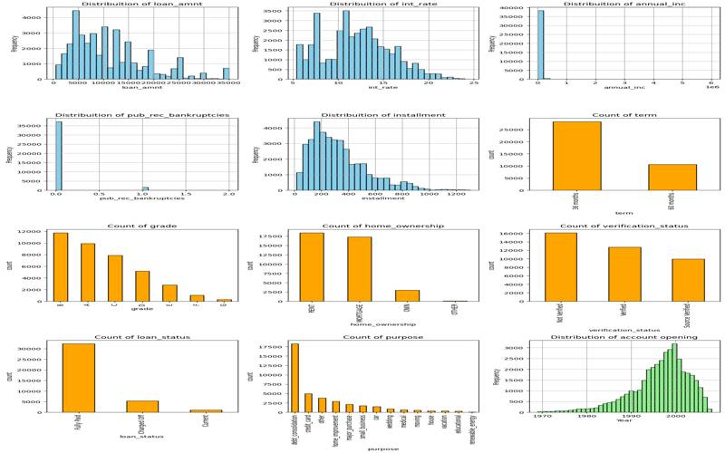
Exploratory Analysis: Loan Defaults
Findings: - Most defaults occur in specific loan grades (C, D, E). - Safer borrowers concentrated in A/B grades.

Slide 5
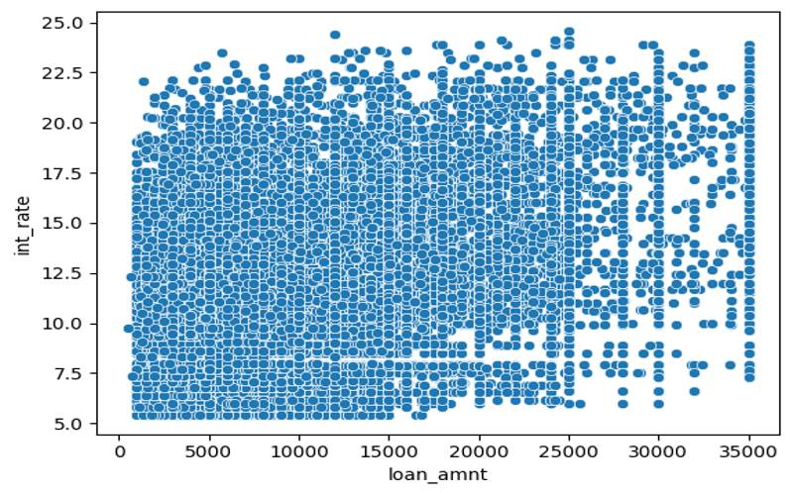
Exploratory Analysis: Loan Defaults
Findings: - Higher interest rates strongly correlate with higher default rates.

Slide 6
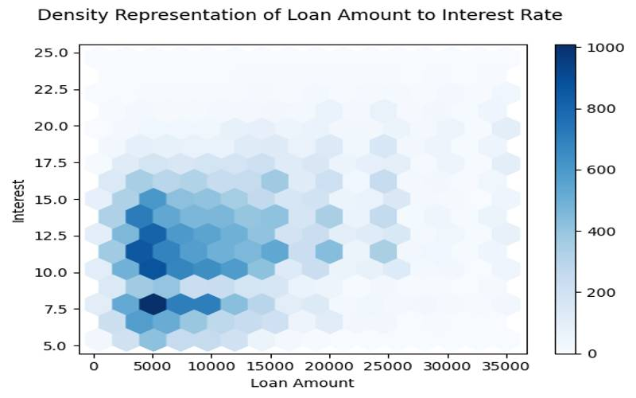
Exploratory Analysis: Loan Defaults
Findings: - Borrowers with lower annual income are more likely to default.

Slide 7
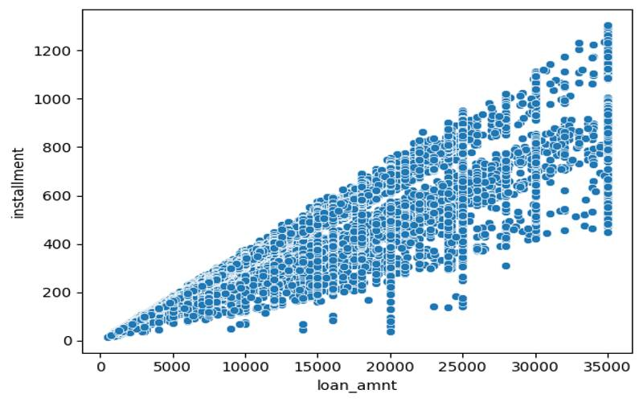
Exploratory Analysis: Loan Defaults
Findings: - Self-employed and short employment history borrowers show more defaults.

Slide 8
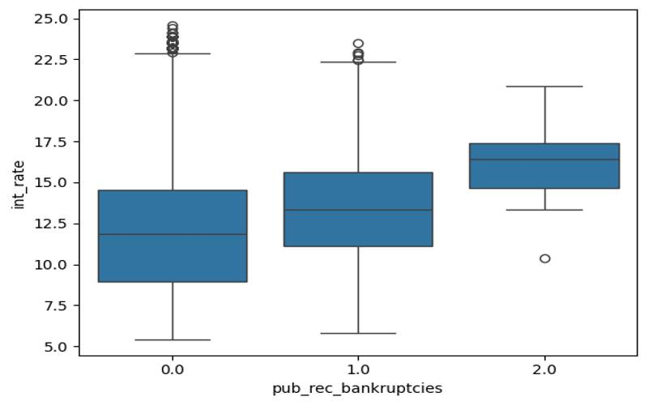
Exploratory Analysis: Loan Defaults
Findings: - Small business and credit card loans show higher risk than debt consolidation/home improvement.

Slide 9
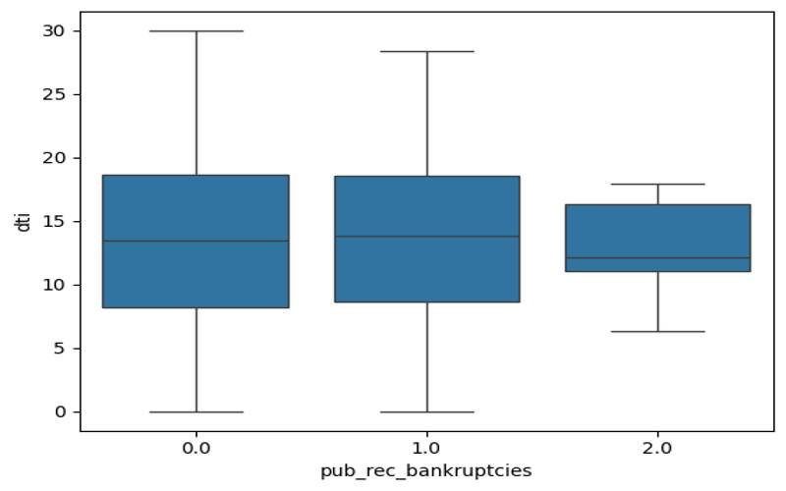
Exploratory Analysis: Loan Defaults
Findings: - Larger loan amounts increase probability of default.

Slide 10
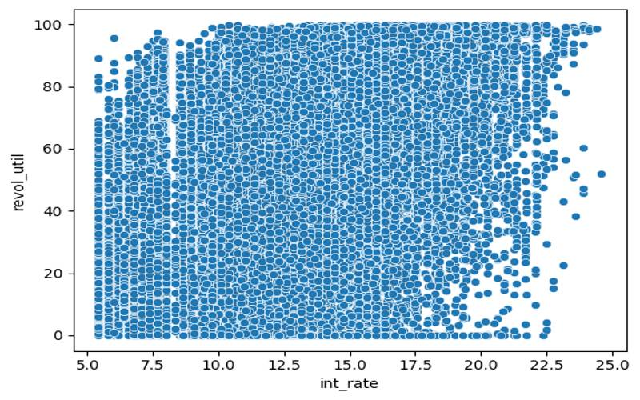
Exploratory Analysis: Loan Defaults
Findings: - Home ownership (Mortgage/Rent) borrowers default more than 'Own'.

Slide 11

Exploratory Analysis: Loan Defaults
Findings: - Certain states show higher proportions of defaults than others.

Slide 12
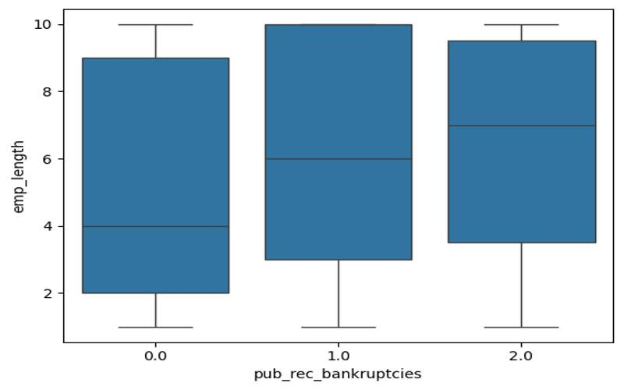
Exploratory Analysis: Loan Defaults
Findings: - Longer loan terms (60 months) have higher default rates than 36 months.

Slide 13
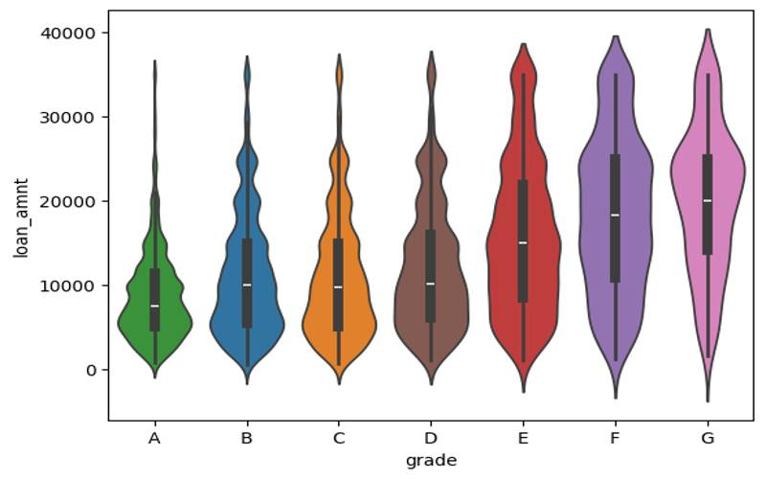
Exploratory Analysis: Loan Defaults
Findings: - Debt-to-Income ratio is higher among defaulters compared to fully paid borrowers.

Slide 14
Business Implications
- Use loan grade, interest rate, and purpose as primary risk filters.
- Tighten approval for high-risk groups: low income, short employment, small business loans.
- Offer lower amounts or stricter conditions for high-risk borrowers.
- Monitor regional patterns and adjust strategies accordingly.

Slide 15
Final Conclusion
This analysis reveals that borrower demographics, loan amount, interest rate, loan grade, and loan purpose are major factors driving defaults. Defaults are more common among lower-income borrowers, high-interest loans, longer terms, and small business purposes.
Financial institutions can leverage these insights to:
- Minimize risks through better screening.
- Improve profitability by focusing on low-risk borrowers.
- Enhance credit policies to balance growth with stability.
By combining data-driven insights with lending strategy, institutions can significantly reduce default rates while optimizing credit distribution.

