Slide 1
QR CODE BASED DESCRIPTION OF EXHIBITS IN MUSEUM -Viswanathan Krishnan

Slide 2
AGENDA
Introduction
Existing System
Drawbacks
Proposed Solution
Advantages
Literature survey
Requirements
Workflow
Conclusion

Slide 3
INTRODUCTION
In today's dynamic digital landscape, museums are increasingly embracing technology to enrich visitor experiences and stay relevant in a rapidly evolving world. Traditional methods of interpretation, such as static placards or audio guides, are being complemented, and sometimes replaced, by innovative digital solutions that offer interactive, personalized, and immersive encounters with cultural artifacts.
Our QR code-based guide represents a significant advancement in the realm of museum interpretation and visitor engagement. By seamlessly integrating technology into the museum experience, we aim to foster deeper connections between audiences and cultural heritage.
This ensure that museums remain vibrant and upcoming generations too learn about the culture and heritage in the museum.

Slide 4
EXISTING SYSTEM
Currently, museums use static placards or signage that are positioned next to each exhibit and contain written descriptions of the object or piece of art.
Visitors who wish to view the exhibit while listening to narrated descriptions or historical context may also be able to utilize audio guides.
Additionally, some museums provide in-depth explanations and exhibit interpretations during guided tours that are led by docents or museum employees.

Slide 5

Drawbacks
The drawbacks of the existing solution for describing exhibits in museums include static placards offering limited information, lack of interactivity, and accessibility barriers for visitors with disabilities.
Additionally, traditional audio guides may be cumbersome to use and require additional equipment, limiting accessibility and engagement for some visitors.
Also, the description given in placards are static, i.e.. They are not updated if there are any changes in the description of the exhibit.
DRAWBACKS

Slide 6
PROPOSED SOLUTION
1
QR code scanning
2
Providing description
3
Description Translation
4
Accessibility features
The proposed solution for describing exhibits using QR codes offers a more interactive and engaging experience for museum visitors. Each exhibit would be equipped with a QR code that visitors can scan using their smartphones or tablets.
Upon scanning the QR code, visitors are directed to a webpage where they can access detailed information, multimedia content, and interactive experiences related to the exhibit.

Slide 7
ADVANTAGES
The proposed QR code-based museum guide system offers enhanced interactivity, rich content delivery, and personalized experiences. Visitors can easily access multimedia content, interactive elements, and personalized recommendations by scanning QR codes, promoting deeper engagement and understanding of exhibits.
Additionally, the system prioritizes accessibility, providing features such as text-to-speech and adjustable font sizes for visitors with disabilities.
With minimal hardware requirements and intuitive usage, the system offers a cost-effective and user-friendly solution for museums to deliver dynamic content which can be updated over the timeline.

Slide 8
Literature survey
Paper Title | Author | Inference
QR Code Generator : A Security Perspective | Deepak Kumar Verma, Jitendra K Srivastava, Utkarsh Gupta, Divyansh Srivastava | This paper outlines a method to create QR codes using a web interface, integrating a Drupal module with the libqrencode library.
QR Code Generator using Python | Rohit Sahay, Mayur Waghela, Abhishek Mulgaonkar, Vansh Tiwari | The paper discusses the widespread use of QR codes in modern society, offering a method for creating them via a web interface using Drupal and libqrencode.

Slide 9
Literature survey
Paper Title | Author | Inference
Effective use of QR Code technology for library and information services | Sunil Kunaragi, Suryakanth. Halburgi, U.A. Kaladagi | This paper discusses the transformative role of QR codes in libraries, highlighting their convenience in accessing resources and enhancing user experience.
Smart Museum and Visitor Satisfaction | Siyang Liu, Jian Guo | The paper discusses smart museums, blending physical spaces with technology to enhance visitor experiences, evaluate museum intelligence, and suggest future research directions.

Slide 10
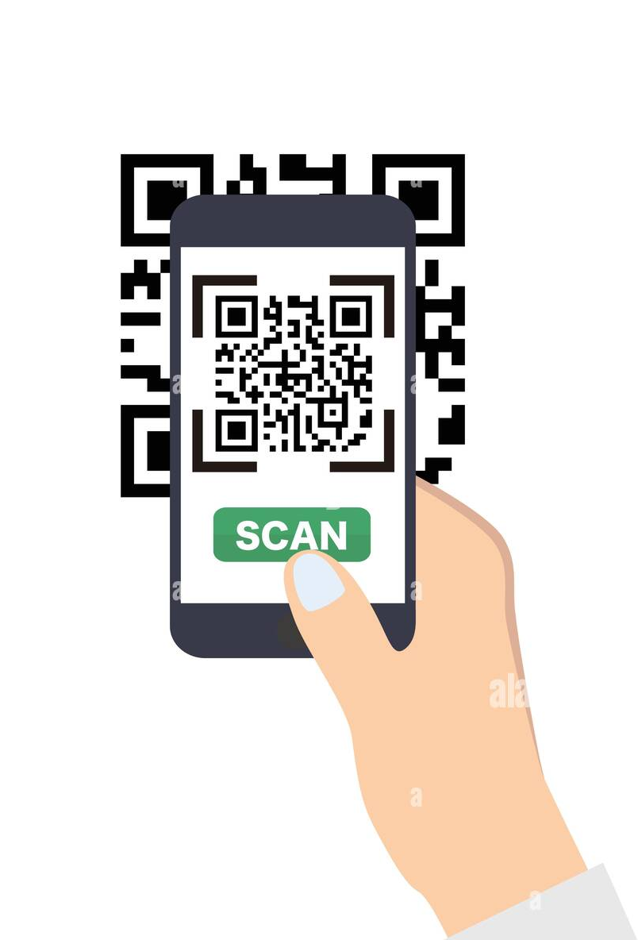
REQUIREMENTS
Hardware Requirements :
Smartphone/Tablet
Internet connectivity
Audio Output Devices
QR Code labels
Software Requirements :
QR code generation and decoding with Python.
API keys

Slide 11
PACKAGES USED
QRCode
Qreader
Flask
PIL
Pandas
JSON
googletrans

Slide 12
WORKFLOW
The QR code is initially captured by the website and the image is sent to the backend using Flask server which decodes the QR code and returns the data of the exhibit.
Using this, the description of the exhibit is retrieved and translated to the desired language provided by the user. The audio file is also played upon user request.

Slide 13
OUTCOMES OF THE PROJECT
The outcome of the QR code-based museum guide project is a sophisticated and user-friendly system that enhances visitor experiences within museum spaces.
Through the seamless integration of QR code technology, visitors can access dynamic and interactive content, including multimedia resources, personalized recommendations, and immersive experiences related to museum exhibits.
The project promotes deeper engagement, understanding, and appreciation of cultural heritage and artistic endeavors while prioritizing accessibility for all visitors.

Slide 14
FUTURE INITIATIVES
Integrating AR features to overlay digital content such as 3D models, animations etc..
Enhanced personalization for providing tailored experiences for each visitor.
Feedback system for customer feedback which enhances both customer experience and museum standards.

Slide 15
CONCLUSION
In conclusion, the QR code-based museum guide project presents a transformative solution for enhancing visitor engagement and accessibility within museum spaces. By leveraging QR code technology, the project offers dynamic and interactive experiences, enriching visitors' understanding and appreciation of exhibits.
With a focus on personalization and inclusivity, the system ensures that all visitors, regardless of abilities or preferences, can enjoy immersive and informative museum journeys. The project represents a significant step forward in leveraging technology to promote cultural education and heritage preservation, while also providing museums with a versatile platform for content delivery and visitor interaction.

Slide 16
THANK YOU

