Slide 1
Data Analysis and Insights for different page Optimization

Slide 2
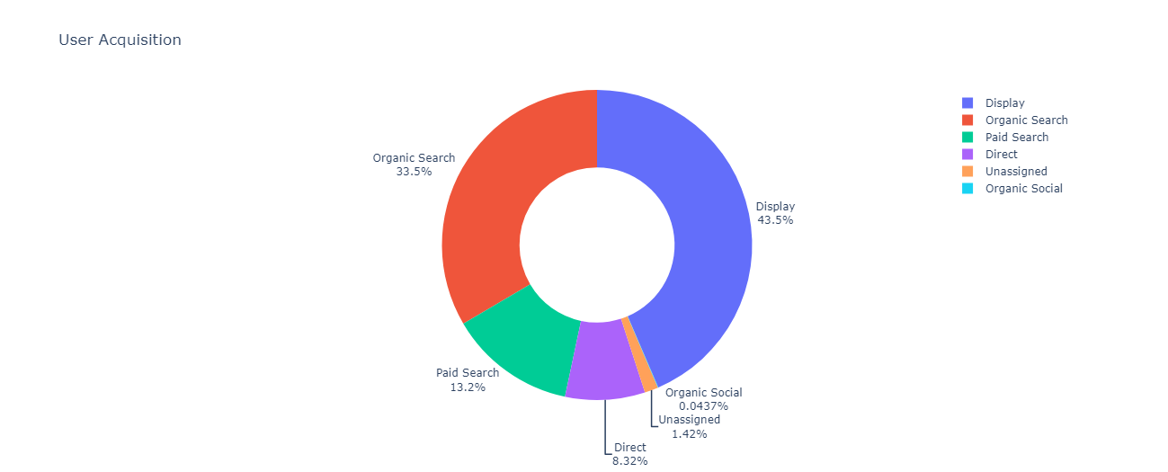
User Acquisition Insights
Display has been the most successful channel for acquiring new users

Slide 3
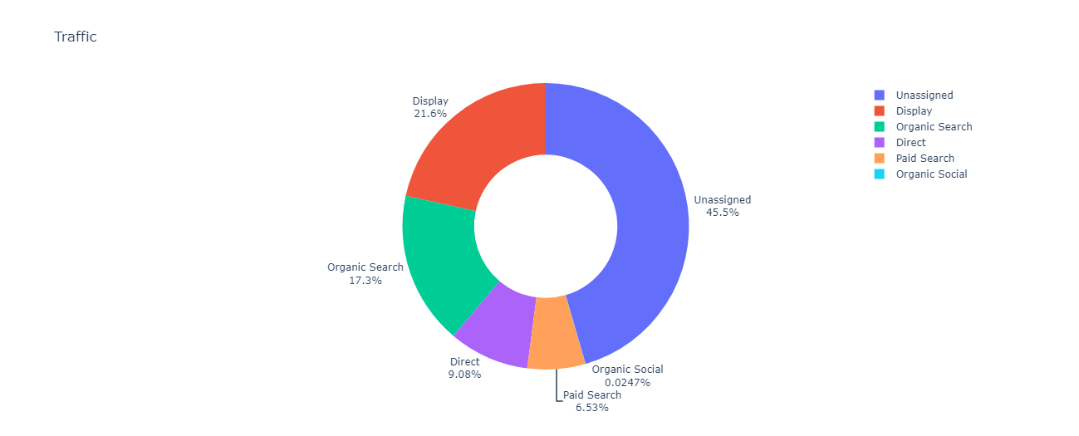
Traffic Insights
Unassigned has been the most successful channel for acquiring new users

Slide 4
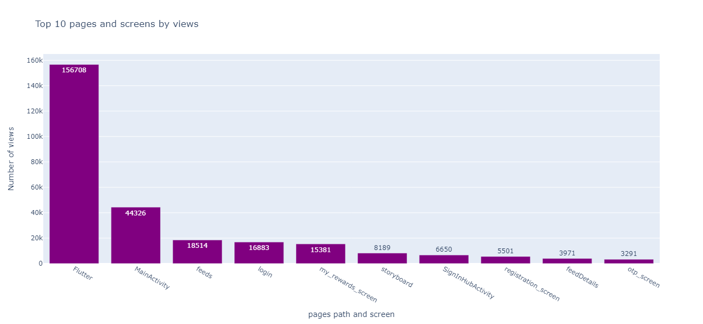
Top 10 Pages path & Screen
Flutter is the highest at 1,56,708.

Slide 5
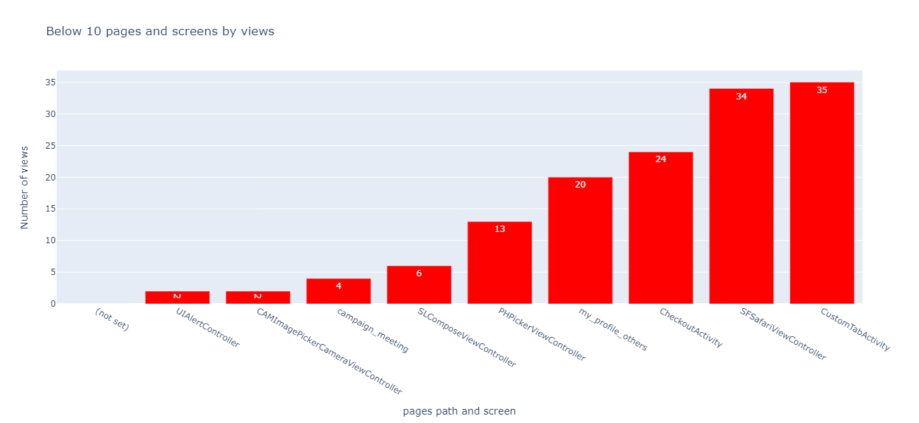
Below 10 Pages and Screen Views
Below 10 pages and screens by views. that should be controlled or Optimized

Slide 6
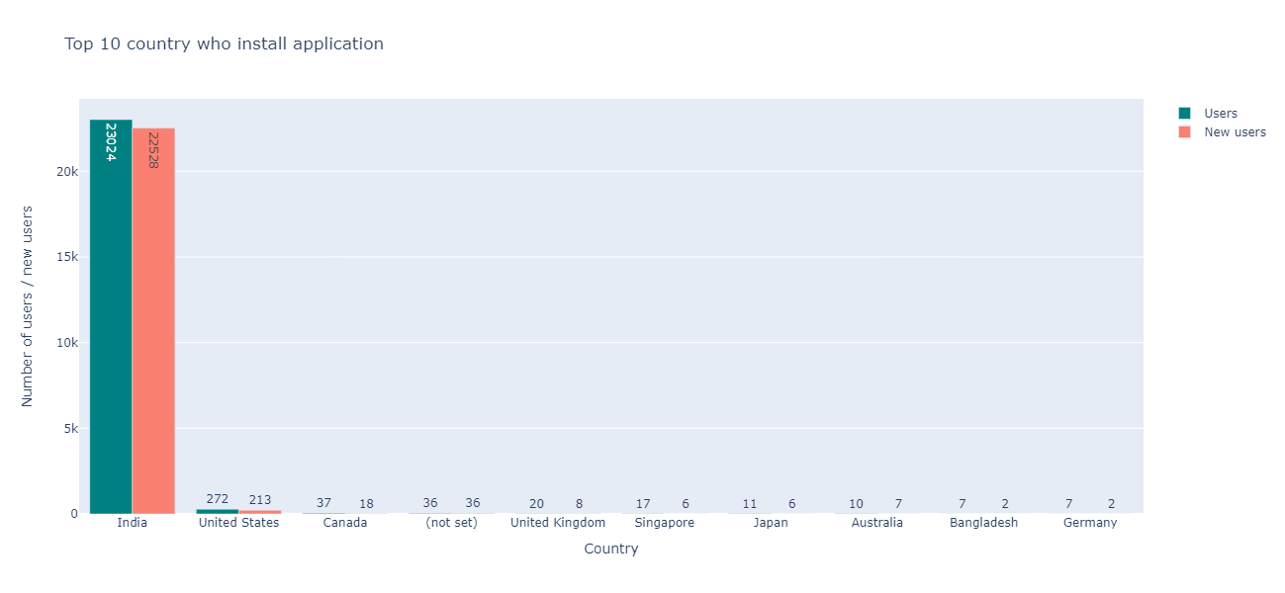
Top 10 Country installed application
india is the Top country that has the highest number of users and new users, 23024 and 22528

Slide 7
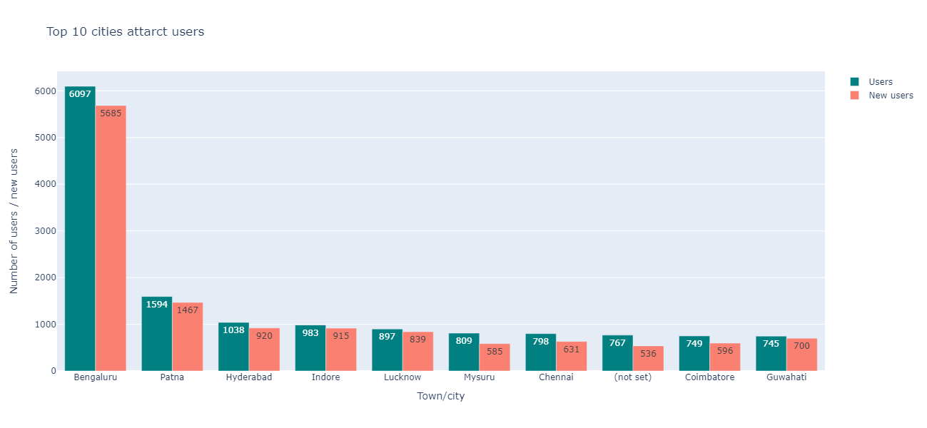
Top 10 Cities
Bengaluru is the Top city that has the highest number of users and new

Slide 8
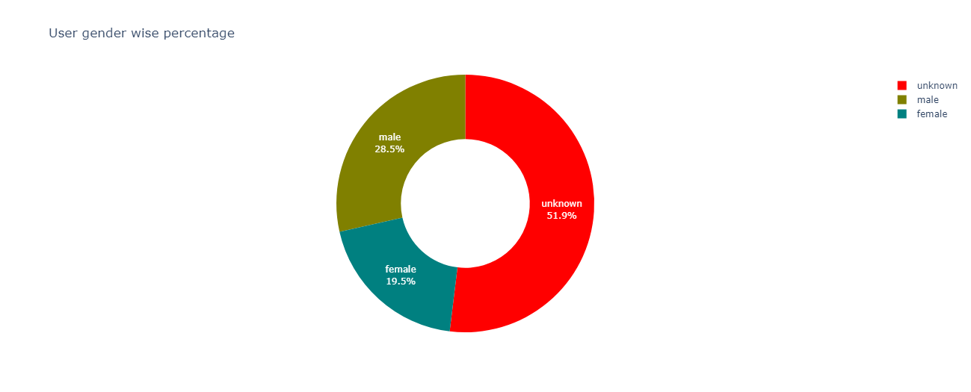
Gender Report

Slide 9
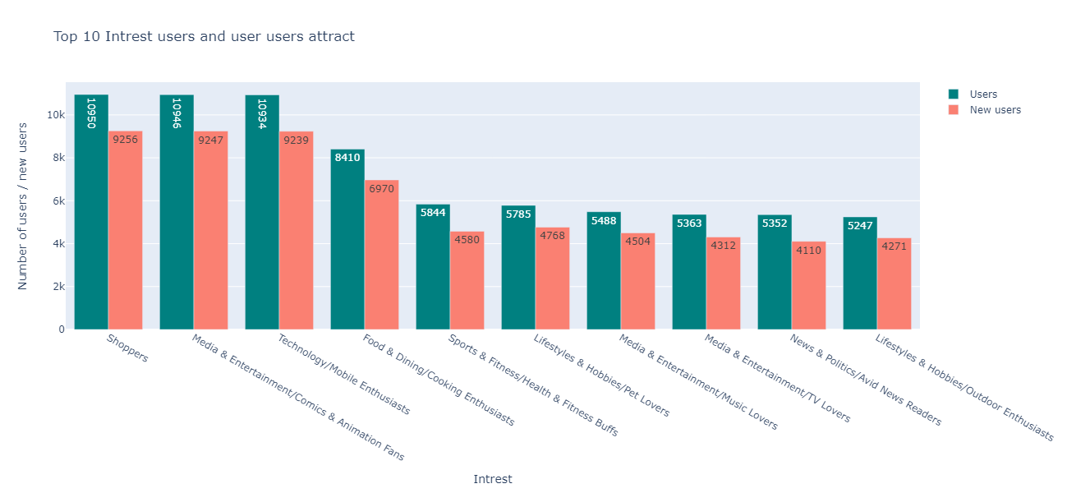
Top 10 Interest Users
Shoppers is attracting more interest in users and new users

Slide 10
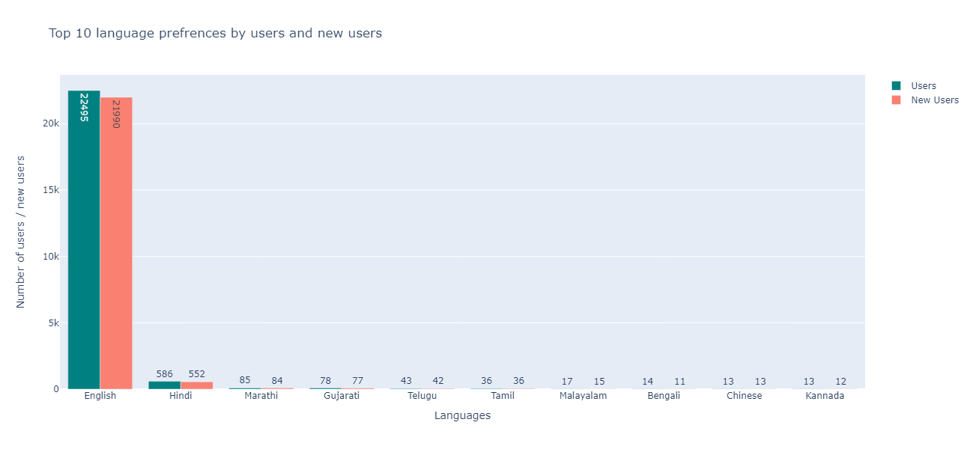
Top 10 Language
English is the popular language for the user and new users. so we have to put our application's default language

Slide 11
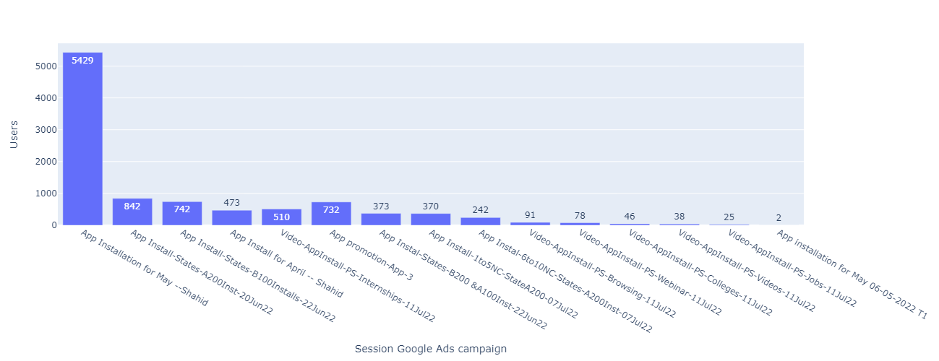
Session Google Ads
We can improve or keep maintain the area of user's interest

Slide 12
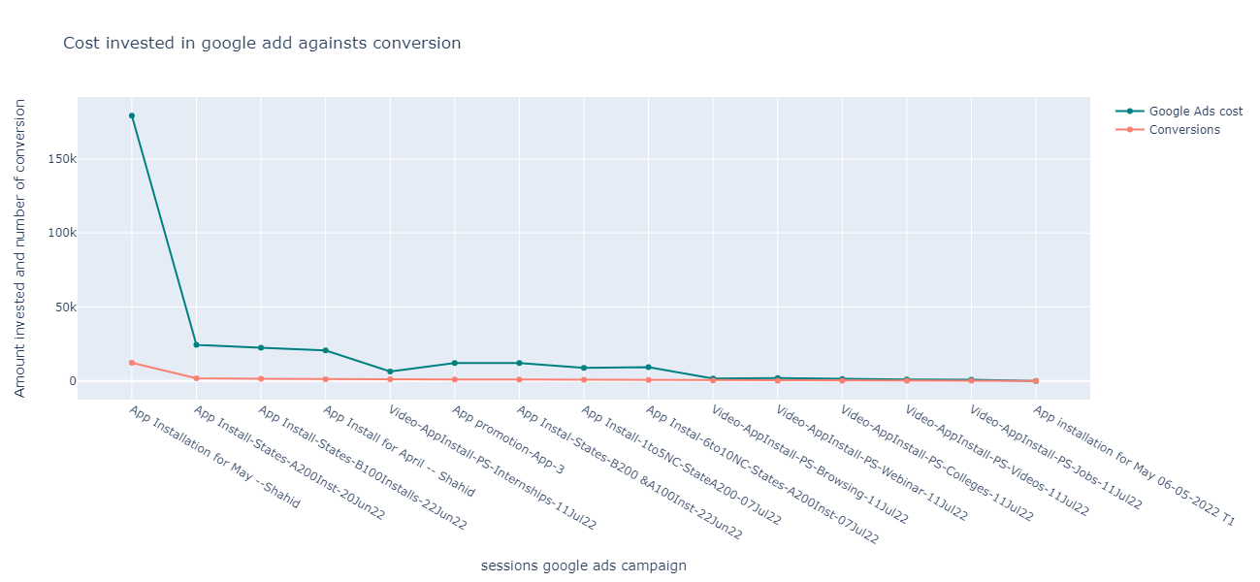
Cost Invested
Conversion report

Slide 13
Recommendation
Traffic Report
Strengthen brand recognition to boost direct traffic. Optimize paid search campaigns and prioritize social media engagement to tap into their full potential. Regularly monitor traffic sources and adapt strategies to achieve sustainable growth and success.
Gender Report
User Gender percentage-wise report. already discuss the unidentified category by "Unknown" have to be clear

Slide 14
Recommendation
Language
English is the popular language for the user and new users. so we have to put our application's default language English.
Top 10 interests of users
We can improve or keep maintain the area of user's interest. Most of the users and new users are using the app for shopping, media & entertainment comic and animation fans, and technology

