Slide 1
Modelling and Forecasting the Interest rate Changes
By Viswanath Durairaj

Slide 2
Project overview
The objective of this project is to predict the changes of quarterly interest rate of credit card lending to households using quarterly data of macro-economic variables like Inflation, gross domestic product, average weekly income, credit card lending and unemployment.

Slide 3
Literature review
From literature review, we found out Interest rate is fixed by the Bank of England. We came to know how the inflation, GDP, unemployment and other macro economic variable influence the interest rate. If inflation gets raised, then Bank of England will raise the interest rate to balance the economy.

Slide 4
Data collection
After consideration of several research papers and banking repositories. We have considered the Interest rate for credit card lending to households to individuals (in sterling Millions) from Bank of England database duals (in sterling Millions), period of 2000 quarter 1 to 2021 quarter 4. Our primary source are macro economic variables data from Bank of England and ons.gov.uk.
Macro economic variables
GDP
Unemployment
Inflation
Interest rate
Income
https://www.bankofengland.co.uk/boeapps/database/
https://www.ons.gov.uk/

Slide 5
Data Pre-Processing
Data Cleaning Data integration Data Transformation Data Reduction

Slide 6
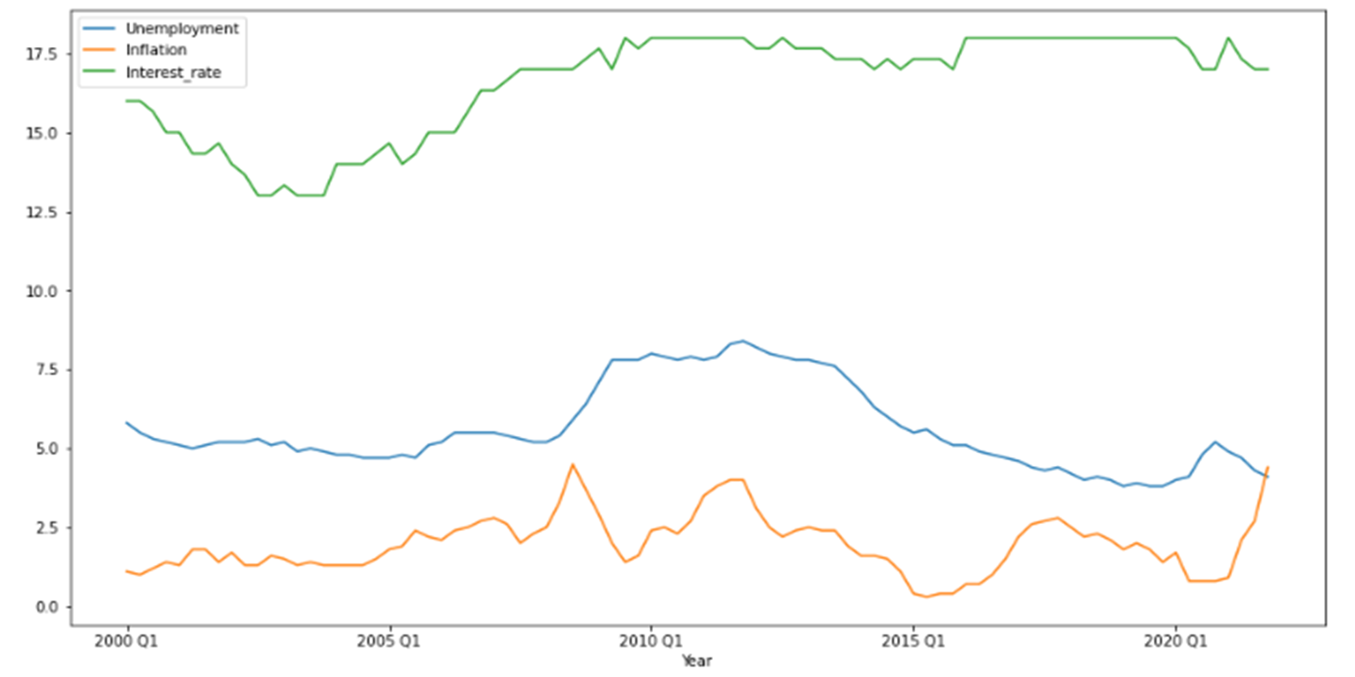
Time series of data

Slide 7
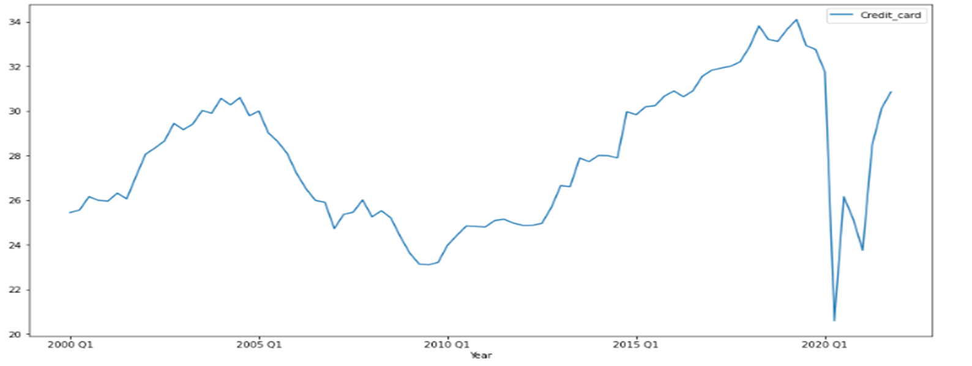
Time series of data for credit card

Slide 8
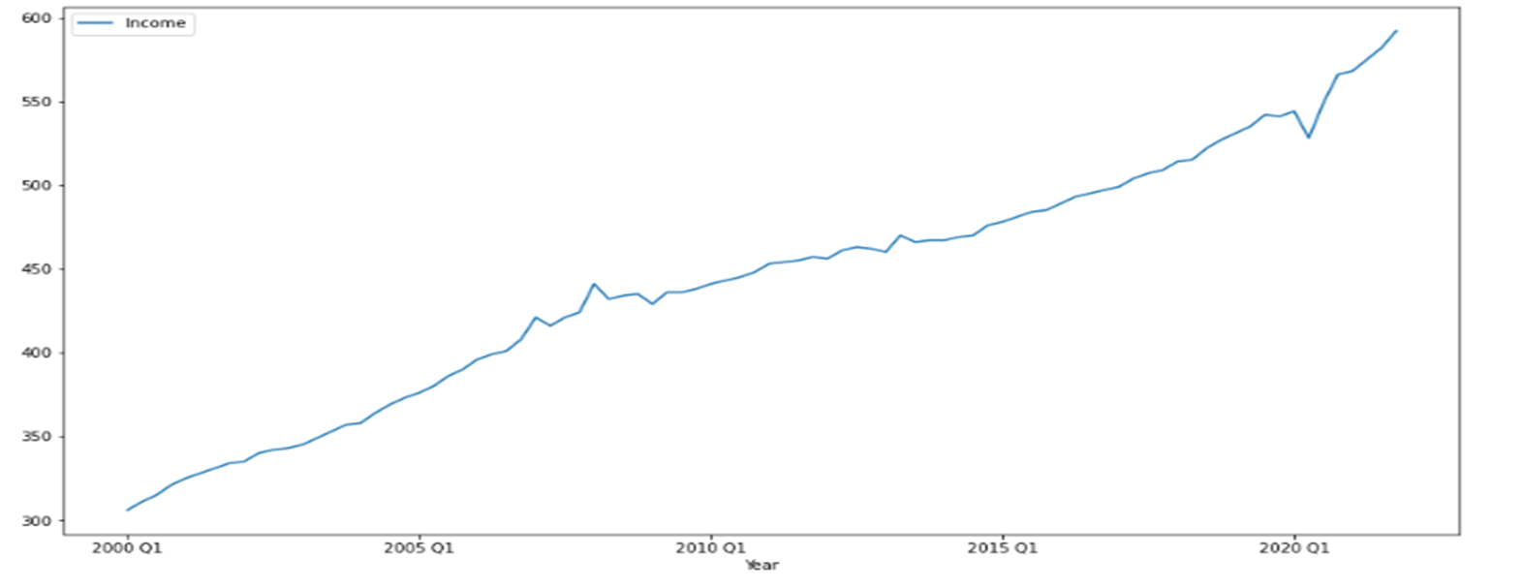
Time series of data for income

Slide 9
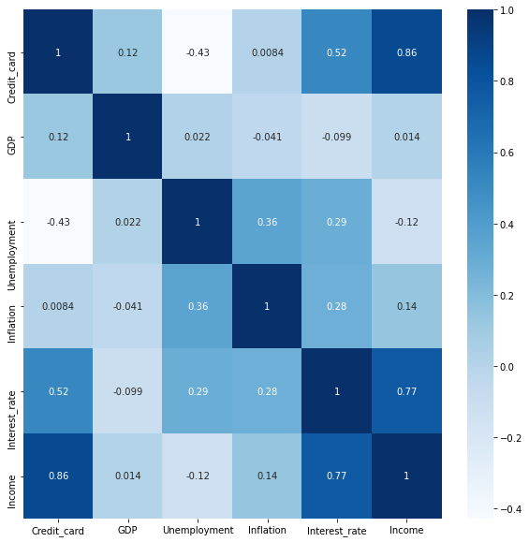
Data and Correlation Matrix
Considered the quarterly values for our data
plotted as the heat map.

Slide 10
Creation of Relation Database System
We are using AWS RDS (Relational data schema) from Amazon to create an instance, so that we can access data from any system using instance Id and details. We Use MySQL as our database server and AWS instance as schema to make remote connection possible and use although server-side system is shutdown.

Slide 11
Modelling Of Data
PRINCIPAL COMPONENT ANALYSIS Performed PCA on the macro economic variables Reduce Dimensionality of Data Total Variance: 97.49%

Slide 12
Modelling Of Data
MULTIPLE LINEAR REGRESSION Multi Linear Regression was applied for interest rate for credit card lending and output from PCA Analysis. Dependent Variable: Interest rate Independent Variable: Output from PCA R squared value: 75%,RMSE value was found to be 0.66 Train data: 70%, Test data: 30%

Slide 13
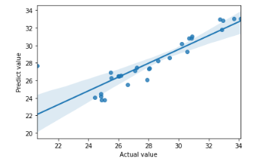
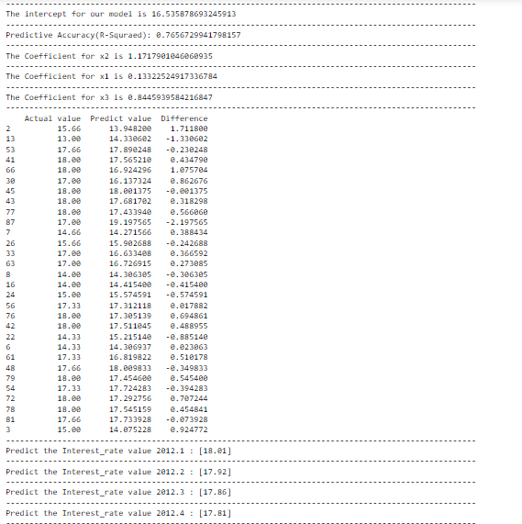
BACK TESTING-Prediction for the year 2012:

Slide 14
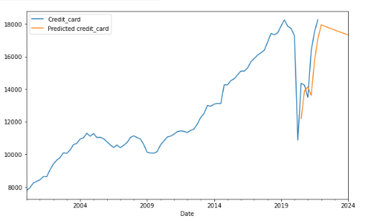
Forecasting using ARIMA – Credit Card

Slide 15
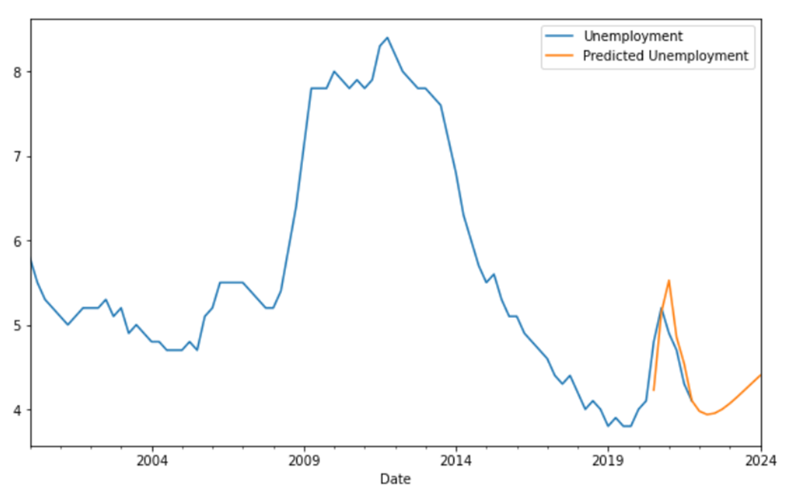
Forecasting using ARIMA - Unemployment

Slide 16
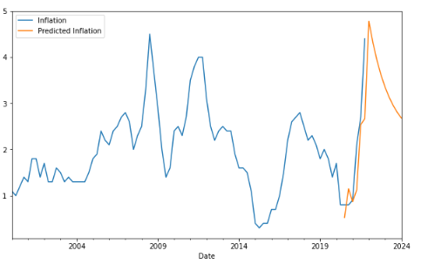
Forecasting using ARIMA - Inflation

Slide 17
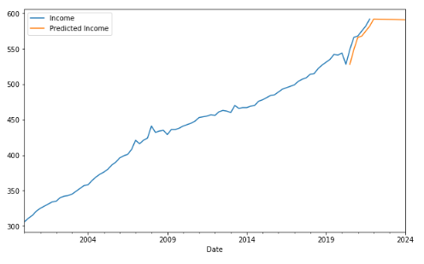
Forecasting using ARIMA - Income

Slide 18
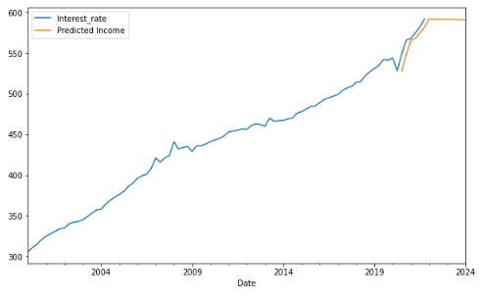
Forecasting using ARIMA - Interest Rate

Slide 19
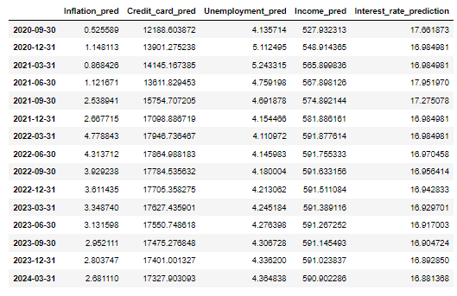
Forecasted Values using ARIMA

Slide 20
PCA Analysis on Predicted data
MULTIPLE LINEAR REGRESSION Performed PCA on the forecasted data. Reduce Dimensionality of Data and then applied in applied in the MLR. Total Variance: 96.43%.

Slide 21
Multi linear Regression Model on predicted data
Multi Linear Regression was applied for forecasted Interest rate for credit card lending and output from PCA Analysis from ARIMA model. R squared value was found to be 78%. RMSE value was found to be 0.68 The model performed well against the predicted data.

Slide 22
CONCLUSION
MLR and ARIMA are best fit to predict an interest rate. I prove that interest rate can be predicted with pretty good accuracy.

