Slide 1
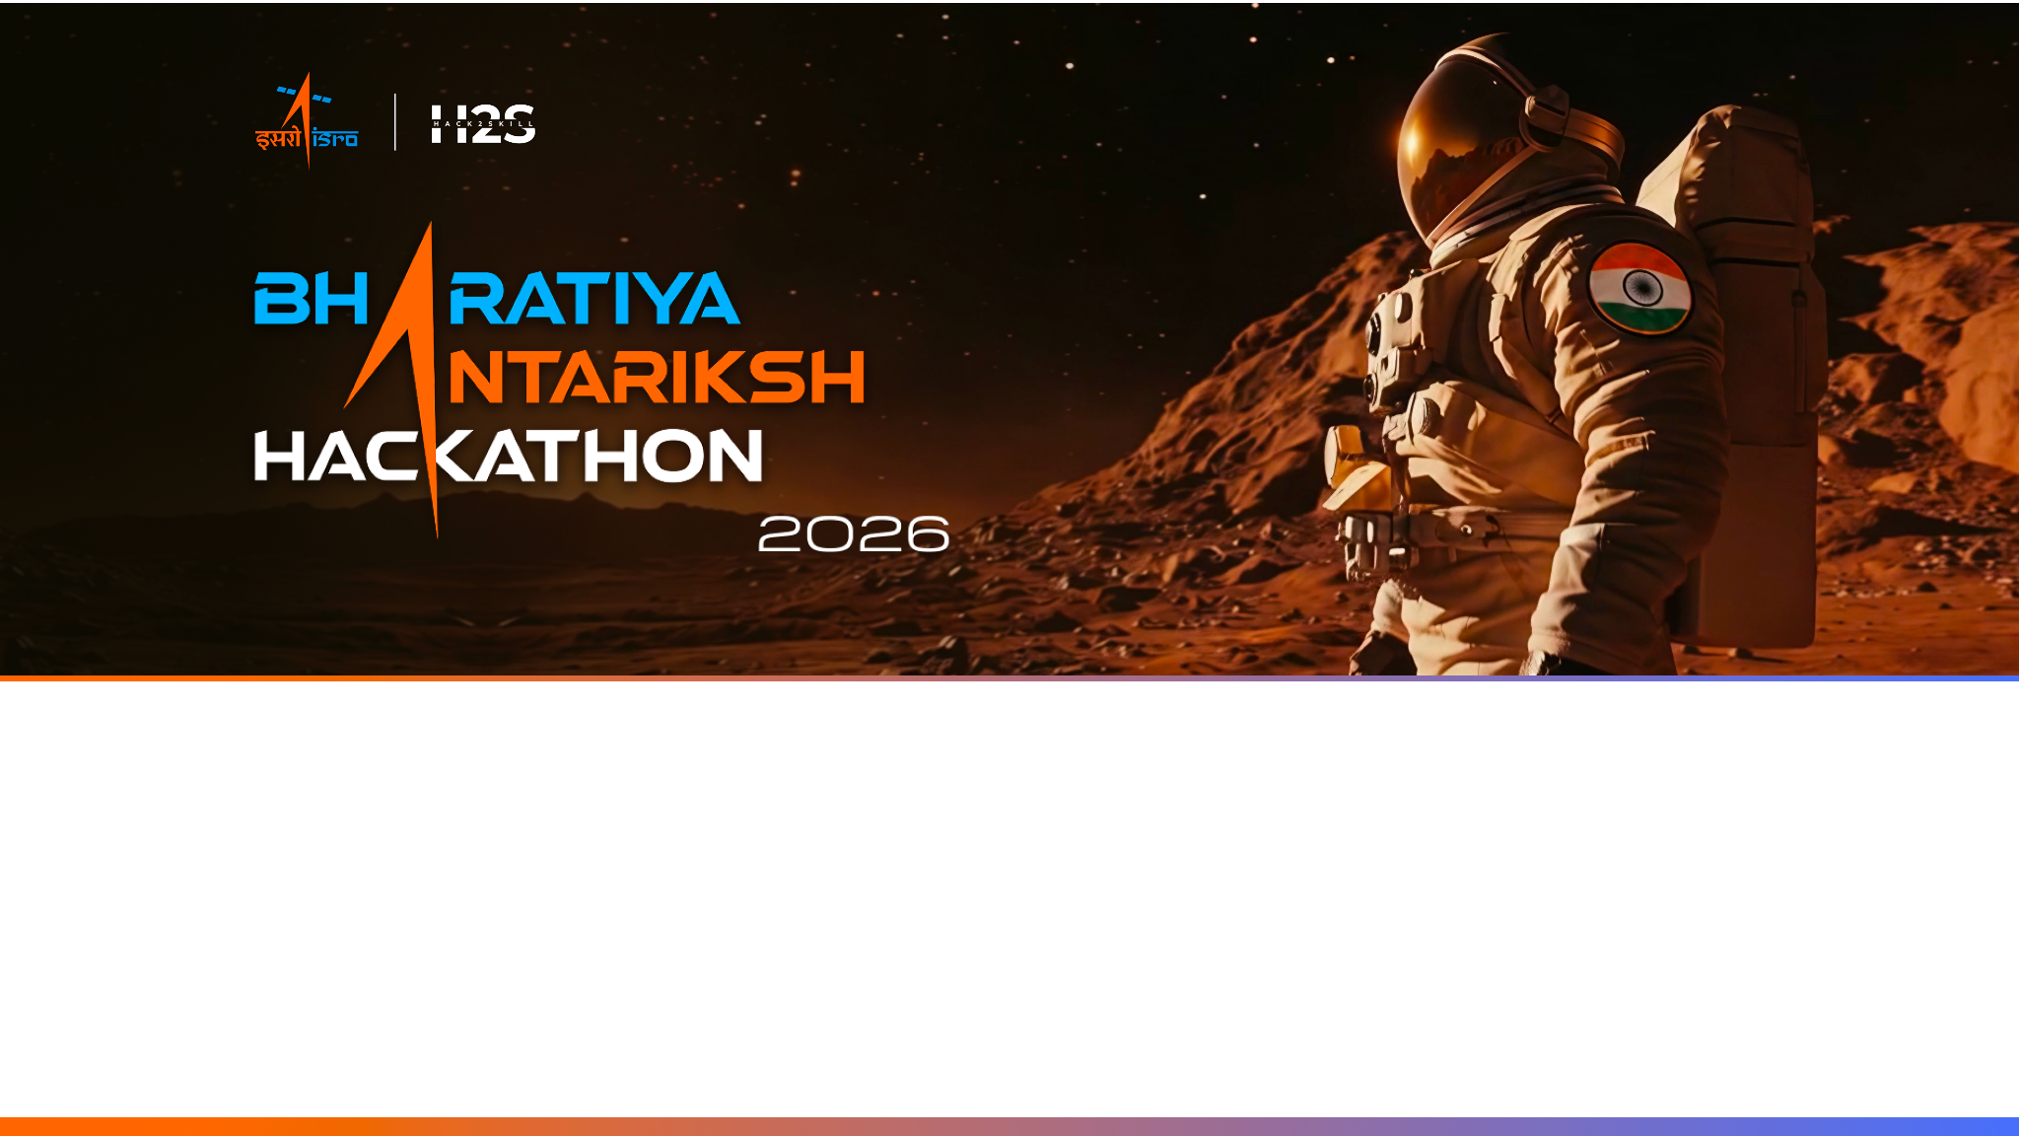
Team Name : Escape the Matrix
Team Leader Name : Viswas R Bhat
Problem Statement : PS-4 · Route Resilience — Occlusion-Robust Road Extraction & Graph-Theoretic Criticality Analysis

Slide 2

Team Members
Team Member -1 Name: Viswas R Bhat College: BMS College of Engineering Team Member-2 Name: Mayank Kumar Singh College: BMS College of Engineering Team Member -3 Name: Dibyansh Raj College: BMS College of Engineering

Slide 3
Opportunity & Unique Selling Proposition
The gap: Satellite road extraction suffers “spectral blindness” — tree canopy, building shadows and clouds break the mask, leaving it topologically disconnected and useless for routing, traffic or disaster response.
How we are different
Broken mask → Healed routable network
Occlusion-robust extraction
Multi-scale inference + canopy-aware hysteresis grow faint roads from confident seeds — recovering streets missed at native scale and segments deep under tree cover.
Evidence-based topological healing
Union-Find bridges gaps — endpoint-pairs AND mid-edge T-junctions — only where evidence agrees the road continues: the model's sub-threshold confidence, an Excess-Green canopy mask and trajectory alignment
Predictive resilience: failure & flood
Weighted-betweenness ablation, DEM flood-submersion and demand-weighted criticality quantify systemic collapse.
Validated against OSM ground truth
A topological-accuracy benchmark scores the graph vs OpenStreetMap: recall, path-length error and routing match.
Standard extraction
Route Resilience

Slide 4
Key Features
Occlusion-robust segmentation
U-Net/ResNet34 + multi-scale inference & canopy-aware hysteresis recover roads under canopy, shadow, and below the 1x receptive field.
Topological reconstruction
Skeletonize → graph → Union-Find healing yields a routable weighted vector network.
1
2
Evidence-based gap healing
Endpoint + mid-edge T-junction bridges gated by model soft-confidence, Excess-Green canopy & trajectory — each tagged high/med/low.
Gatekeeper-node detection
Weighted betweenness (k-sampled at scale) maps critical intersections & weakest links.
3
4
Flood & failure stress-test
DEM-driven flood submersion + node ablation drive a live Resilience Index.
Demand-weighted criticality
Betweenness × local road-density surfaces nodes whose failure strands real travel.
5
6
OSM validation benchmark
Graph scored vs OpenStreetMap: recall, path-length error & routing match.
Live interactive dashboard
Custom Leaflet + Three.js (WebGL) UI — search any place for live GPU analysis.
7
8

Slide 5
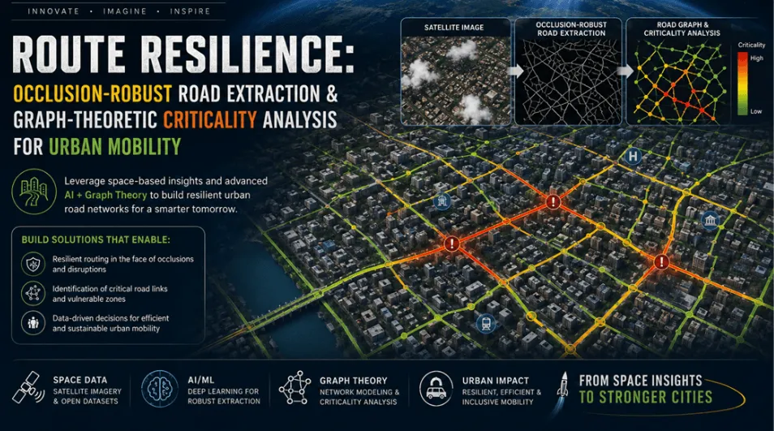
Process Flow
Imagery → extraction → skeleton/graph → canopy-aware healing → resilience → OSM validation → dashboard

Slide 6
Live Dashboard
Premium dark UI · Leaflet + Three.js (WebGL) · live GPU backend · search any place
◉ ROUTE RESILIENCE
ISRO BAH 2026 · PS-4
RESILIENCE INDEX
ROAD NODES
CONNECTIVITY
OSM RECALL
0.78
187
90%
65%
HSR Layout · stable
healed graph
LCC post-healing
vs ground truth
CRITICALITY MAP · HSR Layout, Bengaluru
GATEKEEPER NODES
#1 N-78
0.390
#2 N-73
0.312
✕
#3 N-74
0.284
#4 N-69
0.267
#5 N-76
0.265

Slide 7
Solution Architecture
INPUTS DeepGlobe (training) · Esri World Imagery ~0.6 m (live) · AWS DEM · OpenStreetMap (validation) · NIR-ready for LISS-IV / Cartosat-3
P1 Segmentation
P2 Skeleton → Graph
P3 Canopy Healing
P4 Resilience
P5 Live Dashboard
U-Net + ResNet34 (SMP)
Canopy-aware hysteresis
D4 TTA · occlusion aug
Zhang-Suen thinning
sknw graph + spur prune
length-weighted edges
Union-Find + Excess-Green
Trajectory alignment
Confidence-tiered bridges
Betweenness (k-sampled)
Flood-DEM + ablation
Demand-weighted crit.
Leaflet + Three.js (WebGL)
ECharts · /api/analyze
stdlib Python server
▸ road mask
▸ raw graph
▸ routable graph
▸ criticality + RI
▸ live planner UI

Slide 8
Technology Stack
Data & Imagery
NumPy
OpenCV
Pillow
Albumentations
Web-Mercator tiling
Segmentation (DL)
PyTorch
SMP · U-Net/ResNet34
D4 TTA
Mixed-Precision (AMP)
Dice+BCE+Connectivity loss
Skeleton & Graph
scikit-image · Zhang-Suen
sknw
NetworkX
SciPy cKDTree
Resilience & Analysis
Betweenness (k-sampled)
Union-Find healing
Flood-DEM ablation
Demand weighting
Dashboard & Backend
Vanilla JS
Leaflet.js
Three.js (WebGL)
Apache ECharts
Python http.server
Data Sources
Esri World Imagery
OpenStreetMap / Overpass
AWS DEM
DeepGlobe
LISS-IV / Cartosat (NIR-ready)

Slide 9
Honest Cost Breakdown
Open data & open source — the only real recurring cost is the GPU that powers live inference
Satellite & map imagery
Esri tiles · OpenStreetMap / Overpass · AWS DEM — open, no API key
₹0
Training & validation data
DeepGlobe (training) · OpenStreetMap (validation) — open
₹0
Model training
One-time, a few GPU-hours on the team's own laptop GPU
₹0
Live inference — GPU backend
≈ 50 s / scene; cloud GPU ≈ ₹1–2 per scene, or ₹0 on an owned GPU
≈₹1–2
Static dashboard hosting
Vanilla-JS bundle on Vercel / Netlify free tier — no server
₹0
DEV & DEMO ≈ ₹0 · open data · owned GPU · free static hosting
At scale the only recurring cost is the GPU for live inference — ≈ ₹1–2 per analysed scene on a cloud GPU, ₹0 on owned hardware.

Slide 10


