Slide 1
Development of a Geolocation-based Attendance Tracking Mobile Application
CSE7101- Capstone Project
Review-1
Batch Number: PSCS-337
Roll Number | Student Name
20221COM0054 | Rangu Viswa Teja
20221COM0051 | Sande Varalakshmi
20221COM0112 | Amilineni Poojitha
Under the Supervision of,
Dr. Sandeep Albert Mathias
Assistant Professor
School of Computer Science and Engineering
Presidency University
Name of the Program: B.Tech
Name of the HoD: Dr. Pallavi R
Name of the Program Project Coordinator: Ms. Benitha Christinal J
Name of the School Project Coordinators: Dr. Sampath A K , Dr. Geetha A

Slide 2
Content
Abstract
Literature Survey
Objectives
Existing Methods and Drawbacks
Proposed Methods and Feasibility Study
Architecture Diagram
Modules
Hardware and Software Details
Git-hub Link
Timeline of the Project
References

Slide 3
Abstract
This project aims to develop a modern, automated attendance tracking mobile application leveraging geolocation technology, specifically GPS and geofencing, to address the limitations of traditional attendance methods such as manual registers and biometric devices that are prone to errors, tampering, and inefficiency. The primary objective is to automate real-time attendance authentication by detecting user presence within predefined virtual boundaries, thereby minimizing manual intervention, reducing fraudulent entries, and enhancing accuracy. The approach involves continuous GPS location detection combined with geofencing to ensure attendance is marked only within authorized zones, supported by a secure admin dashboard for data analytics, reporting, and absentee management. The system emphasizes privacy and data security compliance while being scalable and adaptable for varied organizational needs, with future potential for integration of multi-technology enhancements such as BLE beacons and AI-assisted features.

Slide 4
Literature Survey
Mane et al. (2025) proposed a geofencing-based employee attendance and tracking system integrating GPS and face-tracking cameras to prevent buddy punching and inaccurate time tracking. The system includes real-time monitoring, AI analytics for productivity assessment, and offline functionality for uninterrupted operation.
Yoganathan et al. (2021) developed a location-based smart attendance system using GPS, focused on automating attendance marking within geofenced areas to improve accuracy and reduce fraud in educational settings.
Ali et al. (2021) proposed a framework leveraging Fourth Industrial Revolution (4IR) technologies for location-based attendance, emphasizing scalability, data security, and seamless integration with payroll systems.
Alagasan et al. (2021) reviewed advancements in attendance and monitoring systems, highlighting the improvements brought by IoT and geolocation technologies toward reliable, remote-capable attendance management.

Slide 5
Literature Survey
Bharathy et al. (2021) designed a smart attendance monitoring system combining IoT and RFID, pointing out the challenges of conventional methods and introducing smart tech to enhance accuracy and reduce manual intervention.
Baharin et al. (2020) used Bluetooth smart location-based techniques for student absenteeism monitoring, revealing indoor location tracking as a persistent challenge mitigated by hybrid location strategies.
Gulzar and Kumar (2021) developed an employee monitoring system using geofencing, emphasizing real-time tracking, attendance authenticity, and workforce productivity enhancement.
Mehmood and Ahmed (2020) implemented an IoT-based smart employee attendance system that utilized sensor data for automatic attendance capturing with reduced errors and manual work.

Slide 6
Literature Survey
Xu and Kai (2016) studied GPS-based attendance systems addressing accuracy and reliability challenges, advocating improved algorithms and hybrid sensor integration for better system performance.
Banerjee and Mukherjee (2019) surveyed geofencing as an innovative location-based service technology, outlining its applications in attendance systems and issues like privacy, accuracy, and implementation complexities.

Slide 7
Objectives
Develop a mobile application leveraging GPS and geofencing to automate attendance tracking.
Ensure real-time, location-based attendance authentication for users within defined geofenced areas.
Minimize manual intervention, reduce errors, and prevent fraudulent entries (e.g., proxy or remote attendance).
Provide an intuitive admin dashboard for data analytics, reporting, and absentee management.
Protect user privacy and data security, complying with regulations.
Make the system scalable and adaptable for organizations of different sizes and requirements

Slide 8
Existing Methods and Drawbacks
Manual Registers
Prone to human errors, time delays, and tedious administrative workload.
Easily susceptible to proxy attendance where one person marks attendance for another.
Biometric Systems (Fingerprint, Iris, Facial Recognition)
While more secure than manual methods, biometric devices are often expensive and require maintenance.
Systems can still be bypassed through buddy punching or spoofing attacks.
Early GPS-based Attendance Systems
Provide location-based attendance but suffer from GPS inaccuracies especially in indoor or densely constructed environments.
Hybrid Systems with QR Codes or RFID
Require additional hardware or user actions (scanning codes), which can be inconvenient.

Slide 9
Proposed Methods and Feasibility Study
Use of GPS-based geofencing to automate, authenticate, and secure attendance marking.
Privacy-first approach with data encryption and minimal location data collection.
Admin analytics dashboard for real-time monitoring and reporting.
Potential to integrate BLE beacons and other technologies for indoor accuracy improvements.
Feasibility in terms of technology available on smartphones, cost-effectiveness, and resource requirements.

Slide 10
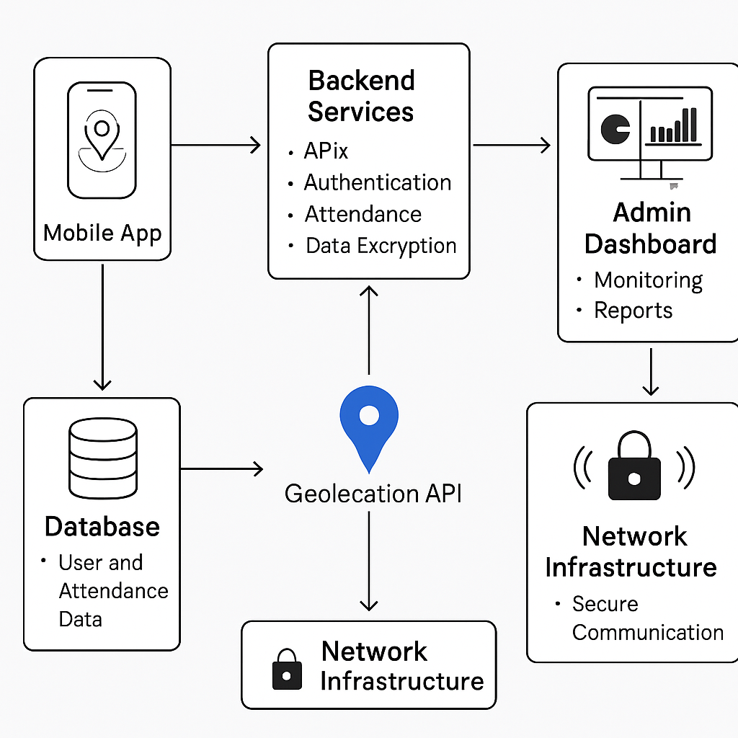
Architecture Diagram

Slide 11
Modules
User authentication and registration.
GPS location tracking and geofencing.
Attendance marking and validation.
Admin dashboard for reports and absentee management.
Data security and privacy controls.

Slide 12
Hardware and Software Details
Smartphones (Android/iOS) as client devices.
Backend server supporting database and API services.
Usage of GPS, geofencing APIs, secure authentication protocols.
Admin workstation for management and monitoring.

Slide 13
Github Link
The Github link provided should have public access permission.
Github Link
https://github.com/Viswateja06/Geolocation-based-Attendance-Tracking-Mobile-Application

Slide 14
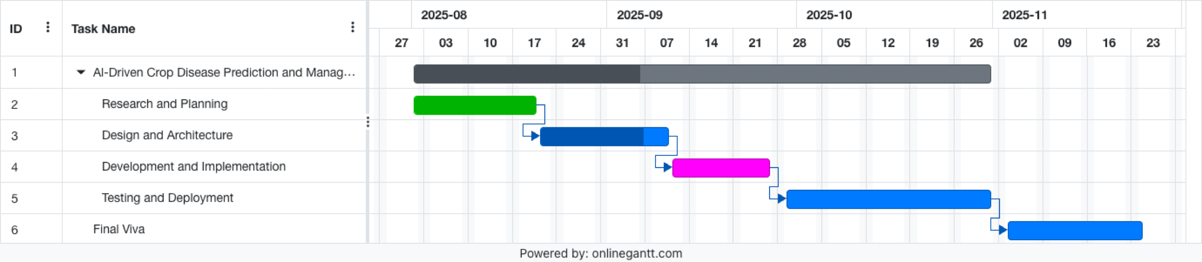
Timeline of the Project (Gantt Chart)
1 | Requirement Analysis and Planning
2 | Design and Architecture Development
3 | Implementation and Integration
4 | Testing, Validation, and Optimization
5 | Deployment, Maintenance, and Enhancement

Slide 15
References (IEEE Paper format)
[1]. Yoganathan, N. S., Raviteja, S., Sathyanarayanan, R., & Anup Kumar, N. K. R. ( 2021 ). Location Based Smart Attendance System Using GPS. Annals of the Romanian Society for Cell Biology, 4510–4516.
[2]. Ali, A., Koondhar, M. Y., Depar, M. H., Maher, Z. A., Rind, M. M., & Shah, A. ( 2021 ). Framework for Location Based Attendance System by Using Fourth Industrial Revolution (4IR) Technologies. International Journal, 10 ( 3 ).

Slide 16


