Slide 1


Speed vs context
Viswaz Gummadi

Slide 2
Overview
In this project, we present a Personalized Question Answering Chatbot built using Retrieval-Augmented Generation (RAG) and enhanced with Parameter-Efficient Fine-Tuning (PEFT) techniques such as LoRA and QLoRA.
The system is designed to answer queries using information extracted from user-specific PDF documents, which are:
Preprocessed,
Tagged using custom HTML-like tags,
And converted into vector representations to build an efficient knowledge base.
We explore two modes of retrieval:
Precomputed vector databases for large contexts with deep understanding.
Runtime vector generation for faster, lightweight queries.
To make the system more customizable, we use fine-tuning techniques to control output formats (like tables or bullet points), optimize performance, and handle large models efficiently using PEFT strategies.

Slide 3
Data preprocessing
pdf
If scanned docs
Custom HTML-like tags are used to structure the content.
This improves context understanding for the model.
Tables are formatted clearly for better interpretation.
Images are replaced with placeholders and stored structurally.
All content is easily converted into a vector database.
OCR
Pypdf
Formatted data
Pdf text files

Slide 4
Retrieval-Augmented Generation(RAG)
RAG = Search + Generate
Instead of relying only on what the model remembers, RAG:
Retrieves relevant info from a custom knowledge base (like your PDF data),
Feeds it into the model as context,
The model then generates an answer using both the context + its own knowledge.
Why RAG?
Avoids hallucination
Keeps answers accurate & grounded
Lets you query outside knowledge (like company docs, notes, PDFs)
Made of:
Retriever (e.g., FAISS, Chroma) – pulls top-k relevant chunks
Generator (e.g., LLaMA, Mistral, GPT) – generates response using those chunks

Slide 5

Database Creation
File1 – chunk1
File1 – chunk1
Overlap
File1 – chunk2
File1 – chunk2
PDF
text
w2vec
PDF
text
PDF
text
Knowledge base
Filen – chunkz
Filen – chunkz
Fixed tokens
Data Chunks
Embeddings

Slide 6

Pre-computed vecdb
What is a neural network?
Query
The entire context is converted into a vector database beforehand.
Similarity search may take longer due to the larger search space.
However, it provides more context for each query.
Question Embedding
Answer
Semantic Search
LLM
Ranked Results

Slide 7
Run-time vector computation
What is a neural network?
Query
Pdf
Question Embedding
Answer
The vector database is computed at runtime for each query.
Only a small amount of data or context is used.
It is fast due to the smaller search space.
Semantic Search
LLM
Ranked Results

Slide 8
Parameters
RAG – Key Hyperparameters (Defaults)
Chunk Size: Fixed size of each text chunk (default: 512 tokens).
Temperature: Controls randomness in responses (default: 0.3).
Max Tokens: Maximum length for input + context (default: 2048 tokens).
If this limit is exceeded, the beginning of the input may be cut off.
Top_k: Number of top matching chunks retrieved (default: 3).
Higher top_k → more context → better answer quality (but slower).
Lower top_k → faster response → but may miss useful info.
Can We Get Both Speed and Rich Context?
Fast responses come from optimized computations and small search space.
More data requires tweaking model weights or increasing retrieved context.
To balance both, we can fine-tune the LLM instead of retraining from scratch.
Fine-tuning also helps us generate responses in specific formats (e.g., tables, lists, bullet points).

Slide 9
PEFT
What is PEFT?
Parameter-Efficient Fine-Tuning (PEFT) lets you fine-tune large models by training only a small subset of new parameters—saving compute and memory.
Why LoRA / QLoRA?
LoRA: Adds lightweight adapters to model layers. Only these are trained.
QLoRA: Combines LoRA with 4-bit quantization of the base model → can fine-tune huge models (like 65B) on a single GPU.
How I Fine-Tuned:
Loaded a pre-trained LLM (e.g., Mistral).
Froze original weights.
Used LoRA adapters on attention layers (q_proj, v_proj).
Trained only the adapters on my custom data (PDFs in tagged format).
Saved & plugged back the tiny adapter weights.
Benefits:
Reusability: Share adapters across models/tasks.
Efficient: Uses way less memory & compute.
Scalable: Fine-tune even very large models.
Lightweight: Adapters are just a few MBs!

Slide 10
LoRA and QLoRA
+
k
Pre trained weights
Fixed normal
distribution
Tune-able weights
X
d
d
In LoRA we use 32 bit floating point precision
In QLoRA we use 4 bit precision
This decreases the space needed by ~75 %
A chance to experiment on larger models
k

Slide 11
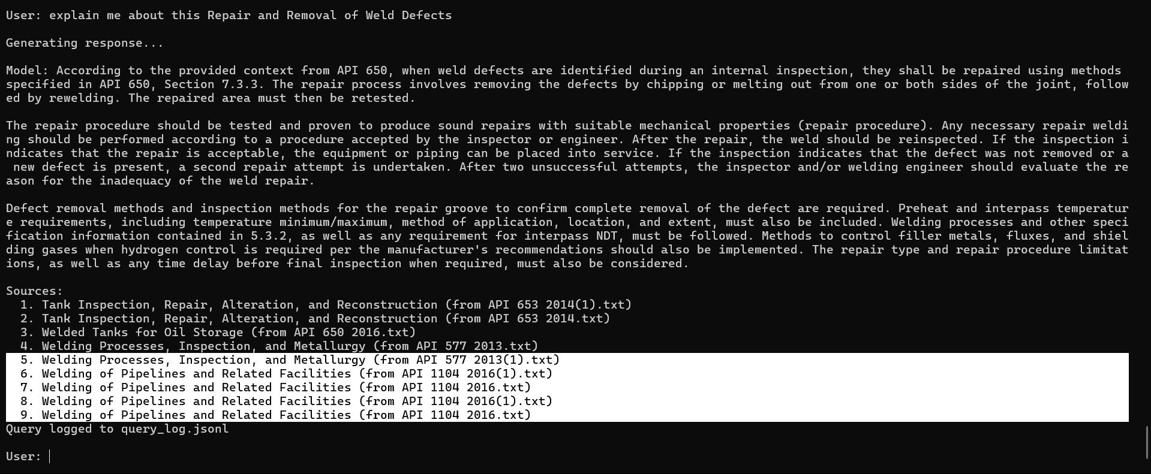
Responses
Response, Chunk parents in RAG-precomputed version

Slide 12
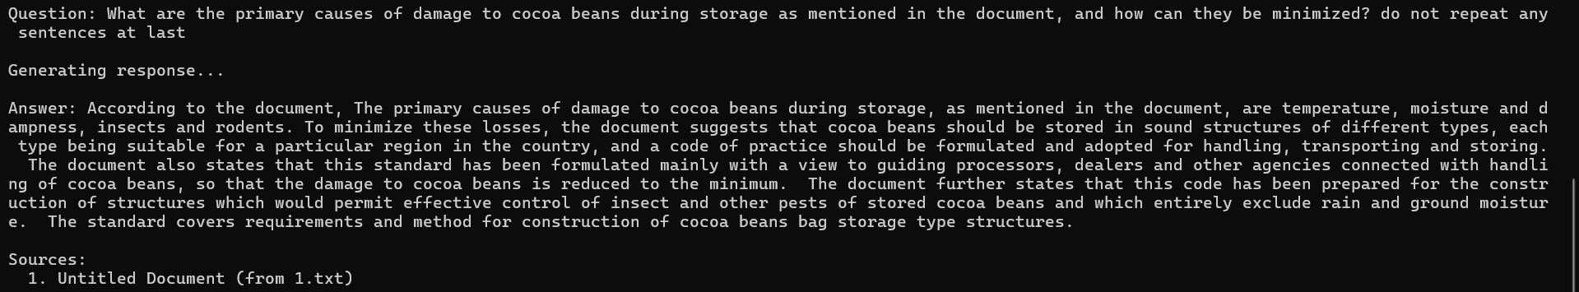
Responses
RAG-run time computation version
Fine Tuned version
We do not need source files anymore the adapter can also be easily transferred

Slide 13
Future scope: Dynamic Multi-Modal Workflow
Evolve from a single, continuous pipeline to a dynamic, task-aware architecture.
The system will analyze the prompt, build a custom pipeline, and execute it intelligently.
Multiple specialized models will run in the background, each fine-tuned for specific tasks like:
Summarization
Table analysis
Data extraction
Visual OCR (if needed)
Based on the prompt, only the relevant models and steps will be activated.
This approach mirrors the Mixture-of-Experts (MoE) strategy used in advanced models like Mistral, improving both accuracy and efficiency.
We focus more on the attributes of the prompt so we achieve good results.
Result: Better responses tailored to the query, with smarter resource usage.

