Slide 1
GE 23627 DESIGN THINKING AND INNOVATION
OmniLegal AI
Design thinking semester review for a citation-grounded legal research assistant
Presented by
HEMAKUMAR U (231801054)
VISWESWAR (231801902)
SANJAY N (231801149)
III YEAR - B.Tech
Artificial Intelligence and Data Science
Notes:
Cover concept: serious academic review with legal-gold accent and AI/product dark background.
Introduce the project as a design-thinking solution, not only as a coding project.

Slide 2
Problem
PROBLEM STATEMENT
Users need fast legal answers, but legal AI must be source-grounded
Legal research is slow, complex, and difficult to trust when citations are hidden or unsupported.
Students, researchers, MUN delegates, and non-law users need understandable outputs with verifiable sources.
Legal documents are long and difficult to scan quickly.
Different jurisdictions may give different legal answers.
General AI tools can hallucinate cases, statutes, or citation details.
Users need different explanation levels: layman, student, researcher, and debate-focused.
A useful tool must show proof, not only polished text.
GE 23627 Design Thinking and Innovation | OmniLegal AI
02
Notes:
Frame the project around trust and usability: fast answer plus visible evidence.

Slide 3
DESIGN THINKING APPROACH
Human-centered design turned the project into task-based workflows
The project follows empathize, define, ideate, prototype, and test rather than starting directly from model selection.
1. Empathize
2. Define
3. Ideate
4. Prototype
5. Test
Students and MUN users struggle with long documents and uncertain AI answers.
How might we create fast, understandable, citation-grounded legal research?
Research Console, Citation Forensics, Conflict Atlas, Comparative IRAC, Advocacy Studio.
React UI, Chainlit chat, FastAPI backend, RAG pipeline, and citation verifier.
Smoke tests, citation checks, UI walkthroughs, and design feedback.
Personas for different users
Key design insight
Visible citation trail
The user does not only need an answer. The user needs confidence that the answer came from a real source and is written at the right level.
Source-backed workflows
Testing and iteration plan
GE 23627 Design Thinking and Innovation | OmniLegal AI
03
Notes:
Use this slide to prove the project satisfies the subject's design-thinking requirement.

Slide 4
KNOWLEDGE BASE USED
The system is grounded in legal texts, datasets, and evaluation registries
The knowledge base combines local law texts, curated datasets, case-law registries, and manual gold sets.
Source group
Examples used in this project
Purpose
Local legal texts
Indian Constitution, UN Charter, ICCPR, ICESCR, Brownlie's Principles, Roman law text, arbitration law texts
Runtime retrieval and source-backed explanation
Parsed corpus
parsed_pdf.txt and Law Text Files grouped into Indian Law and International Law
Chunking, search, and grounding
Dataset registry
17 registered datasets including QA, summarization, conflict, stance, retrieval, and benchmark references
Training and evaluation planning
Donor registry
Law-AI summarization, CLERC, LLeQA, BSARD, argument mining, FairLex, CaseHOLD, LexGLUE
Reusable patterns and benchmark framing
Case-law sources
Indian, US, UK, EU, Russia, Israel, and international source groups
Comparative and jurisdiction-specific analysis
Design note: the system should always distinguish source-grounded answers from AI-inferred or unavailable-source answers.
GE 23627 Design Thinking and Innovation | OmniLegal AI
04
Notes:
Mention that knowledge base quality determines answer quality.

Slide 5
LITERATURE REVIEW
The project combines ideas from legal NLP, RAG, and responsible AI evaluation
The literature review shows why plain generation is not enough for the legal domain.
Area
Existing direction
Gap addressed by OmniLegal
Legal search platforms
Retrieve cases, statutes, and documents but require manual interpretation.
Adds summarized, structured, and persona-specific outputs.
General LLMs
Generate fluent legal explanations but may hallucinate citations.
Adds retrieval, source panels, and citation verification.
Legal NLP datasets
LexGLUE, CaseHOLD, CLERC, LLeQA, BSARD, FairLex support evaluation.
Uses dataset registry and benchmark ideas inside an app workflow.
RAG systems
Ground answers using retrieved context.
Adds jurisdiction routing, legal personas, and forensic citation audit.
Responsible AI
Measures faithfulness, hallucination risk, and source support.
Uses smoke tests, citation existence, quote match, and production gates.
GE 23627 Design Thinking and Innovation | OmniLegal AI
05
Notes:
Keep this literature slide concise: existing systems are useful, but legal AI needs verification.

Slide 6
UNIQUENESS
Citation Forensics
Conflict Atlas
The verdict.
The map.
The proof.
Checks legal prose and labels claims as verified, partial, suspicious, hallucinated, or not found.
Maps legal topics across jurisdictions using grounded sources and clearly tagged fallback inference.
OmniLegal is unique because it treats trust as a product feature, not an afterthought.
Multi-persona research
Evaluation-aware build
Researcher, Law Student, Tourist, Layman, and Conflict Detector modes change depth and language.
Smoke tests, citation existence, quote match, completion gates, and documented limitations.
GE 23627 Design Thinking and Innovation | OmniLegal AI
06
Notes:
Use the phrase verdict, map, proof as the memory hook.

Slide 7
METHODOLOGY
From legal text to verified answer
The methodology follows a retrieval-first pipeline so the model generates from evidence instead of memory.
1. Ingest
2. Retrieve
3. Reason
4. Verify
5. Present
Parse law texts, PDFs, registries, and datasets into usable chunks.
Search relevant passages using vector search, sparse search, and filters.
Generate answer using legal prompts, personas, and workflow context.
Check citations, quote match, source support, and hallucination risk.
Show answer, citations, map, IRAC, or report in the UI.
Frontend
Backend
Pipeline
React pages and Chainlit chat give task-based workflows instead of a blank chatbot.
FastAPI routers expose atlas, forensics, advocacy, live search, council, research, and comparative endpoints.
Classifier, entity extractor, retriever, reranker, synthesizer, source gate, and citation verifier.
GE 23627 Design Thinking and Innovation | OmniLegal AI
07
Notes:
Explain the methodology as a pipeline: ingest, retrieve, reason, verify, present.

Slide 8
OUTPUT
The prototype produces multiple user-facing legal research outputs
Each output corresponds to a real user need discovered during design thinking.
Research answer
Citation audit
Persona-based cited legal explanation with source passages and verification status.
Annotated legal prose showing which citations are verified or risky.
Comparative analysis
Presentation material
Jurisdiction-wise IRAC with agreements, conflicts, and legal gaps.
Advocacy packets, position papers, opening speeches, rebuttal cards, and reports.
Example result:
A user asks about erga omnes obligations. OmniLegal returns a legal explanation with citation markers and a citation rail showing sources.
GE 23627 Design Thinking and Innovation | OmniLegal AI
08
Notes:
This output slide summarizes what the user receives, before showing screenshots.

Slide 9
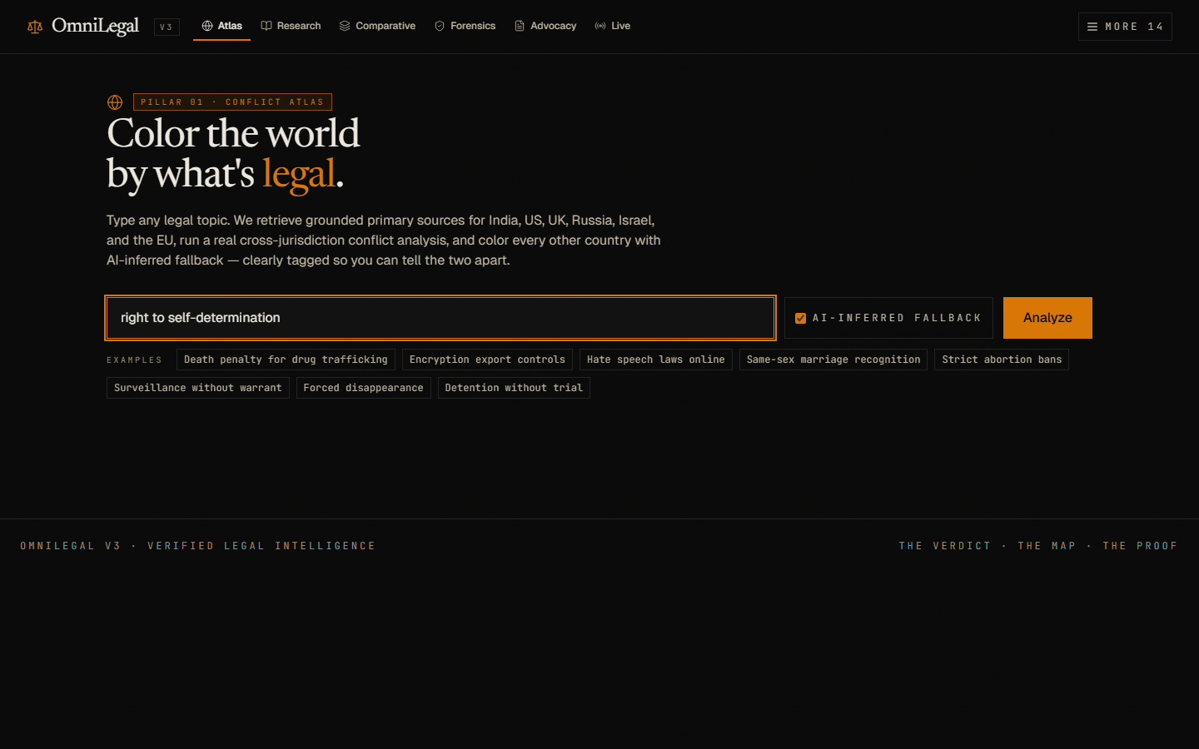
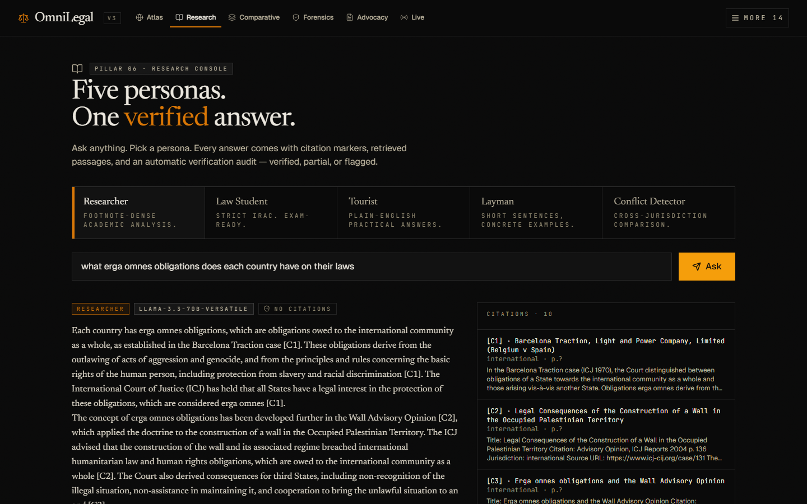
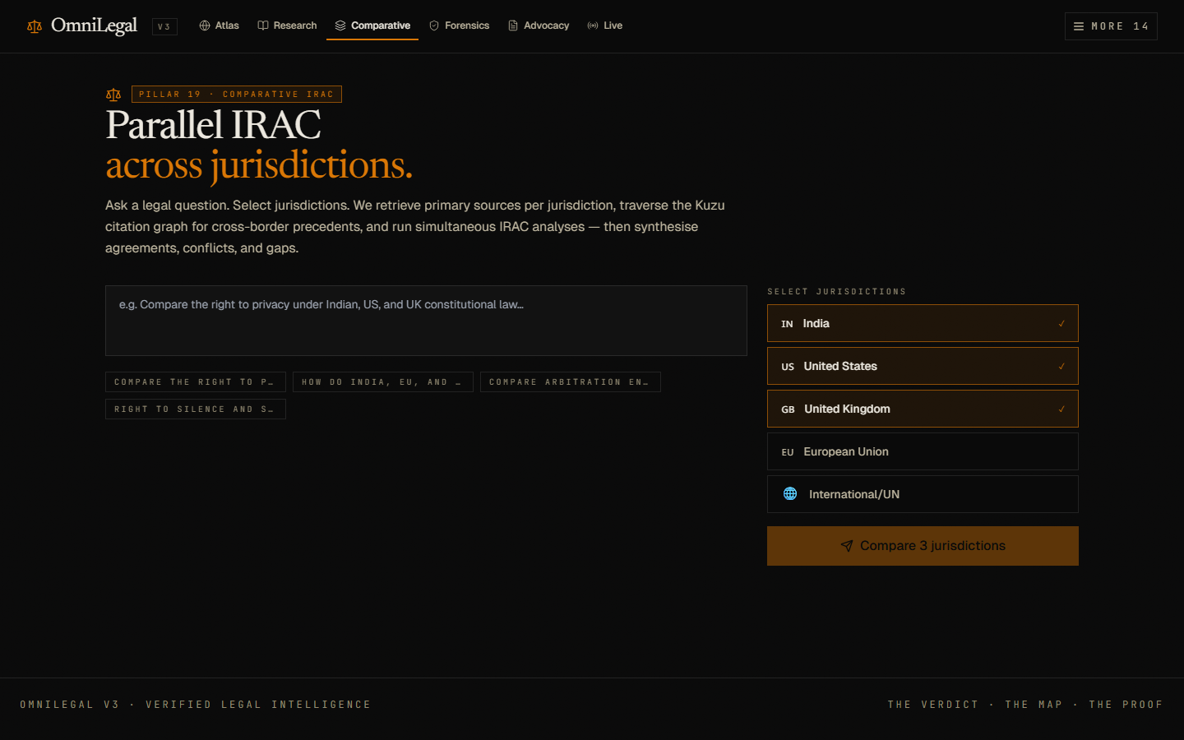
OUTPUT SCREENSHOTS
Working prototype screens
Screenshots from the local React interface show how users interact with the research, atlas, and comparative workflows.
GE 23627 Design Thinking and Innovation | OmniLegal AI
09
Notes:
Use this slide for visual proof that the prototype exists and has working UI flows.

Slide 10
Thank You
OmniLegal AI | Design Thinking Semester Review
Presented by HEMAKUMAR U, VISWESWAR, and SANJAY N
Problem
Innovation
Impact
Legal research needs faster source-backed understanding.
RAG plus citation verification builds trust.
Useful for students, researchers, and MUN preparation.
Questions?
Notes:
End by inviting questions about design thinking process, knowledge base, methodology, and output.

