Slide 1
Site Layout
Best practices
Cross browser’s implementation
by Tkachuk Vitaliy

Slide 2
What is
Site Layout

Slide 3
INTRODUCTION
Site layout – stage of development, when website design drown by designer is transformed into a web page using markup language HTML and stylesheet language CSS.
So, what are the types of site layout:
Table
Block (div based)
Fixed (static)
Fluid
Rubber (elastic)
Adaptive
Responsive

Slide 4
Types of site layout

Slide 5
Table Site Layout
This layout option is based on the HTML tables creation, allowing you to divide the page structure into separate elements — columns and cells — in which site components will be placed.
<table cellpadding="0" cellspacing="0" border="0">
<tr>
<td colspan="3" height="120px">....</td>
</tr>
<tr>
<td class="menu" valign="top">...</td>
<td class="content" valign="top">...</td>
<td class=“sidebar" valign="top">...</td>
</tr>
<tr>
<td colspan="3">...</td>
</tr>
</table>

Slide 6
<div> based Site Layout
<div> tag is used to group block and inline level elements and to create divisions in a webpage. Before 2004, we were using Table Based Layouts. But After 2004, Div based layout become popular.
Code is more compact
Flexibility and more possibilities
Div blocks render faster than tables
<div class=“wrap”>
<div class = “header”>…</div>
<div class = “nav”>…</div>
<div class = “container”>…</div>
<div class = “footer”>…</div>
</div>

Slide 7
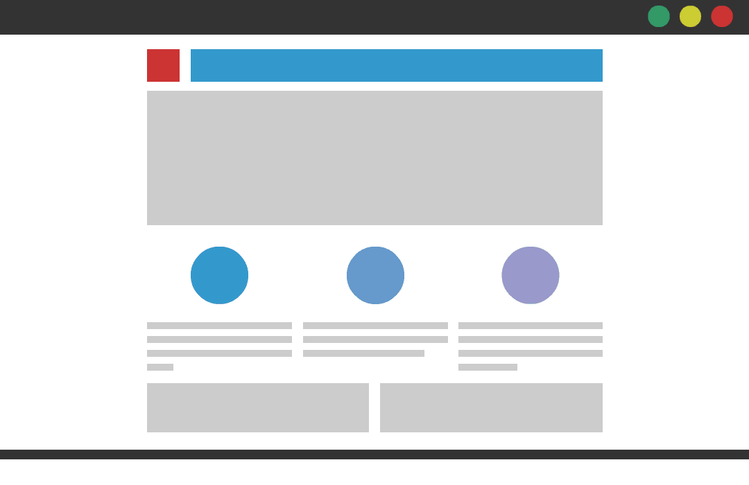
Fixed (static) Site Layout
Fixed (static) layout has a fixed width in pixels. The ‘container’ of the website is programmed to not move. This width stays the same independently of which screen size or resolution the viewer has. It appears that the width of 960px is the most widely used size for fixed-layout websites.
The drawback is that when viewing such layout on smaller screens you get the hideous horizontal scroll, which ruins the overview, experience an usability.

Slide 8
Fluid Site Layout
With fluid layout you specify sizes not in pixels, but in percentages. Meaning, if the screen size changes, the proportion of elements will stay the same.
The drawback is that on smaller screens the columns can get really narrow.

Slide 9

Adaptive Site Layout
An adaptive page layout uses CSS media queries to detect the width of the browser and alter the layout accordingly. Adaptive layouts will use fixed unit like pixels, just like a static layout, but the difference is that there are essentially multiple fixed widths defined by specific media queries.

Slide 10
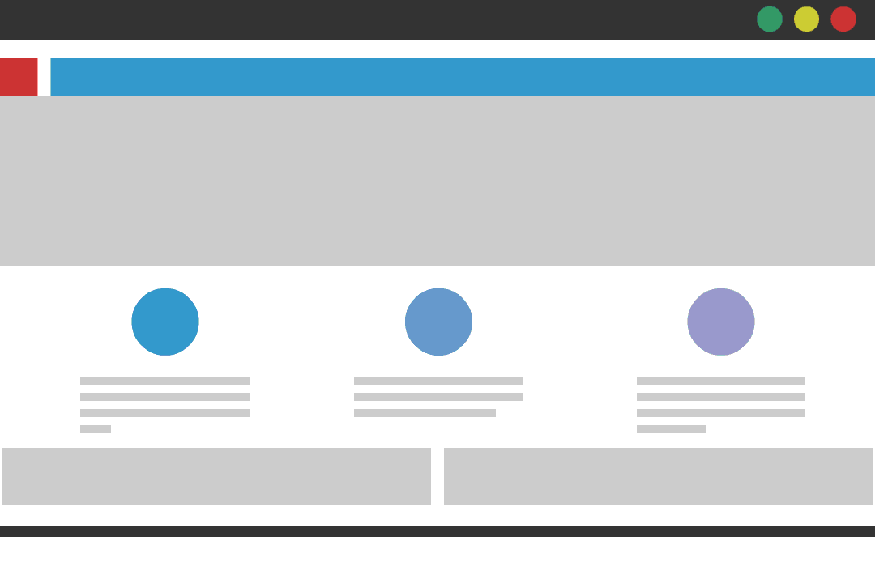
Responsive Site Layout
Responsive design takes the best of the two worlds of fluid and adaptive design.
There are several so-called breakpoints (media queries), which divide all possible screen sizes in ranges. The interface has different layout depending on the screen size it’s viewed on.
Also, depending on the screen size, elements will stretch or shrink accordingly. Responsive layout provides a custom experience for whichever screen size it’s viewed on.

Slide 11
Best practices

Slide 12
Requirements For Modern Layout
The better the layout of the site, the better the site will work. What are the requirements for layout today? Here they are:
Responsiveness
Accessibility
High page loading speed
Semantics
Validity
Cross-browser compatibility

Slide 13
Responsiveness
We live in a world where our sites our not only being visited by a variety of different devices and screen sizes, but the same customers are returning to our sites at different times using these different devices. This means that, to best support their experience, our sites must work well regardless of which device they may be using at a given time. The same content that they have access to on one devices must be present when they return on other devices to ensure consistency in the information that they are seeking.
Responsive web design has become more important as the amount of mobile traffic now accounts for more than half of total internet traffic. Therefore, Google announced Mobilegeddon in 2015, and started to boost the ratings of sites that are mobile friendly if the search was made from a mobile device.

Slide 14
Accessibility
“The power of the Web is in its universality.
Access by everyone regardless of disability is an essential aspect”
Tim Berners-Lee, W3C Director and inventor of the World Wide Web
Accessibility is essential for developers and organizations that want to create high quality websites and web tools, and not exclude people from using their products and services.
Write HTML with accessibility in mind. Provide the user a good way to navigate and interact with your site. Make your HTML code as semantic as possible, so that the code is easy to understand for visitors and screen readers.

Slide 15
High Page Loading Speed
A one-second delay in page load time yields:
11% fewer page views
16% decrease in customer satisfaction
How to speed up your website in 2019:
Minimize HTTP requests
Minify and combine files
Reduce image sizes
Use asynchronous loading for CSS and JavaScript files
Defer JavaScript loading

Slide 16
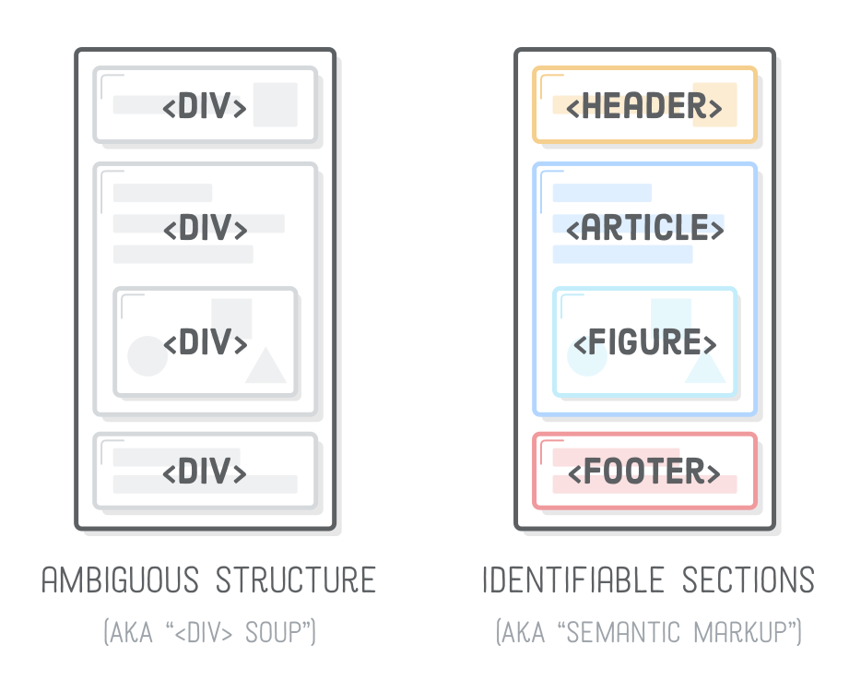
Semantics
Semantic elements are elements with clearly defined meaning to both the browser and the developer. Elements like <header>, <nav>, <footer>, or <article> do a much better job of explaining the content that is contained within the element than <span> or <div>.
Also, that explicit information helps robots/crawlers like Google and Bing to better understand which content is important, which is subsidiary, which is for navigation, and so on.

Slide 17
Validity
There are a number of reasons why you should validate your page:
Improves usability and functionality because your users are less likely to run into errors
It Helps Cross-Browser, Cross-Platform and Future Compatibility
Search Engine Visibility
Validation tools:
HTML validator checks to make sure the HTML code on your web page complies with the standards set by the W3 Consortium
A CSS validator checks your Cascading Style Sheet in the same manner. That is, it will check that it complies with the CSS standards set by the W3 Consortium.

Slide 18
Cross-Browser Compatibility
As a web developer, it is your responsibility to make sure that not only do your projects work, but they work for all your users, no matter what browser, device, or additional assistive tools they are using.
You need to test your website in different browsers other than the one or two that you use regularly on your devices.

Slide 19
Cross-Browser
Compatibility

Slide 20
8 Essential Tips for Building a
Cross-Browser Compatible Website
Keep Your Code Simple
Use Frameworks
Define Valid Doctype
CSS Reset
Validate
Conditional Comments
Vendor Prefixes
Prepare For Differences
Don’t Skip Cross-Browser Testing

Slide 21
Keep Your Code Simple
Think quality over quantity when it comes to coding.
Don’t dedicate ten lines of code to a feature that only needs three.
Not only will simple code be more cross-browser friendly, it will also be more maintainable when the time comes that you do have to debug or adjust it for compatibility.

Slide 22
Use Frameworks
CSS frameworks like Foundation and Bootstrap will give you style code to make cross-compatibility easier for you.
If you take the time to become familiar with some of the features, building a responsive web application becomes much faster and easier.
These will also help you make the application look and behave correctly in mobile browsers.

Slide 23
Define Valid Doctype
The Doctype is the first line in your code which describes the HTML that will be used in your application.
Because different browsers have different standards and rules, you need to define the Doctype or the rendering engine will basically guess it for you.
Of course, this is what can lead to bugs and inconsistencies that you want to avoid.

Slide 24
CSS Reset
Every browser has different default CSS rules that they follow.
This is why you use CSS reset stylesheet to make sure your browsers follow the same basic rules and behave consistently.
You want to add one of these as the first stylesheet in order to reset unless you use a framework which will already have one.

Slide 25
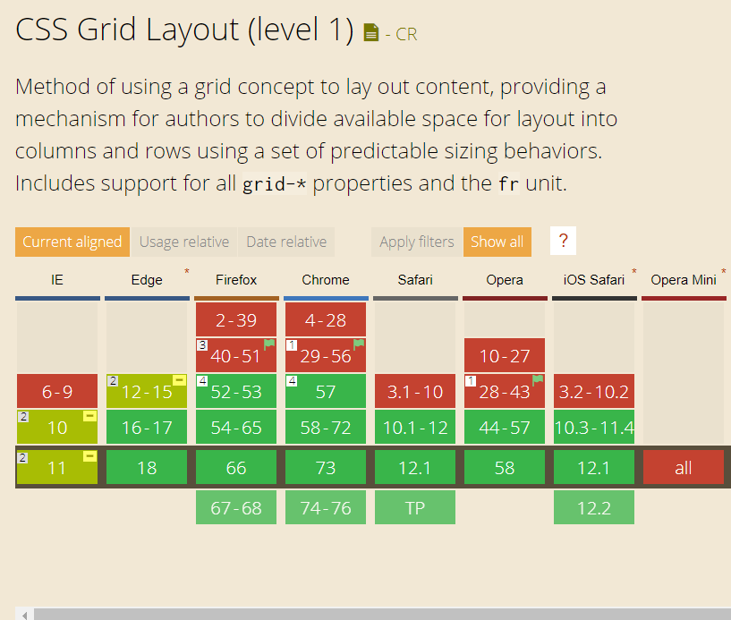
Validate
It’s a good idea to validate your HTML and CSS to prevent problems.
Use the W3C HTML Validator and CSS Validator to make sure your code is error free and fix it if it’s not.
Use caniuse.com to check if tag/feature/technology you want to use is supported by latest versions of popular browsers.

Slide 26
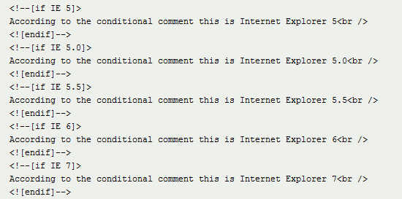
Conditional Comments
Conditional comments allow you to link style sheets for different browsers, which is especially helpful when it comes to design challenges that are common with Internet Explorer.

Slide 27
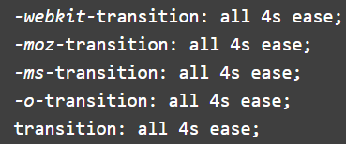
Vendor Prefixes
CSS vendor prefixes, also sometimes known as or CSS browser prefixes, are a way for browser makers to add support for new CSS features before those features are fully supported in all browsers.
This may be done during a sort of testing and experimentation period where the browser manufacturer is determining exactly how these new CSS features will be implemented.
These prefixes became very popular with the rise of CSS3 a few years ago.
The major browsers use the following prefixes:
-webkit- (Chrome, Safari, newer versions of Opera, almost all iOS browsers, basically all WebKit based browsers)
-moz- (Firefox)
-o- (old, pre-WebKit version of Opera)
-ms- (Internet Explorer and Microsoft Edge)

Slide 28
Prepare For Differences
Again, it’s pretty much impossible to have a design that looks the same on every browser unless it’s extremely basic.
Details like forms and typography will likely vary no matter what rules you follow. Your main concern should not be making the design look identical on every browser.
Instead, you should make sure that it looks acceptable and is usable without having elements that are out of place or that prevent someone from accessing certain functions.

Slide 29
Don’t skip Cross-Browser Testing
It’s not just enough to keep these tips in mind while developing. As hard as you try to avoid it, it’s easy to accidentally write something that doesn’t work in one browser.
This is why you need to check that the site actually works on different browsers before delivery.
Using a tool like CrossBrowserTesting and BrowserStack gives you access to do this in over 1,500 browsers, so you never have to wonder what users are seeing when they visit your page from a different machine.

Slide 30
QUESTIONS ?

Slide 31
USED MATERIALS
https://medium.com/@space.alpaca/so-what-exactly-is-the-difference-between-fixed-fluid-adaptive-and-responsive-layouts-and-why-3773272d8481
https://www.awwwards.com/why-responsive-design-support-is-the-most-important-feature-you-can-add-to-your-website.html
https://www.w3schools.com/html/html_accessibility.asp
https://www.crazyegg.com/blog/speed-up-your-website/
https://www.thesitewizard.com/webdesign/htmlvalidation.shtml
https://developer.mozilla.org/en-US/docs/Learn/Tools_and_testing/Cross_browser_testing/HTML_and_CSS
https://crossbrowsertesting.com/blog/development/cross-platform-website-development/

Slide 32
THANK YOU

