Slide 1
JavaScript Code Convention, Linters
by Vitaliy Tkachuk

Slide 2
AGENDA
What are JavaScript Coding Conventions?
JavaScript Code Convention used by W3Schools
Airbnb JavaScript Style Guide
Google JavaScript Style Guide
Idiomatic JavaScript Style Guide
JavaScript Standard Style Guide
What is a Linter?
JSLint
JSHint
JSCS
ESLint

Slide 3
JavaScript Code Conventions

Slide 4
What are JavaScript Coding Conventions?
Coding conventions are style guidelines for programming. They typically cover:
Naming and declaration rules for variables and functions.
Rules for the use of white space, indentation, and comments.
Programming practices and principles
Coding conventions secure quality:
Improves code readability
Make code maintenance easier
Coding conventions can be documented rules for teams to follow, or just be your individual coding practice.
Always use the same coding conventions for all your JavaScript projects.

Slide 5
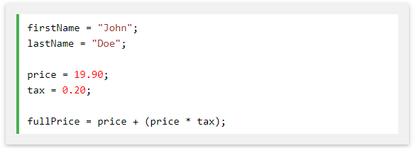

W3Schools JavaScript Style Guide
Variable Names
Naming convention recommended by W3schools:
Variable and function names written as camelCase
Global variables written in UPPERCASE
Constants (like PI) written in UPPERCASE
All names start with a letter.

Slide 6
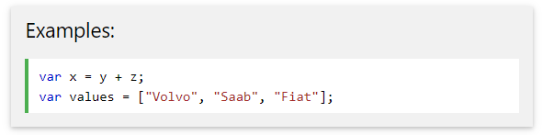
W3Schools JavaScript Style Guide
Spaces Around Operators
Always put spaces around operators ( = + - * / ), and after commas:

Slide 7
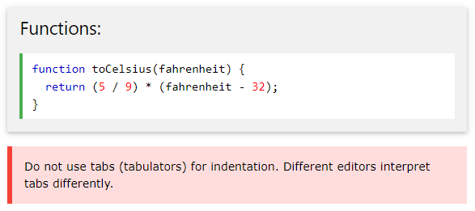
W3Schools JavaScript Style Guide
Code Indentation
Always use 2 spaces for indentation of code blocks:

Slide 8
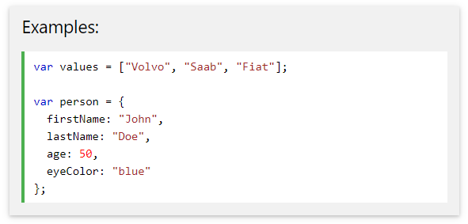
W3Schools JavaScript Style Guide
Statement Rules
General rules for simple statements:
Always end a simple statement with a semicolon.

Slide 9
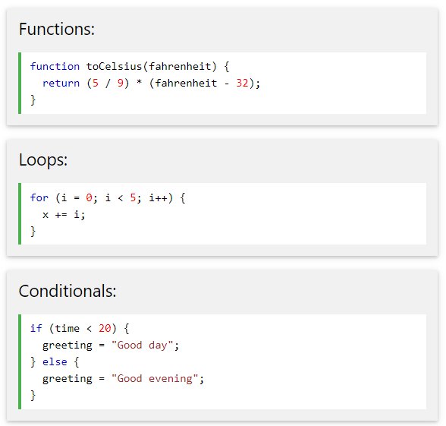
W3Schools JavaScript Style Guide
Statement Rules
General rules for complex (compound) statements:
Put the opening bracket at the end of the first line.
Use one space before the opening bracket.
Put the closing bracket on a new line, without leading spaces.
Do not end a complex statement with a semicolon.

Slide 10
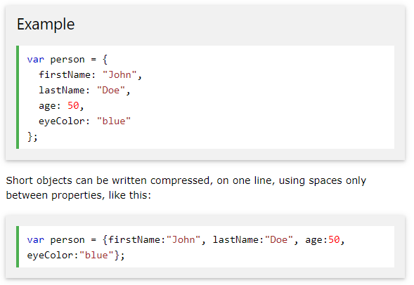
W3Schools JavaScript Style Guide
Object Rules
General rules for object definitions:
Place the opening bracket on the same line as the object name.
Use colon plus one space between each property and its value.
Use quotes around string values, not around numeric values.
Do not add a comma after the last property-value pair.
Place the closing bracket on a new line, without leading spaces.
Always end an object definition with a semicolon.

Slide 11
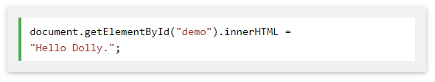
W3Schools JavaScript Style Guide
Line Length < 80
For readability, avoid lines longer than 80 characters.
If a JavaScript statement does not fit on one line, the best place to break it, is after an operator or a comma.

Slide 12

W3Schools JavaScript Style Guide
Avoid Global Variables
Minimize the use of global variables.
This includes all data types, objects, and functions.
Global variables and functions can be overwritten by other scripts.
Use local variables instead, and learn how to use closures.
Always Declare Local Variables
All variables used in a function should be declared as local variables.
Local variables must be declared with the var keyword or the let keyword, otherwise they will become global variables.

Slide 13
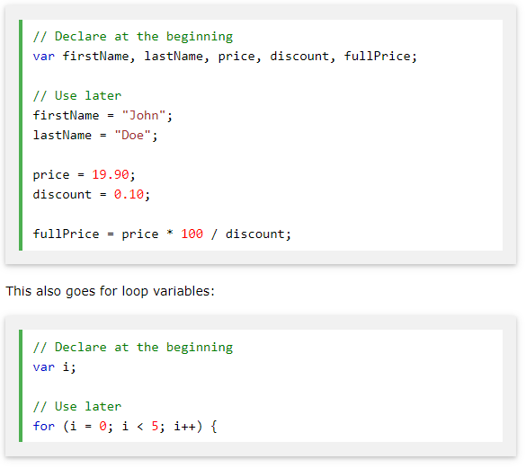

W3Schools JavaScript Style Guide
Declarations on Top
It is a good coding practice to put all declarations at the top of each script or function.
This will:
Give cleaner code
Provide a single place to look for local variables
Make it easier to avoid unwanted (implied) global variables
Reduce the possibility of unwanted re-declarations

Slide 14
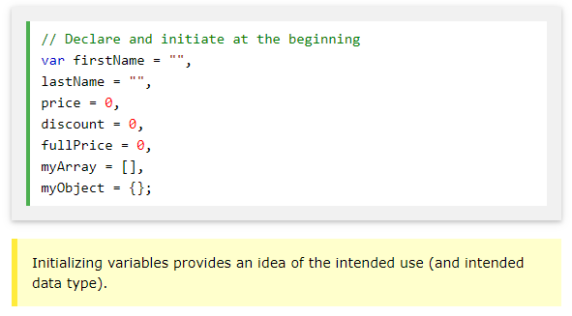
W3Schools JavaScript Style Guide
Initialize Variables
It is a good coding practice to initialize variables when you declare them.
This will:
Give cleaner code
Provide a single place to initialize variables
Avoid undefined values

Slide 15
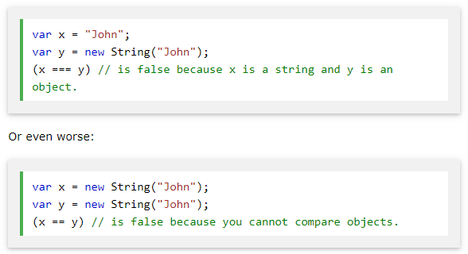
W3Schools JavaScript Style Guide
Never Declare Number, String, or Boolean Objects
Always treat numbers, strings, or booleans as primitive values. Not as objects.
Declaring these types as objects, slows down execution speed, and produces nasty side effects…

Slide 16
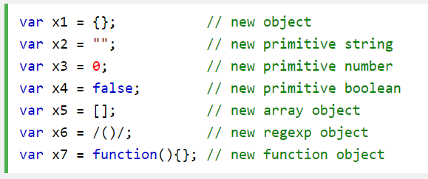
W3Schools JavaScript Style Guide
Don't Use new Object()
Use {} instead of new Object()
Use "" instead of new String()
Use 0 instead of new Number()
Use false instead of new Boolean()
Use [] instead of new Array()
Use /()/ instead of new RegExp()
Use function (){} instead of new Function()

Slide 17
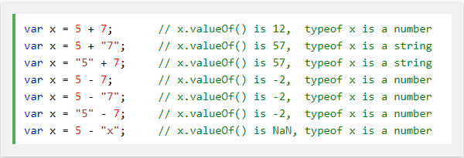
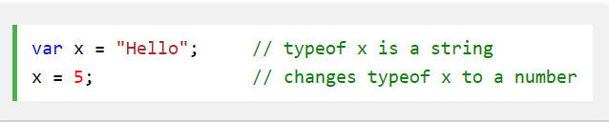

W3Schools JavaScript Style Guide
Beware of Automatic Type Conversions
Beware that numbers can accidentally be converted to strings or NaN (Not a Number).
JavaScript is loosely typed. A variable can contain different data types, and a variable can change its data type:
When doing mathematical operations, JavaScript can convert numbers to strings:
Subtracting a string from a string, does not generate an error but returns NaN (Not a Number):

Slide 18
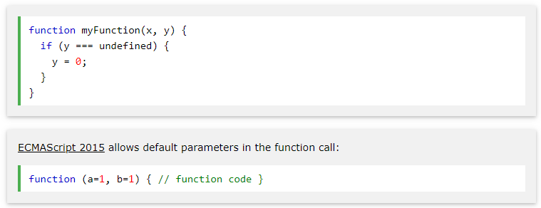
W3Schools JavaScript Style Guide
Use === Comparison
The == comparison operator always converts (to matching types) before comparison.
The === operator forces comparison of values and type:
Read more about function parameters and arguments at Function Parameters

Slide 19
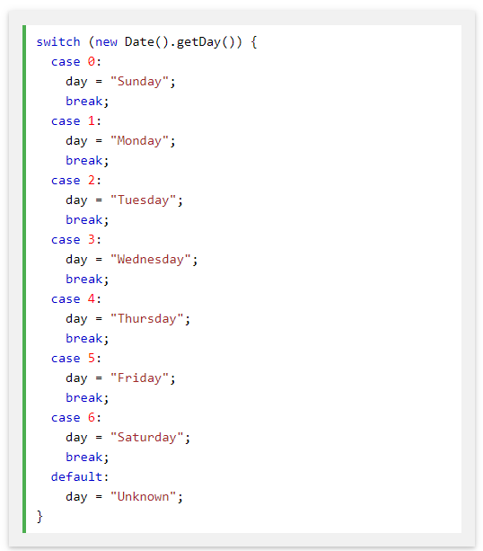
W3Schools JavaScript Style Guide
End Your Switches with Defaults
Always end your switch statements with a default. Even if you think there is no need for it.

Slide 20
W3Schools JavaScript Style Guide
Avoid Using eval()
The eval() function is used to run text as code. In almost all cases, it should not be necessary to use it.
Because it allows arbitrary code to be run, it also represents a security problem.

Slide 21
Most Popular JavaScript Code Conventions
Google JavaScript Style Guide
  You can view Google’s style guide on GitHub
Airbnb JavaScript Style Guide
  Airbnb has one of the most popular JavaScript style guides on the internet. It covers nearly every aspect of JavaScript as well.
  You can view Airbnb’s style guide on GitHub.
Idiomatic JavaScript Style Guide
  Another of the most popular JavaScript style guides, the Idiomatic guide is available in multiple languages, and is open to pull requests.
  You can view the Idiomatic style guide on GitHub.
JavaScript Standard Style Guide
  This style guide is used by many tech companies including NPM, GitHub, mongoDB, and ZenDesk.
  You can view the JavaScript Standard style guide on GitHub.

Slide 22
LINTERS

Slide 23
What is a Linter?
Linters are tools that can automatically check the style of your code and make suggestions for refactoring.
The great thing about them is that style-checking can also find some bugs, like typos in variable or function names. Because of this feature, installing a linter is recommended even if you don’t want to stick to one particular “code style”.
Here are the most well-known linting tools:
JSLint – one of the first linters.
JSHint – more settings than JSLint.
ESLint – probably the newest one.
Most linters are integrated with many popular editors: just enable the plugin in the editor and configure the style.

Slide 24
JSLint
JSLint is the oldest of the four. Douglas Crockford created it in 2002 to enforce what, in his experience, are the good parts of JavaScript. If you agree with the good parts, JSLint can be a good tool—you install it and it’s ready to go.
The downsides are that JSLint is not configurable or extensible. You can’t disable many features at all, and some of them lack documentation. The official website is not very helpful, for example it lacks any information on how to integrate it with your editor.
Pros
Comes configured and ready to go (if you agree with the rules it enforces)
Cons
JSLint doesn’t have a configuration file, which can be problematic if you need to change the settings
Limited number of configuration options, many rules cannot be disabled
You can’t add custom rules
Undocumented features
Difficult to know which rule is causing which error

Slide 25
JSHint
JSHint was created as a more configurable version of JSLint (of which it is a fork). You can configure every rule, and put them into a configuration file, which makes JSHint easy to use in bigger projects. JSHint also has good documentation for each of the rules, so you know exactly what they do. Integrating it into editors is also simple.
A small downside to JSHint is that it comes with a relaxed default configuration. This means you need to do some setup to make it useful. When comparing it with ESLint, it’s also more difficult to know which rules you need to change in order to enable or disable certain error messages.
Pros
Most settings can be configured
Supports a configuration file, making it easier to use in larger projects
Has support for many libraries out of the box, like jQuery, QUnit, NodeJS, Mocha, etc.
Basic ES6 support
Cons
Difficult to know which rule is causing an error
Has two types of option: enforcing and relaxing (which can be used to make JSHint stricter, or to suppress its warnings). This can make configuration slightly confusing
No custom rule support

Slide 26
ESLint
ESLint is the most recent out of the four. It was designed to be easily extensible, comes with a large number of custom rules, and it’s easy to install more in the form of plugins. It gives concise output, but includes the rule name by default so you always know which rules are causing the error messages.
ESLint documentation can be a bit hit or miss. The rules list is easy to follow and is grouped into logical categories, but the configuration instructions are a little confusing in places. It does, however, offer links to editor integration, plugins and examples all in a single location.
Pros
Flexible: any rule can be toggled, and many rules have extra settings that can be tweaked
Very extensible and has many plugins available
Easy to understand output
Includes many rules not available in other linters, making ESLint more useful for detecting problems
Best ES6 support, and also the only tool to support JSX
Supports custom reporters
Cons
Some configuration required
Slow, but not a hindrance

Slide 27
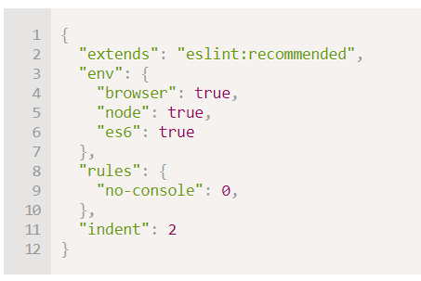
Linter configuring
for ESLint you should do the following:
Install Node.js.
Install ESLint with the command npm install -g eslint (npm is a JavaScript package installer).
Create a config file named .eslintrc in the root of your JavaScript project (in the folder that contains all your files).
Install/enable the plugin for your editor that integrates with ESLint. The majority of editors have one.
Here’s an example of an .eslintrc file:
Here the directive "extends" denotes that the configuration is based on the “eslint:recommended” set of settings. After that, we specify our own.
Notes:
Environments - which environments your script is designed to run in. Each environment brings with it a certain set of predefined global variables.
Rules - which rules are enabled and at what error level.
An environment defines global variables that are predefined. The available environments are:
browser - browser global variables.
node - Node.js global variables and Node.js scoping.
es6 - enable all ECMAScript 6 features except for modules (this automatically sets the ecmaVersion parser option to 6).
MORE:
jest - Jest global variables.
mocha - adds all of the Mocha testing global variables.
jquery - jQuery global variables.
mongo - MongoDB global variables.
It is also possible to download style rule sets from the web and extend them instead. See http://eslint.org/docs/user-guide/getting-started for more details about installation.
Also certain IDEs have built-in linting, which is convenient but not as customizable as ESLint.

Slide 28
QUESTIONS ?

Slide 29
USED MATERIALS
https://www.w3schools.com/js/js_conventions.asp
https://www.w3schools.com/js/js_best_practices.asp
https://www.sitepoint.com/comparison-javascript-linting-tools/

Slide 30
USEFUL LINKS
https://www.w3schools.com/js/js_conventions.asp
https://medium.freecodecamp.org/javascript-naming-conventions-dos-and-don-ts-99c0e2fdd78a

Slide 31
THANK YOU

