Slide 1
Conditional Rendering in React
by Vitaliy Tkachuk

Slide 2
What is conditional rendering in React?

Slide 3
INTRODUCTION
There may arise a situation when we want to render something based on some condition.
For example, consider the situation of handling a login/logout button. Both the buttons have different functions so they will be separate components. Now, the task is if a user is logged in then we will have to render the Logout component to display the logout button and if the user is not logged in then we will have to render the Login component to display the login button.
This is what we call Conditional Rendering in ReactJS. That is to create multiple components and render them based on some conditions. This is also a kind of encapsulation supported by React.

Slide 4
LIST
of options for conditional rendering
If/Else
Ternary operator
Logical && operator
Switch case operator
Conditional Rendering with enums
Immediately-invoked function expressions (IIFE)
Subcomponents
Multi-Level Conditional Rendering
Higher-order components
External Templating Components

Slide 5
If/Else
The easiest way to have a conditional rendering is to use an if else in React in your render method.
Imagine you don’t want to render your component, because it doesn’t have the necessary props.
For instance, a List component shouldn’t render the list when there is no list of items. You can use an if statement to return earlier from the render lifecycle.

Slide 6
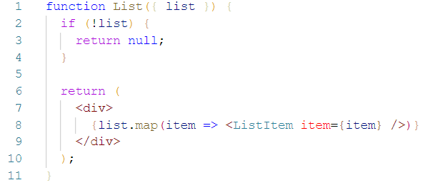
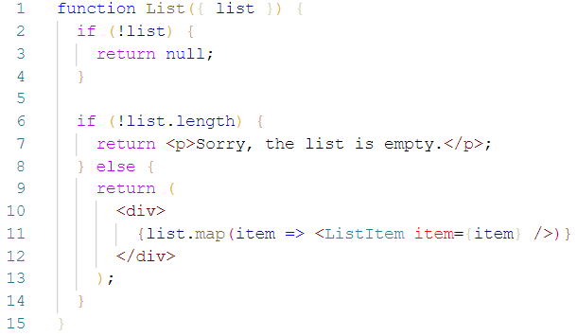
A component that returns null will render nothing. However, you might want to show a text when a list is empty to give your app user some feedback for a better user experience.
The List renders either nothing, a text or the list of items. The if-else statement is the most basic option to have a conditional rendering in React.

Slide 7

Ternary operator
Instead of using an if/else block we can use the ternary conditional operator:
The operator is wrapped in curly braces and the expressions can contain JSX, optionally wrapped in parentheses to improve readability.
And it can be applied in different parts of the component. Let’s apply it to the example so you can see this in action.

Slide 8
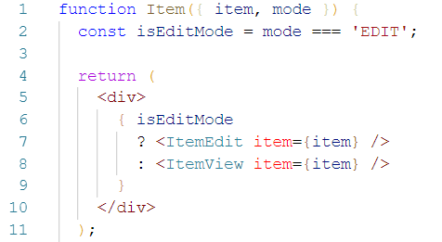
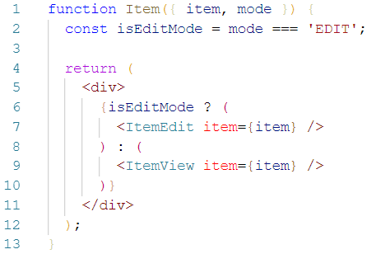
For instance, imagine you have a toggle to switch between two modes, edit and view, in your component. The derived condition is a simple Boolean. You can use the Boolean to decide which element you want to return.
The ternary operation makes the conditional rendering in React more concise than the if-else statement. It is simple to inline it in your return statement.
If your blocks in both branches of the ternary operation are getting bigger, you can use parentheses.

Slide 9
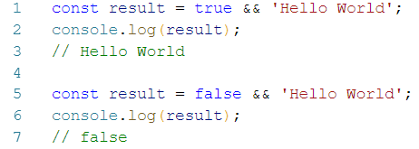
Logical && operator
It happens often that you want to render either an element or nothing. For instance, you could have a LoadingIndicator component that returns a loading text or nothing. You can do it in JSX with an if statement or ternary operation.
But there is an alternative way that omits the necessity to return null. The logical && operator helps you to make conditions that would return null more concise.
How does it work?
In JavaScript a true && 'Hello World' always evaluates to ‘Hello World’.
A false && 'Hello World' always evaluates to false.

Slide 10
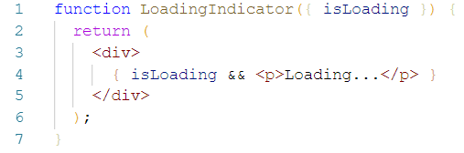
In React you can make use of that behavior. If the condition is true, the expression after the logical && operator will be the output. If the condition is false, React ignores and skips the expression.
That’s your way to go when you want to return an element or nothing. The technique is also called short-circuit evaluation. It makes it even more concise than a ternary operation when you would return null for a condition.

Slide 11
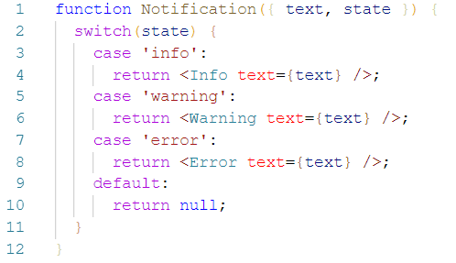
Switch case operator
Now there might be cases where you have multiple conditional renderings. For instance, the conditional rendering could apply based on different states.
Let’s imagine a notification component that can render an error, warning or info component based on the input state. You can use a switch case operator to handle the conditional rendering of these multiple states.
Please note that you always have to use the default for the switch case operator. In React a component has always to return an element or null.

Slide 12
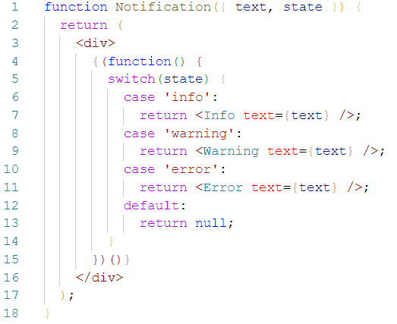
Now you have one generic component to show different kinds of notifications.
For instance, based on the state prop the component could have different looks. An error could be red, a warning would be yellow and an info could be blue.
An alternative way would be to inline the switch case. Therefore you would need a self invoking JavaScript function.

Slide 13
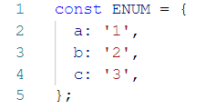
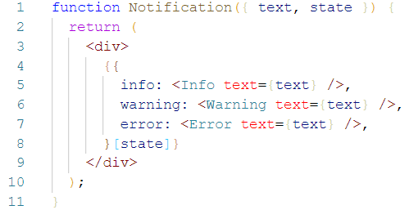
Conditional Rendering with enums
In JavaScript an object can be used as an enum when the object is used as a map of key value pairs.
An enum is a great way to have multiple conditional renderings. Let’s consider the notification component again. This time we can use the enum as inlined object.
The state property key helps us to retrieve the value from the object. That’s neat, isn’t it? It is much more readable compared to the switch case operator.

Slide 14
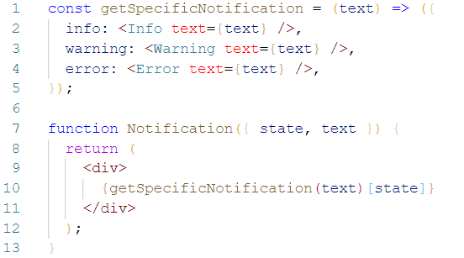
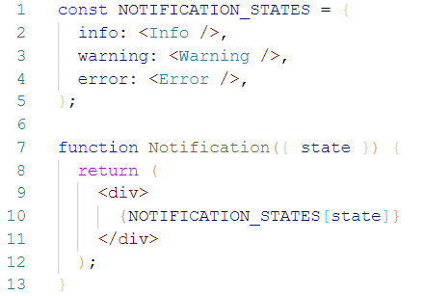
In previous case we had to use an inline object, because the values of the object depend on the text property. That would be my recommended way anyway. However, if it wouldn’t depend on the text property, you could use an external static enum too.
Although we could use a function to retrieve the value, if we would depend on the text property.

Slide 15
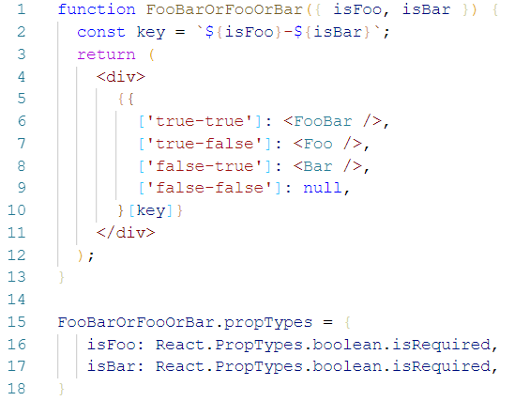
After all, the enum approach in comparison to the switch case statement is more readable. Objects as enums open up plenty of options to have multiple conditional renderings. Consider this last example to see what’s possible:

Slide 16



Immediately-Invoked Function Expressions (IIFE)
As the name implies, IIFEs are functions that are executed immediately after they are defined, there’s no need to call them explicitly.
Generally, this is how you define and execute (at a later point) a function:
But if you want to execute the function immediately after it is defined, you have to wrap the whole declaration in parenthesis (to convert it to an expression) and execute it by adding two more parentheses (passing any arguments the function may take.
Either this way:
Or this way:

Slide 17


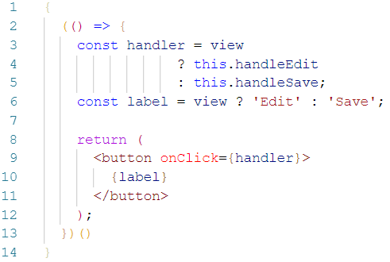
Since the function won’t be called in any other place, you can drop the name:
Or you can also use arrow functions:
In React, you use curly braces to wrap an IIFE, put all the logic you want inside it (if/else, switch, ternary operators, etc), and return whatever you want to render.
For example, here’s how the logic to render the save/edit button could look with an IIFE:

Slide 18
Subcomponents
Sometimes, an IFFE might seem like a hacky solution.
After all, we’re using React, where the recommended approaches are things like splitting up the logic of your app in as many components as possible and using functional programming instead of imperative programming.
So moving the conditional rendering logic to a sub-component that renders different things based on its props would be a good option.
But here, I’m going to do something a bit different to show you how you can go from an imperative solution to more declarative and functional solutions.

Slide 19
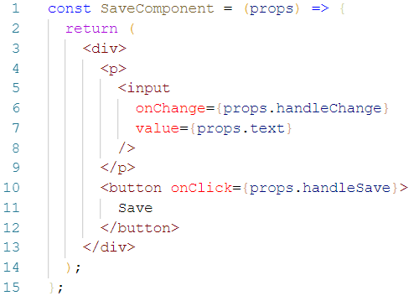
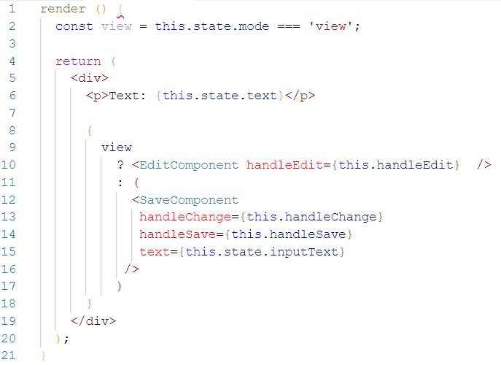
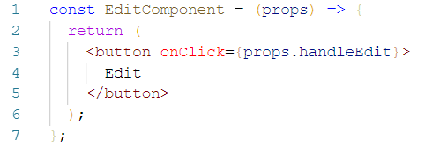
I’m going to start by creating a SaveComponent:
Now the render method can look like this:
As properties, it receives everything it needs to work. In the same way, there’s an EditComponent:

Slide 20
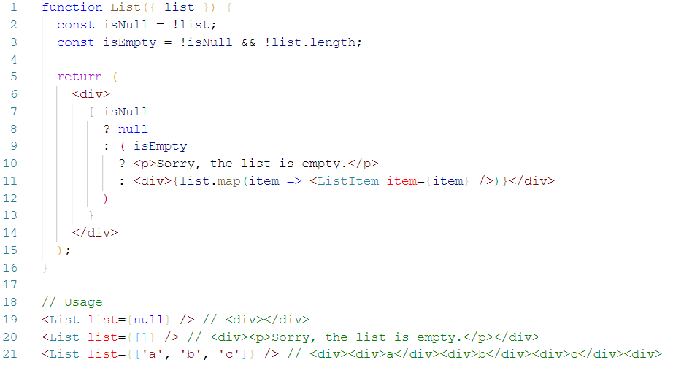
Multi-Level Conditional Rendering
What about nested conditional renderings? Yes, it is possible. For instance, let’s have a look at the List component that can either show a list, an empty text or nothing.

Slide 21
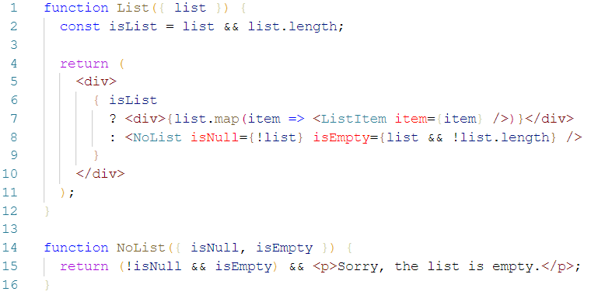
It works. However I would recommend to keep the nested conditional renderings to a minimum. It makes it less readable. My recommendation would be to split it up into smaller components which themselves have conditional renderings.
Still, it doesn’t look that appealing. Let’s have a look at higher order components and how they would help to tidy it up.

Slide 22
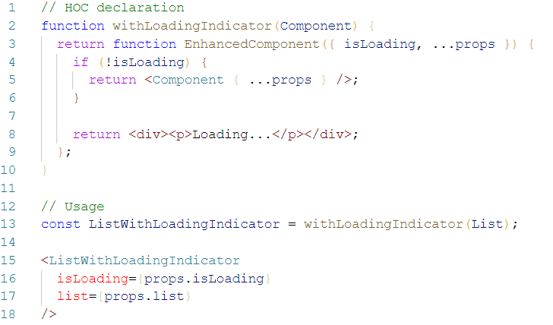
Higher-order components
Higher order components (HOCs) are a perfect match for conditional rendering in React. HOCs can have multiple use cases. Yet one use case could be to alter the look of a component. To make the use case more specific: it could be to apply a conditional rendering for a component. Let’s have a look at a HOC that either shows a loading indicator or a desired component.
In the example, the List component can focus on rendering the list. It doesn’t have to bother with a loading state. Ultimately you could add more HOCs to shield away multiple conditional rendering edge cases.

Slide 23
A HOC can opt-in one or multiple conditional renderings. You could even use multiple HOCs to handle several conditional renderings. After all, a HOC shields away all the noise from your component. If you want to dig deeper into conditional renderings with higher order components, you should read the conditional rendering with HOCs article.

Slide 24
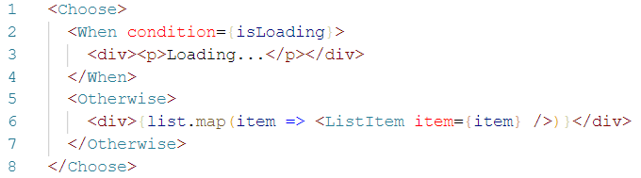
External Templating Components
Last but not least there exist external solutions to deal with conditional renderings. They add control components to enable conditional renderings without JavaScript in JSX. Then it is not question anymore on how to use if else in React.
Some people use it. Personally I wouldn’t recommend it. JSX allows you to use the powerful set of JavaScript functionalities to handle conditional rendering. There is no need to add templating components to enable conditional rendering. A lot of people consider React including JSX as their library of choice, because they can handle the rendering with pure HTML and JS in JSX.

Slide 25
Conclusion

Slide 26
Just as with many things in programming, there are many ways to implement conditional rendering in React.
I’d say that with exception of the first method (if/else with many returns), you’re free to choose whatever method you want.
You can decide which one is best for your situation based on:
Your programming style
How complex the conditional logic is
How comfortable you are with JavaScript, JSX, and advanced React concepts (like HOCs)
And all things being equal, always favor simplicity and readability.

Slide 27
When to use which type of conditional render? My opinionated answer:
If-else
  is the most basic conditional rendering
  beginner friendly
  use if to opt-out early from a render method by returning null
Ternary operator
  use it over an if-else statement
  it is more concise than if-else
Logical && operator
  use it when one side of the ternary operation would return null
  but be careful that you don’t run into bugs when using multiple conditions

Slide 28
Switch case
  verbose
  can only be inlined with self invoking function
  avoid it, use enums instead
Enums
  perfect to map different states
  perfect to map more than one condition
Multi-level/nested conditional renderings
  avoid them for the sake of readability
  split up components into more lightweight components with their own simple conditional rendering
  use HOCs
HOCs
  use them to shield away conditional rendering
  components can focus on their main purpose
External templating components
  avoid them and be comfortable with JSX and JavaScript

Slide 29
CHILDREN TYPES

Slide 30
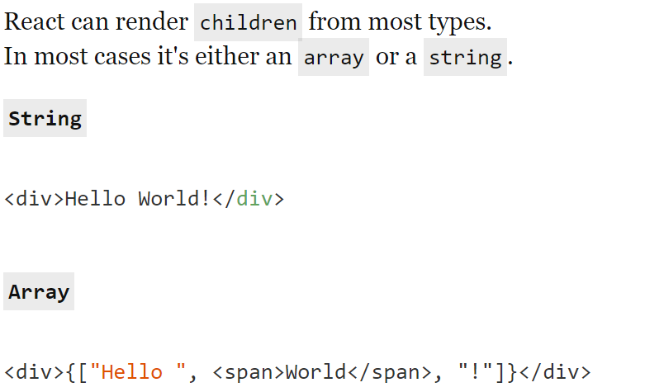
Children types

Slide 31
QUESTIONS ?

Slide 32
USED MATERIALS
https://blog.logrocket.com/conditional-rendering-in-react-c6b0e5af381e
https://hackernoon.com/conditional-rendering-on-react-57a864c2d04d
https://www.robinwieruch.de/conditional-rendering-react/

Slide 33
THANK YOU

