Slide 1
OOP
by Vitaliy Tkachuk

Slide 2
AGENDA
Object model
Constructing objects
Inheritance and prototype chain
This keyword
Object methods
Built-in objects

Slide 3
Object Model

Slide 4
JavaScript is an object-based language based on prototypes, rather than being class-based. Because of this different basis, it can be less apparent how JavaScript allows you to create hierarchies of objects and to have inheritance of properties and their values.
Lets try to clarify the situation…

Slide 5
Class-based vs. prototype-based languages
Class-based object-oriented languages, such as Java and C++, are founded on the concept of two distinct entities: classes and instances.
A class defines all of the properties that characterize a certain set of objects (considering methods and fields in Java, or members in C++, to be properties). A class is abstract rather than any particular member in a set of objects it describes. For example, the Employee class could represent the set of all employees.
An instance, on the other hand, is the instantiation of a class; that is, one of its members. For example, Victoria could be an instance of the Employee class, representing a particular individual as an employee. An instance has exactly the same properties of its parent class (no more, no less).

Slide 6
Class-based vs. prototype-based languages
A prototype-based language, such as JavaScript, does not make this distinction: it simply has objects. A prototype-based language has the notion of a prototypical object, an object used as a template from which to get the initial properties for a new object. Any object can specify its own properties, either when you create it or at run time. In addition, any object can be associated as the prototype for another object, allowing the second object to share the first object's properties.

Slide 7
Defining a class
In class-based languages, you define a class in a separate class definition. In that definition you can specify special methods, called constructors, to create instances of the class. A constructor method can specify initial values for the instance's properties and perform other processing appropriate at creation time. You use the new operator in association with the constructor method to create class instances.
JavaScript follows a similar model, but does not have a class definition separate from the constructor. Instead, you define a constructor function to create objects with a particular initial set of properties and values. Any JavaScript function can be used as a constructor. You use the new operator with a constructor function to create a new object.
JavaScript classes, introduced in ECMAScript 2015, are primarily syntactical sugar over JavaScript's existing prototype-based inheritance. The class syntax does not introduce a new object-oriented inheritance model to JavaScript.

Slide 8
Subclasses and inheritance
In a class-based language, you create a hierarchy of classes through the class definitions. In a class definition, you can specify that the new class is a subclass of an already existing class. The subclass inherits all the properties of the superclass and additionally can add new properties or modify the inherited ones. For example, assume the Employee class includes only the name and dept properties, and Manager is a subclass of Employee that adds the reports property. In this case, an instance of the Manager class would have all three properties: name, dept, and reports.
JavaScript implements inheritance by allowing you to associate a prototypical object with any constructor function. So, you can create exactly the Employee — Manager example, but you use slightly different terminology. First you define the Employee constructor function, specifying the name and dept properties. Next, you define the Manager constructor function, calling the Employee constructor and specifying the reports property. Finally, you assign a new object derived from Employee.prototype as the prototype for the Manager constructor function. Then, when you create a new Manager, it inherits the name and dept properties from the Employee object.

Slide 9
Adding and removing properties
In class-based languages, you typically create a class at compile time and then you instantiate instances of the class either at compile time or at run time. You cannot change the number or the type of properties of a class after you define the class. In JavaScript, however, at run time you can add or remove properties of any object. If you add a property to an object that is used as the prototype for a set of objects, the objects for which it is the prototype also get the new property.

Slide 10
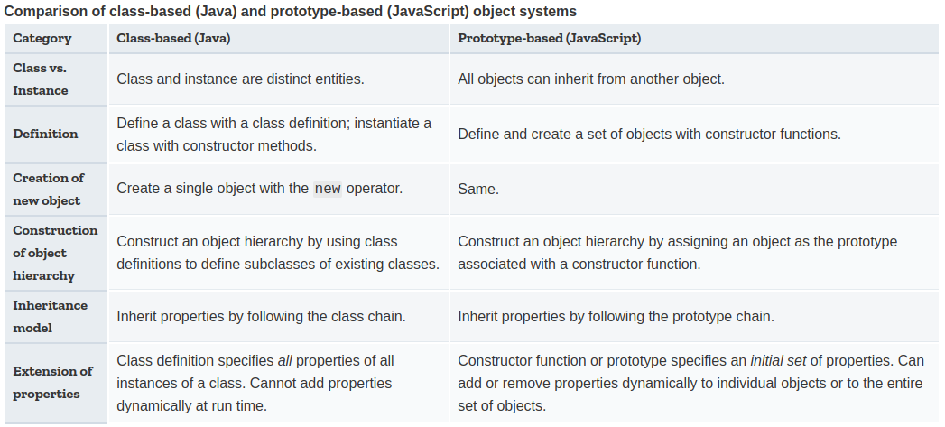
Summary of differences
The following table gives a short summary of some of these differences. The rest of this chapter describes the details of using JavaScript constructors and prototypes to create an object hierarchy and compares this to how you would do it in Java.

Slide 11
Constructing
objects

Slide 12
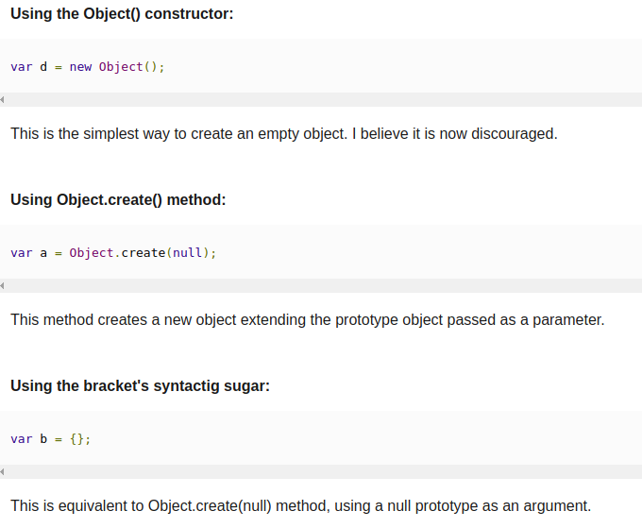
Different ways of creating an Object in javascript

Slide 13
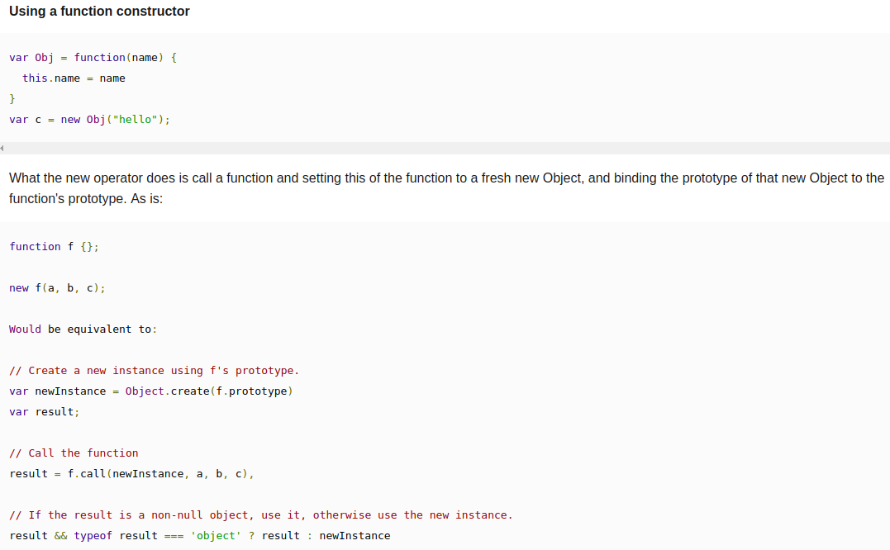

Slide 14
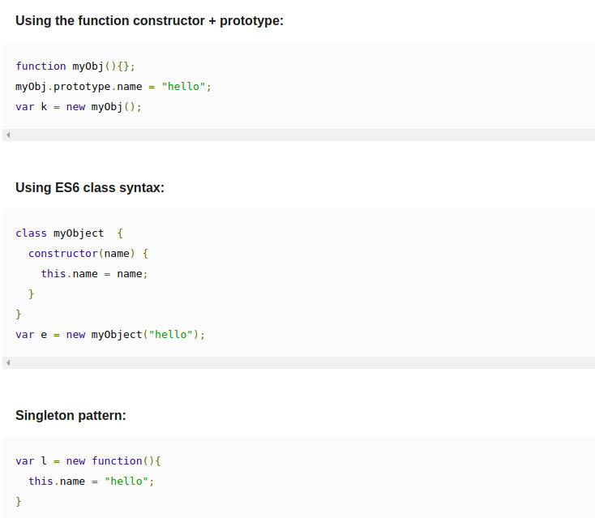

Slide 15
Inheritance and Prototype Chain

Slide 16
Understanding Inheritance and Prototype Chain in JavaScript.
Inheritance is a very important topic when it comes to object oriented programming, by virtue of which children classes inherit from their parent class. But unlike many conventional languages, JavaScript's inheritance is based on prototypes rather than classes.
Before we get started, please keep in mind a function is an object in JavaScript. As it goes with object to have properties, functions have a property called ‘prototype’ property which plays an important role in Prototypal Inheritance ( we will be discussing this property in detail later in this presentation )

Slide 17
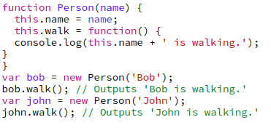
Using the function constructor
A constructor is a normal function in JavaScript. They are meant to be used to create instances of an object with the“new” keyword.
In this example, we created two object instances bob and john using Person constructor. One point to notice `is that each object has its own walk method. You may want the walk method shared across objects with the value of “this” set to the object calling the method. This can be achieved using “prototype” property of the function object.

Slide 18
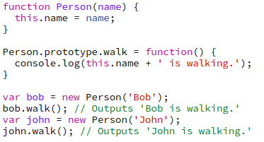
Using the function constructor
Here, the walk method is not getting copied to each of the object instance. Instead it is part of the prototype of the Person constructor function.
(bob.hasOwnProperty(‘walk’) === false) while bob.walk() gives “Bob is walking”. Let us understand how this is working:
When we call bob.walk(), it looks for the walk function in the properties of bob.
As the function doesn’t exist, it looks up the prototype chain to Person.prototype and call the function with “this” set to object calling the method.
This is referred as Prototype Chain.

Slide 19
Using Object.Create()
With Object.Create() JavaScript provided a new function to create object in ES5.
Some important points about Object.create() are as follows:
This method takes two arguments .The first argument is the prototype of the object to be inherited, and is the required argument. To create an empty object, you must pass the Object.prototype as the first argument.
The second optional argument is an object containing the object’s property descriptors.

Slide 20
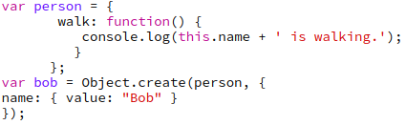
Using Object.Create()
In this case we first define the prototype object person, and then we use Object.create to make a new object which inherits from person. That second argument might look a little strange, but it's just a simple property descriptor object. Inheritance managed by Object.create can't be detected by instanceof. Instead you'll need to use the isPrototypeOf method.

Slide 21
Classical Inheritance vs Prototypal Inheritance
Prototypal Inheritance is dynamic
You can add new properties to prototypes after they are created. This allows you to add new methods to a prototype which will be automatically made available to all the objects which delegate to that prototype.
This is not possible in classical inheritance because once a class is created you can’t modify it at run time. This is probably the biggest advantage of prototypal inheritance over classical inheritance.

Slide 22
Classical Inheritance vs Prototypal Inheritance
Prototypal inheritance is just as powerful as classical inheritance
JavaScript supports multiple inheritance. There are actually two ways to implement prototypal inheritance:
Delegation or Differential Inheritance
Concatenative Inheritance
Differential Inheritance is same as what we discussed above ( looking through the prototype chain ).
Concatenative inheritance is the process of copying the properties from one object to another, without retaining a reference between the two objects. With the introduction of ES6, it is achieved using Object.assign() . The method which is used to copy the values of all enumerable own properties from one or more source objects to a target object. It will return the target object.

Slide 23
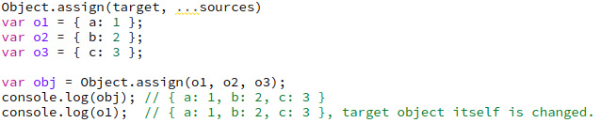
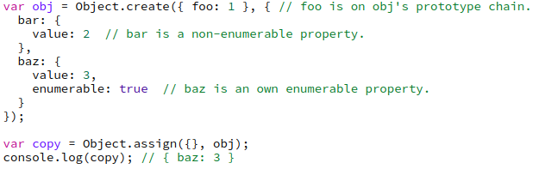
Classical Inheritance vs Prototypal Inheritance
However, Properties on the prototype chain and non-enumerable properties cannot be copied.

Slide 24
Classical Inheritance vs Prototypal Inheritance
Developers from the classical background argue classical inheritance is more powerful as it has private variables. Even Javascript supports private variables using Closures and with the introduction of let and const in ES6 we have block scoping available as well.

Slide 25
This keyword

Slide 26
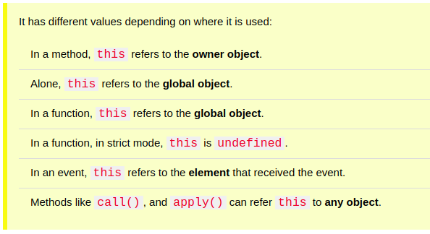
What is this?
The JavaScript this keyword refers to the object it belongs to.

Slide 27
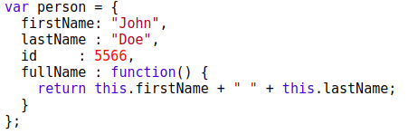
this in a Method
In an object method, this refers to the "owner" of the method.
In the example on the top of this page, this refers to the person object.
The person object is the owner of the fullName method.

Slide 28

this Alone
When used alone, the owner is the Global object, so this refers to the Global object.
In a browser window the Global object is [object Window]:
In strict mode, when used alone, this also refers to the Global object [object Window]:

Slide 29

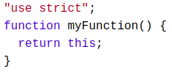
this in a Function
In a JavaScript function, the owner of the function is the default binding for this.
So, in a function, this refers to the Global object [object Window].
JavaScript strict mode does not allow default binding.
So, when used in a function, in strict mode, this is undefined.

Slide 30

this in Event Handlers
In HTML event handlers, this refers to the HTML element that received the event:

Slide 31
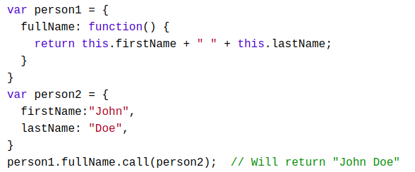
Explicit Function Binding
The call() and apply() methods are predefined JavaScript methods.
In the example below, when calling person1.fullName with person2 as argument, this will refer to person2, even if it is a method of person1:

Slide 32
Object Methods

Slide 33
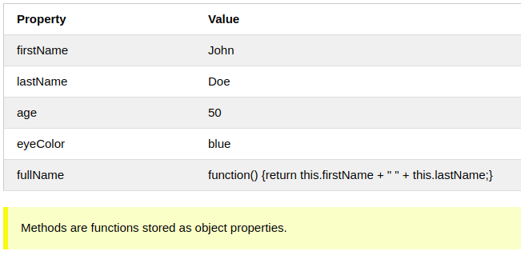
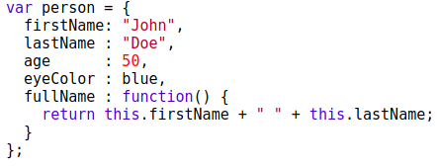
JavaScript Methods
JavaScript methods are actions that can be performed on objects.
A JavaScript method is a property containing a function definition.

Slide 34

Accessing Object Methods
You access an object method with the following syntax:
You will typically describe fullName() as a method of the person object, and fullName as a property.
The fullName property will execute (as a function) when it is invoked with ().
This example accesses the fullName() method of a person object:
If you access the fullName property, without (), it will return the function definition:

Slide 35


Using Built-In Methods
This example uses the toUpperCase() method of the String object, to convert a text to uppercase:
The value of x, after execution of the code above will be:

Slide 36

Adding a Method to an Object
Adding a new method to an object is easy:

Slide 37
Built-in objects

Slide 38
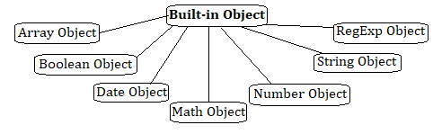
JavaScript Built in Objects
JavaScript has several built-in or core language objects. These built-in objects are available regardless of window content and operate independently of whatever page your browser has loaded.

Slide 39
Array Object
Multiple values are stored in a single variable using the Array object.
In JavaScript, an array can hold different types of data types in a single slot, which
implies that an array can have a string, a number or an object in a single slot.

Slide 40
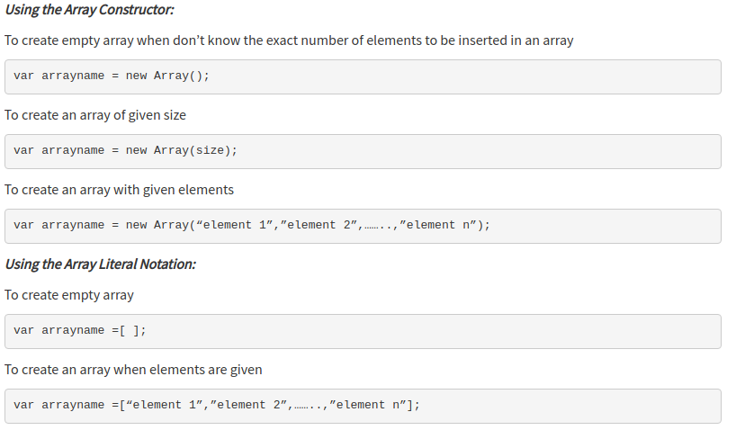
Array Object
An Array object can be created by using following ways...

Slide 41
Array Object
Properties of the Array object
  Length - Returns the number of elements in the array.
  Constructor - Returns the function that created the Array object.
  Prototype - Add properties and methods to an object.
Methods of the Array object
  reverse() - Reverses the array elements
  concat() - Joins two or more arrays
  sort() - Sort the elements of an array
  push() - Appends one or more elements at the end of an array
  pop() - Removes and returns the last element
  shift() - Removes and returns the first element
unshift(), join(), indexOf(), lastIndexOf(), slice(startindex, endindex) are some of the methods used in Array object.

Slide 42
Boolean Object
The Boolean object is wrapper class and member of global objects.
It is used to convert a non-Boolean value to a Boolean value (true or false).
If the Boolean object has no initial value or if it is 0, -0, null, "", false, undefined, or NaN, the object is set to false. Otherwise it is true (even with the string "false")!
Boolean object can be created by using following ways:
Using Boolean Literal Notation: var bool = true;
Using Boolean Object as Function: var bool = Boolean(true);
Using Testable Expressions: if(true) {………….}

Slide 43
Boolean Object
Properties of the Boolean object
  Constructor - Returns the function that created the Boolean object.
  Prototype - Add properties and methods to an object.
Methods of the Boolean object
  toSource() - Returns a string containing the source of the Boolean object; you can use this string to create an equivalent object.
  toString() - Returns a string of either "true" or "false" depending upon the value of the object.
  valueOf() - Returns the primitive value of the Boolean object

Slide 44
Date Object
At times when user need to access the current date and time and also past and future date and times. JavaScript provides support for working with dates and time through the Date object.
The Date object provides a system-independent abstraction of dates and times.
Date object can be created as : var today = new Date( );
Dates may be constructed from a year, month, day of the month, hour, minute, and second, and those six components, as well as the day of the week, may be extracted from a date.
Dates may also be compared and converted to a readable string form. A Date is represented to a precision of one millisecond.

Slide 45
Date Object
Properties of Date object
  Constructor - Returns the function that created the Date object.
  Prototype - Add properties and methods to an object.
Methods of Date object
  Date() - Returns today's date and time
  getDate() - Returns the day of the month for the specified date
  getDay() - Returns the day of the week for the specified date
  getFullYear() - Returns the year of the specified date
  getHours() - Returns the hour in the specified date according to local time.
  getMilliseconds() - Returns the milliseconds in the specified date according to local time.
getMinute(), getMonth(), getTime(), getTimezoneOffset(), setDate(), setFullYear(), setHours(), setMilliseconds(), setMinutes(), setMonth(), setSeconds(), setTime() are some of the methods used in Date object.

Slide 46
Math Object
The Math object is used to perform simple and complex arithmetic operations.
The Math object provides a number of properties and methods to work with Number values
The Math object does not have any constructors. All of its methods and properties are static; that is, they are member functions of the Math object itself. There is no way to create an instance of the Math object.
Properties of Math object
  PI - The value of Pi
  E - The base of natural logarithm e
  LN2 - Natural logarithm of 2
  LN10 - Natural logarithm of 10
  LOG2E - Base 2 logarithm of e
  LOG10E - Base 10 logarithm of e
  SQRT2 - Square root of 2
  SQRT1_2 - Square root of ½

Slide 47
Math Object
Methods of Math object
  max(a,b) - Returns largest of a and b
  min(a,b) - Returns least of a and b
  round(a) - Returns nearest integer
  ceil(a) - Rounds up. Returns the smallest integer greater than or equal to a
  floor(a) - Rounds down. Returns the largest integer smaller than or equal to a
  exp(a) - Returns ea
  pow(a,b) - Returns ab
  abs(a) - Returns absolute value of a
  random() - Returns a pseudo random number between 0 and 1
  sqrt(a) - Returns square root of a
  sin(a) - Returns sin of a (a is in radians)
  cos(a) - Returns cos of a (a is in radians)

Slide 48
Number Object
The Number objects represents numerical date, either integers or floating-point numbers.
A Number objects are created using the Number() constructor var num = new number(value);
Properties of Number object
  Constructor - Returns the function that created the Number object.
  MAX VALUE - Returns maximum numerical value possible in JavaScript.
  MIN VALUE - Returns minimum numerical value possible in JavaScript.
  NEGATIVE INFINITY - Represent the value of negative infinity.
  POSITIVE INFINITY - Represent the value of infinity.
  Prototype - Add properties and methods to an object.

Slide 49
Number Object
Methods of Number object
  toExponential() - Converts a number into exponential notation.
  toFixed() - Formats a number with a specific number of digits to the right of the decimal.
  toLocaleString() - Returns a string value version of the current number in a format that may vary according to a browser's locale settings.
  toPrecision() - Defines how many total digits to display of a number.
  toString() - Returns the string representation of the number's value.
  valueOf() - Returns the number's value.

Slide 50
String Object
in JavaScript, all strings are represented as instances of the String object.
The String object is wrapper class and member of global objects.
String object used to perform operations on the stored text, such as finding the length of the string, searching for occurrence of certain characters within string, extracting a substring etc.
A String is created by using literals. A string literal is either enclosed within single quotes(‘ ‘) or double quotes(“ “) var string1= “ Ques10“ ;
Properties of String object
  Length - Returns the length of string.
  Constructor - Returns the function that created the String object
  Prototype - Add properties and methods to an object

Slide 51
String Object
Methods of String object
  charAt() - Returns the character at a specified position.
  concat() - Combines two or more strings.
  toLowerString() - Converts a string to lowercase.
  toUpperString() - Converts a string to uppercase.
  indexOf(searchtext, index) - Searches for the specified string from the beginning of the string.
  lastIndexof(searchtext, index) - Searches for the specified string from the end of the string

Slide 52
RegExp Object
RegExp object used to validate the pattern of characters.
RegExp define methods that use regular expressions to perform powerful pattern-matching and search and replace functions on text.
Regular expressions can be defined by using following ways
Using RegExp() Constructor:
var RegularExpression = new RegExp(“pattern”,”flag”);
Using Literal:
var RegularExpression = /pattern/flag;

Slide 53
RegExp Object
Pattern – A String that specifies the pattern of the regular expression or another regular expression.
Flag – An optional string containing any of the “g”, “I” and “m” attributes that specify global, case-insensitive and multiple matches respectively.
Properties of RegExp object
  Constructor - Returns the function that created the RegExp object
  Global - Checks whether the "g" modifier is set
  ignoreCase - Checks whether the "i" modifier is set
  lastIndex - Specifies the index at which to start the next match
  multiline - Checks whether the "m" modifier is set
  source - Returns the text of the RegExp pattern
Methods of RegExp object
  exec() - Tests for a match in a string. Returns the first match.
  test() - Tests for a match in a string. Returns true or false.
  toString() - Returns the string value of the regular expression.
  toSource() - Returns an object literal representing the specified object.

Slide 54
QUESTIONS ?

Slide 55
USED MATERIALS
https://developer.mozilla.org/en-US/docs/Web/JavaScript/Guide/Details_of_the_Object_Model
https://medium.com/@akash.mihul/understanding-inheritance-and-prototype-chain-in-javascript-75d0086fd90f
http://www.ques10.com/p/29073/explain-built-in-objects-of-javascript/
https://www.tutorialride.com/javascript/javascript-built-in-objects.htm

Slide 56
THANK YOU

