Slide 1

WILDFIRES
Vit Vajnar I2.C

Slide 2
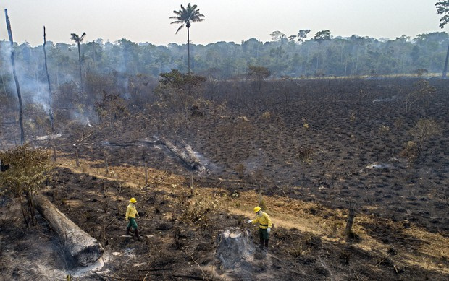
Introduction
Wildfires
Wildfires are uncontrolled fires that spread quickly through vegetation
They can occur naturally or be caused by humans

Slide 3
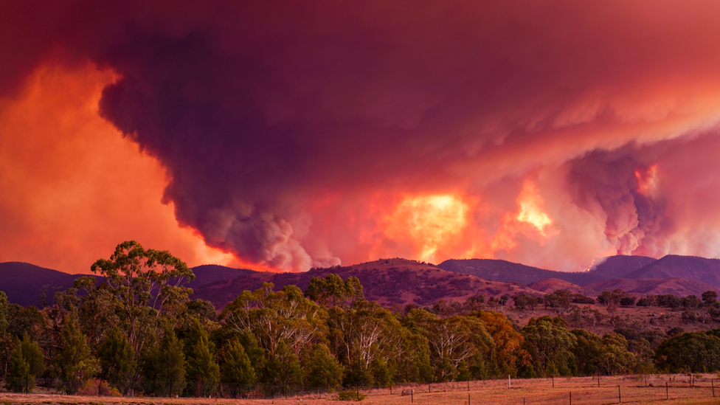
Causes of Wildfires
They are divided into two groups
Natural Causes
Lightning strikes
Volcanic activity
High temperatures
Human Causes
Campfires
Discarded cigarettes
Sparks from machinery
Arson
4

Slide 4
Impact of Wildfires
1
2
3
Environmental damage
Human impact
Air pollution
Smoke can travel for miles, affecting air quality
Destruction of ecosystems, loss of wildlife
Property damage, injuries

Slide 5
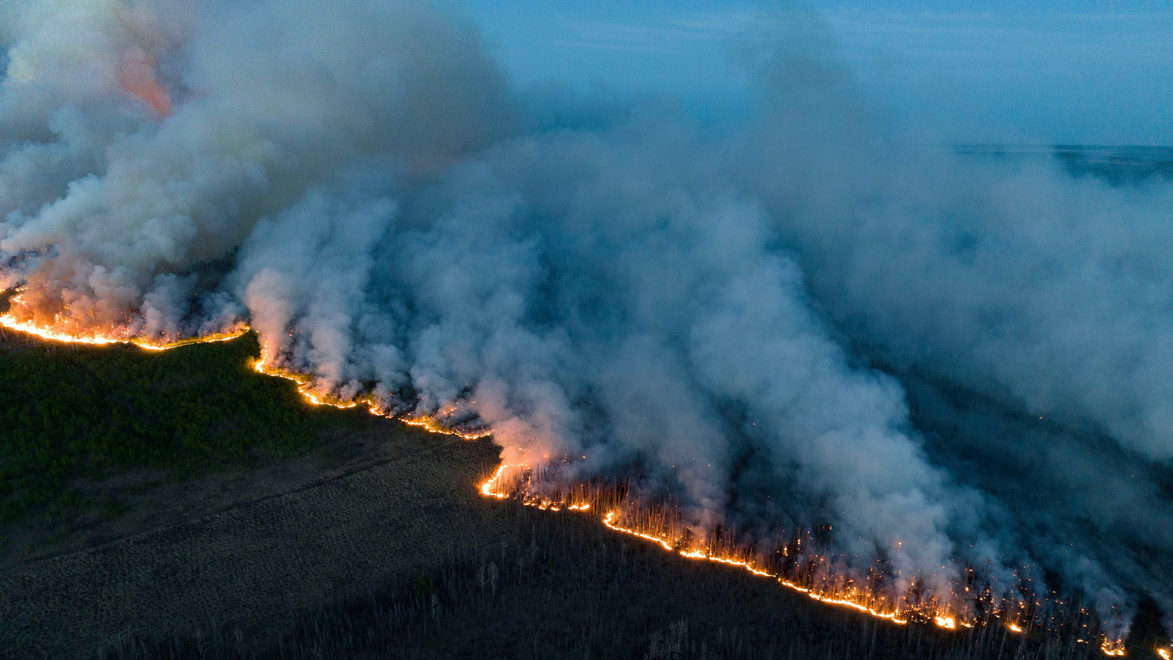
Prevention and management
Prevention
creating firebreaks
controlling campfires
maintaining fire safety practices
Management
Firefighters use controlled burns, air support, and ground teams to contain wildfires
8

Slide 6
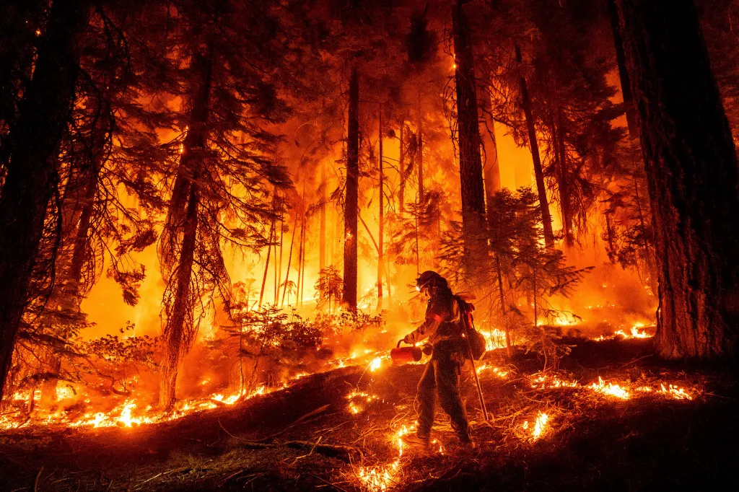
Advice for surviving wildfires
Create a plan
Avoid smoke
Follow authorities' instructions
Wear protective clothes
Emergency kit
8

Slide 7
Famous Wildfires
1
2
3
2019-2020 Australian Bushfires
2003 Siberian Taiga Wildfire
2019 Amazon Rainforest Fires
Burned around 17 millions hectares across Australia Destroyed thousands of homes, killed at least 33 people
The fires were mostly caused by illegal deforestation
The Amazon makes 20% of the world’s oxygen, so the fires harmed the environment
The largest wildfire in recorded history
Burned over 22 milions hectares of forest
Happened cause of high temperatures

Slide 8
Resources
https://en.wikipedia.org/wiki/Wildfire
https://chatgpt.com/
https://www.jagranjosh.com/general-knowledge/list-of-largest-wildfires-in-history-1736422705-1

Slide 9
THANK YOU
For Your Attention
VIT VAJNAR I2.C

