Slide 1
Week 2 (Instructor EP)
Bayes rule and Naive Bayes classifier (T)
Linear and quadratic discriminant analysis (lda, qda) (T)
Nearest neighbor classifier (T)
Classification and regression tree (T)
Support vector machines (W)
Classifier independent learning, (W)
validation, model complexity one more time (W)

Slide 2
Different names for similar data analysis areas, lets define how we understand them
Data mining
Machine learning
Pattern recognition
Artificial intelligence
Business intelligence
Statistical learning theory
Deep learning

Slide 3

Recognizing patterns. Conceptually this task comes down to Find N differences between M datasets

Slide 4
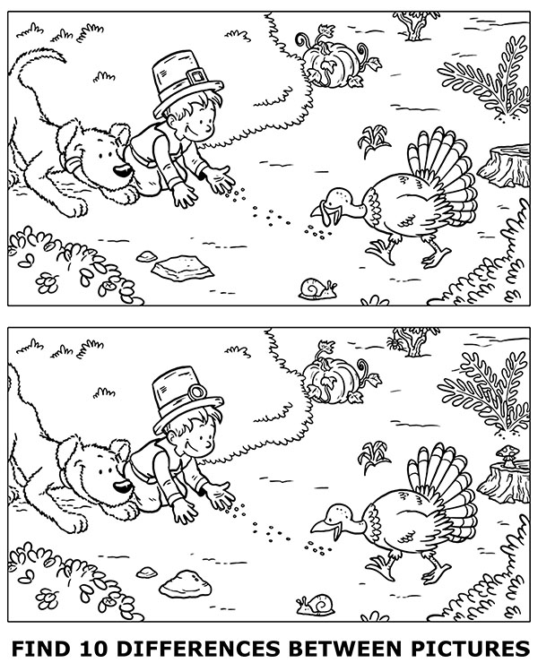
Is this a more difficult problem ?

Slide 5
Tasks that we can formalize and categorize
Supervised learning – has a teacher
Classification, regression, clustering
Unsupervised learning – no teacher
Clustering, dimensionality reduction, deep learning
Reinforcement learning – learn from nonspecific feedback
Case based reasoning, transduction, deep learning

Slide 6
Representation
Feature space froom 1D to 2D to mD
Decision regions and boundaries
Generalization performance : the algorithm that we build learns from data ( in a supervised or unsupervised or semi-supervised way) and is able to generalize well on novel patterns.
What matters most – good features to represent the nature of the data that we wish to analyze/ to mine
Training set, test set, validation set, evaluation criteria

Slide 7
Let’s say we have data. What is next? Is there a question? What question we can ask to start with?
Datasets in R
library(datasets)
ls(package:datasets)
data(iris)
data(cars) ..
Stop here. What can we say about this Iris dataset? What question we may ask?

Slide 8
Data resources. Competitions, challenges and post challenge participation
http://clopinet.com/isabelle/Projects/NIPS2003/#challenge
https://competitions.codalab.org/competitions/6131
https://competitions.codalab.org/competitions/3931#results
http://www.agnostic.inf.ethz.ch/results.php
http://chalearnlap.cvc.uab.es/
https://www.kdnuggets.com/competitions/index.html

Slide 9
Datasets and repositories to learn data mining, machine learning
Kaggle
UCI Machine learning datasets
KDnuggets portal
Chalearn
else?

Slide 10
Why to?
to grasp some fundamental theoretical concepts underlying practical tools based on David Hand’s
Principles of data mining (2001)
How to?
practical recipes from
R-bloggers https://www.r-bloggers.com/
A

Slide 11
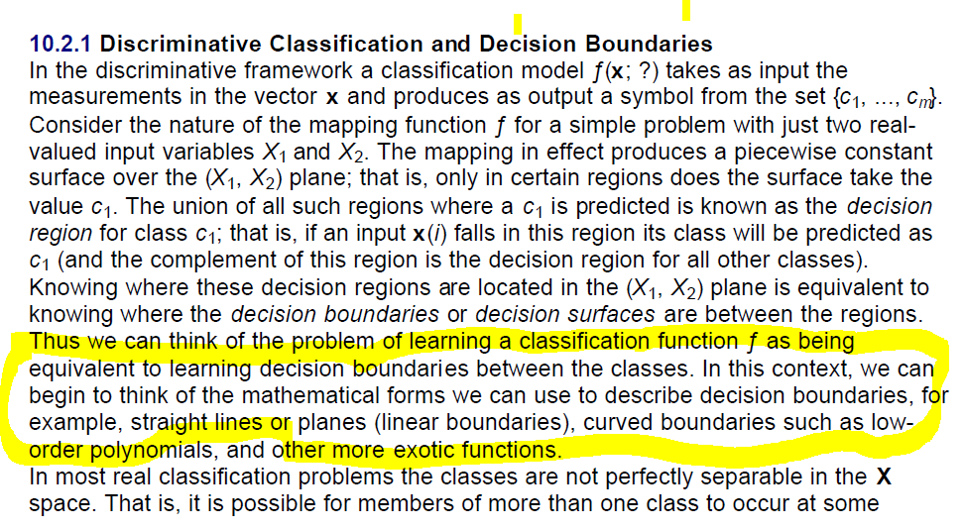
Concepts
David Hand. Principles of data mining. P 197

Slide 12
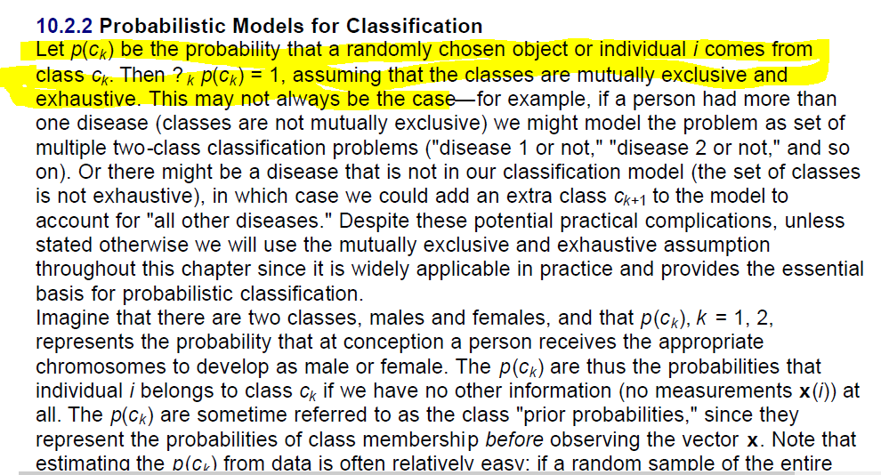

Slide 13
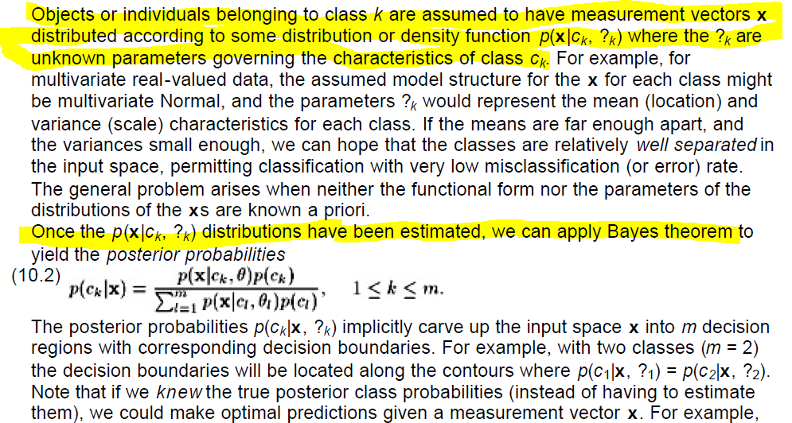
Bayes rule

Slide 14
Probabilistic learning Bayes rule
https://www.r-bloggers.com/understanding-naive-bayes-classifier-using-r/

Slide 15
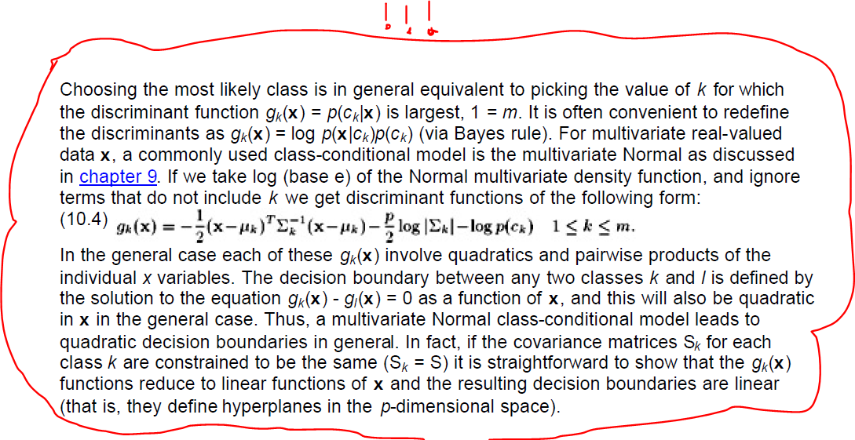
This is a very important summary for understanding how to perceive discriminant functions
D.Hand
P 201
Lets try
Figure 10.2
Principle on Iris DS

Slide 16
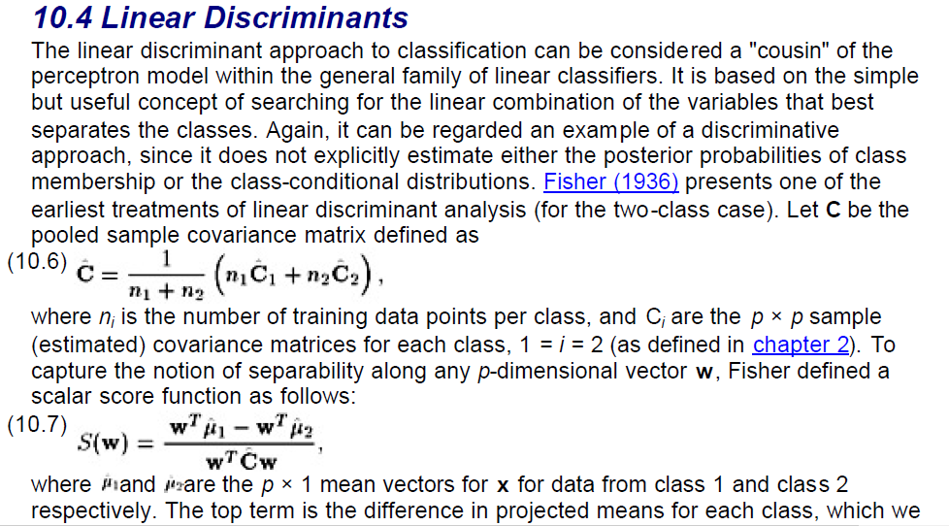
This is essence of what linear discriminat is (1)

Slide 17
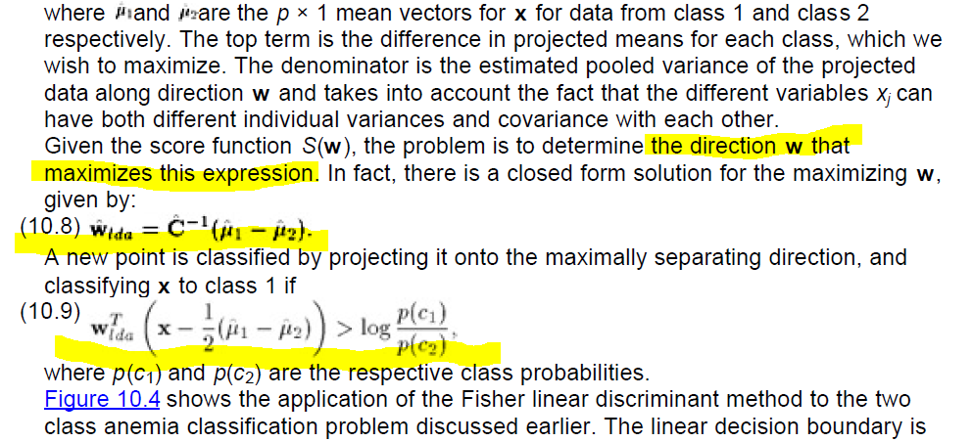
(2) How to compute weights in LD and to classify

Slide 18
Linear discriminant analysis
https://www.r-bloggers.com/discriminant-analysis-statistics-all-the-way/
https://www.r-bloggers.com/computing-and-visualizing-lda-in-r/
Quadratic discriminant analysis
https://www.r-bloggers.com/quadratic-discriminant-analysis-of-two-groups/

Slide 19
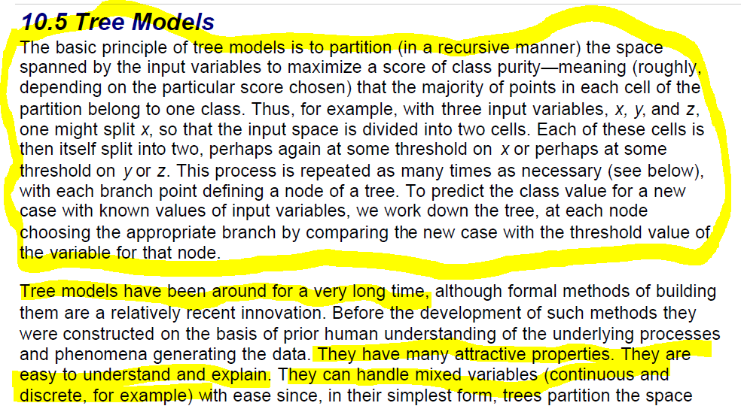
Classification trees

Slide 20
Classification and regression trees (CART) also sometimes called Decision trees
https://www.r-bloggers.com/a-brief-tour-of-the-trees-and-forests/
https://www.r-bloggers.com/how-to-identify-risky-bank-loans-using-c-50-decision-trees/
https://www.r-bloggers.com/classification-tree-models/
https://www.r-bloggers.com/why-do-decision-trees-work/

Slide 21
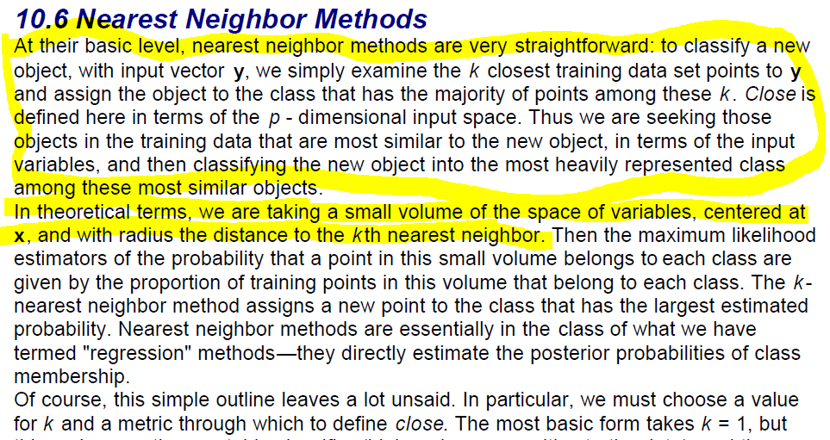
K-NN method

Slide 22
K nearest neighbors classifier
https://www.r-bloggers.com/machine-learning-in-r-for-beginners/
https://www.r-bloggers.com/using-knn-classifier-to-predict-whether-the-price-of-stock-will-increase/

Slide 23
Summary
Naive Bayes classifier is based on Bayes theorem and requires prior probabilities of the classes and class conditional probability distributions
Linear/quadratic discriminant estimates/searches the weight vector that maximizes within class to between class variance ratio and ensures the best separation of projected feature vectors between classes. It turns out that the most optimal estimate is difference between estimates of class means multiplied by inverse covariance matrix.
Classification tree classifiers are conceptually different – they search for the best splits on the classes based on the feature values and create classification rule systems.
K nearest neighbor classifiers are the simplest, but very powerful tools, because these cassifiers are capable of realising very complex decision boundaries.
Everything works if classes are well separated (some feature values
or some combinations of features do not overlap)

Slide 24
Recommended literature in depth
https://www.r-bloggers.com/in-depth-introduction-to-machine-learning-in-15-hours-of-expert-videos/
https://www.r-bloggers.com/the-geometry-of-classifiers/

Slide 25
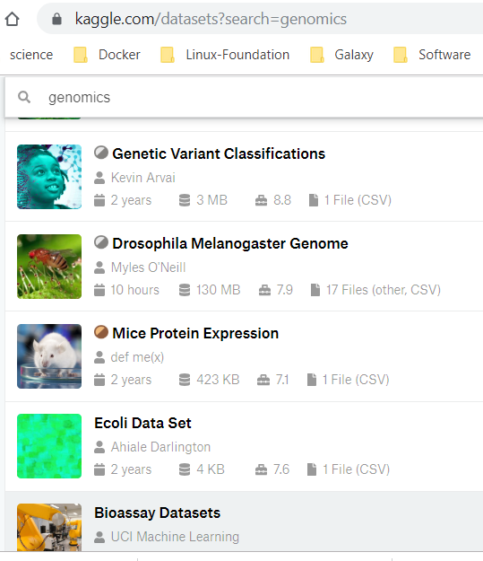
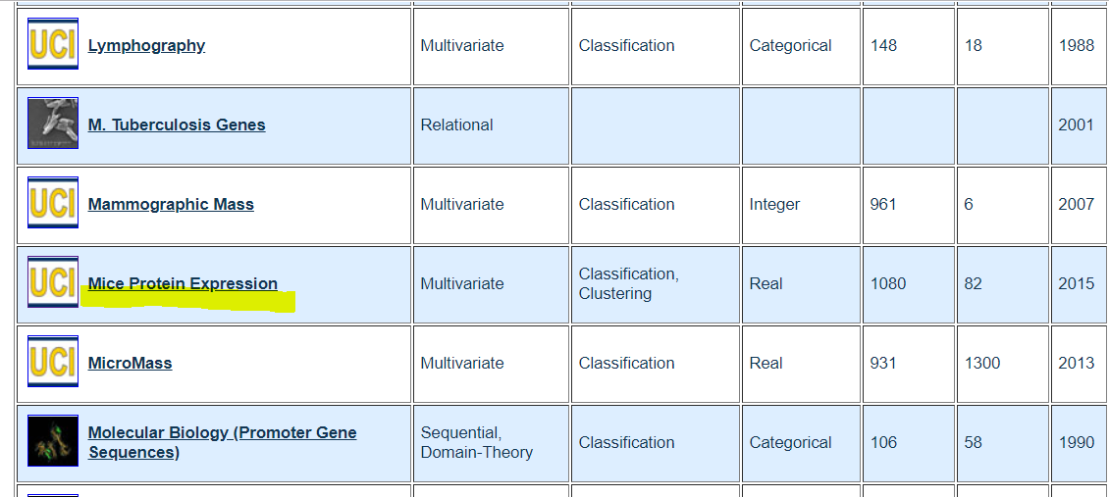
Course Dataset Mice Protein Expression in Kaggle and UCI ML datasets
Download https://archive.ics.uci.edu/ml/datasets/Mice+Protein+Expression

Slide 26
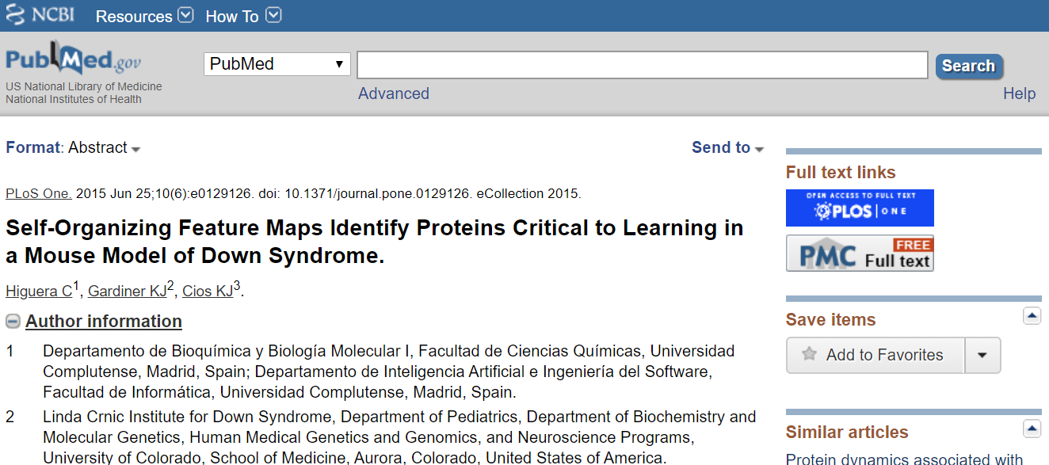
Dataset paper

