Slide 1

Unsupervised learning introduction
Clustering
Machine Learning

Slide 2


Supervised learning
Training set:

Slide 3
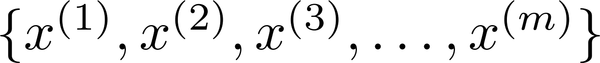
Unsupervised learning
Clustering algorithm
Training set:

Slide 4


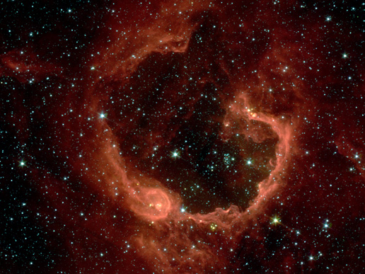
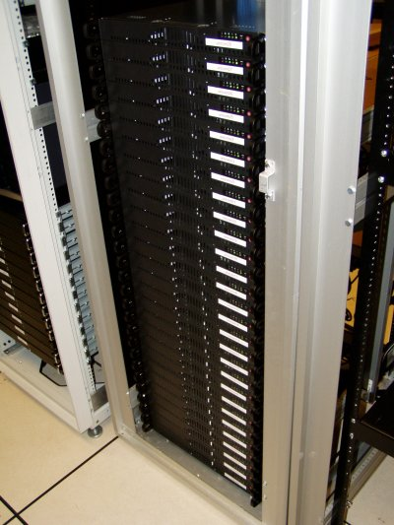
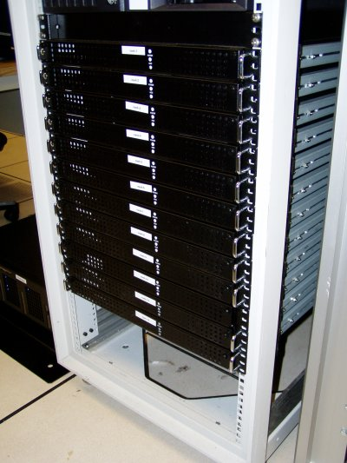
Applications of clustering
Market segmentation
Social network analysis
Image credit: NASA/JPL-Caltech/E. Churchwell (Univ. of Wisconsin, Madison)
Organize computing clusters
Astronomical data analysis
Notes:
Swap: market seg and organize clusters

Slide 5
K-means algorithm
Clustering
Machine Learning

Slide 6
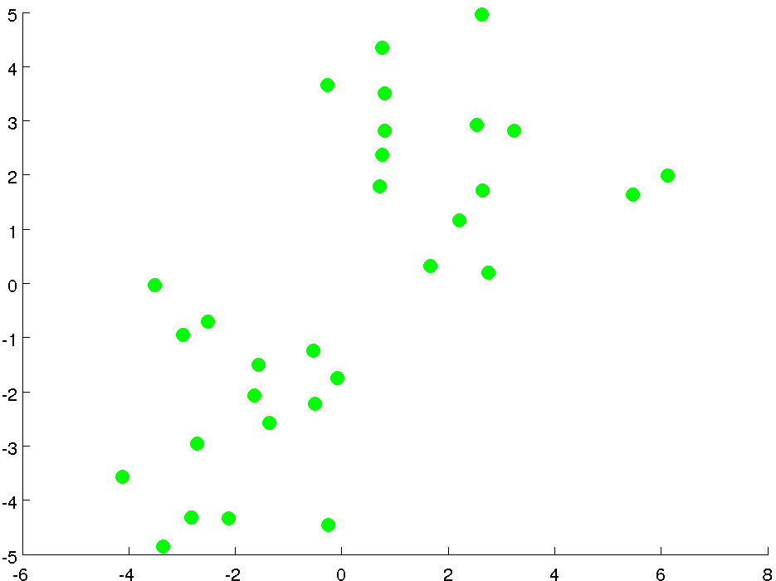

Slide 7
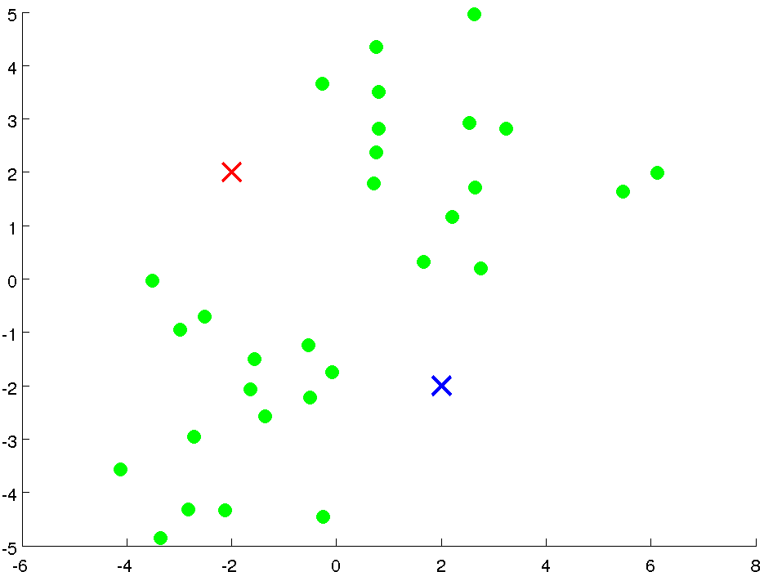
Cluster centroids

Slide 8
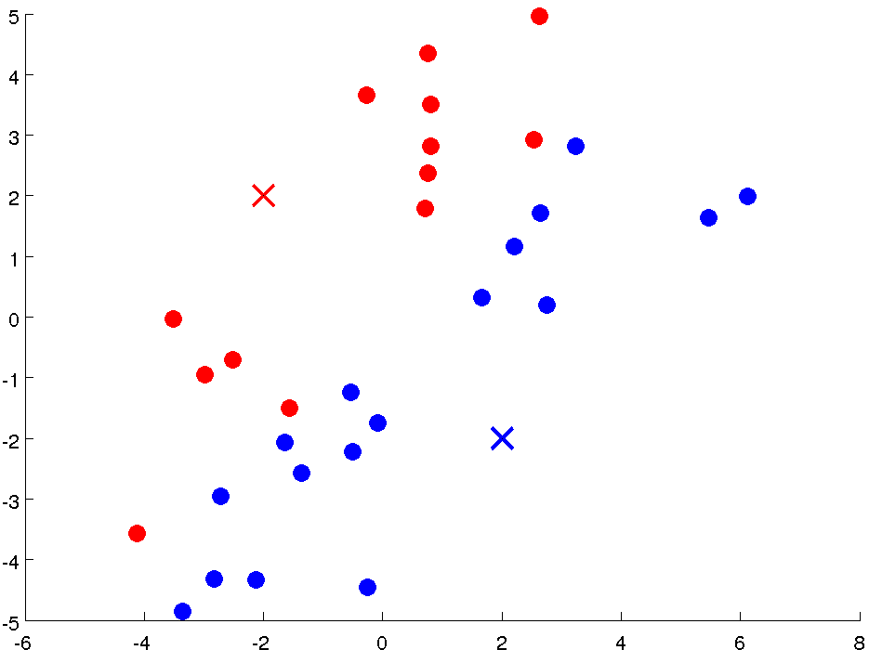

Slide 9
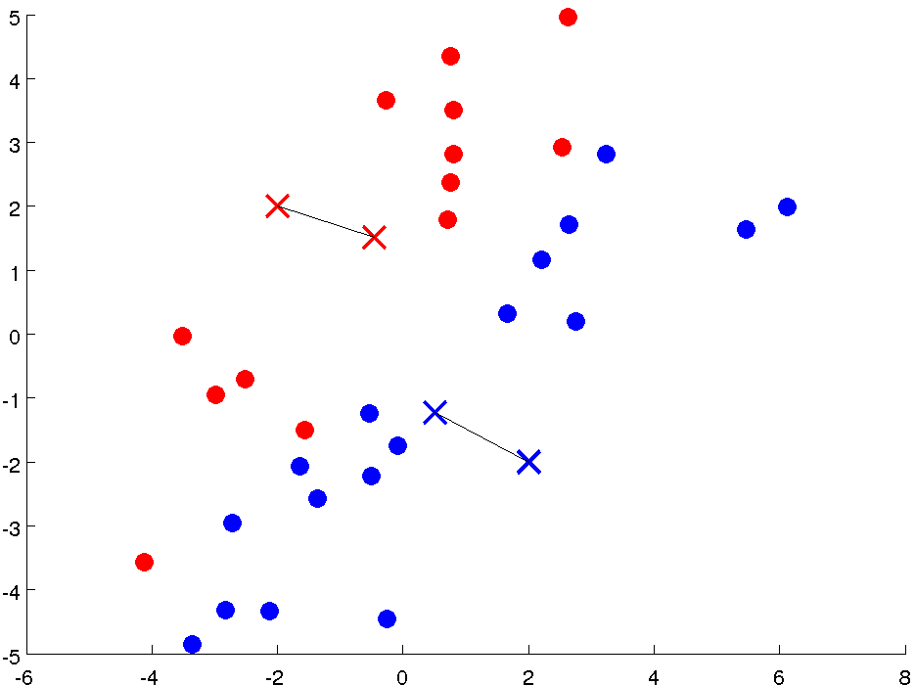

Slide 10
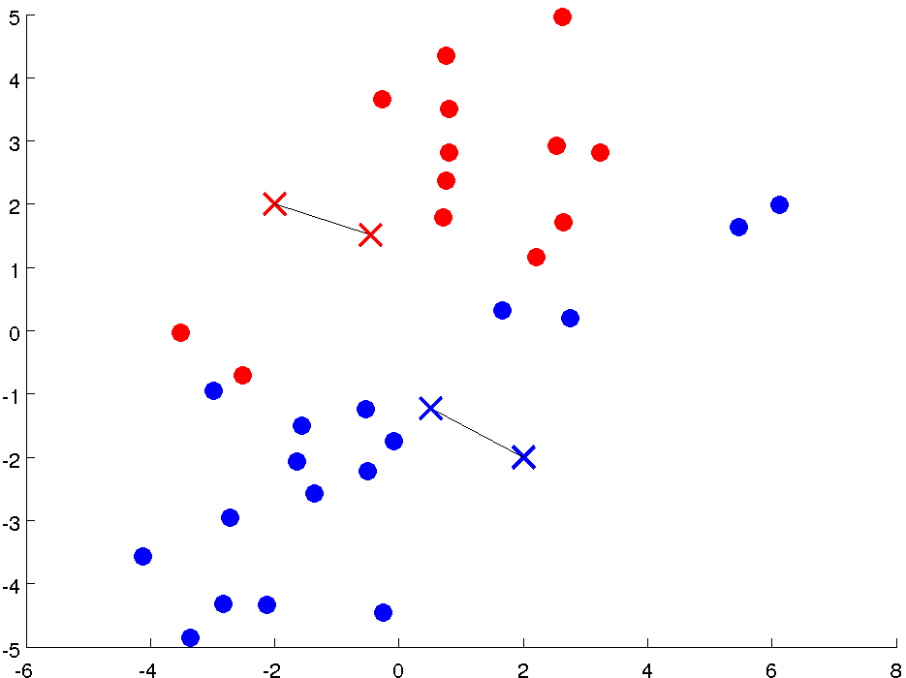

Slide 11
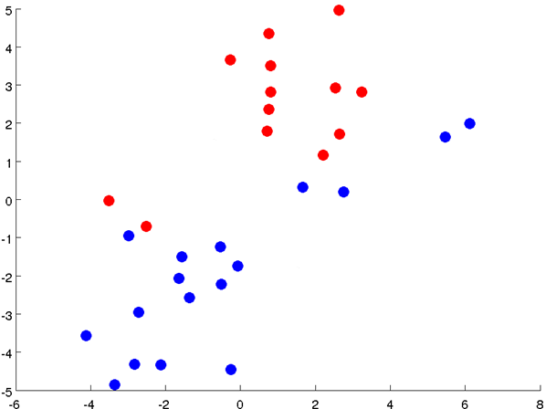

Slide 12
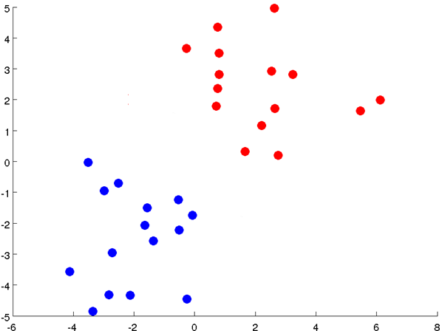

Slide 13
Notes:
Get rid of the legacy points

Slide 14
Notes:
Get rid of the legacy points

Slide 15

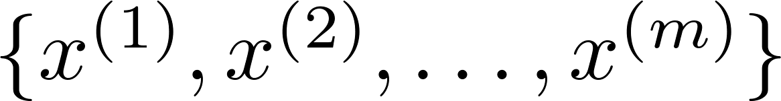
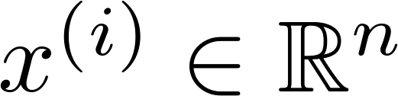
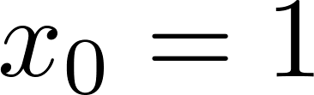
K-means algorithm
Input:
(number of clusters)
Training set
(drop convention)

Slide 16

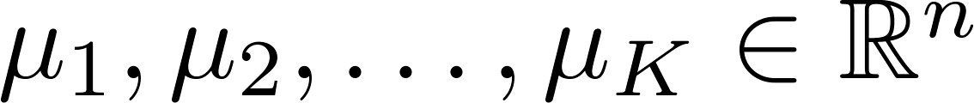
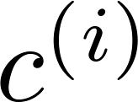
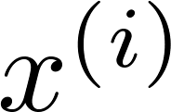


K-means algorithm
Randomly initialize cluster centroids
Repeat {
for = 1 to
:= index (from 1 to ) of cluster centroid
closest to
for = 1 to
:= average (mean) of points assigned to cluster
}
Cluster assignment step
$$\min_{k}=||x^{\left(i\right)}−u_{k}||^{2}$$
Move centroids
step
Notes:
Replace with normal text, size with LATEX fonts

Slide 17
K-means for non-separated clusters
S,M,L
T-shirt sizing
L
Weight
M
S
separable
Height

Slide 18
Optimization objective
Clustering
Machine Learning

Slide 19

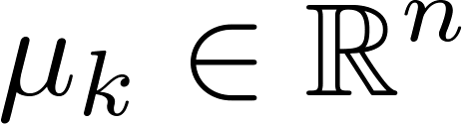

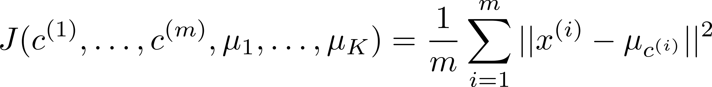
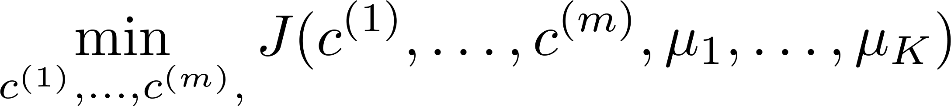


K-means optimization objective
= index of cluster (1,2,…, ) to which example is currently assigned
= cluster centroid ( )
= cluster centroid of cluster to which example has been assigned
$$x^{\left(i\right)}→5 c^{\left(i\right)}=5{ μ}_{c^{\left(i\right)}}=μ_{5}$$
Optimization objective:
Notes:
Change numbers to LATEX as well

Slide 20



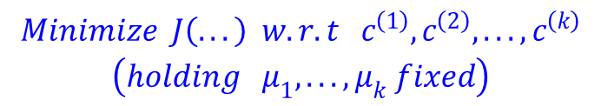
K-means algorithm
Randomly initialize cluster centroids
$$\begin{matrix}Minimize J\left(...\right) w.r.t{ c}^{\left(1\right)},c^{\left(2\right)},...,c^{\left(k\right)} \\ \left(holding μ_{1},...,μ_{k} fixed\right)\end{matrix}$$
Cluster assignment step
Repeat {
for = 1 to
:= index (from 1 to ) of cluster centroid
closest to
for = 1 to
:= average (mean) of points assigned to cluster
}
Move centroids step
$$Minimize J\left(...\right) w.r.t μ_{1},...,μ_{k}$$
Notes:
Replace as previous; change spacing to fill page

Slide 21
Random initialization
Clustering
Machine Learning

Slide 22
K-means algorithm
Randomly initialize cluster centroids
Repeat {
for = 1 to
:= index (from 1 to ) of cluster centroid
closest to
for = 1 to
:= average (mean) of points assigned to cluster
}
Notes:
Replace as previous; change spacing to fill page

Slide 23

Random initialization
Example:
K=2
Should have
Randomly pick training
examples.
Set equal to these
examples.
Notes:
LATEX font

Slide 24
Local optima
But…..
Unlucky random initialization

Slide 25
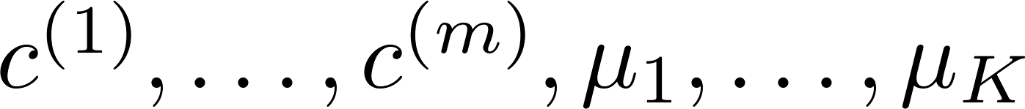
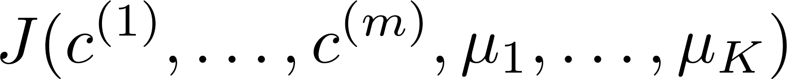
Random initialization
For i = 1 to 100 {
Randomly initialize K-means.
Run K-means. Get .
Compute cost function (distortion)
}
Pick clustering that gave lowest cost

Slide 26
Choosing the number of clusters
Clustering
Machine Learning

Slide 27
What is the right value of K?

Slide 28

Choosing the value of K
Elbow method:
There is no clear elbow
elbow
Cost function
Cost function
(no. of clusters)
(no. of clusters)

Slide 29
Choosing the value of K
Sometimes, you’re running K-means to get clusters to use for some later/downstream purpose. Evaluate K-means based on a metric for how well it performs for that later purpose.
E.g.
K=S,M,L
K=XS,S,M,L,XL
T-shirt sizing
T-shirt sizing
XL
L
L
Weight
Weight
M
M
S
S
XS
Height
Height

