Slide 1

A DISCRETE FRACTURE NETWORK GENERATION AND ANALYSIS LIBRARY FOR USE IN CAD SOFTWARE ENVIRONMENTS
By
Falola, Yusuf
Supervisors: Dr Adriana Paluszny and Dr Robin Thomas
September 2019

Slide 2
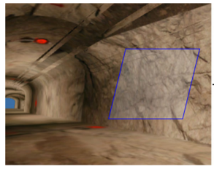
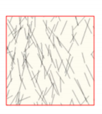
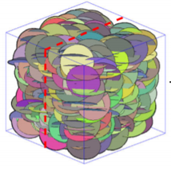
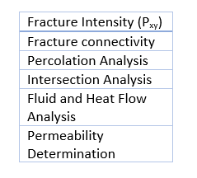
INTRODUCTION
Fractures represent a space between planes and are ubiquitous in many materials [1].
A fracture network is a system of fractures developed within the same rock volume [2].
A Discrete Fracture Network (DFN) is a computational model for representing fracture networks.
Adapted and modified from Wang et al. [3]
Notes:
Define fracture briefly
Fracture network
DFN
Explain how DFN is done

Slide 3
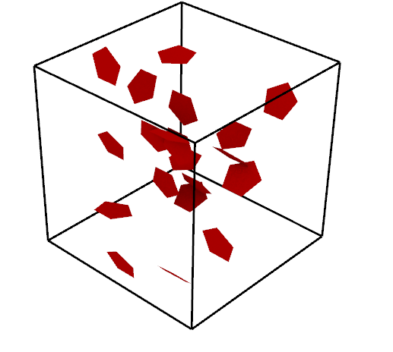
EXISITING DFN TOOLS
MoFrac
DfnWorks
Flow123d
FracMan
SIDNUR
NAPSAC
ADFNE
ICGT
3
Notes:
1. Explain tools and shortcomings.

Slide 4
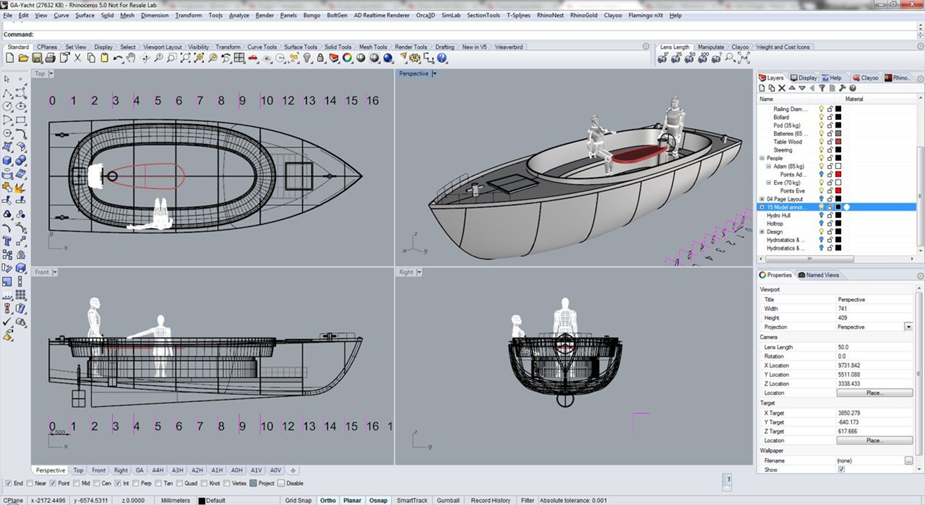
RHINOCEROS 3D CAD SOFTWARE
CAD software package developed by Robert McNeel and Associates.
Rhino allows users to write python script and includes python API.
Well documented, actively developed, fast, cheap, and available to download on a free trial.
Adapted from Steemhunt [4]
Notes:
Why CAD softwares?
What is Rhino, why Rhino?

Slide 5
RESEARCH OBJECTIVES
To develop a computationally cheap, open sourced, and easy to use python library for DFN generation and analysis (Y-Frac).
To ensure the python library is able to reload fracture network using an input file.
To validate functionality and practical applicability of Y-Frac.

Slide 6
SOFTWARE DEVELOPMENT STRATEGY
Git and GitHub were used for version control and code merging.
V-Model software development methodology was adopted.
Library was developed based on modular programming.
Auto-documentation using Sphinx.
Automated and Unit Testing could not be done because, it was not possible to import the Rhino library and output data type are not usual.

Slide 7
Y-FRAC STRUCTURE (1)
DFN_Gen
DFN Generation
Domain
Domain creation and analysis
Frac
Fracture objects creation
DFN_Analysis
3D and cut-plane analysis
Y-FRAC
DFN_ReGen
DFN Re-generation
DFN_PostProcessing
Network postprocessing
Matrix
Intersection matrix handling
Input
Fracture parameters specification
StatInput
Statistical distribution specification

Slide 8
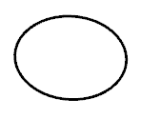
Y-FRAC STRUCTURE (2)
Fracture orientation, location, size and intensity follow uniform distribution.
Fractures are stored as surfaces on Rhino and as GUIDs in python.
Fractures are objects. Each fracture stores its name, GUID and location.
Postprocessing is done outside the Rhinoceros environment.
python
Rhino

Slide 9
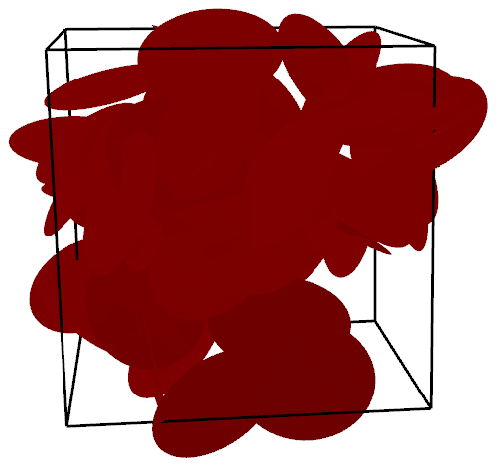
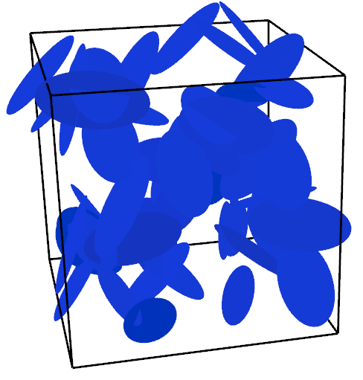
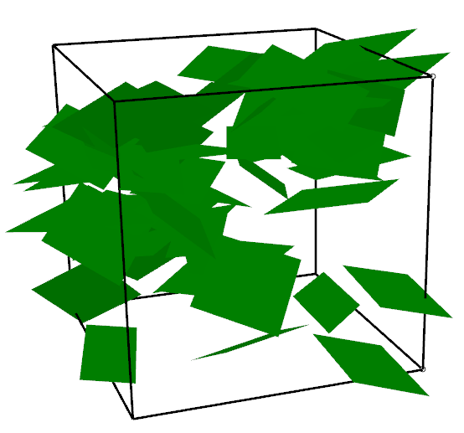
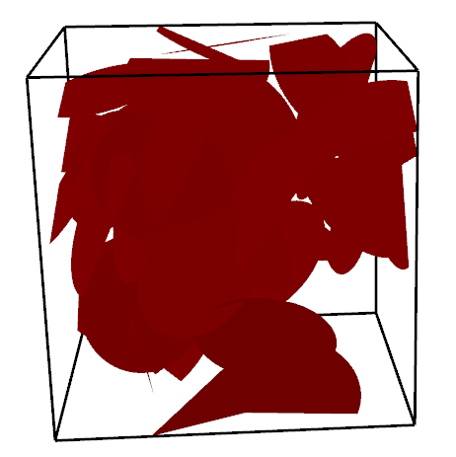
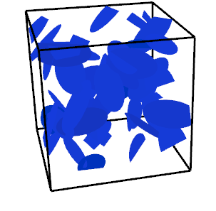
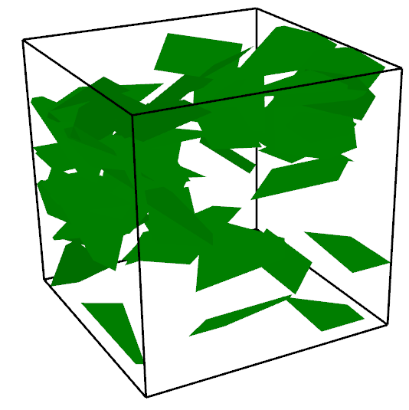
Y-FRAC FUNCTIONALITIES (FRACTURE NETWORK GENERATION)
Circular, P₃₂ = 0.511 | Elliptical, P₃₂ = 0.267 | Square, P₃₂ = 0.374
Notes:
1. Mention other analysis: cutplanes, P21, num of intersecting fractures, P32, total lengths of fractures,

Slide 10
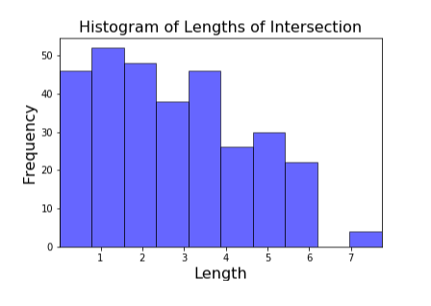
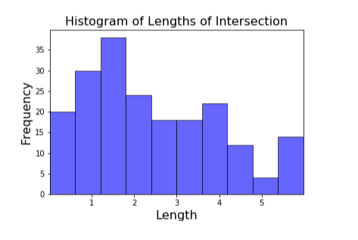
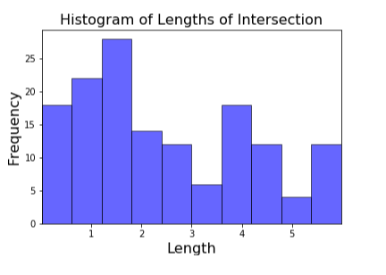
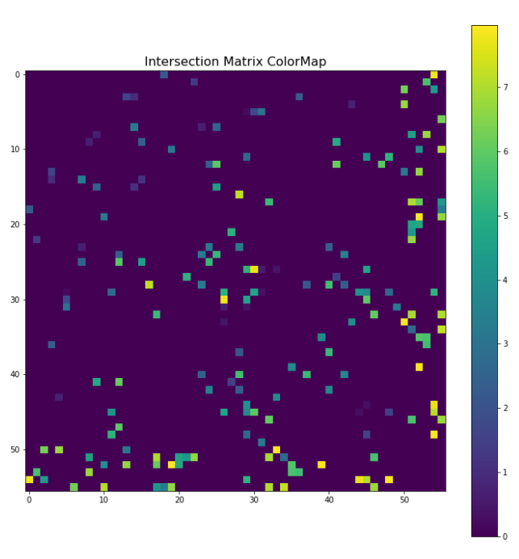
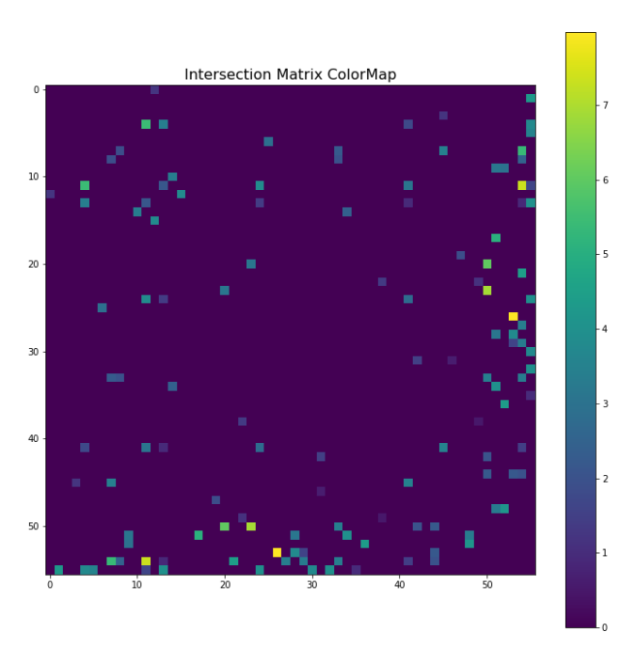
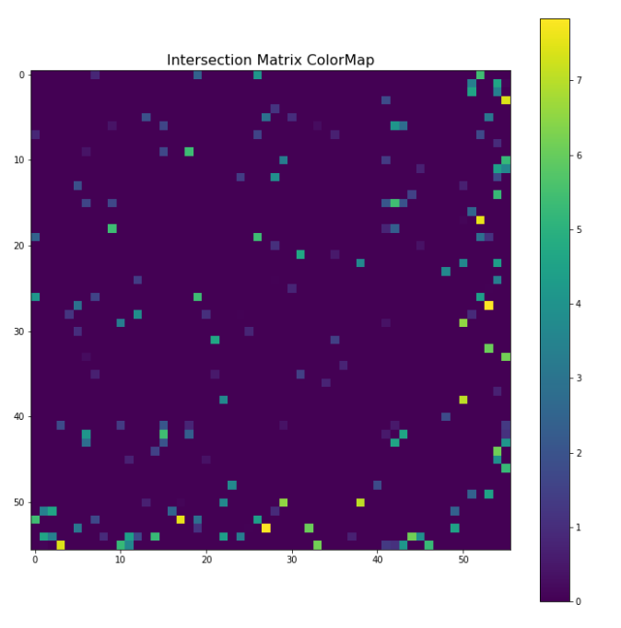
Y-FRAC FUNCTIONALITIES (FRACTURE NETWORK POSTPROCESSING)
Circular | Elliptical | Square
Histogram of Lengths of Intersection
Intersection Matrix Colour Map
Notes:
Mention the third pp
Explain what is in colour map. How the inter matrix is structured, its advantage?

Slide 11
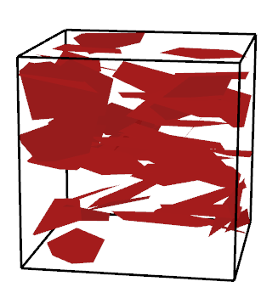
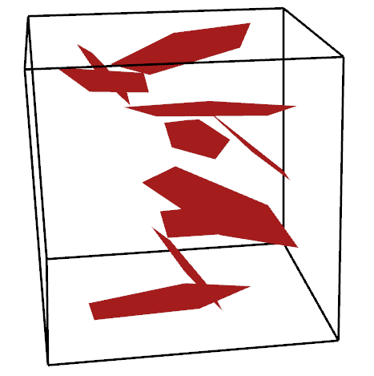
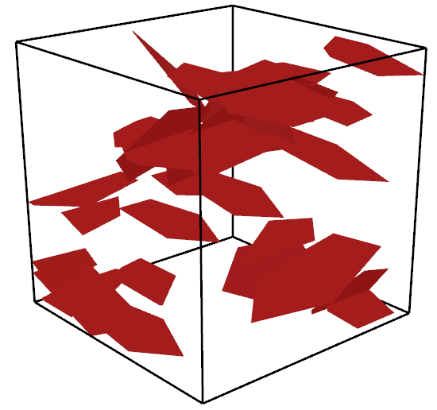
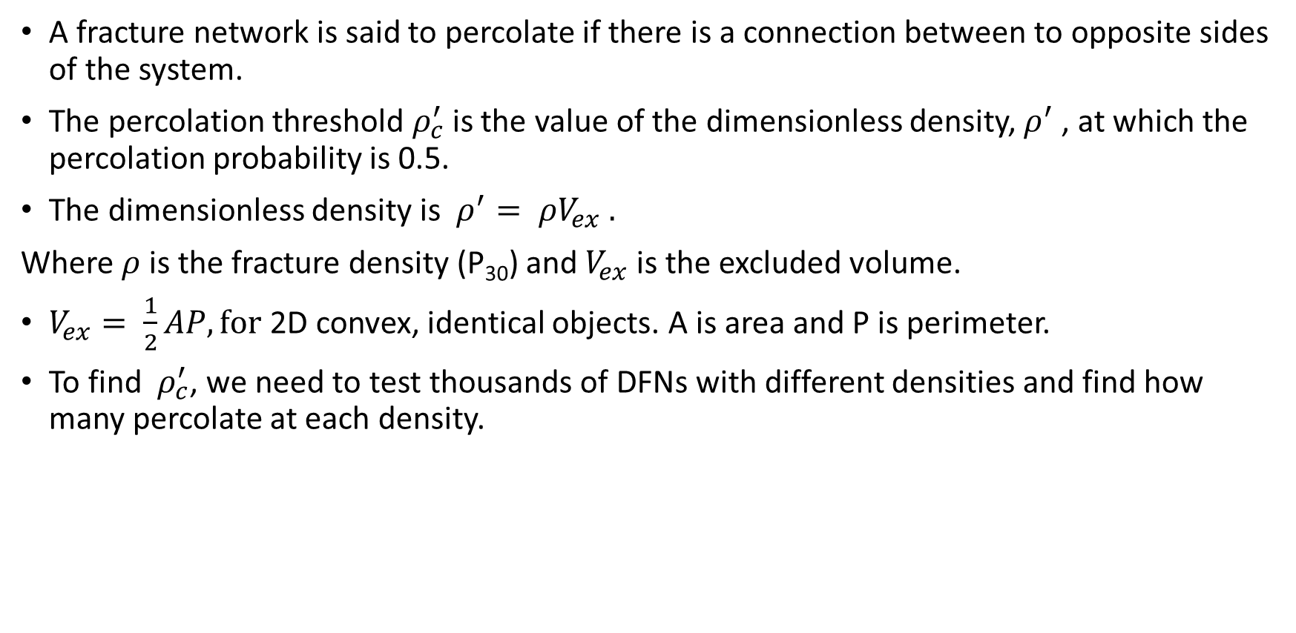
PERCOLATION THRESHOLD
A fracture network is said to percolate if there is a connection between to opposite sides of the system.
The percolation threshold $ρ_{c}^{′}$is the value of the dimensionless density, $ρ^{′}$, at which the percolation probability is 0.5.
The dimensionless density is $ρ^{′}= ρV_{ex} .$
Where $ρ$ is the fracture density (P₃₀) and $V_{ex}$is the excluded volume.
$V_{ex}= \frac{1}{2}AP, for$2D convex, identical objects. A is area and P is perimeter.
To find $ρ_{c}^{′}$, we need to test thousands of DFNs with different densities and find how many percolate at each density.
Notes:
1. 20 x 20 x 20 domain, 4m radius,

Slide 12
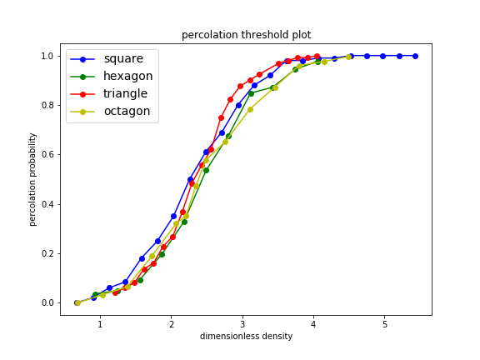
PERCOLATION THRESHOLD ANALYSIS
Shape | Triangle | Square | Hexagon | Octagon
Percolation threshold | 2.32 | 2.26 | 2.37 | 2.37
Author | Huseby et al. [5] | Mourzenko et al. [6] | Sisavath et al. [7] | Y-Frac
Percolation threshold | 2.26 ± 0.04 | 2.3 ± 0.1 | 2.254 | 2.315 ± 0.055
Notes:
1. IIOUD. Identical, isotropically oriented and uniformly distributed.

Slide 13
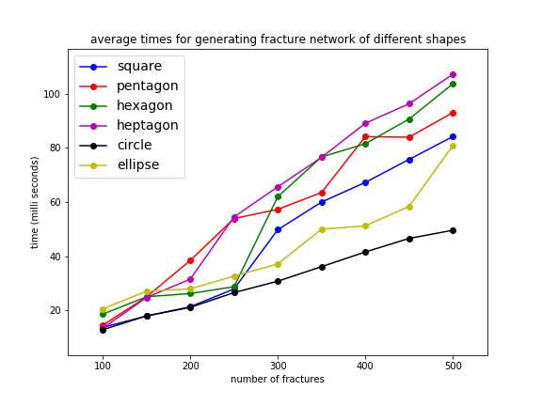
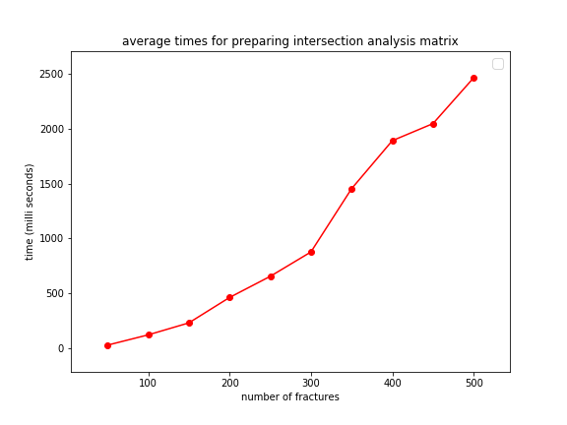
Y-FRAC COMPUTATIONAL COST
Test conducted on a Laptop computer with 4 cores, 1.7GHz clock rate, and 8GB RAM.
Y-Frac performed well enough to generate a network of 500 fractures in less than 150 milliseconds.

Slide 14
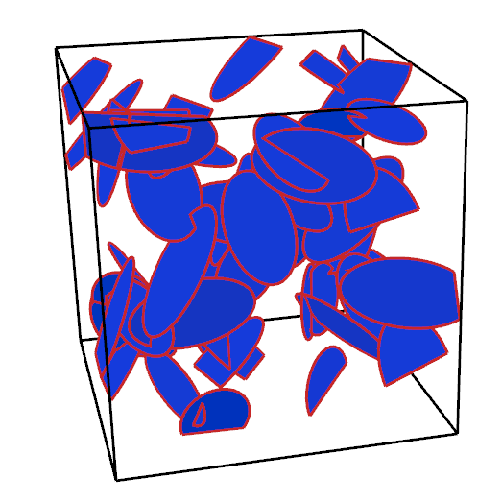
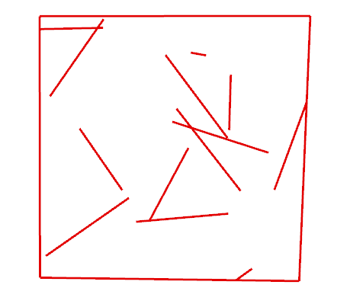
CONCLUSIONS
An open-source, easy to use library for DFN generation, regeneration and analysis for use in Rhinoceros CAD environment has been developed.
Output text file from Y-Frac can serve as input for appropriate software packages to simulate flow and perform mechanical analysis in fracture networks.
Practical applicability of Y-Frac was demonstrated through percolation analysis.
Y-Frac is available for use for researchers and students for practical research in geoscience.

Slide 15
RECOMMENDATIONS
Further functionalities to be added to Y-Frac include:
determination of percolation state in space,
irregular polygon fracture shapes,
inclusion of more statistical distribution for fracture parameters,
determination of percolation clusters,
flexibility in domain shapes,
permeability determination,
integration of geo-mechanical properties for DFN simulation, and
fluid flow in fracture networks.

Slide 16

ACKNOWLEDGEMENT
My Supervisors.
Professor Gareth Collins.
Classmates, friends and family.
My sponsor.

Slide 17
REFERENCES
Hernqvist L. Characterization of the Fracture System in Hard Rock for Tunnel Grouting. Chalmers University of Technology; 2009.
Gillespie PA, Howard CB, Walsh JJ, Watt J. Measurement and characterisation of spatial distributions of fractures. 1993;226:113–41.
Wang, P., Cai, M., Ren, F. et al. Rock Mech Rock Eng (2017) 50: 1801. https://doi.org/10.1007/s00603-017-1200-8Rogers S, Elmo D, Stead D, Guidelines for the quantitative description of discontinuities for use in DFN modeling. 2015;(May):1–11.
Steemhunt. Rhino 6 [Internet]. [cited 2019 September 5]. Available from: https://steemhunt.com/author/@carloamc/rhino-6-the-world-s-most-versatile-3d-modeler-for-macos
Huseby O, Thovert J-F, Adler PM. Geometry and topology of fracture systems. Journal of Physics A: Mathematical and General. 1997;3–11.
Mourzenko V V., Thovert JF, Adler PM. Percolation and permeability of fracture networks in excavated damaged zones. Physical Review E - Statistical, Nonlinear, and Soft Matter Physics. 2012;86(2):1–13.
Sisavath S, Mourzenko V, Genthon P, Thovert J-F, Adler PM. Geometry, percolation and transport properties of fracture networks derived from line data. Geophysical Journal. 1965;157(2):917–34.

Slide 18
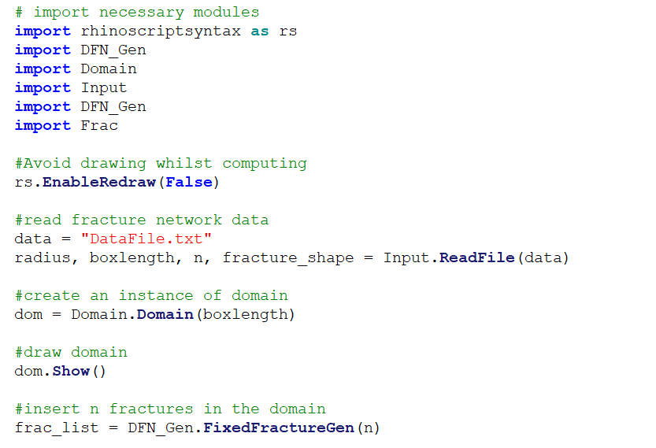
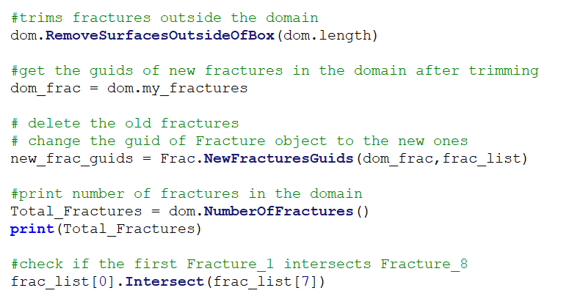
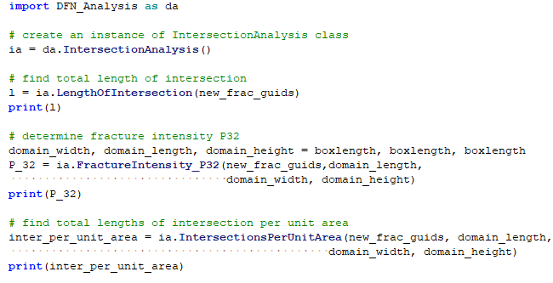
BACK UP SLIDES (1)

Slide 19
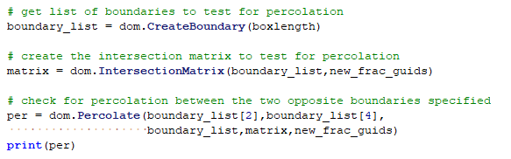
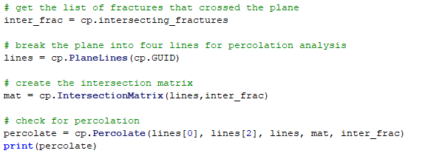
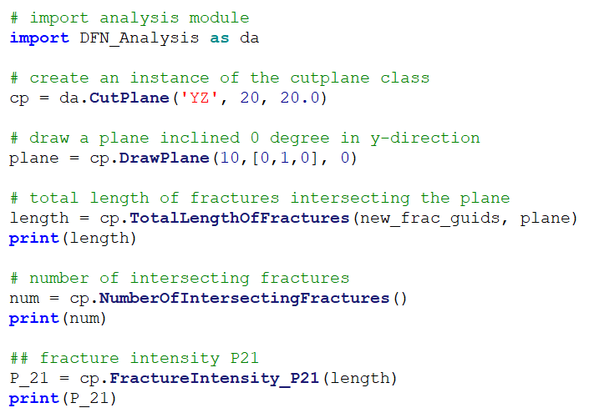
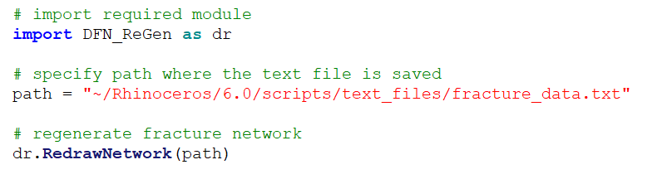
BACK UP SLIDES (2)

Slide 20
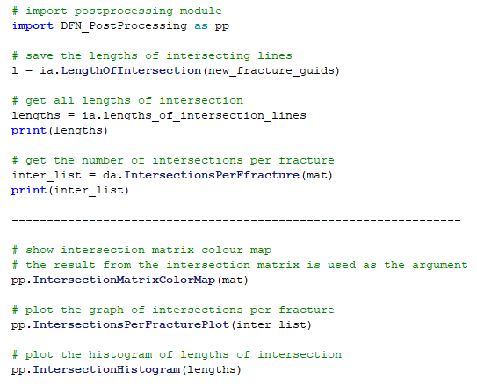
BACK UP SLIDES (3)

Slide 21
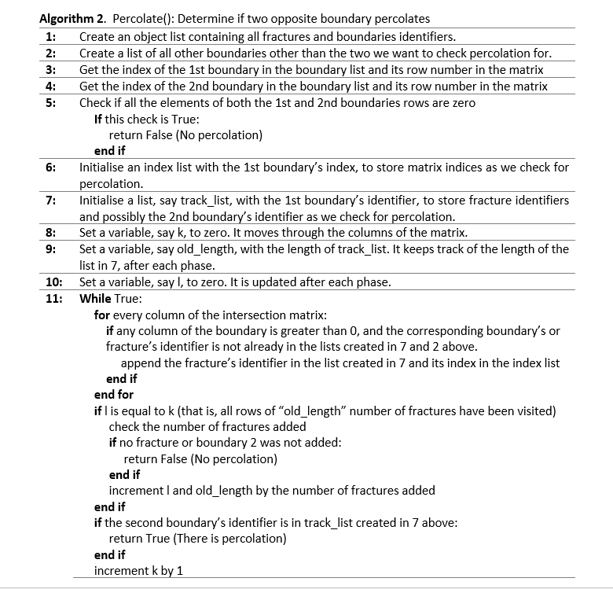
BACK UP SLIDES (4)

Slide 22
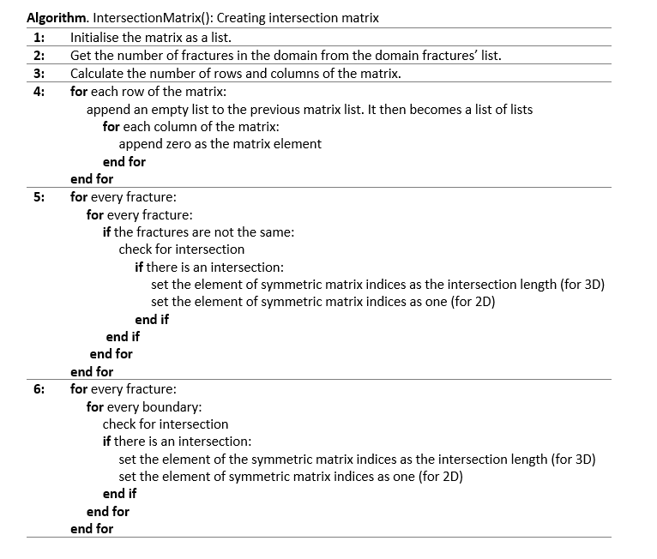
BACK UP SLIDES (5)

Slide 23
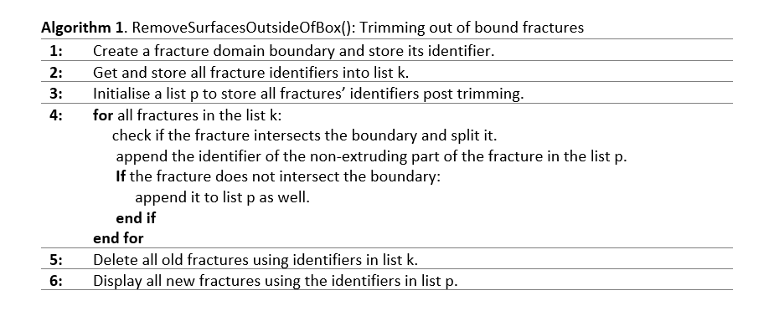
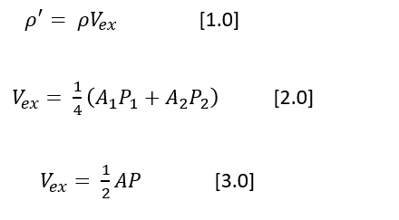
BACK UP SLIDES (6)

Slide 24
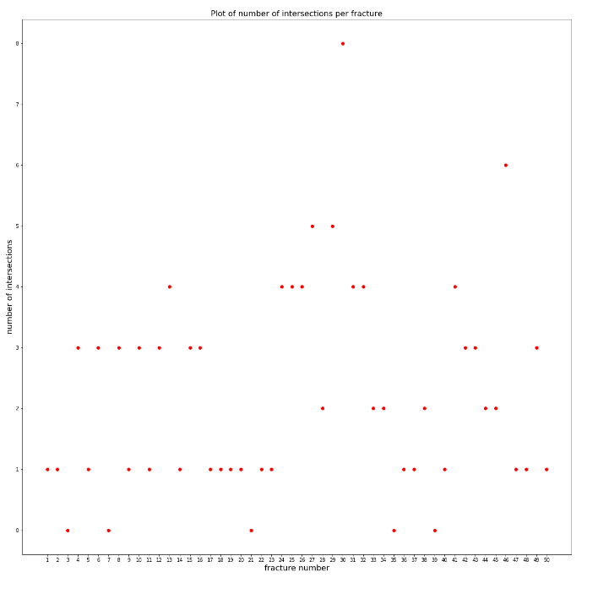
BACK UP SLIDES (7)

Slide 25
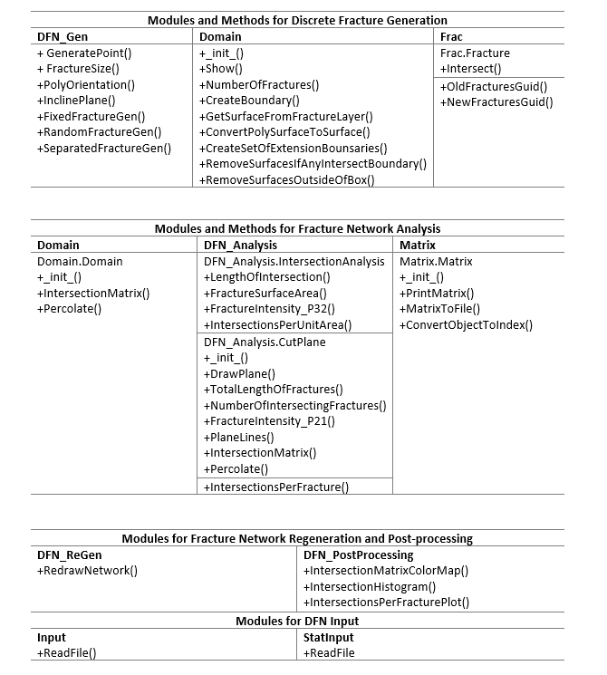
BACK UP SLIDES (8)

