Slide 1
Ui.

Slide 2
?

Slide 3
Tanks?

Slide 4
Planes?

Slide 5
Ships?

Slide 6
one more thing.

Slide 7
Trains.

Slide 8
World of Trains.

Slide 9
World of WarTrains.

Slide 12
tkinter
PyQt5

Slide 13
PyQt5

Slide 14
First Blood.

Slide 15
task1.

Slide 16
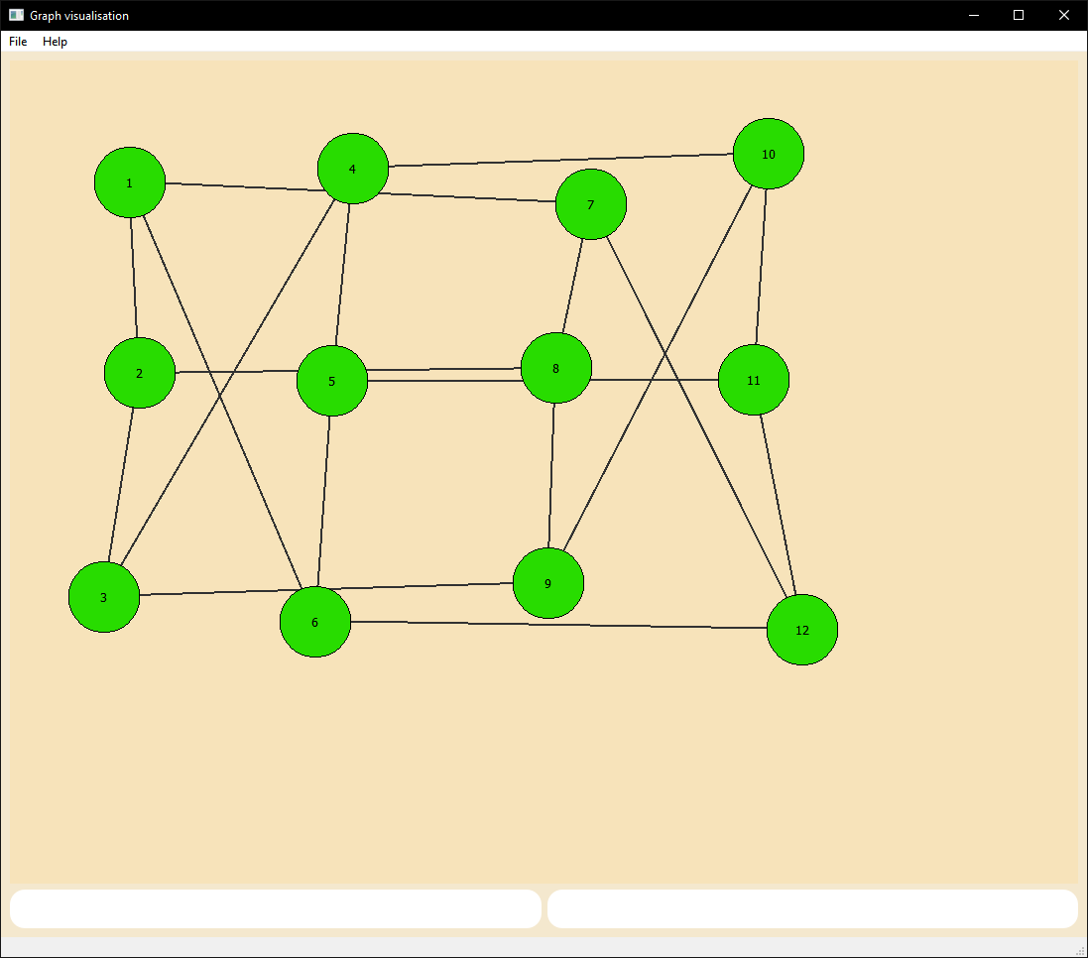

Slide 17
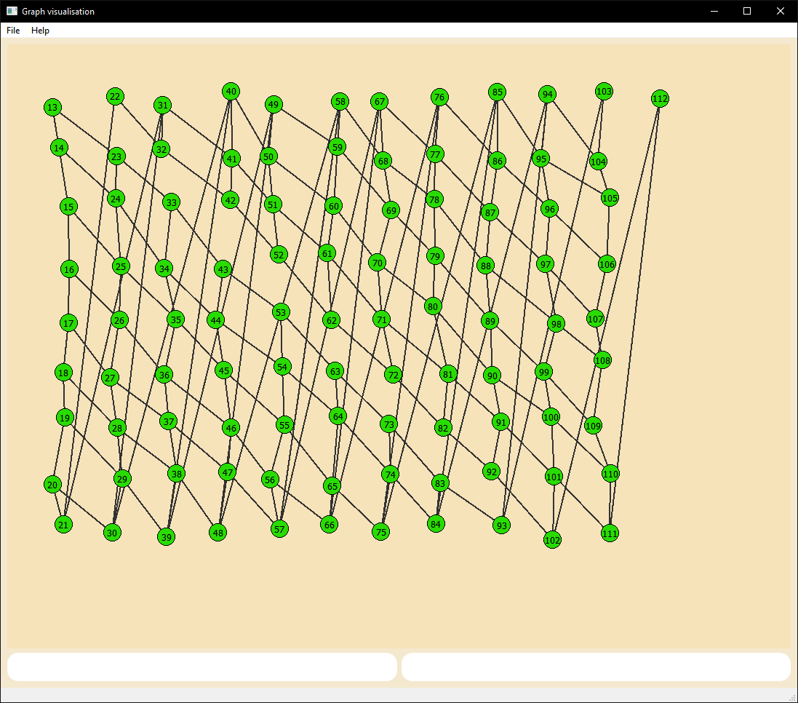

Slide 18
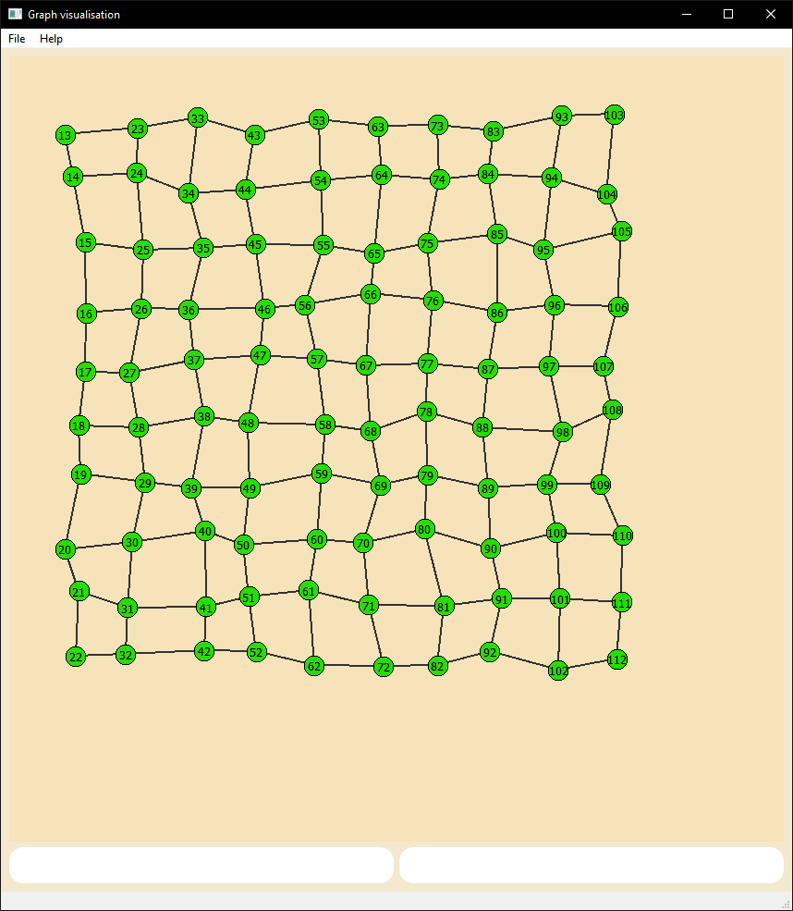

Slide 19
task2.

Slide 20
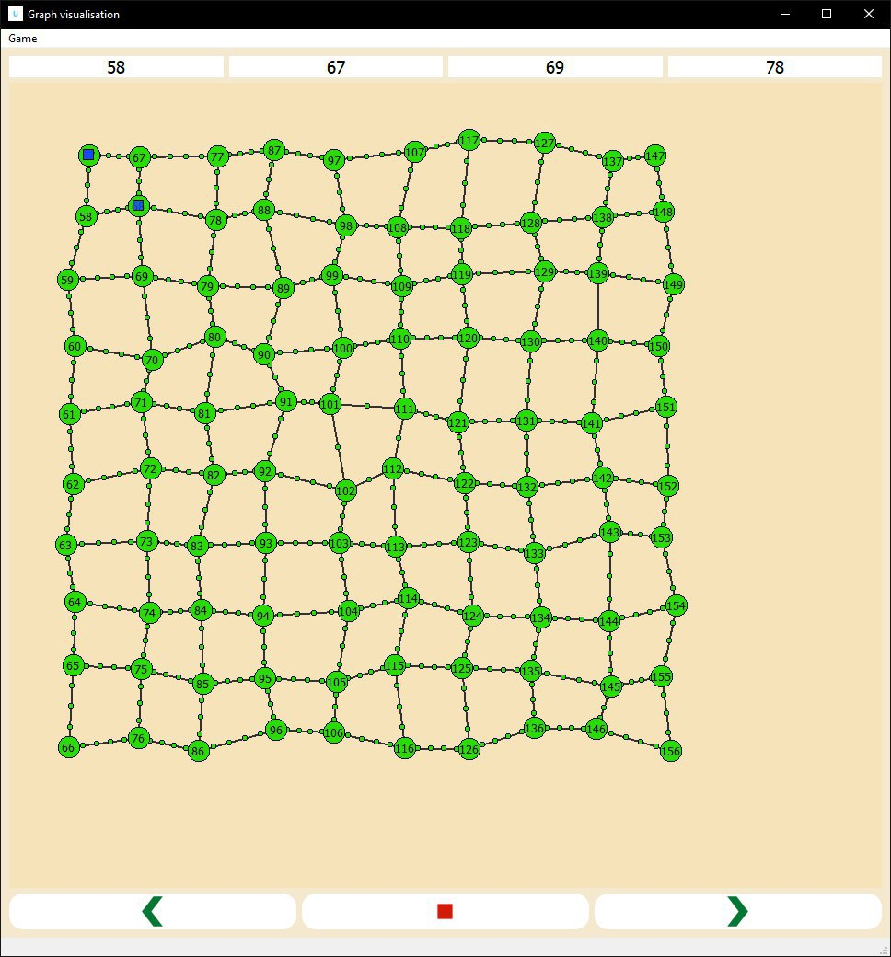

Slide 21
task3.

Slide 22
Single train strategy.

Slide 23
task4.

Slide 24
Products or armor.

Slide 25
task5.

Slide 26
Group train strategy.

Slide 27
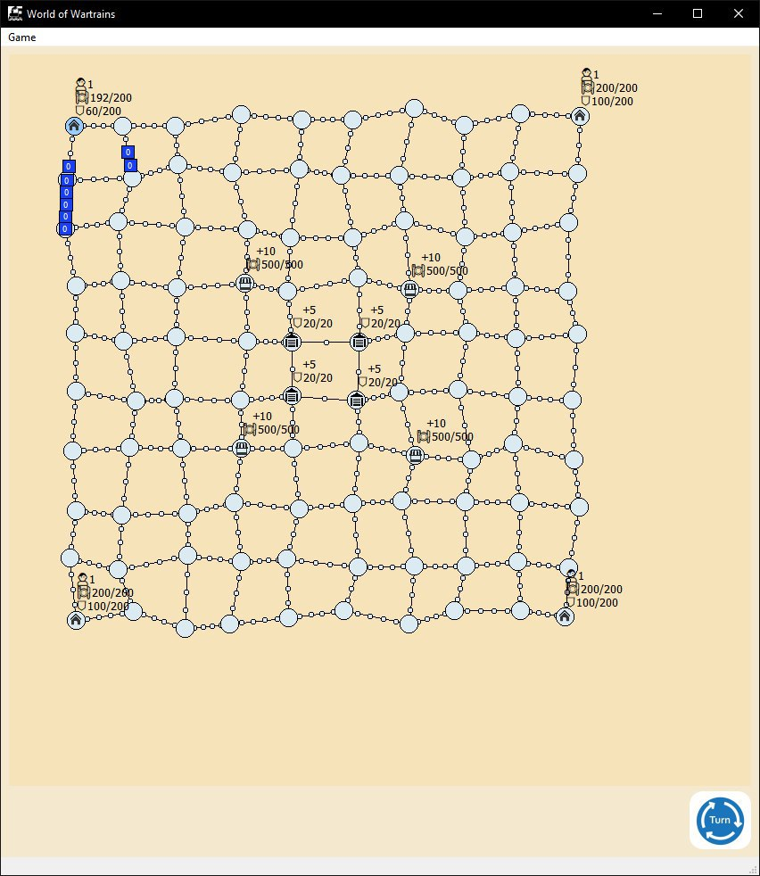

Slide 28
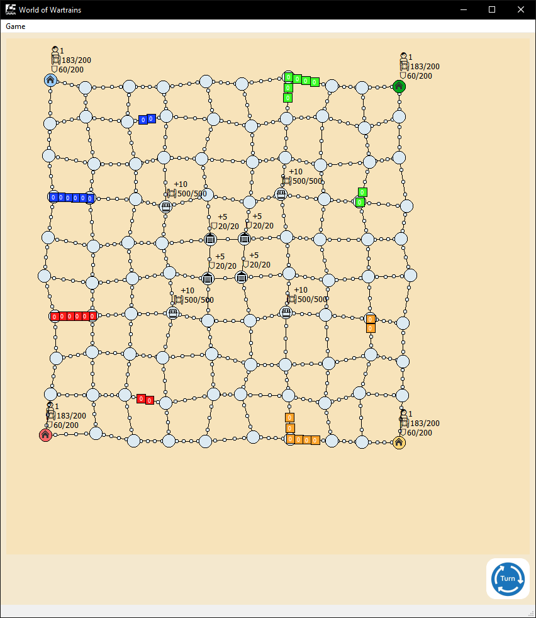

Slide 29
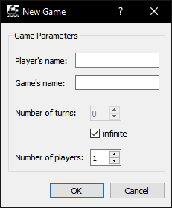
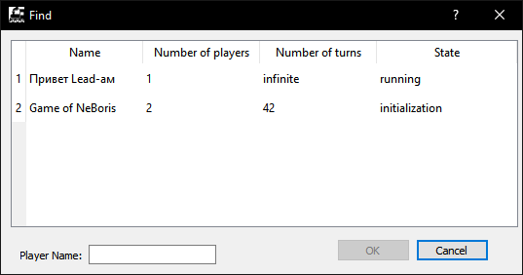

Slide 30
Questions?

Slide 31
ui.
Thanks.

