Slide 1
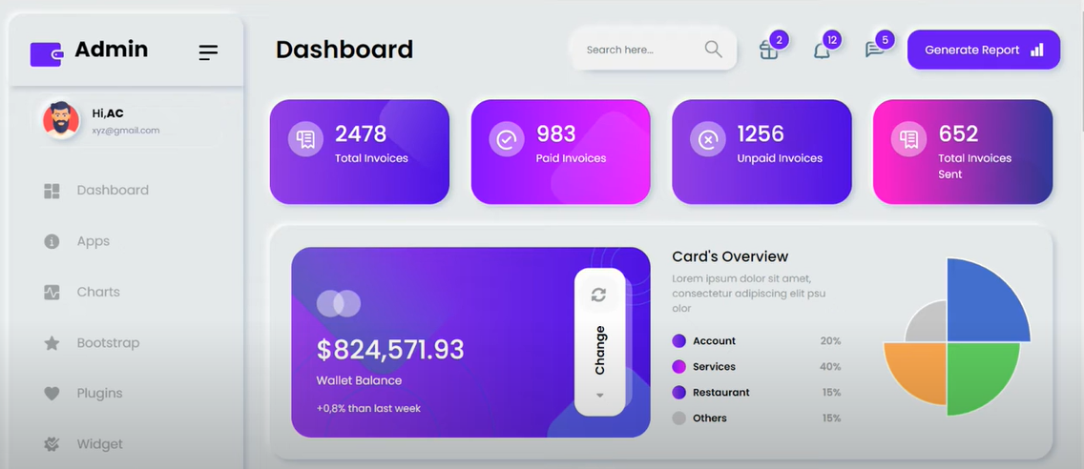
How do we do this presentation ?

Slide 2

3 task
Dash board
Arrange the square
Weather data / api

Slide 3
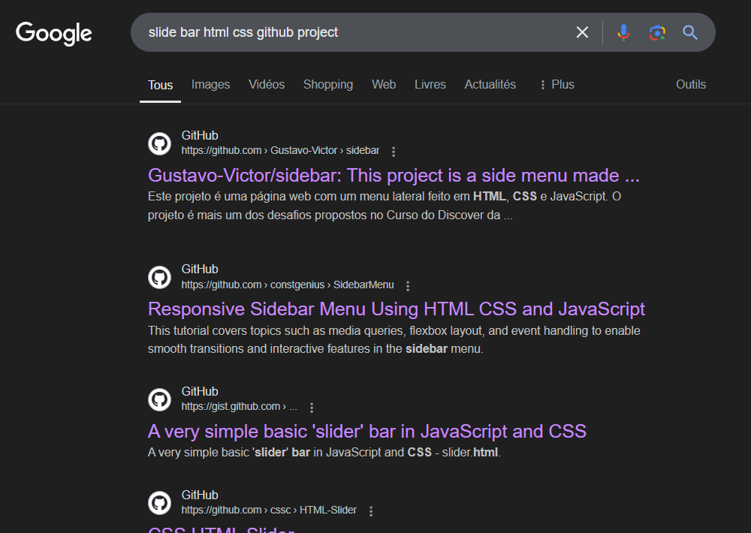
1) Dash board
Recherche on youtube and google
for a lot of projects we had to pay.

Slide 4
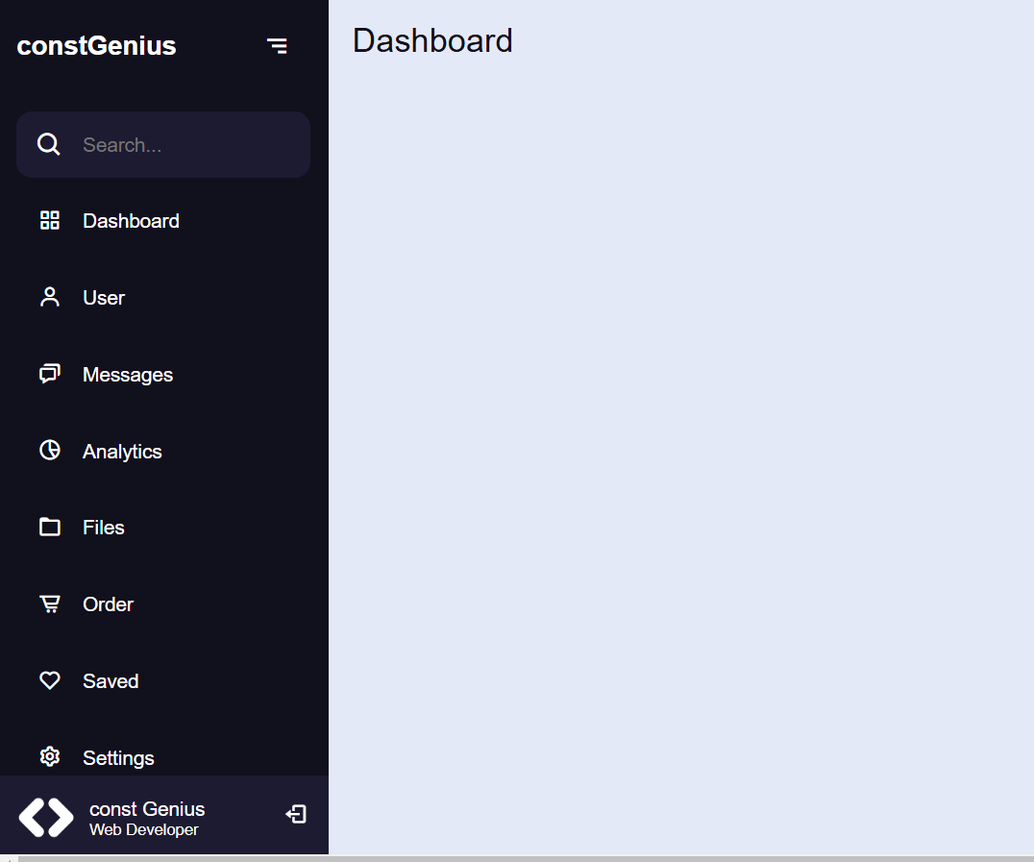
I started from this

Slide 5

2) Css Grid

Slide 6
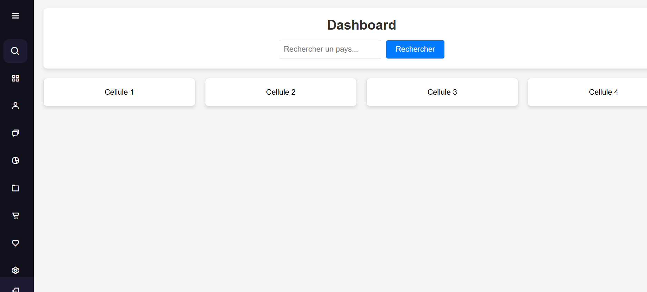

Slide 7
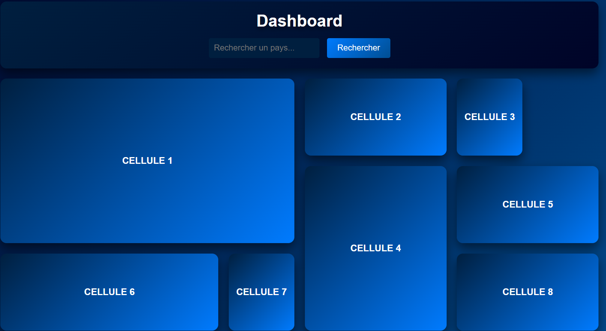

Slide 8
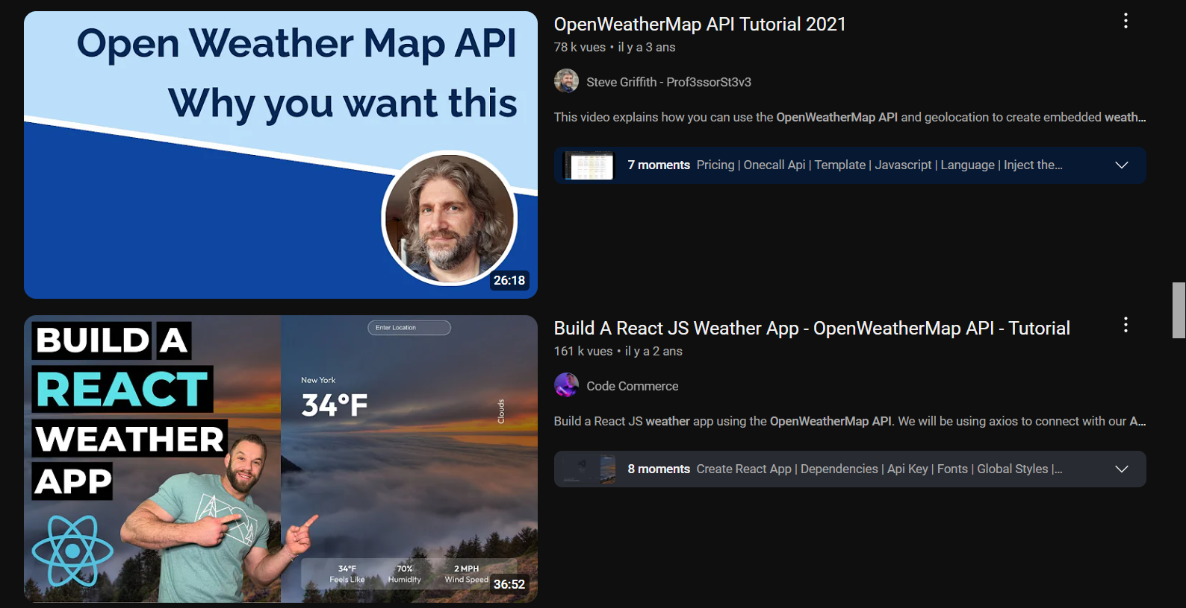

3) Data weather / api openweathermap

Slide 9

We had to run the code with an internet connexion

Slide 10
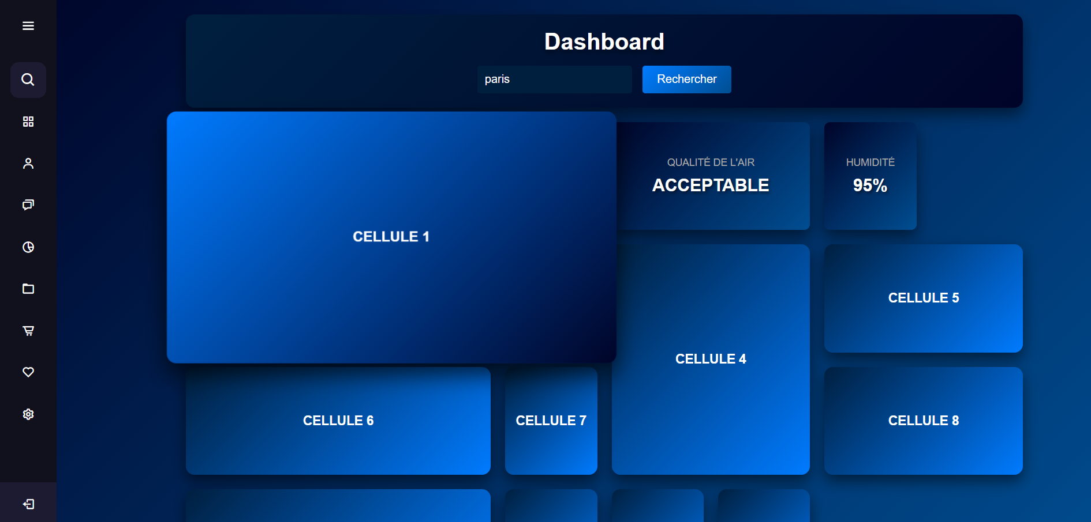

Slide 11
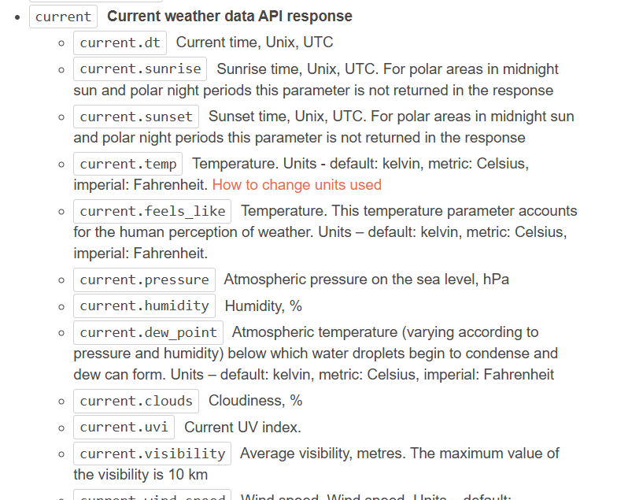
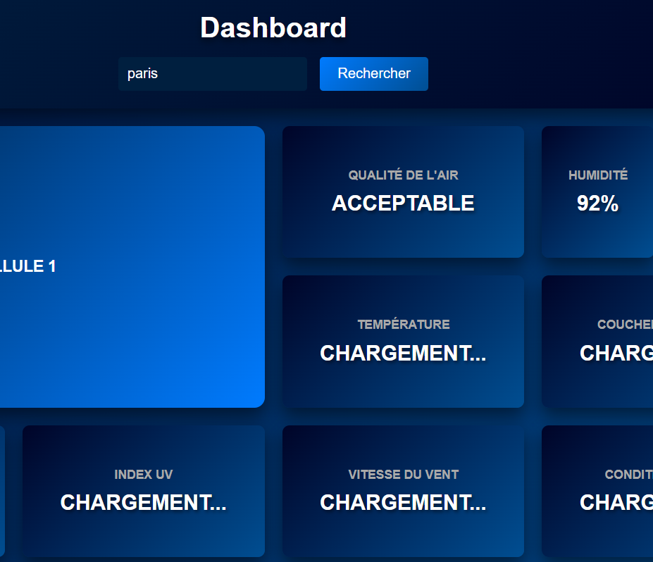

Slide 12
