Slide 1
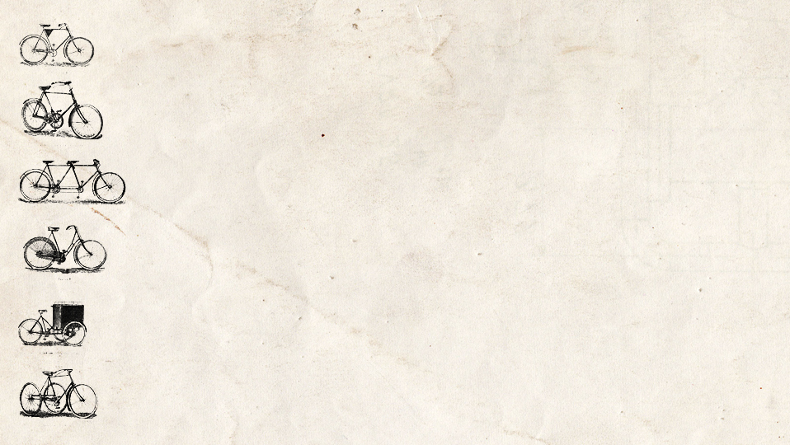
Dynamic reloading of java-classes
Vitaliy Savkin
VitaliySavkin@epam.com
1

Slide 2
Objective
Implementation of plugin-based system
Plugins may be changed on the fly
Solution
Represent each module type as a class and each module instance as an object
(Re)load class and instantiate instance when needed
Problem
How to (re)load a class?
2
Notes:
2

Slide 3
// file BasicModule.scala
package com.epam
class BasicModule { def method(): Unit = println(“B1") }
// TestNaive.scala
package com.epam
object TestNaive extends App {
  // first time we load class
  val c1 = getClass.getClassLoader.loadClass("com.epam.BasicModule")
  var i: BasicModule = c1.newInstance().asInstanceOf[BasicModule]
  i.method() // B1
  // wait, change and recompile BasicModule.scala(println(“B2"))
  readLine()
  // then we try to reload
  // name is the same, but class has been changed
  val c2 = getClass.getClassLoader.loadClass("com.epam.BasicModule")
  i = c2.newInstance().asInstanceOf[BasicModule]
  i.method() // B1 - WTF???
}
https://github.com/Vitaliy-Savkin/lt_reloading
3
Notes:
3

Slide 4
What has happened?
Built-in class loaders cache classes they have loaded
Therefore reloading of a class is not possible using Java's built-in class loaders
So we have to implement own class loader
4
Notes:
4

Slide 5
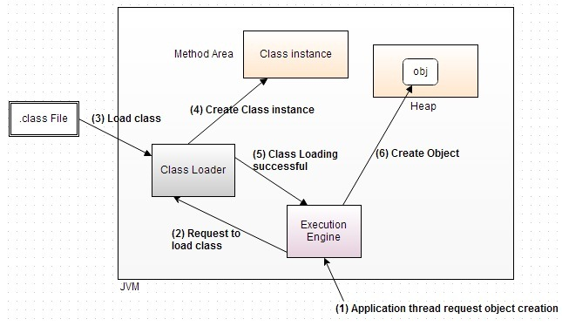
Class loading
5
Notes:
5

Slide 6
Class Loaders
Any class in a Java application is loaded using some subclass of java.lang.ClassLoader
Class Loaders are organized in a hierarchy - each class loader has a "parent" class loader, except of bootstrap (system) class loader
Class Loader can delegate loading of classes to their parents in two ways:
  parent-first
  self-first
Class loader loads classes only when they are needed
Class loader lives until all the classes it has loaded are in use
6
Notes:
6

Slide 7
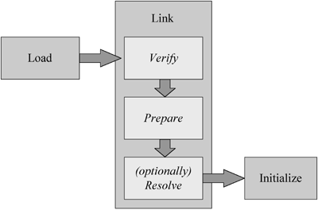
Type's lifetime
Resolution is done using the final ClassLoader.resolve() method.
The resolve() method will not allow any given ClassLoader instance to link the same class twice.
Therefore, every time you want to reload a class you must use a new instance of your ClassLoader subclass.
7
Notes:
7

Slide 8
Every class loaded in a Java application is identified by
its fully qualified name (package name + class name), and
the ClassLoader instance that loaded it.
8
Notes:
8

Slide 9
So we have problem with the following code:
val c1 = new CustomClassLoader().loadClass("com.epam.A")
// ClassCastException
var i: A = c1.newInstance().asInstanceOf[A]
The A class is referenced in the code, as the type of the i variable
This causes the A class to be loaded by the same class loader that loaded the class this code is residing in (built-in class-loader)
Therefore, classOf[A] and c1.newInstance().getClass are regarded as different classes
9
Notes:
9

Slide 10
Workaround:
Use an interface as the variable type, and just reload an implementing class.
Use a superclass as the variable type, and just reload a subclass.
10
Notes:
10

Slide 11
Implementation of class loader
We use self-first delegation strategy,
but do not want to reload all the standard library again and again
so we have to define which classes should be loaded by custom class loader and which should be delegated to built-in class loader
11
Notes:
11

Slide 12
class NonCachingClassLoader(classFilter: String => Boolean)
(implicit parent: ClassLoader)
extends ClassLoader(parent){
protected def classNameToPath(name: String): String = …
override def loadClass(name: String): Class[_] =
try {
if(!classFilter(name)) parent.loadClass(name)
else {
val fileURL = parent.getResource(classNameToPath(name))
val file = new File(fileURL.getFile)
val classData = Array.ofDim[Byte](file.length.toInt)
val dis = new DataInputStream(new FileInputStream(file))
dis.readFully(classData)
dis.close()
defineClass(name, classData, 0, classData.length)
}
} catch {
case e @ (_: MalformedURLException | _: IOException) => null
}
}
https://github.com/Vitaliy-Savkin/lt_reloading
12
Notes:
12

Slide 13
// file TestCustomCL.scala
package com.epam
object TestCustomCL extends App {
  implicit val parent = this.getClass.getClassLoader
  // first time we load class
  val c1 = new NonCachingClassLoader(_ startsWith "com.epam.impl")
  .loadClass("com.epam.impl.Module")
  var i: BasicModule = c1.newInstance().asInstanceOf[BasicModule]
  i.method() // Module1
  // wait, change and recompile AImpl.scala (println(“Module2"))
  readLine()
  // then we try to reload
  val c2 = // same stuff
  i = c2.newInstance().asInstanceOf[BasicModule]
  i.method() // Module2 – Reloaded!
}
// file Module.scala
package com.epam.impl
class Module extends BasicModule { def method() = println(“Module1") }
https://github.com/Vitaliy-Savkin/lt_reloading
13
Notes:
13

Slide 14
Caution!
Your strategy of filtration of classes may be much more complicated then in example
but you have only string to take decision
so consider the possibility of redesigning organization of namespaces and naming conventions to make your strategies more clear.
Be very care with inner classes, take into account how their names are constructed, how are they used, and do you really need them.
Be care with companion objects in Scala.
14
Notes:
14

Slide 15
Class unloading
You can not explicitly unload class
VM can optionally unload the classes after they are no longer referenced by the program
You must have no references to any instance of a class allow JVM unload definition of this class
Therefore, there is a danger of memory leaks
Which is especially noticeable in Java 7 and earlier versions, where classes were stored in Permanent Generation (PermGen)
15
Notes:
15

Slide 16
Questions?
Notes:
16

Slide 17
Thanks for attention!
Notes:
17

