Slide 1
FlowRefine
Local generation and verification
of editable process flowcharts
Motivation: process documentation
in my oil and gas engineering field
General synthetic tasks, with CPU and GPU experiments
Generative AI final project 25 October 2026
FlowRefine CPU pilot and exploratory GPU comparison 1
Notes:
My main field of study is oil and gas engineering, so I wanted to explore a practical application of generative AI that could be useful in my field.
Working with production processes involves describing sequences of operations, decision points, and actions when conditions change. Flowcharts can help communicate this logic, but creating and updating them manually takes time.
This motivated me to build a prototype that turns a process description into an editable flowchart and then uses feedback to check and revise it. I also wanted to explore whether the system could run locally on modest hardware.
For this project, I started with simple synthetic processes rather than real industrial procedures. The goal was to test the basic approach and understand its limitations before considering an application to oil and gas workflow

Slide 2
Can feedback improve a generated flowchart?
Editable graph
Evaluation after one edit
Nodes: steps and decisions
Exact graph match
Directed edges: process logic
Node F1 and edge F1
JSON scene rendered as SVG / PNG
Separate geometry checks
Sources: frozen protocol and original task descriptions
FlowRefine CPU pilot and exploratory GPU comparison 2
Notes:
“The main question of this project is: can feedback improve an automatically generated flowchart? We compare the initial diagram with the result after one correction round.
On the left is our representation. A flowchart is an editable graph: nodes represent process steps and decisions, while directed edges describe the connections between them. The language model produces this structure in JSON, and our program renders it as SVG and PNG.
This allows us to evaluate the actual process logic. For each test task, we have a reference graph prepared in advance. The models do not receive this reference; it is used only for evaluation.
On the right are the metrics. Exact graph match requires the complete structure to be correct. Node F1 measures matching nodes, while edge F1 measures matching connections, including their direction and branch labels. We check layout problems separately.
The important point is that correction can also introduce errors. We therefore measure both improvements and regressions. The next slide explains how the pipeline works

Slide 3
The architecture separates generation and verification
Process description
Text model
JSON graph B0
Renderer
SVG and PNG
Programmatic checks
Visual critic
Text editor
B0 + selected feedback
Saved graph and metrics
B1 checks / B2 visual / B3 both
Source: pipeline implementation and frozen_protocol.json
FlowRefine CPU pilot and exploratory GPU comparison 3
Notes:
“This slide shows the pipeline and separates generation from verification.
First, the text model receives a process description and produces a JSON graph. We call this initial result B0. The renderer converts the graph into SVG and PNG.
We then check the same initial diagram in two ways. Programmatic checks examine the graph and its layout for formal and geometric problems. The visual critic receives the rendered image together with the original request and produces written feedback.
The text model then acts as an editor. It receives B0, the original request, and the selected feedback, and generates a revised graph.
We compare three correction modes: B1 uses programmatic feedback, B2 uses visual feedback, and B3 uses both. Each mode starts independently from the same B0. They are separate alternatives, rather than consecutive editing steps.
Finally, we save the outputs and evaluate them against the reference graph. The reference is available only during evaluation, so neither the critics nor the editor can use the expected answer.
This setup lets us compare the effect of each feedback source.”

Slide 4
Compact models test local execution on a CPU
Role / control | Original CPU configuration
Generator and editor | Qwen2.5-3B-Instruct, Q4_K_M
Visual critic | SmolVLM-256M-Instruct, Q8_0
Data | 5 development + 15 synthetic test tasks
Comparison | Same saved B0, one correction round
Office-PC feasibility was the motivation. No hardware-wide benchmark.
Sources: model manifests, dataset card, frozen protocol
FlowRefine CPU pilot and exploratory GPU comparison 4
Notes:
For the first experiment, I selected compact models to test whether the complete pipeline could run locally on a CPU, without a powerful graphics card. The motivation was potential use on ordinary office computers, although I did not benchmark a range of office hardware.
The generator and editor use Qwen2.5 with approximately three billion parameters. Its weights use Q4_K_M quantization to reduce memory requirements. The visual critic is SmolVLM with 256 million parameters, using eight-bit quantization.
I used five development tasks to check the output format and select a working configuration. The main evaluation then used fifteen separate synthetic tasks: five linear processes, five branching processes, and five loops.
Every correction mode starts from the same saved initial graph and performs one correction round. This makes the feedback sources comparable.
These tasks test basic process structure rather than real oil and gas procedures. The experiment therefore establishes local feasibility and measures correctness within a small, controlled setting. The next slide shows the results

Slide 5
The original feedback modes reduce exact correctness
Exactly correct graphs out of 15
B0 Initial
B1 Checks
B2 Visual critique
B3 Both
No edit fixes an incorrect B0 to exact correctness
Source: analysis/test_v1/aggregate.json, all 15 test tasks
FlowRefine CPU pilot and exploratory GPU comparison 5
Notes:
This slide shows the results of the original CPU experiment. Each bar represents the number of completely correct graphs out of fifteen test tasks.
The initial generation, B0, produced eleven correct graphs. Programmatic feedback, B1, kept the total at eleven. With visual feedback, B2, the number fell to nine. Combining both feedback sources, B3, reduced it to seven.
Here, complete correctness means that all required nodes and directed, labelled connections match the reference. A single incorrect connection is enough to lose an exact match, even if most of the diagram remains correct.
None of the initially incorrect graphs became completely correct after editing. Some edits improved individual connections, but these improvements did not produce a fully correct graph. Meanwhile, the visual feedback modes damaged some initially correct outputs.
The conclusion is limited to this configuration: adding feedback did not improve semantic correctness. These results alone do not tell us whether the main problem lies in the critic or the editor. This motivated the next experiment with a larger visual critic.

Slide 6
The GPU experiment replaces the visual critic
Component | GPU comparison
Visual critic | Qwen2.5-VL-3B-Instruct, FP16
Hardware | RTX 3060, 12 GB VRAM
Measured peak allocation | 7.33 GiB
Reused controls | Same B0 / B1, text editor and 15 tasks
Exploratory rerun after viewing the original test results
Sources: gpu_vlm_v1 manifest and execution metadata
FlowRefine CPU pilot and exploratory GPU comparison 6
Notes:
The first experiment raised a possible explanation: perhaps the visual critic was too small to inspect the diagrams reliably. I therefore tested a larger visual model.
I replaced SmolVLM with Qwen2.5-VL-3B-Instruct, running in FP16 on an RTX 3060 with twelve gigabytes of video memory. The measured peak PyTorch allocation was approximately 7.33 GiB.
Importantly, I reused the same initial graphs and images. The text editor also remained unchanged and continued running on the CPU. I generated new visual feedback and used it to produce new B2 and B3 outputs.
This keeps the starting diagrams and editor consistent, making the comparison easier to interpret. However, the replacement changes the model family, numerical precision, and image-processing backend as well as model size. It is therefore a comparison of critic configurations.
This was also an exploratory rerun on the same fifteen tasks after inspecting the original results, rather than an independent evaluation on a new test set. The next slide shows whether the replacement improved the final graphs

Slide 7
The larger critic lowers downstream graph scores
Exactly correct graphs out of 15
Mean edge F1
B2 0.912 to 0.810
B3 0.899 to 0.810
New invalid: 1/15 each
System outcome, including the unchanged text editor
Sources: test_v1 and gpu_vlm_v1 aggregate.json, same 15 saved tasks
FlowRefine CPU pilot and exploratory GPU comparison 7
Notes:
This slide compares the final graph quality with the original and the larger visual critic. The darker bars show SmolVLM, and the lighter bars show Qwen-VL.
In B2, the number of completely correct graphs fell from nine to five out of fifteen. In B3, it fell from seven to five.
Mean edge F1 also decreased: from approximately 0.912 to 0.810 in B2, and from 0.899 to 0.810 in B3. Therefore, the decline appears both in complete graph correctness and in the accuracy of individual connections.
Each new mode also produced one invalid output. These failures receive zero semantic scores rather than being excluded from the evaluation.
The key distinction is that we measure the final outcome of the critic-and-editor pipeline. We have not independently scored every criticism, so this does not establish that Qwen-VL is generally a worse visual model.
What we can say is that replacing the critic did not improve this system on these tasks. The next slide shows a concrete example of how incorrect feedback can damage a correct graph.

Slide 8
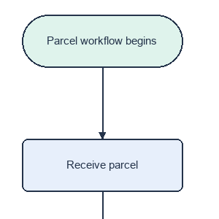
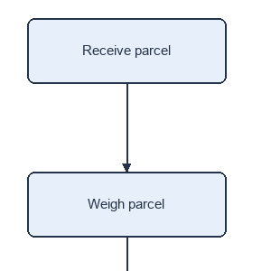
False criticism removes a required start node
B0: required start
New B3: start removed
Saved critic instruction
“Remove the
"Parcel workflow begins"
box as it is redundant.”
Exact: yes to no
Edge F1: 1.000 to 0.909
Source: test_chain_01, saved B0, GPU visual critique and new B3
FlowRefine CPU pilot and exploratory GPU comparison 8
Notes:
“This example shows how false criticism can damage a correct diagram.
On the left is the initial graph for a parcel-handling process. The task explicitly requires the start node, ‘Parcel workflow begins’. The complete initial graph matches the reference, with an edge F1 of one.
However, the new visual critic recommends removing this node because it considers the block redundant. The exact instruction appears on the right.
In the subsequent B3 output, shown in the middle, the required start node is missing. The diagram now begins directly with ‘Receive parcel’.
As a result, the graph loses one required node and its outgoing connection. Edge F1 falls from 1.000 to approximately 0.909, and the graph no longer achieves an exact match.
This gives us a concrete failure trace: incorrect feedback followed by a corresponding harmful edit. It illustrates one mechanism behind the regression, although it does not explain every failed example.
It also shows why feedback needs verification before application: a correction can remove information that the original graph represented correctly

Slide 9
The evidence points to unreliable feedback and editing
Observed
Plausible explanations
False instruction in a saved critique
General VLM lacks graph calibration
Corresponding deletion in the edit
Full-graph rewriting permits regressions
A valid loop fix remains unexecuted
The same small editor may limit gains
One rerun cannot isolate these mechanisms or rank model families
Sources: saved critic outputs, edited graphs and validity errors
FlowRefine CPU pilot and exploratory GPU comparison 9
Notes:
To interpret this result, I separate observations from possible explanations.
On the left are failures that we can verify in the saved outputs. In the previous example, the critic gives an incorrect instruction, and the editor makes the corresponding harmful change.
We also observe the opposite problem. In a software-testing process, the critic correctly identifies a missing connection from ‘Fix implementation’ back to ‘Run test suite’. However, the editor still does not add it.
These examples reveal two failure points: producing reliable feedback and correctly applying that feedback.
The right-hand side presents possible explanations. A general-purpose visual model may not reliably verify individual graph connections. Also, our editor regenerates the complete graph, which allows unrelated mistakes to appear during correction. Finally, the unchanged text editor may limit the benefit of a larger critic.
This experiment does not isolate the contribution of each mechanism. We would need separate evaluations of criticism quality and editing accuracy.
The practical conclusion is that increasing the critic’s size alone is insufficient. We also need to verify its recommendations and control how the editor changes the graph.

Slide 10
Local execution works, while correction remains unreliable
Local editable flowchart generation is feasible.
A larger critic alone did not improve this pipeline.
Next: verify critiques and constrain accepted edits.
New held-out tasks and repeated runs remain necessary.
Project conclusions and next experiment proposal
FlowRefine CPU pilot and exploratory GPU comparison 10
Notes:
To conclude, this project demonstrates a working local pipeline for generating editable flowcharts. It connects text generation, rendering, verification, correction, and evaluation, and the original configuration runs entirely on a CPU.
However, technical feasibility does not guarantee reliable correction. In the first experiment, feedback did not improve semantic correctness. Replacing the visual critic with a larger model also failed to improve the final graphs in this pipeline.
The saved examples show why both components matter: the critic can recommend an incorrect change, and the editor can fail to apply a useful recommendation.
My next step would therefore be to verify feedback before applying it and constrain editing to specific graph elements. This could help protect parts of the diagram that are already correct, although that improvement still needs experimental validation.
A broader evaluation would also require new held-out tasks and repeated runs. For oil and gas applications, we would need realistic process descriptions and review by domain specialists.
The project provides a working prototype and identifies concrete reliability problems to investigate further. Thank you. I would be happy to take your questions

Slide 11
References and experiment sources
Qwen2.5-3B-Instruct-GGUF: huggingface.co/Qwen/Qwen2.5-3B-Instruct-GGUF
SmolVLM: huggingface.co/ggml-org/SmolVLM-256M-Instruct-GGUF
Qwen2.5-VL-3B: huggingface.co/Qwen/Qwen2.5-VL-3B-Instruct
Original results: runs/test_v1 and analysis/test_v1
GPU results: snapshots/gpu_return_20261025_121148/contents/runs/gpu_vlm_v1
Appendix A Source files and official model cards
FlowRefine CPU pilot and exploratory GPU comparison 11
Notes:
Справочный слайд для вопросов. Модели предобученные, обучение в проекте не выполнялось. Нефтегазовое применение служит мотивацией, эксперимент использует общие синтетические задачи.
Appendix A Source files and official model cards

Slide 12
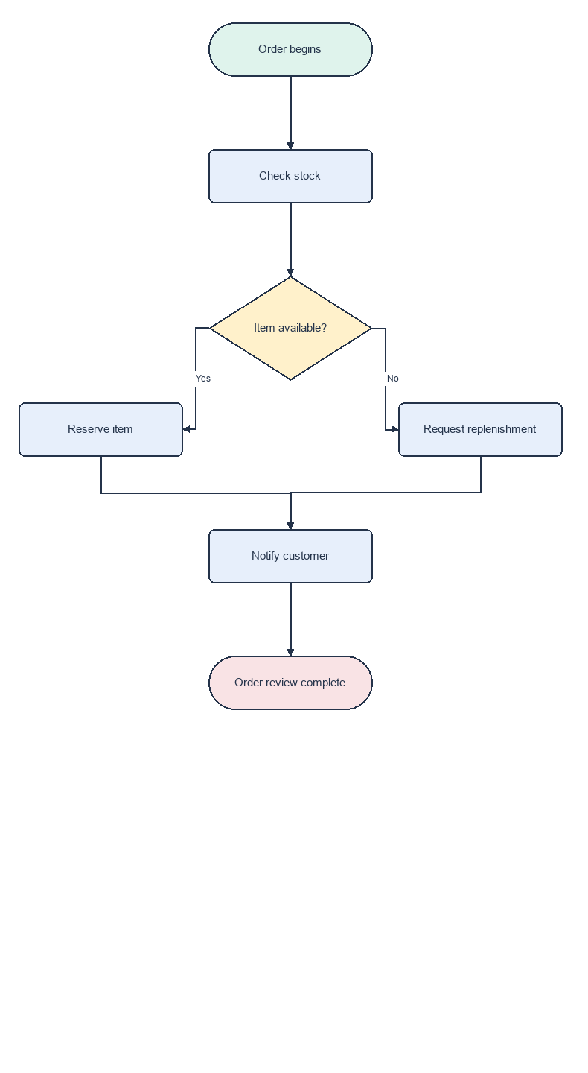
A generated branching process matches the request
B0: complete saved output
Decision and merge, enlarged
Edge F1 1.000 Exact match
Source: test_branch_01/B0/chart.png and scene.json. Enlarged branch detail at right.
Appendix B Saved original CPU example 12
Notes:
Удачный исходный результат: ветвление заказа. Покажите весь граф слева и увеличенный фрагмент справа. Yes ведёт к Reserve item, No к Request replenishment; обе ветви объединяются в Notify customer. Node F1=1, edge F1=1, exact=1; zero hard geometry errors. This is a selected success, not a representative estimate. No improvement claim.
Images are unmodified saved PNGs. PowerPoint cropping removes only the indicated margins/stages. No new inference or reference-guided editing.
Source: test_branch_01/B0/chart.png and scene.json. Enlarged branch detail at right.

Slide 13
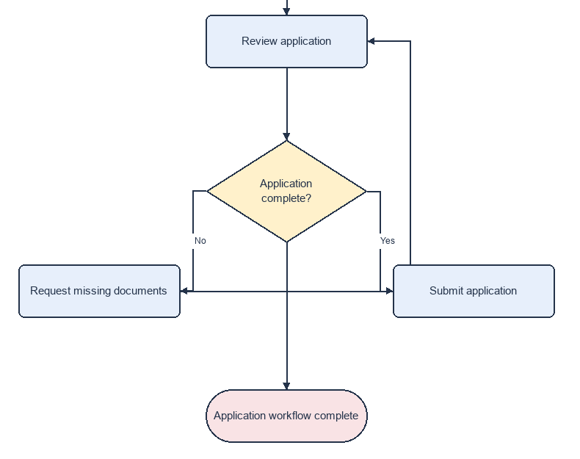
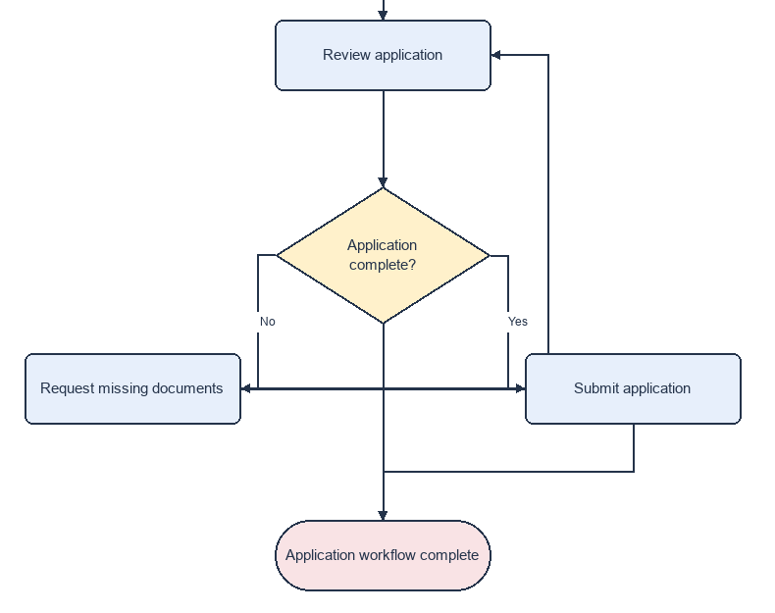
A loop edit improves edge F1 but stays incorrect
B0: initial
B3: combined feedback
Edge F1: 0.857 to 0.875
Both graphs remain incorrect
Submit application gains an exit and a wrong link to Request missing documents.
Source: test_loop_02/B0 and B3 chart.png. Detail: review, decision, loop and exit.
Appendix C Saved original CPU example 13
Notes:
Сложный цикл заявки: условие Application complete? должно отправлять No на Request missing documents с возвратом к Review application, а Yes на Submit application и далее к концу. B0 не содержит Submit to end и содержит лишний прямой выход из условия. B3 добавляет нужное Submit to end, но также неверное Submit to Request missing documents; прежний лишний выход остаётся. F1 0.857142857 to 0.875. Both graphs incorrect; geometry errors 1 to 1. Selected partial improvement, not a successful full correction. Crops omit initial start and Collect documents stages.
Images are unmodified saved PNGs. PowerPoint cropping removes only the indicated margins/stages. No new inference or reference-guided editing.
Source: test_loop_02/B0 and B3 chart.png. Detail: review, decision, loop and exit.

