Slide 1
FlowRefine
Feedback and constrained editing
for editable flowcharts
Frozen four-arm pilot + exploratory follow-up
15 saved initial diagrams, one correction round
Generative AI final project | 24 October 2026
FROZEN TEST + EXPLORATORY FOLLOW-UP test_v1 1
Notes:
Pretrained CPU models; no training. AI-assisted implementation and synthetic tasks. Original frozen test and later exploratory additions are explicitly distinguished.
Source run: C:\Users\User\Desktop\учеба\GenAI_Final_Project\runs\test_v1
Analysis: C:\Users\User\Desktop\учеба\GenAI_Final_Project\analysis\test_v1
Text model: qwen2.5-3b-instruct-q4_k_m.gguf
Source files and prompt version: manifest.json
Generative AI final project | 24 October 2026

Slide 2
Can criticism improve a generated flowchart?
Generate editable JSON, then render SVG and PNG.
Compare correctness before and after one edit.
Follow-up: edit without feedback; edit coordinates only.
Source: baseline report; follow-up protocol and saved manifests
FROZEN TEST + EXPLORATORY FOLLOW-UP test_v1 2
Notes:
Research question: whether deterministic or image-conditioned criticism improves graph correctness and layout. Later exploratory questions: whether editing alone changes correctness, and whether coordinates can be changed safely. No causal or universal claim follows from one seed and template-based tasks.
Source run: C:\Users\User\Desktop\учеба\GenAI_Final_Project\runs\test_v1
Analysis: C:\Users\User\Desktop\учеба\GenAI_Final_Project\analysis\test_v1
Text model: qwen2.5-3b-instruct-q4_k_m.gguf
Source files and prompt version: manifest.json
Source: baseline report; follow-up protocol and saved manifests

Slide 3
Every comparison reuses the same saved B0
Frozen: B0 initial; B1 program; B2 image; B3 both.
Post-test C0: rewrite B0 without external criticism.
Post-test L3 v2: both critiques; coordinates only.
All 15 B0 and saved image critiques reused.
Source: frozen_protocol.json; followup.py; run manifests
FROZEN TEST + EXPLORATORY FOLLOW-UP test_v1 3
Notes:
B0-B3 are the original frozen experiment, not rerun. C0/L3 were designed after seeing original test outcomes. C0 is feedback-free editing, not independent generation or a perfectly single-variable ablation: the final instruction differs. L3 reuses saved B0 geometry and visual feedback and uses a different constrained output schema. No new visual-model call. The initial L3 format produced eight invalid saved scenes in sixteen logged calls, then one response was interrupted before persistence. A revised schema was tested on development and saved separately in layout_v2; the final L3 values describe that revision. All failed calls are retained and included in logged follow-up cost; interrupted cost is unknown. All models receive public descriptions only; references enter evaluation.
Source run: C:\Users\User\Desktop\учеба\GenAI_Final_Project\runs\test_v1
Analysis: C:\Users\User\Desktop\учеба\GenAI_Final_Project\analysis\test_v1
Text model: qwen2.5-3b-instruct-q4_k_m.gguf
Source files and prompt version: manifest.json
Source: frozen_protocol.json; followup.py; run manifests

Slide 4
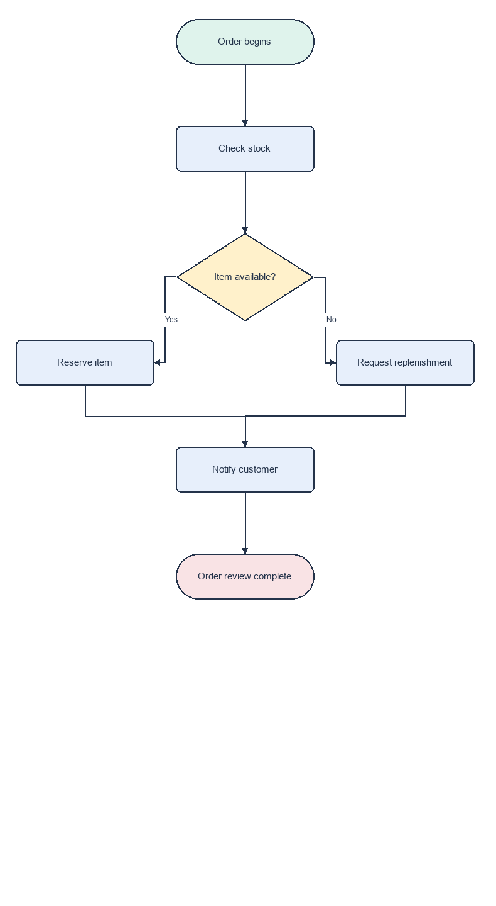
A generated branching process matches the request
B0: complete saved output
Decision and merge, enlarged
Edge F1 1.000 Exact match
Source: test_branch_01/B0/chart.png and scene.json. Enlarged branch detail at right.
FROZEN TEST + EXPLORATORY FOLLOW-UP test_v1 4
Notes:
Удачный исходный результат: ветвление заказа. Покажите весь граф слева и увеличенный фрагмент справа. Yes ведёт к Reserve item, No к Request replenishment; обе ветви объединяются в Notify customer. Node F1=1, edge F1=1, exact=1; zero hard geometry errors. This is a selected success, not a representative estimate. No improvement claim.
Images are unmodified saved PNGs. PowerPoint cropping removes only the indicated margins/stages. No new inference or reference-guided editing.
Source: test_branch_01/B0/chart.png and scene.json. Enlarged branch detail at right.

Slide 5
The original feedback modes lower mean edge F1
Mean edge F1 (higher is better)
Exact graphs / 15
B0: 11
B1: 11
B2: 9
B3: 7
Source: frozen analysis/test_v1/aggregate.json
FROZEN TEST + EXPLORATORY FOLLOW-UP test_v1 5
Notes:
Original frozen results only. Node labels/types and labeled directed edges matched exactly after normalization. All 60 scenes valid. No original edit fixes an initially incorrect graph to exact correctness. Partial F1 changes and regressions are shown separately in the supplement.
Source run: C:\Users\User\Desktop\учеба\GenAI_Final_Project\runs\test_v1
Analysis: C:\Users\User\Desktop\учеба\GenAI_Final_Project\analysis\test_v1
Text model: qwen2.5-3b-instruct-q4_k_m.gguf
Source files and prompt version: manifest.json
Source: frozen analysis/test_v1/aggregate.json

Slide 6
Paired outcomes distinguish fixes from regressions
Arm | F1 up | F1 down | Exact fixed | Exact broken
B1 | 1 | 1 | 0 | 0
B2 | 1 | 4 | 0 | 2
B3 | 1 | 5 | 0 | 4
C0 | 0 | 0 | 0 | 0
L3 | 0 | 0 | 0 | 0
Source: analysis/followup_v1/metrics.csv; all changes paired to B0
FROZEN TEST + EXPLORATORY FOLLOW-UP test_v1 6
Notes:
F1 up/down counts refer to edge F1. Exact fixed means incorrect B0 becomes exactly correct; broken means correct B0 becomes incorrect. All fifteen tasks are included. L3 preserves graph semantics by code, not model reasoning. C0 is post-test and one deterministic run.
Source run: C:\Users\User\Desktop\учеба\GenAI_Final_Project\runs\test_v1
Analysis: C:\Users\User\Desktop\учеба\GenAI_Final_Project\analysis\test_v1
Text model: qwen2.5-3b-instruct-q4_k_m.gguf
Source files and prompt version: manifest.json
Source: analysis/followup_v1/metrics.csv; all changes paired to B0

Slide 7
C0 keeps the original semantic scores
Exact C0: 11/15
Fixed: 0
Broken: 0
Mean edge F1
Higher is better
Source: follow-up C0 and frozen B0/B3 saved outputs
FROZEN TEST + EXPLORATORY FOLLOW-UP test_v1 7
Notes:
Exploratory feedback-free editing control C0 is compared descriptively to B0 and B3 on the same saved tasks. The final instruction wording differs, so this is not a perfectly isolated causal ablation. No independent-regeneration arm, repeats or new held-out tasks.
Source run: C:\Users\User\Desktop\учеба\GenAI_Final_Project\runs\test_v1
Analysis: C:\Users\User\Desktop\учеба\GenAI_Final_Project\analysis\test_v1
Text model: qwen2.5-3b-instruct-q4_k_m.gguf
Source files and prompt version: manifest.json
Source: follow-up C0 and frozen B0/B3 saved outputs

Slide 8
Coordinates-only editing preserves graph structure
Mean geometry errors / diagram (lower is better)
Exact L3 v2: 11/15
Topology enforced
v1: 8 invalid scenes
16 failed-format calls
Source: revised runs/layout_v2; failed format attempt preserved separately
FROZEN TEST + EXPLORATORY FOLLOW-UP test_v1 8
Notes:
The program reconstructs all nodes and edges from B0 and accepts only model coordinates. Semantic preservation is guaranteed by code, not learned. L3 cannot fix an incorrect B0 graph. Geometry proxies are not human readability. A different constrained schema and shorter output prevent attribution of cost changes to feedback quality alone.
Source run: C:\Users\User\Desktop\учеба\GenAI_Final_Project\runs\test_v1
Analysis: C:\Users\User\Desktop\учеба\GenAI_Final_Project\analysis\test_v1
Text model: qwen2.5-3b-instruct-q4_k_m.gguf
Source files and prompt version: manifest.json
Source: revised runs/layout_v2; failed format attempt preserved separately

Slide 9
A combined edit adds two wrong shortcuts
B0: correct subgraph
B3: two added shortcuts
Print shipping label
Print shipping label
Attach shipping label
Attach shipping label
Yes
Dispatch parcel
No
Dispatch parcel
Parcel workflow complete
Parcel workflow complete
Saved critic excerpt: Attach shipping label is connected with both Parcel workflow complete and Print shipping label
Affected subgraph: test_chain_01 B0/B3; saved scenes and visual feedback
FROZEN TEST + EXPLORATORY FOLLOW-UP test_v1 9
Notes:
Affected four-node subgraph only; the earlier start, receive and weigh stages are omitted. All three original unlabeled edges remain in B3. Added unsupported edges are Print shipping label to Parcel workflow complete labeled Yes and Attach shipping label to Parcel workflow complete labeled No. The quote is a saved model output, not ground truth; edge additions illustrate association, not a proved causal mechanism. All nodes, labels, route segments and arrowheads are editable native slide objects.
Source run: C:\Users\User\Desktop\учеба\GenAI_Final_Project\runs\test_v1
Analysis: C:\Users\User\Desktop\учеба\GenAI_Final_Project\analysis\test_v1
Text model: qwen2.5-3b-instruct-q4_k_m.gguf
Source files and prompt version: manifest.json
Affected subgraph: test_chain_01 B0/B3; saved scenes and visual feedback

Slide 10
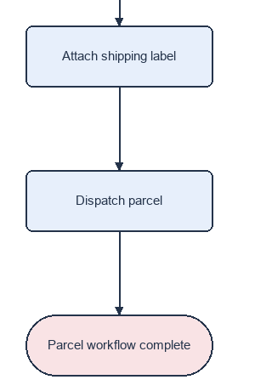

The saved edited image exposes the regression
B0: initial
B3: combined feedback
Two extra
shortcuts
Extra routes
overlap the
original chain
Edge F1: 1.000 to 0.857 Exact match: yes to no
Source: test_chain_01/B0 and B3 chart.png. Detail: final three stages. Full subgraph on previous slide.
FROZEN TEST + EXPLORATORY FOLLOW-UP test_v1 10
Notes:
Переход от предыдущего слайда: там явно показаны два добавленных ребра, здесь настоящий рендер системы. Обрезан верх графа, не исправлена исходная геометрия. В B3 лишние пути от Print shipping label и Attach shipping label к завершению; подписи Yes/No и стрелки накладываются на обычную цепочку. F1 1 to 6/7, exact 1 to 0. This is an illustrative post-hoc case, not proof of critic causality.
Images are unmodified saved PNGs. PowerPoint cropping removes only the indicated margins/stages. No new inference or reference-guided editing.
Source: test_chain_01/B0 and B3 chart.png. Detail: final three stages. Full subgraph on previous slide.

Slide 11
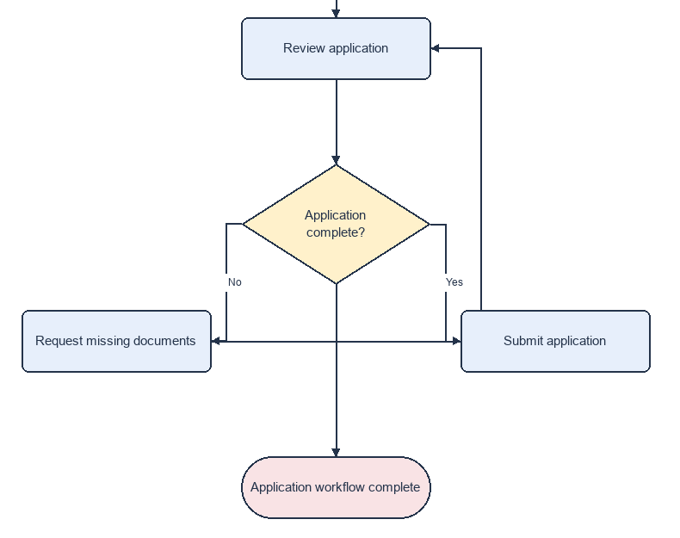
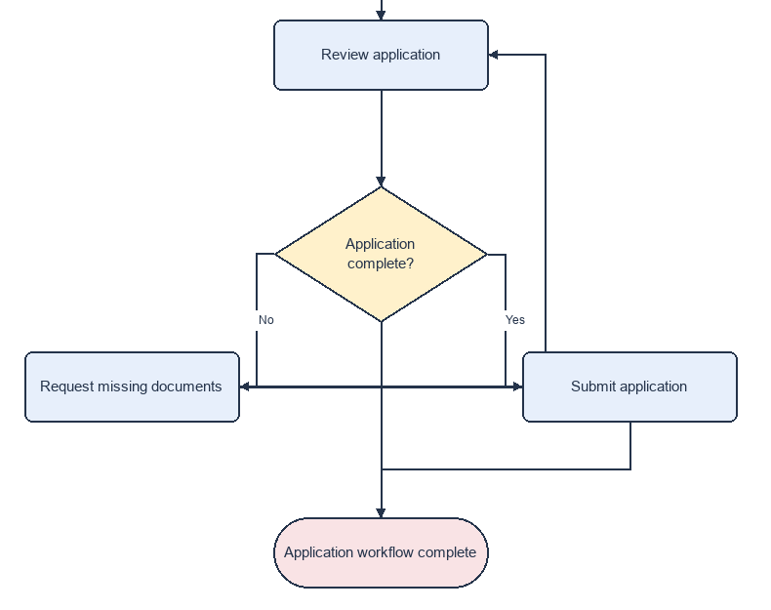
A loop edit improves edge F1 but stays incorrect
B0: initial
B3: combined feedback
Edge F1: 0.857 to 0.875
Both graphs remain incorrect
Submit application gains an exit and a wrong link to Request missing documents.
Source: test_loop_02/B0 and B3 chart.png. Detail: review, decision, loop and exit.
FROZEN TEST + EXPLORATORY FOLLOW-UP test_v1 11
Notes:
Сложный цикл заявки: условие Application complete? должно отправлять No на Request missing documents с возвратом к Review application, а Yes на Submit application и далее к концу. B0 не содержит Submit to end и содержит лишний прямой выход из условия. B3 добавляет нужное Submit to end, но также неверное Submit to Request missing documents; прежний лишний выход остаётся. F1 0.857142857 to 0.875. Both graphs incorrect; geometry errors 1 to 1. Selected partial improvement, not a successful full correction. Crops omit initial start and Collect documents stages.
Images are unmodified saved PNGs. PowerPoint cropping removes only the indicated margins/stages. No new inference or reference-guided editing.
Source: test_loop_02/B0 and B3 chart.png. Detail: review, decision, loop and exit.

Slide 12
The follow-up remains exploratory and limited
5 development; 15 synthetic test tasks, 6-7 nodes.
One seed, one round, strict label matching.
C0/L3 are post-test; failed L3 format revised separately.
Pretrained models: Qwen2.5-3B and SmolVLM-256M.
Sources: dataset card; manifests; critic audit; pretrained model cards
FROZEN TEST + EXPLORATORY FOLLOW-UP test_v1 12
Notes:
Qwen: https://huggingface.co/Qwen/Qwen2.5-3B-Instruct-GGUF
SmolVLM: https://huggingface.co/ggml-org/SmolVLM-256M-Instruct-GGUF
Dataset and analysis are original AI-assisted project artifacts. No training, human readability experiment, unseen topology test or stronger-critic comparison. Detailed audit and case evidence are in the supplemental report and analysis directory.
Source run: C:\Users\User\Desktop\учеба\GenAI_Final_Project\runs\test_v1
Analysis: C:\Users\User\Desktop\учеба\GenAI_Final_Project\analysis\test_v1
Text model: qwen2.5-3b-instruct-q4_k_m.gguf
Source files and prompt version: manifest.json
Sources: dataset card; manifests; critic audit; pretrained model cards

Slide 13
Evaluate corrections and protect graph structure
Feedback did not improve the original CPU pilot.
C0: 0 exact fixes, 0 exact regressions.
L3 keeps B0 semantics; geometry 0.33 to 0.47 errors.
Broader claims need new tasks and repeated evaluation.
Reproduction and saved demonstration: README.md; demo/followup.html
FROZEN TEST + EXPLORATORY FOLLOW-UP test_v1 13
Notes:
Original frozen result: criticism does not improve mean edge F1. Follow-up adds a descriptive feedback-free control and an enforceable topology constraint. Interpret measured C0 outcomes and geometry separately. Stronger critics, new held-out tasks, repetitions and human readability study remain future work. Original artifacts remain preserved. No public publication or submission is performed.
Source run: C:\Users\User\Desktop\учеба\GenAI_Final_Project\runs\test_v1
Analysis: C:\Users\User\Desktop\учеба\GenAI_Final_Project\analysis\test_v1
Text model: qwen2.5-3b-instruct-q4_k_m.gguf
Source files and prompt version: manifest.json
Reproduction and saved demonstration: README.md; demo/followup.html

