Slide 1
CS454 Proposal
Vitaliy Kudrik | Jingyu Cao

Slide 2
Find My Anime
Simple and easy to use anime searcher
Over 17000 anime to choose from
Advanced search feature to allow for better results
Post search filtering which allows the user to prioritize a data type

Slide 3
The data
All of the data for our website was scraped from myanimelist.net
I literally took all 17665 anime from the website except for the extra 1435 that was just hentai (porn)
The data categories are as follows: Title, Rating, Link, Picture, Episode count, Airing Dates, Genres, Description and Producers

Slide 4
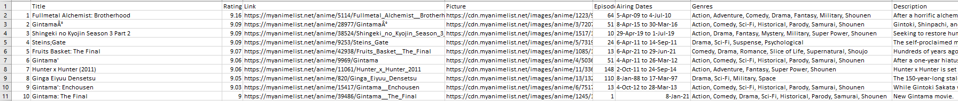
The data continued
Each data category was picked for its relevance to user searching
This data was saved in a csv file but will be converted into an index using whoosh for our backend
This is a snippet of some of the data that is scraped.

Slide 5
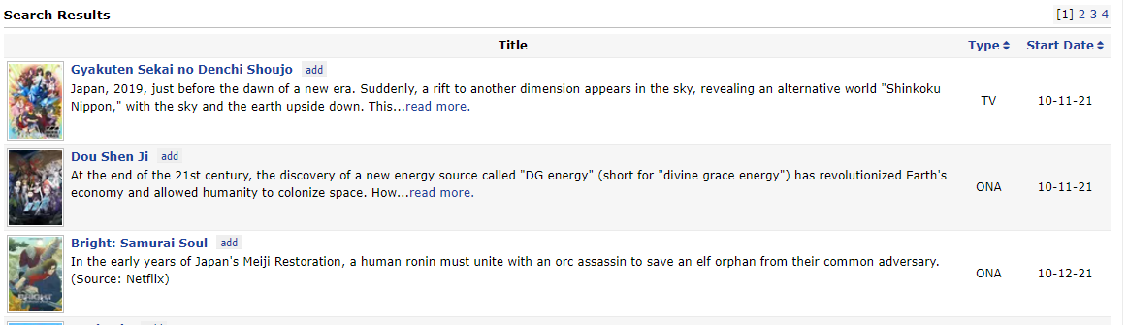
Webpage style
We are keeping a similar style to myanimelist with slight changes
They keep a simple setup and then include all the data on an individual web page for that anime
They include more than the top 10 per page, but we will be showing only 10 results per page
Not sure if we will include all data on the same page or do what myanimelist does.
Any advice?

Slide 6
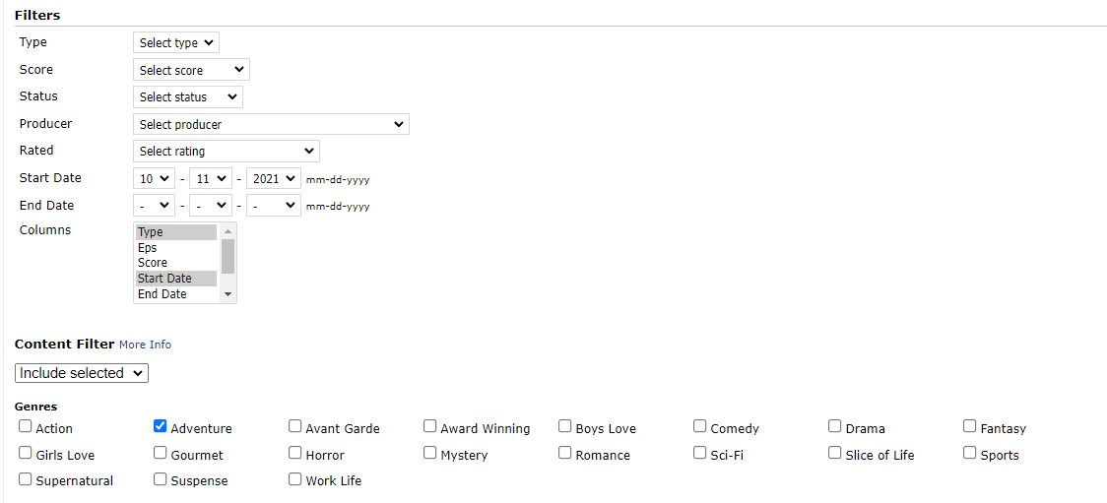
Advanced search
Myanimelist has an excellent advanced search feature.
Ours will look extremely similar except for the data that we don’t have such as status and type.
Users will use search bar
for description based
queries and advanced
search for specific kinds
of animes before their
submission

Slide 7
Data filtering
Similar to advanced search but applied after search
Allow user to prioritize the kind of data they want to see first
As shown above, a user can click on Start Date and the data will be filtered to show the anime in time ascending/descending
Other attributes like “anime’s rating” and “episode count” will also be included in filtering
Data can be ordered newest to oldest or oldest to newest interchangeably on all three filterable data types

Slide 8
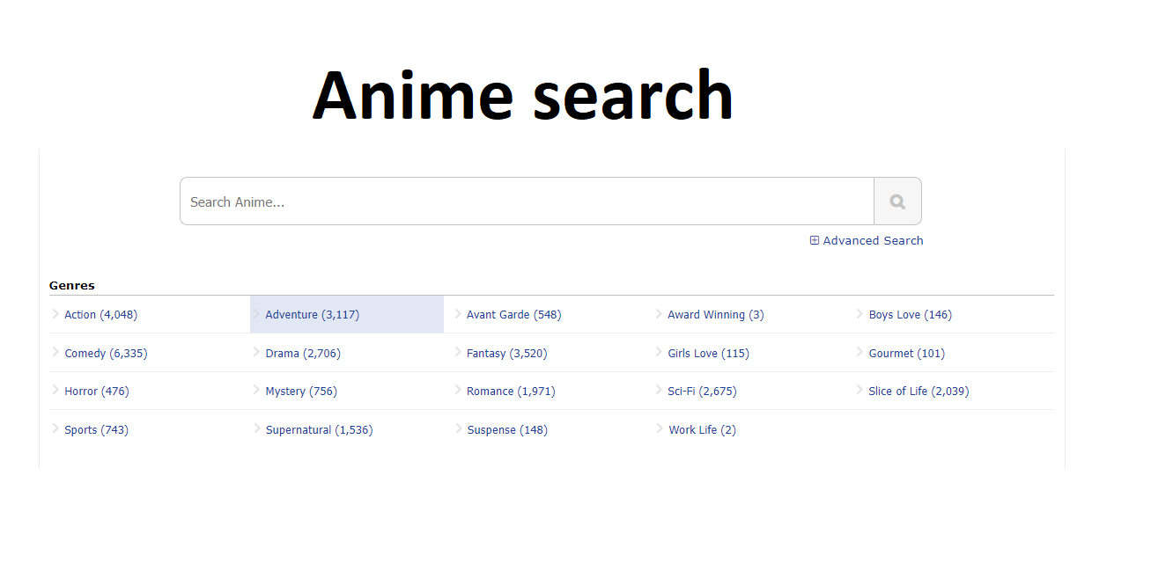
Front End
Front end, will be created using html and css(possibly bootstrap)
Features like Advanced search and Result filtering, their ports will be integrated with UI

Slide 9
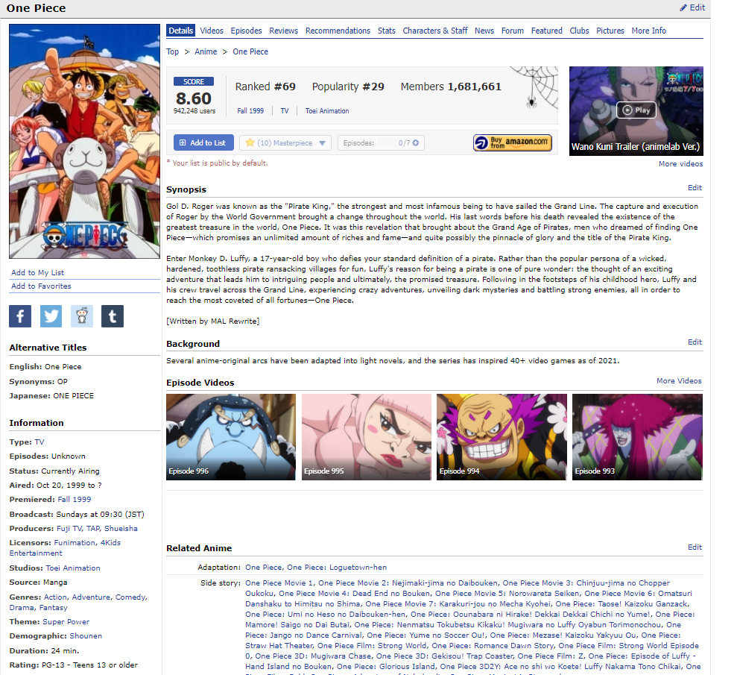
Front End - Page Holder
Once a user clicks on an anime they would like to see information on they will be taken to a separate page
All anime will be formatted using a
placeholder page which is then populated
with the anime information.
The format will be similar to this, with
a lot less information because we simply
didn’t scrape it all.

Slide 10
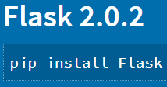
Front End - Api
Python has a framework “Flask” for building web applications
It’s a lightweight framework; suitable for this project since we scraped much less data compared to myanimelist; need a quick and easy setup for front end.

Slide 11
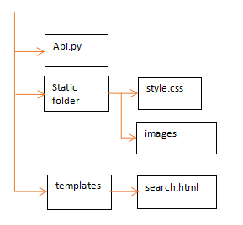
Front End - Design intent
The structure is similar to HTML+CSS+JS
Templates contains main html files
Static folder stores style files and
sources like images(for buttons).
Api.py file will link the python codes
and html, performs “get and post”
actions

