Slide 1
METABET
Uncovering Insider Edge
From Blockchain Data to Systematic Alpha
Decentralized Prediction Market Analysis – Vitaly Chait
CONFIDENTIAL
Notes:
Welcome everyone. Today I'm presenting MetaBet — a research and analysis engine that uses blockchain data to uncover insider trading patterns and arbitrage opportunities in decentralized prediction markets, specifically Polymarket on Polygon. The core question: Does the Efficient Market Hypothesis hold in Web3, or does the blockchain leave a permanent, readable trail of market manipulation?

Slide 2

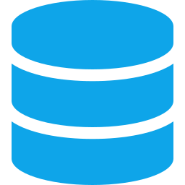

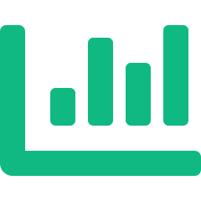

AGENDA
The Problem
Why prediction markets aren't efficient
Data Sources
On-chain, off-chain, and external context
Methodology
Wallet clustering, statistical modeling, latency analysis
Key Findings
Empirical results and detected patterns
Applications
Dashboard, Poly ETF, auto-arbitrage, regulatory reporting
Notes:
Here's what we'll cover in the next 20 minutes. I'll walk through the problem space, the data we're using, our methodology, key findings so far, and potential applications.

Slide 3
THE PROBLEM
The Illusion of Market Efficiency
THE PUBLIC
THE WHALES
Reacts to news after publication
Trades based on publicly available information
Assumes fair market pricing
Limited analytical tools
Position before events become public
Coordinate through sybil wallet networks
Exploit information asymmetry
May turn $1K bets into $16M (1 in 16,000 odds)
Core Question: Does the Efficient Market Hypothesis hold in Web3?
Notes:
The fundamental problem: Decentralized prediction markets like Polymarket appear efficient on the surface, but coordinated 'whales' consistently position early before events become public. We see patterns like turning a $1K bet into $16M returns — odds that are statistically 1 in 16,000. This isn't luck. The blockchain, uniquely, leaves a permanent trail of this behavior. So the question is: does the Efficient Market Hypothesis hold in Web3, or can we read the blockchain to detect and exploit these patterns?

Slide 4



DATA SOURCES
Three-Layer Data Architecture
On-Chain Data
Off-Chain Market Data
External Context
Polygon blockchain scraping
Wallet addresses (origin/dest)
Transaction timestamps
Token transfers via smart contracts
Polymarket API
Order book snapshots
Historical pricing
Liquidity metrics
Real-time market depth
Real-world news feeds
Social media sentiment
Verified user signals
RAG architecture integration
Event timing anchors
Notes:
Our data architecture has three layers. First, on-chain data scraped directly from the Polygon blockchain — wallet addresses, transaction timestamps, and token transfers tied to Polymarket smart contracts. Second, off-chain market data from the Polymarket API — order books, historical pricing, and liquidity metrics. Third, external context data — news feeds, social media from verified accounts, integrated through a RAG architecture. The key insight is comparing WHEN real-world events happen versus WHEN on-chain trades execute.

Slide 5



METHODOLOGY
Combining Network Analysis with Predictive Modeling
01
Wallet Clustering & Pattern Detection
Graph-based analysis to identify 'smart money' networks and sybil rings. Dense block detection reveals coordinated wallet behavior and multi-account structures.
02
Statistical & ML Models
Linear regression for price convergence modeling. Binomial distribution to separate genuine skill from luck — assessing true probability of binary outcomes vs. market implied odds.
03
Latency Analysis
Measuring exact time gaps between real-world events and on-chain price adjustments. Pinpointing brief arbitrage windows where informed traders can extract value.
Notes:
Our methodology has three pillars. First, wallet clustering using graph-based analysis — we identify smart money networks and sybil rings through dense block detection, revealing when a single entity operates multiple wallets to hide their trading patterns. Second, statistical and ML models — we use linear regression for price convergence and binomial distribution to separate genuine skill from luck. If someone wins 14 out of 14 binary bets, we can calculate whether that's statistically possible without insider information. Third, latency analysis — we measure the exact time gap between when a real-world event occurs and when the price adjusts on Polymarket, identifying brief arbitrage windows.

Slide 6
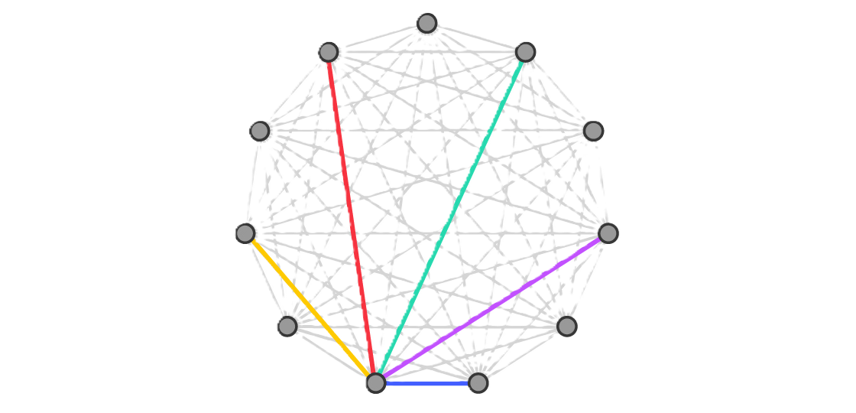
DEEP DIVE
Graph-Based Wallet Clustering
What We Detect
Techniques
Sybil rings: single entities controlling multiple wallets to disguise position sizes
Smart money networks: wallets that consistently take early, highly profitable positions
Coordinated timing: clusters of wallets placing bets within narrow time windows
Fund flow patterns: tracing token movements between seemingly unrelated addresses
Dense block detection in transaction graphs
Temporal correlation of trading activity across addresses
Pattern matching on deposit/withdrawal sequences
Statistical tests for non-random transaction clustering
Notes:
Let me go deeper into wallet clustering. On the detection side: we're looking for sybil rings where a single entity controls multiple wallets to disguise their position sizes. We detect smart money networks — wallets that consistently take early, profitable positions. We look for coordinated timing and fund flow patterns between seemingly unrelated addresses. The techniques involve dense block detection in transaction graphs, temporal correlation analysis, deposit/withdrawal pattern matching, and statistical tests for non-random clustering. Real-world validation: some users we've detected have actually been brought to court.

Slide 7

FINDINGS DETAIL
What the Data Reveals
Arbitrage Spreads
Quantified average spreads across market categories — political events vs. crypto milestones show different inefficiency profiles
News-to-Trade Latency
Mapped correlation between off-chain news velocity and on-chain trading volume, revealing measurable reaction windows
Wallet Clusters
Anonymized visualizations of clustered wallet behavior consistent with asymmetric information patterns
Arbitrage Lifespan
Average lifespan of arbitrage opportunities measured — opportunities exist because decentralized markets + human irrationality = persistent price mismatches
Notes:
Let me walk through the specific findings. First, we've quantified average arbitrage spreads across different market categories — political events and crypto milestones show very different inefficiency profiles. Second, we've mapped the correlation between off-chain news velocity and on-chain trading volume — there are measurable reaction windows. Third, we have anonymized visualizations of clustered wallet behavior. Fourth, we've measured the average lifespan of arbitrage opportunities. The key insight here: because of the decentralized nature and because humans aren't fully rational, there are always price mismatches. These aren't random — they're systematic and exploitable.

Slide 8


PUBLIC VS. PROPRIETARY
Separating Findings from Mechanics
Publicly Shareable
Proprietary / Protected
Aggregated behavioral patterns
Average arbitrage opportunity lifespan
General market inefficiency metrics
Anonymized wallet cluster visualizations
Real examples of arbitrage possibilities
Public user trading history analysis
Scraping module architecture
RAG system implementation
Alert system & Telegram bot logic
Specific trading strategies
Wallet identification algorithms
Live arbitrage execution code
Notes:
An important distinction: we can clearly separate the tool mechanics from the findings. On the public side, we can share aggregated behavioral patterns, average arbitrage lifespan, general market inefficiency metrics, anonymized visualizations, and real examples of arbitrage opportunities. All of this is already on-chain and publicly accessible — we're just making it legible. On the proprietary side, the scraping modules, RAG system, alert infrastructure, and specific trading strategies remain protected. State agencies like the FBI are already investigating some of the patterns we've independently identified — NPR covered a case of Polymarket traders with Israel military connections.

Slide 9
APPLICATIONS
Four Paths to Market
1
Live Dashboard + Trading Bot
2
POLY ETF
Auto-execute profitable cross-market arbitrage trades. Real-time alerts for suspicious insider-driven activity.
A fund that algorithmically mirrors verified 'whale' traders, turning their insider edge into systematic alpha.
3
Auto-Arbitrage Engine
4
Regulatory Reporting
Automated tool that captures any information mismatch across platforms — harvesting risk-free price spreads globally 24/7.
Verified analytical packets provided to federal agencies (FBI/SEC) regarding specific coordinated actors and market manipulation.
Notes:
Four potential applications. First, a live dashboard and trading bot for automated arbitrage execution with real-time alerts — similar to what Polygains.com offers but with our detection layer. Second, a POLY ETF concept — a fund that algorithmically mirrors verified whale traders to capture their alpha. Third, a general auto-arbitrage engine that captures information mismatches across platforms 24/7. Fourth, and perhaps most impactful for the broader ecosystem: regulatory reporting. We can provide verified analytical packets to federal agencies about coordinated manipulation. This dual-purpose approach — profit AND market integrity — is what makes MetaBet unique.

Slide 10
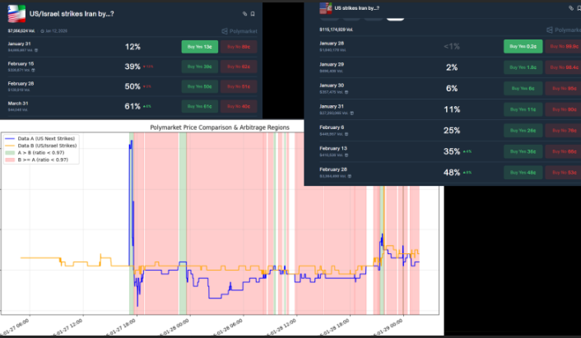
Notes:
Four potential applications. First, a live dashboard and trading bot for automated arbitrage execution with real-time alerts — similar to what Polygains.com offers but with our detection layer. Second, a POLY ETF concept — a fund that algorithmically mirrors verified whale traders to capture their alpha. Third, a general auto-arbitrage engine that captures information mismatches across platforms 24/7. Fourth, and perhaps most impactful for the broader ecosystem: regulatory reporting. We can provide verified analytical packets to federal agencies about coordinated manipulation. This dual-purpose approach — profit AND market integrity — is what makes MetaBet unique.

Slide 11
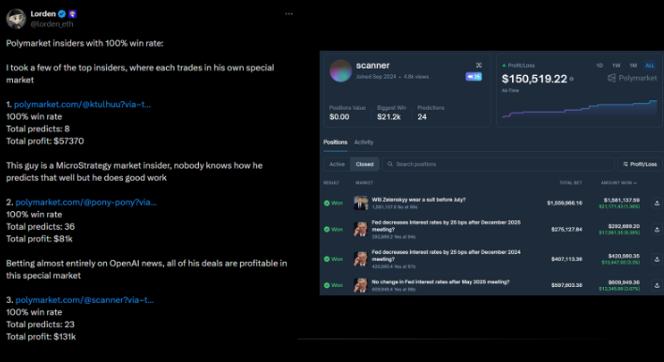
Notes:
Four potential applications. First, a live dashboard and trading bot for automated arbitrage execution with real-time alerts — similar to what Polygains.com offers but with our detection layer. Second, a POLY ETF concept — a fund that algorithmically mirrors verified whale traders to capture their alpha. Third, a general auto-arbitrage engine that captures information mismatches across platforms 24/7. Fourth, and perhaps most impactful for the broader ecosystem: regulatory reporting. We can provide verified analytical packets to federal agencies about coordinated manipulation. This dual-purpose approach — profit AND market integrity — is what makes MetaBet unique.

Slide 12
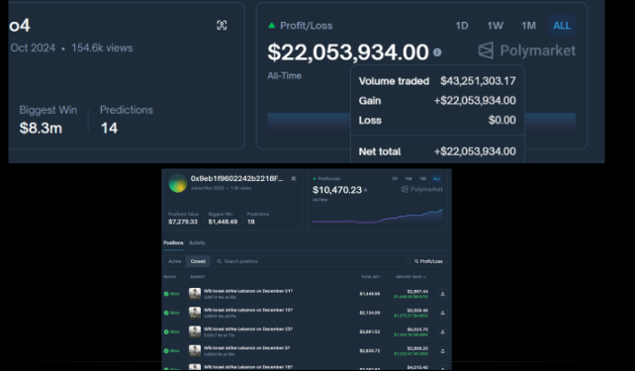
Notes:
Four potential applications. First, a live dashboard and trading bot for automated arbitrage execution with real-time alerts — similar to what Polygains.com offers but with our detection layer. Second, a POLY ETF concept — a fund that algorithmically mirrors verified whale traders to capture their alpha. Third, a general auto-arbitrage engine that captures information mismatches across platforms 24/7. Fourth, and perhaps most impactful for the broader ecosystem: regulatory reporting. We can provide verified analytical packets to federal agencies about coordinated manipulation. This dual-purpose approach — profit AND market integrity — is what makes MetaBet unique.

Slide 13
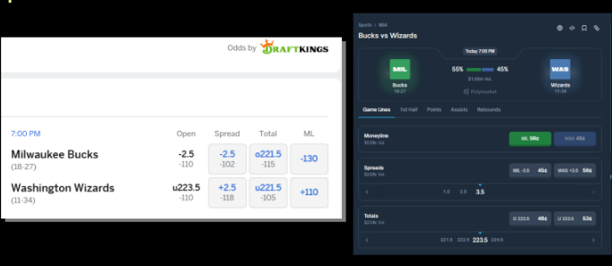
Notes:
Four potential applications. First, a live dashboard and trading bot for automated arbitrage execution with real-time alerts — similar to what Polygains.com offers but with our detection layer. Second, a POLY ETF concept — a fund that algorithmically mirrors verified whale traders to capture their alpha. Third, a general auto-arbitrage engine that captures information mismatches across platforms 24/7. Fourth, and perhaps most impactful for the broader ecosystem: regulatory reporting. We can provide verified analytical packets to federal agencies about coordinated manipulation. This dual-purpose approach — profit AND market integrity — is what makes MetaBet unique.

Slide 14
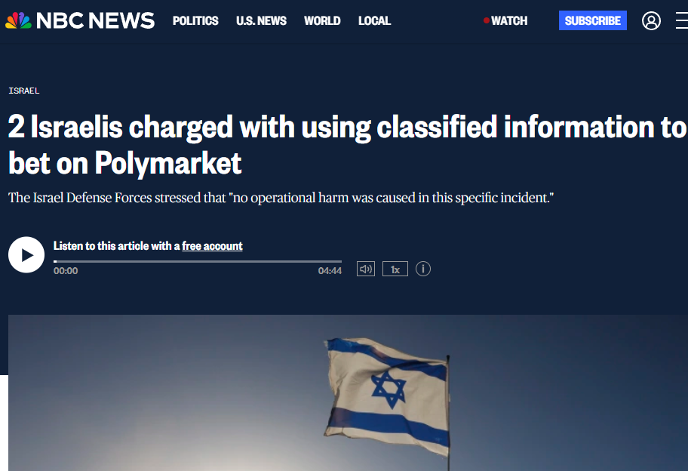
Notes:
Four potential applications. First, a live dashboard and trading bot for automated arbitrage execution with real-time alerts — similar to what Polygains.com offers but with our detection layer. Second, a POLY ETF concept — a fund that algorithmically mirrors verified whale traders to capture their alpha. Third, a general auto-arbitrage engine that captures information mismatches across platforms 24/7. Fourth, and perhaps most impactful for the broader ecosystem: regulatory reporting. We can provide verified analytical packets to federal agencies about coordinated manipulation. This dual-purpose approach — profit AND market integrity — is what makes MetaBet unique.

Slide 15

METABET
The Blockchain Remembers
Every trade, every wallet, every timing advantage -
permanently recorded to be systematically readable.
Prediction markets are not efficient, the data proves it
Blockchain transparency enables forensic-grade analysis
Dual value: profitable trading + market integrity
Questions & Discussion
Notes:
To close: the blockchain remembers everything. Every trade, every wallet, every timing advantage is permanently recorded. Our contribution is making that data systematically readable. Three takeaways: Markets are NOT efficient — the data proves it with over 500% returns. Blockchain transparency enables forensic-grade analysis that isn't possible in traditional markets. And there's dual value here — both profitable trading AND improving market integrity through regulatory reporting. I'm happy to take questions.

