Slide 1
a
b
Response of cells to targeted agents
Overall analytical workflow
Typical experimental design
- unmodified peptides
- multiple conditions
- batch
DMSO
Agent #1
Agent #2
COMBO
Lyse, Digest, Desalt
IP: Ubiquitin K^{GG}
MS Analysis (2x)
Save Peptide Flow Thru
Notes:
Negative (-) and (+) positive controls for method development.
34 modifications were considered in ~150 peptides and ~150 replicates

Slide 2
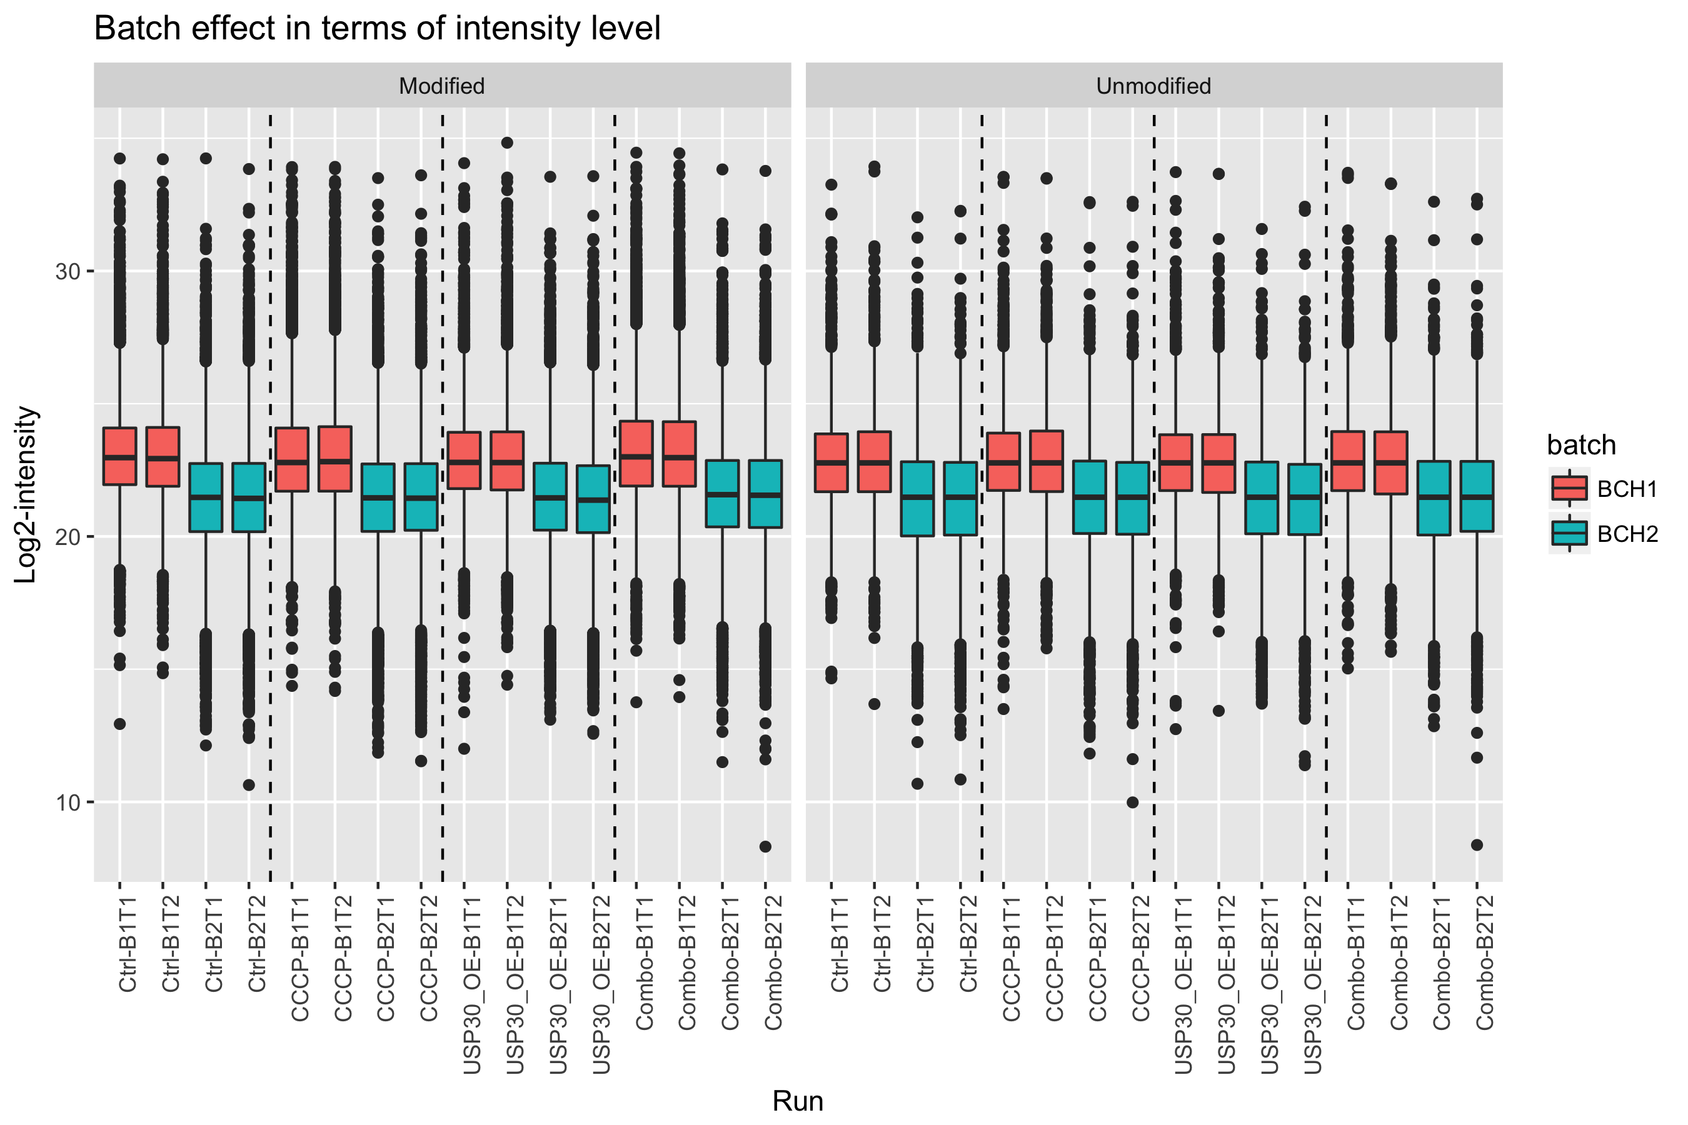
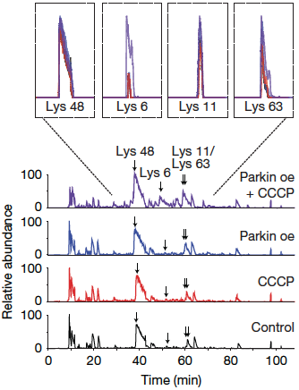
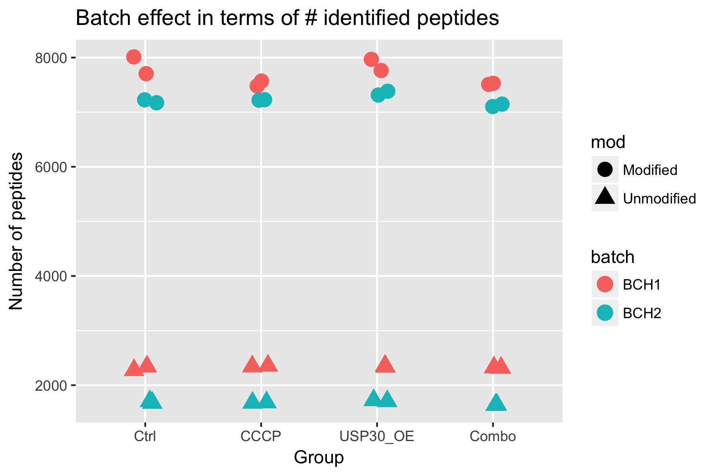
a
b
c
Show chromatogram/spectrum
Show batch effect

Slide 3

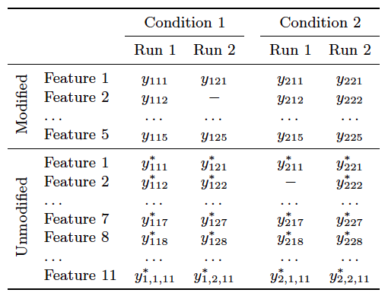
a
Condition 1
Condition 2
LC-MS/MS data acquisition
LC-MS/MS data acquisition
Run 1
Run 1
LC-MS/MS data acquisition
LC-MS/MS data acquisition
Run 2
Run 2
Fully-cleaved peptide
Partially-cleaved peptide
PTM
b Inference for PTM relative quantification
c PTM significance analysis
PTM abundance in Condition 1
Protein abundance in Condition 1
Protein-level adjustment
Increase uncertainty

Slide 4
a
Condition 1
Condition 2
LC-MS/MS data acquisition
LC-MS/MS data acquisition
*
*
*
*
*
*
*
Run 1
Run 1
*
*
*
*
LC-MS/MS data acquisition
LC-MS/MS data acquisition
Run 1
Run 1
Fully-cleaved peptide
Partially-cleaved peptide
PTM
b Inference for PTM relative quantification
c PTM significance analysis
PTM abundance in Condition 1
Protein abundance in Condition 1
Protein-level adjustment
Increase uncertainty

Slide 5
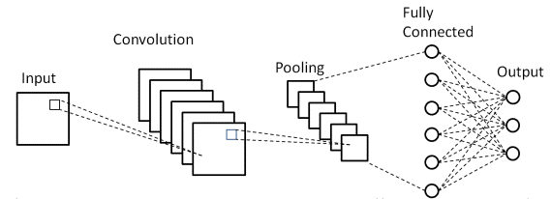
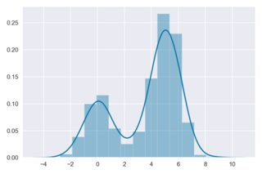







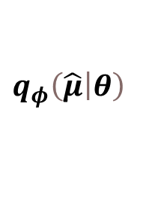



Summary Statistic Generation
Train Model
$$P\left(θ_{S}\right)$$
Simulator
$$y_{sim}$$
$${\hat{μ}}_{sim}$$
$$\left(n,s,t\right)$$
$$\left(n,s\right)$$
SNLE (SNRE/SNPE)
SBI Simulator
SNLE
Conditional Neural Density Estimator
$$P\left(θ_{U}\right)$$
Simulator
$${\hat{μ}}_{sbi}$$
$$θ$$
CNN
$$q_{φ}\left(\left.\hat{μ}\right|θ\right)$$
MCMC
$$y_{obs}$$
CNN
$$\hat{p}\left(θ | {\hat{μ}}_{obs}\right)∝q_{φ}\left({\hat{μ}}_{obs} | θ\right)p(θ)$$

Slide 6
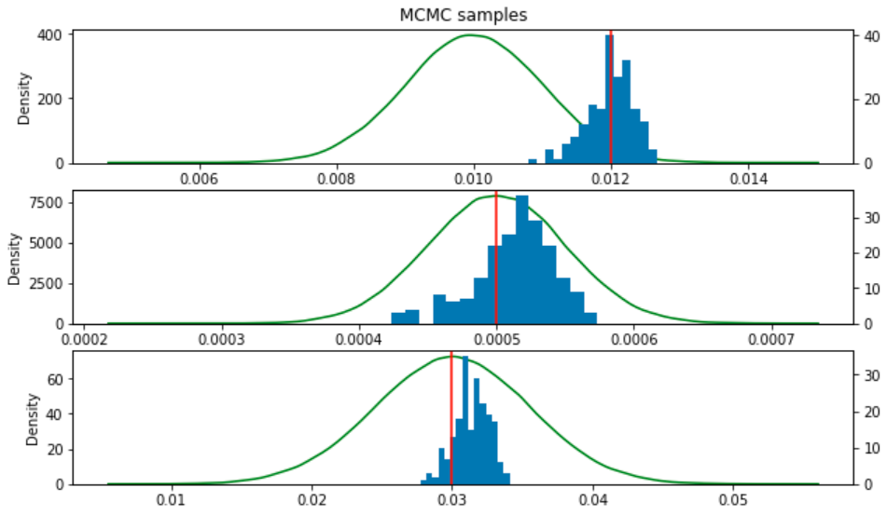
Lotka Volterra

