Slide 1
a
b
Response of cells to targeted agents
DMSO
Agent #1
Agent #2
COMBO
Overall analytical workflow
Typical experimental design
- unmodified peptides
- multiple conditions
- batch
Lyse, Digest, Desalt
IP: Ubiquitin K^{GG}
MS Analysis (2x)
Save Peptide Flow Thru
Notes:
Negative (-) and (+) positive controls for method development.
34 modifications were considered in ~150 peptides and ~150 replicates

Slide 2
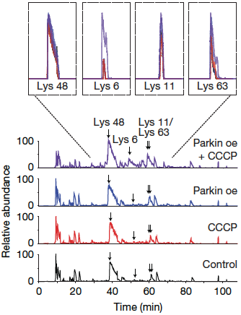
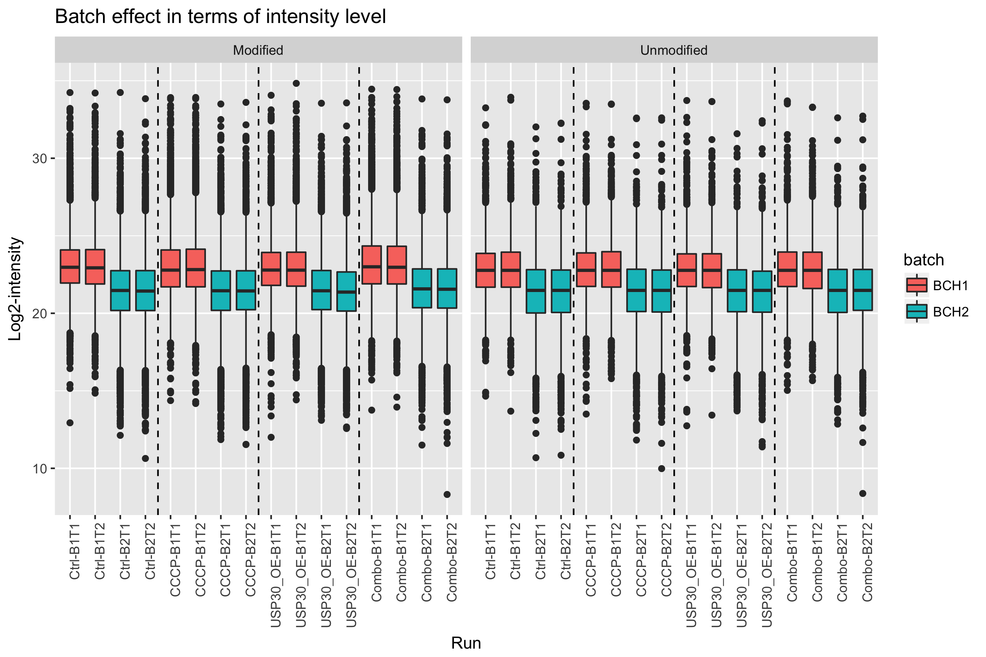
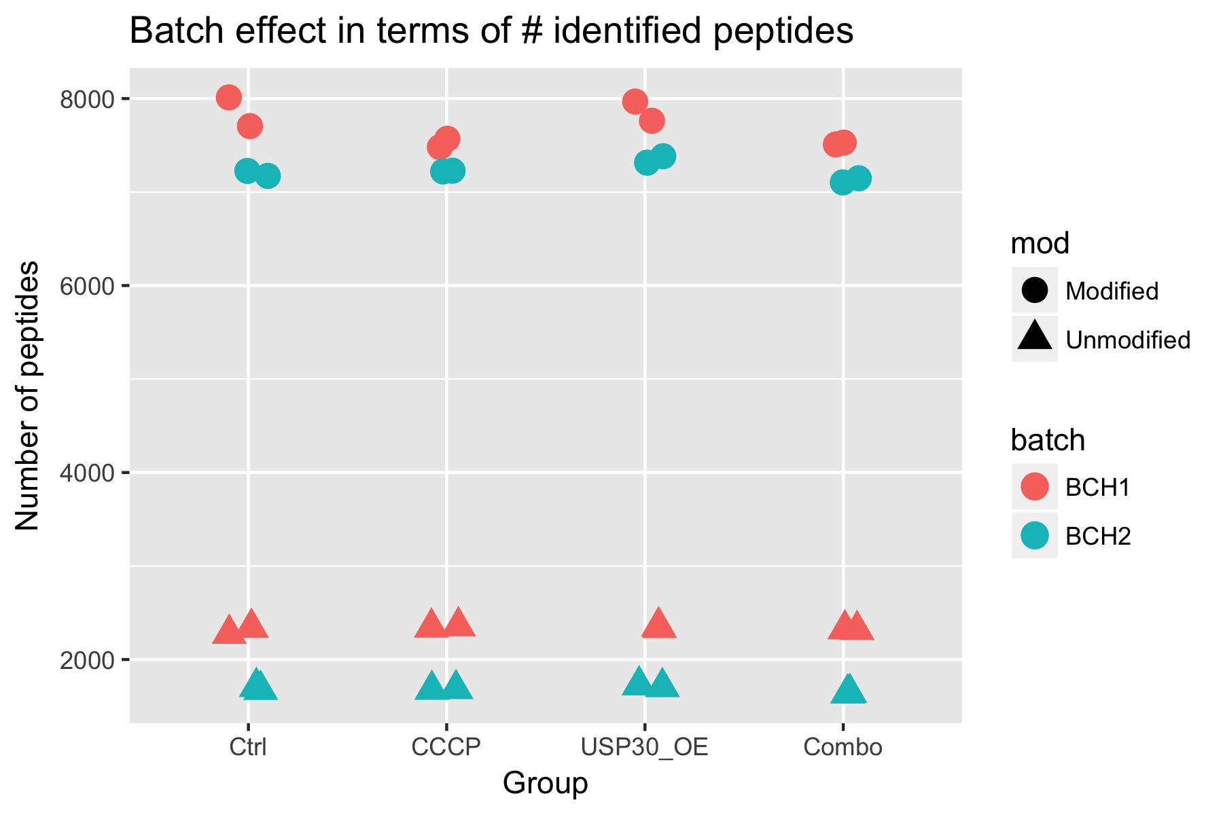
a
b
c
Show chromatogram/spectrum
Show batch effect

Slide 3

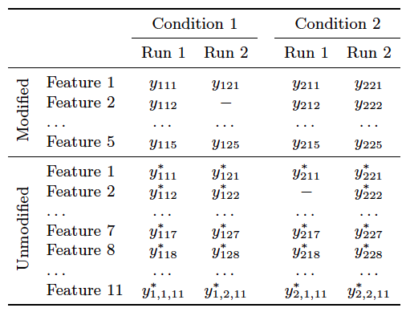
a
Condition 1
Condition 2
LC-MS/MS data acquisition
LC-MS/MS data acquisition
Run 1
Run 1
LC-MS/MS data acquisition
LC-MS/MS data acquisition
Run 2
Run 2
Fully-cleaved peptide
Partially-cleaved peptide
PTM
b Inference for PTM relative quantification
c PTM significance analysis
PTM abundance in Condition 1
Protein abundance in Condition 1
Protein-level adjustment
Increase uncertainty

Slide 4
Condition 1
Condition 2
LC-MS/MS data acquisition
LC-MS/MS data acquisition
BioRep 1
BioRep 2
BioRep 1
BioRep 2
*
*
*
*
*
*
*
Run 1
Run 1
*
*
*
*
LC-MS/MS data acquisition
LC-MS/MS data acquisition
Run 1
Run 1
Fully-cleaved peptide
Partially-cleaved peptide
PTM

Slide 5
Sample preparation and acquisition
Spectral Processing
PTM identification and quantification
Unmodified peptide identification and quantification
MSstatsPTM
Tool specific pre-processing
PTM conversion
Unmodified protein conversion
dataSummarizationPTM
Quantification
dataProcessPlotsPTM
Visualization of summarized data
Summarize PTM intensities
Summarize unmodified protein intensities
groupComparisonPTM
Inference
Fit PTM model
Fit unmodified protein model
groupComparisonPlotsPTM
Visualization of model results
PTM Adjustment
Adjust PTMs for changes in unmodified protein

Slide 6
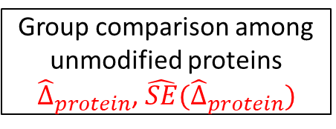
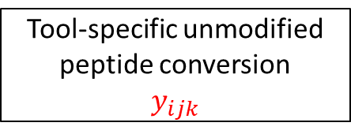
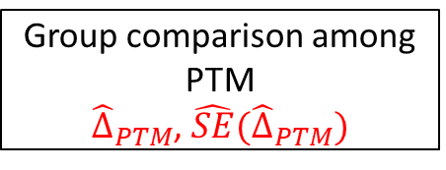
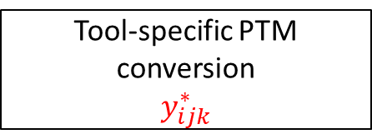
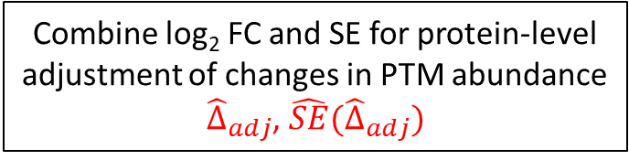
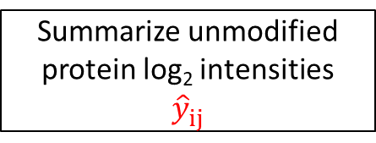
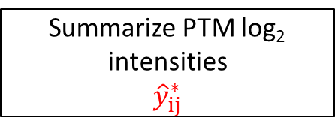
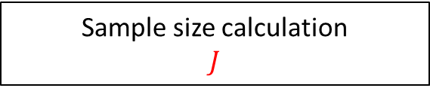
1.
PTM enriched lysates
Global proteome lysate
2.
Identification and quantifications of modified peptides
Identification and quantifications of unmodified peptides
Tool-specific PTM conversion
$$y_{ijk}^{∗}$$
Tool-specific unmodified peptide conversion
$$y_{ijk}$$
3.
Converters
MSstatsPTM
Summarize PTM log₂ intensities
$${\hat{y}}_{ij}^{∗}$$
Summarize unmodified protein log₂ intensities
$${\hat{y}}_{ij}^{ }$$
4.
dataSummarizationPTM()
dataProcessPlotsPTM()
Group comparison among PTM
${\hat{Δ}}_{PTM}$, $\hat{SE}({\hat{Δ}}_{PTM})$
Group comparison among unmodified proteins
${\hat{Δ}}_{protein}$, $\hat{SE}({\hat{Δ}}_{protein})$
5.
groupComparisonPTM()
groupComparisonPlotsPTM()
Combine log₂ FC and SE for protein-level adjustment of changes in PTM abundance
${\hat{Δ}}_{adj}$, $\hat{SE}({\hat{Δ}}_{adj})$
6.
Sample size calculation
$$J$$
designSampleSizePTM()

